Slide 1
Welcome Guests!
OLD UNION
NEW LIFE
Following Jesus changes everything!

Slide 2
Wednesdays @ 7PM Teen Room

Slide 3
Plant. Grow. Become.
Notes:
Meet at the Garden (Teen Room Downstairs)
Wednesdays at 7p.

Slide 5
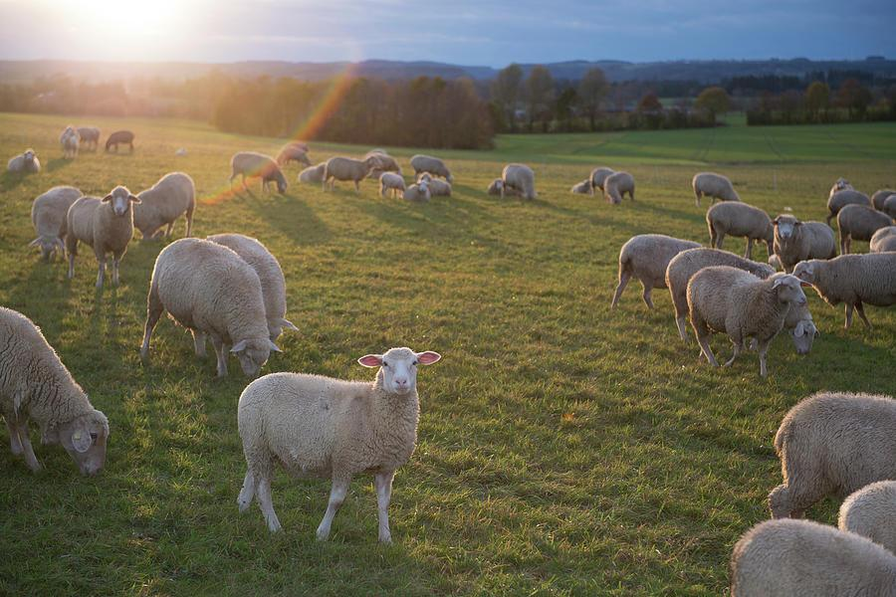
And all the believers were together and had all things in common; and they would sell their property and possessions and share them with all, to the extent that anyone had need. ACTS 2:44-45
Cash/Checks can be given to OU leadership or FHS team
Checks written to “Feeding His Sheep”
Add us as your friend on Venmo!
(Verification code if needed – 9865)

Slide 6
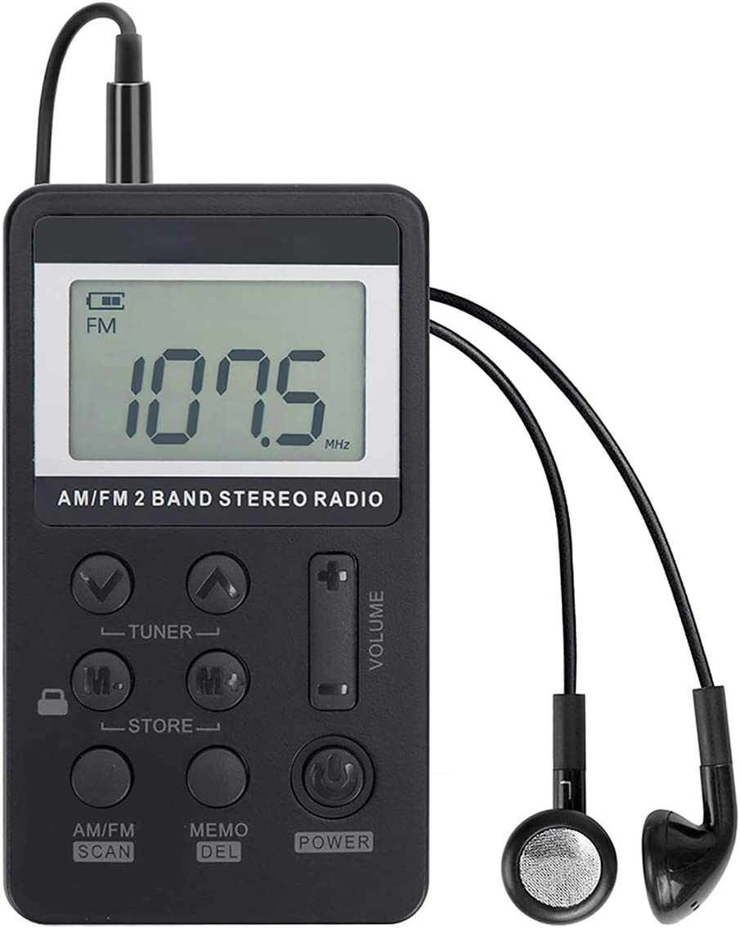
HAVING TROUBLE HEARING? WE HAVE AUDIO AIDS TO HELP YOU.
107.1
See any of our greeters in the foyer.
And THANK YOU for being here!

Slide 8
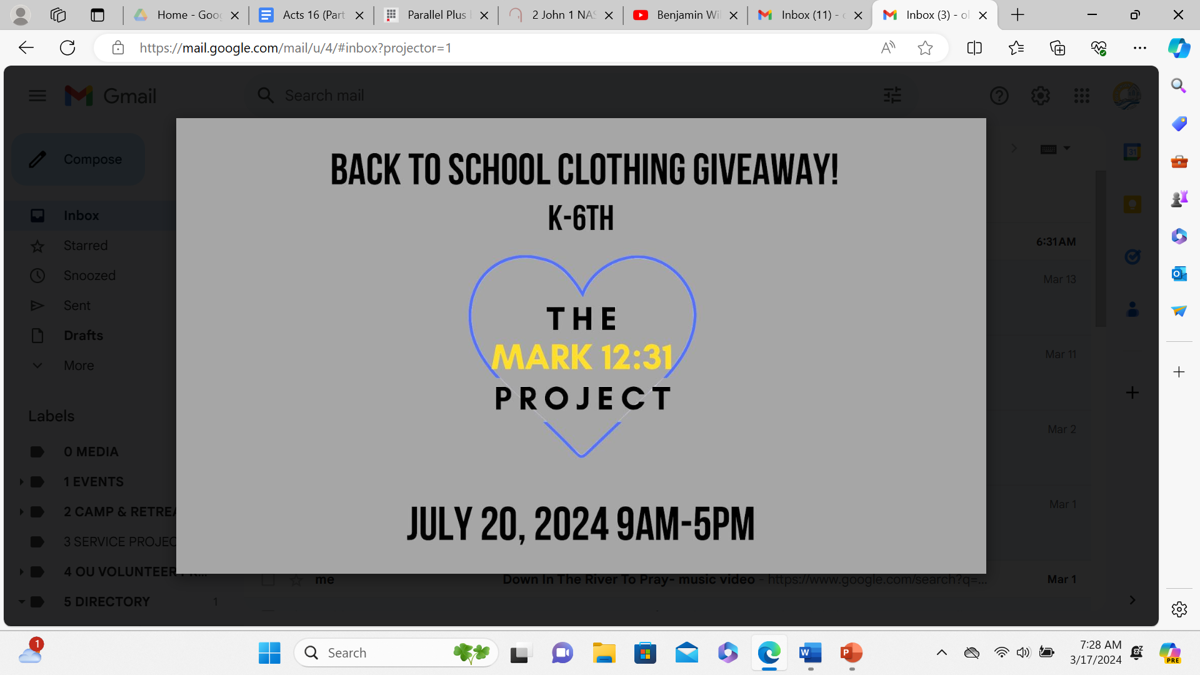

Slide 9
Congregation Membership is a blessing. If interested see our Shepherds.

Slide 10
ENCOURAGEMENT CARD OF THE WEEK Everleigh King
Everleigh is AWESOME and was baptized at Summer Bible Camp. Let’s show her love and encouragement.

Slide 11
First Sunday Singings
Every first Sunday of
the month at 5PM.
This a great time to sing and also improve our song ministry.
Please consider attending.

Slide 12
SUMMER SUNDAY is TONIGHT!

Slide 14
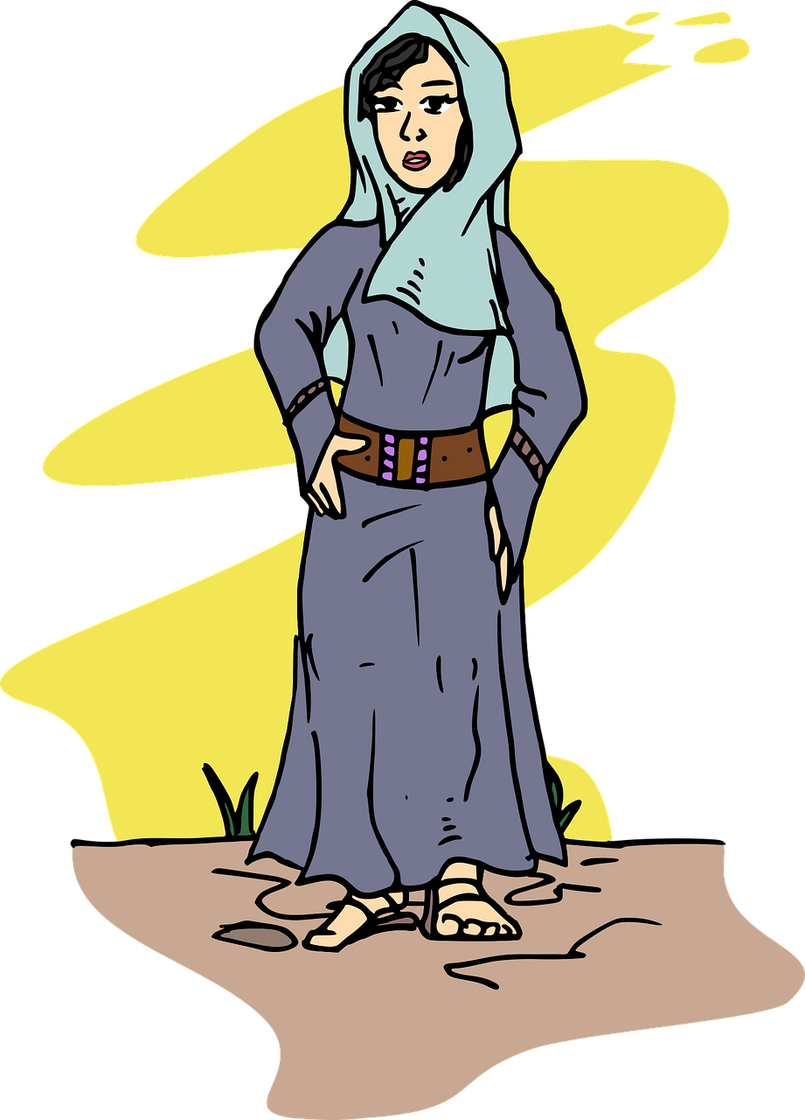
THE VERY MARY Vacation Bible School
A “Very” Big Thanks
To All Helpers and Attendees!!!
Old Union Church of Christ
Sunday, June 9th 3PM

Slide 15
Jesus said, “Let the little children come to Me.”

Slide 16
OUKids Time
Sundays 9AM
Memory, Songs,
and Prayer
Sundays 9:30am
(0-5th Grade Classes)
Wednesdays 7PM
(0-5th Grade Classes)

Slide 17
Lamentations 3:22-24
The steadfast love of the LORD never ceases;
His mercies never come to an end.
They are new every morning.
Great is Thy faithfulness.
The LORD is my portion says my soul;
Therefore I will hope in Him.

Slide 18
Psalm 95:1-2
Come let us sing with joy to the LORD;
Let us shout aloud,
to the Rock of our salvation.
Let us come before Him with thanksgiving;
And extol Him with music and song.

Slide 19
Psalm 95:3-5
For the LORD is a great God
A great King above all gods,
In His hands are the depths of the earth,
And the mountain peaks belong to Him.
The sea is His, He made it.
And His hands they formed the dry land.

Slide 20
Psalm 25
Unto Thee, O LORD, do I lift up my soul!
Unto Thee, O LORD, do I lift up my soul!
Oh my God, I trust in Thee;
Let me not be ashamed,
Let not my enemies triumph over me!

Slide 21
Psalm 95:6-7
Come, let us worship and bow down,
Let us kneel before the LORD our Maker.
For He is our God,
and we are the people of His pasture.
And the sheep of His hand.

Slide 22
Genesis 1:27-28
“God created man in His own image…”
Memory Heart Verse

Slide 23
²⁷ God created man in His own image, in the image of God He created him; male and female He created them.
²⁸ God blessed them; and God said to them, “Be fruitful and multiply, and fill the earth, and subdue it; and rule over the fish of the sea and over the birds of the sky and over every living thing that moves on the earth.”
Genesis 1:27-28

Slide 24
Why did God make us?
Then God said, “Let Us make man in Our image, according to Our likeness; and let them rule over… all the earth...in the image of God He created him; male and female He created them.”
Genesis 1:26-27 (abbr.)
To Share Himself with Us.

Slide 25
Who is Jesus?
Simon Peter answered,
“You are the Christ,
the Son of the living God.”
Matthew 16:16
The Christ, the Son of the Living God

Slide 26
What is our PURPOSE?
Praise be to the God and Father of our Lord Jesus Christ, who has blessed us in the heavenly realms with every spiritual blessing in Christ.
Ephesians 1:3-10
To PRAISE and ENJOY God!

Slide 27
How GOOD is our God?
Oh give thanks to the LORD, for He is good,
For His (HESED) lovingkindness is everlasting.
Let the redeemed of the Lord say so,
Psalm 107:1-2a
SO GOOD!!!

Slide 28
Philippians 4:4
Rejoice in the Lord always;
And again I say rejoice!

Slide 29
What is God doing?
And He who sits on the throne said, “Behold I am making all things new.”
Revelation 21:5
Making all things new.

Slide 30
Where can we find Jesus’ Sermon on the Mount?
The Gospel of Matthew
Chapters 5, 6, and 7

Slide 31
Matthew 5:44
Jesus said,
“Love your enemies.”

Slide 32
How does God save us?
For by grace you have been saved through faith; and that not of yourselves, it is the gift of God;
Ephesians 2:8
By GRACE through FAITH.

Slide 33
How Did Jesus Teach Us To Pray?
“Our Father in heaven, hallowed be Your name,
Your kingdom come, Your will be done,
on earth as it is in heaven.
Give us today our daily bread.
And forgive us our debts,
as we also have forgiven our debtors.
And lead us not into temptation,
but deliver us from the evil one.”

Slide 34
Psalm 3:3
Thou, O LORD,
Are a shield about me.
You’re my glory,
You’re the lifter of my head.
(Hallelujah)

Slide 35
What does God want from us?
He has shown you, O mortal, what is good.
And what does the Lord require of you?
To act justly and to love mercy
and to walk humbly with your God.
Micah 6:8
To Act Justly, Love Mercy, and Walk Humbly

Slide 36
How does God show us love?
“But God demonstrates His own love toward us, in that while we were yet sinners, Christ died for us.”
Romans 8:5
By Christ dying for us.

Slide 37
The Books of the New Testament
Acts
Romans
1 2 Corinthians
Galatians
Ephesians
Philippians
Colossians
1 2 Thessalonians
1 2 Timothy
Titus
Philemon
Hebrews
James
1 2 Peter
Matthew
Mark
Luke
John
1 2 3 John
Jude
Revelation

Slide 38
The Books of the Old Testament
Genesis
Exodus
Leviticus
Numbers
Deuteronomy
Joshua
Judges
Ruth
1 2 Samuel
1 2 Kings
1 2 Chronicles
Ezra
Nehemiah
Esther
Job
Psalms
Proverbs
Ecclesiastes
Songs of Solomon
Isaiah
Jeremiah
Lamentations
Ezekiel
Daniel
Hosea, Joel
Amos, Obadiah
Jonah, Micah
Nahum
Habakkuk
Zephaniah
Haggai
Zechariah
Malachi

Slide 39
What is Success?
“How blessed is the man…
Who delights in the law of the LORD.
He will be like a tree planted firmly…
And in whatever he does, he prospers.”
Psalm 1
Living with God, Now and Forever!

Slide 40
What is the Bible?
All Scripture is (God-breathed) and profitable for teaching, for reproof, for correction, for training in righteousness; so that the man of God may be adequate, equipped for every good work.
2 Timothy 3:16-17
Scripture, Inspired by God.

Slide 41
What is the Greatest Command?
You shall love the Lord your God
with all your heart and with all your soul and with all your might.
Deuteronomy 6:5

Slide 42
What is the 2nd Greatest Command?
Love your neighbor as yourself.
Mark 12:31

Slide 43
The Fruit of the Spirit
LOVE
JOY
PEACE
PATIENCE
KINDNESS
GOODNESS
FAITHFULNESS
GENTLENESS
SELF-CONTROL
“Against such things there is no law.”
Galatians 5:22-23

Slide 44
Restore My Soul
Lily of the Valley
971, 274

Slide 45
1-1 Restore My Soul
Restore My Soul

Slide 46
1-2 Restore My Soul
Restore My Soul

Slide 47
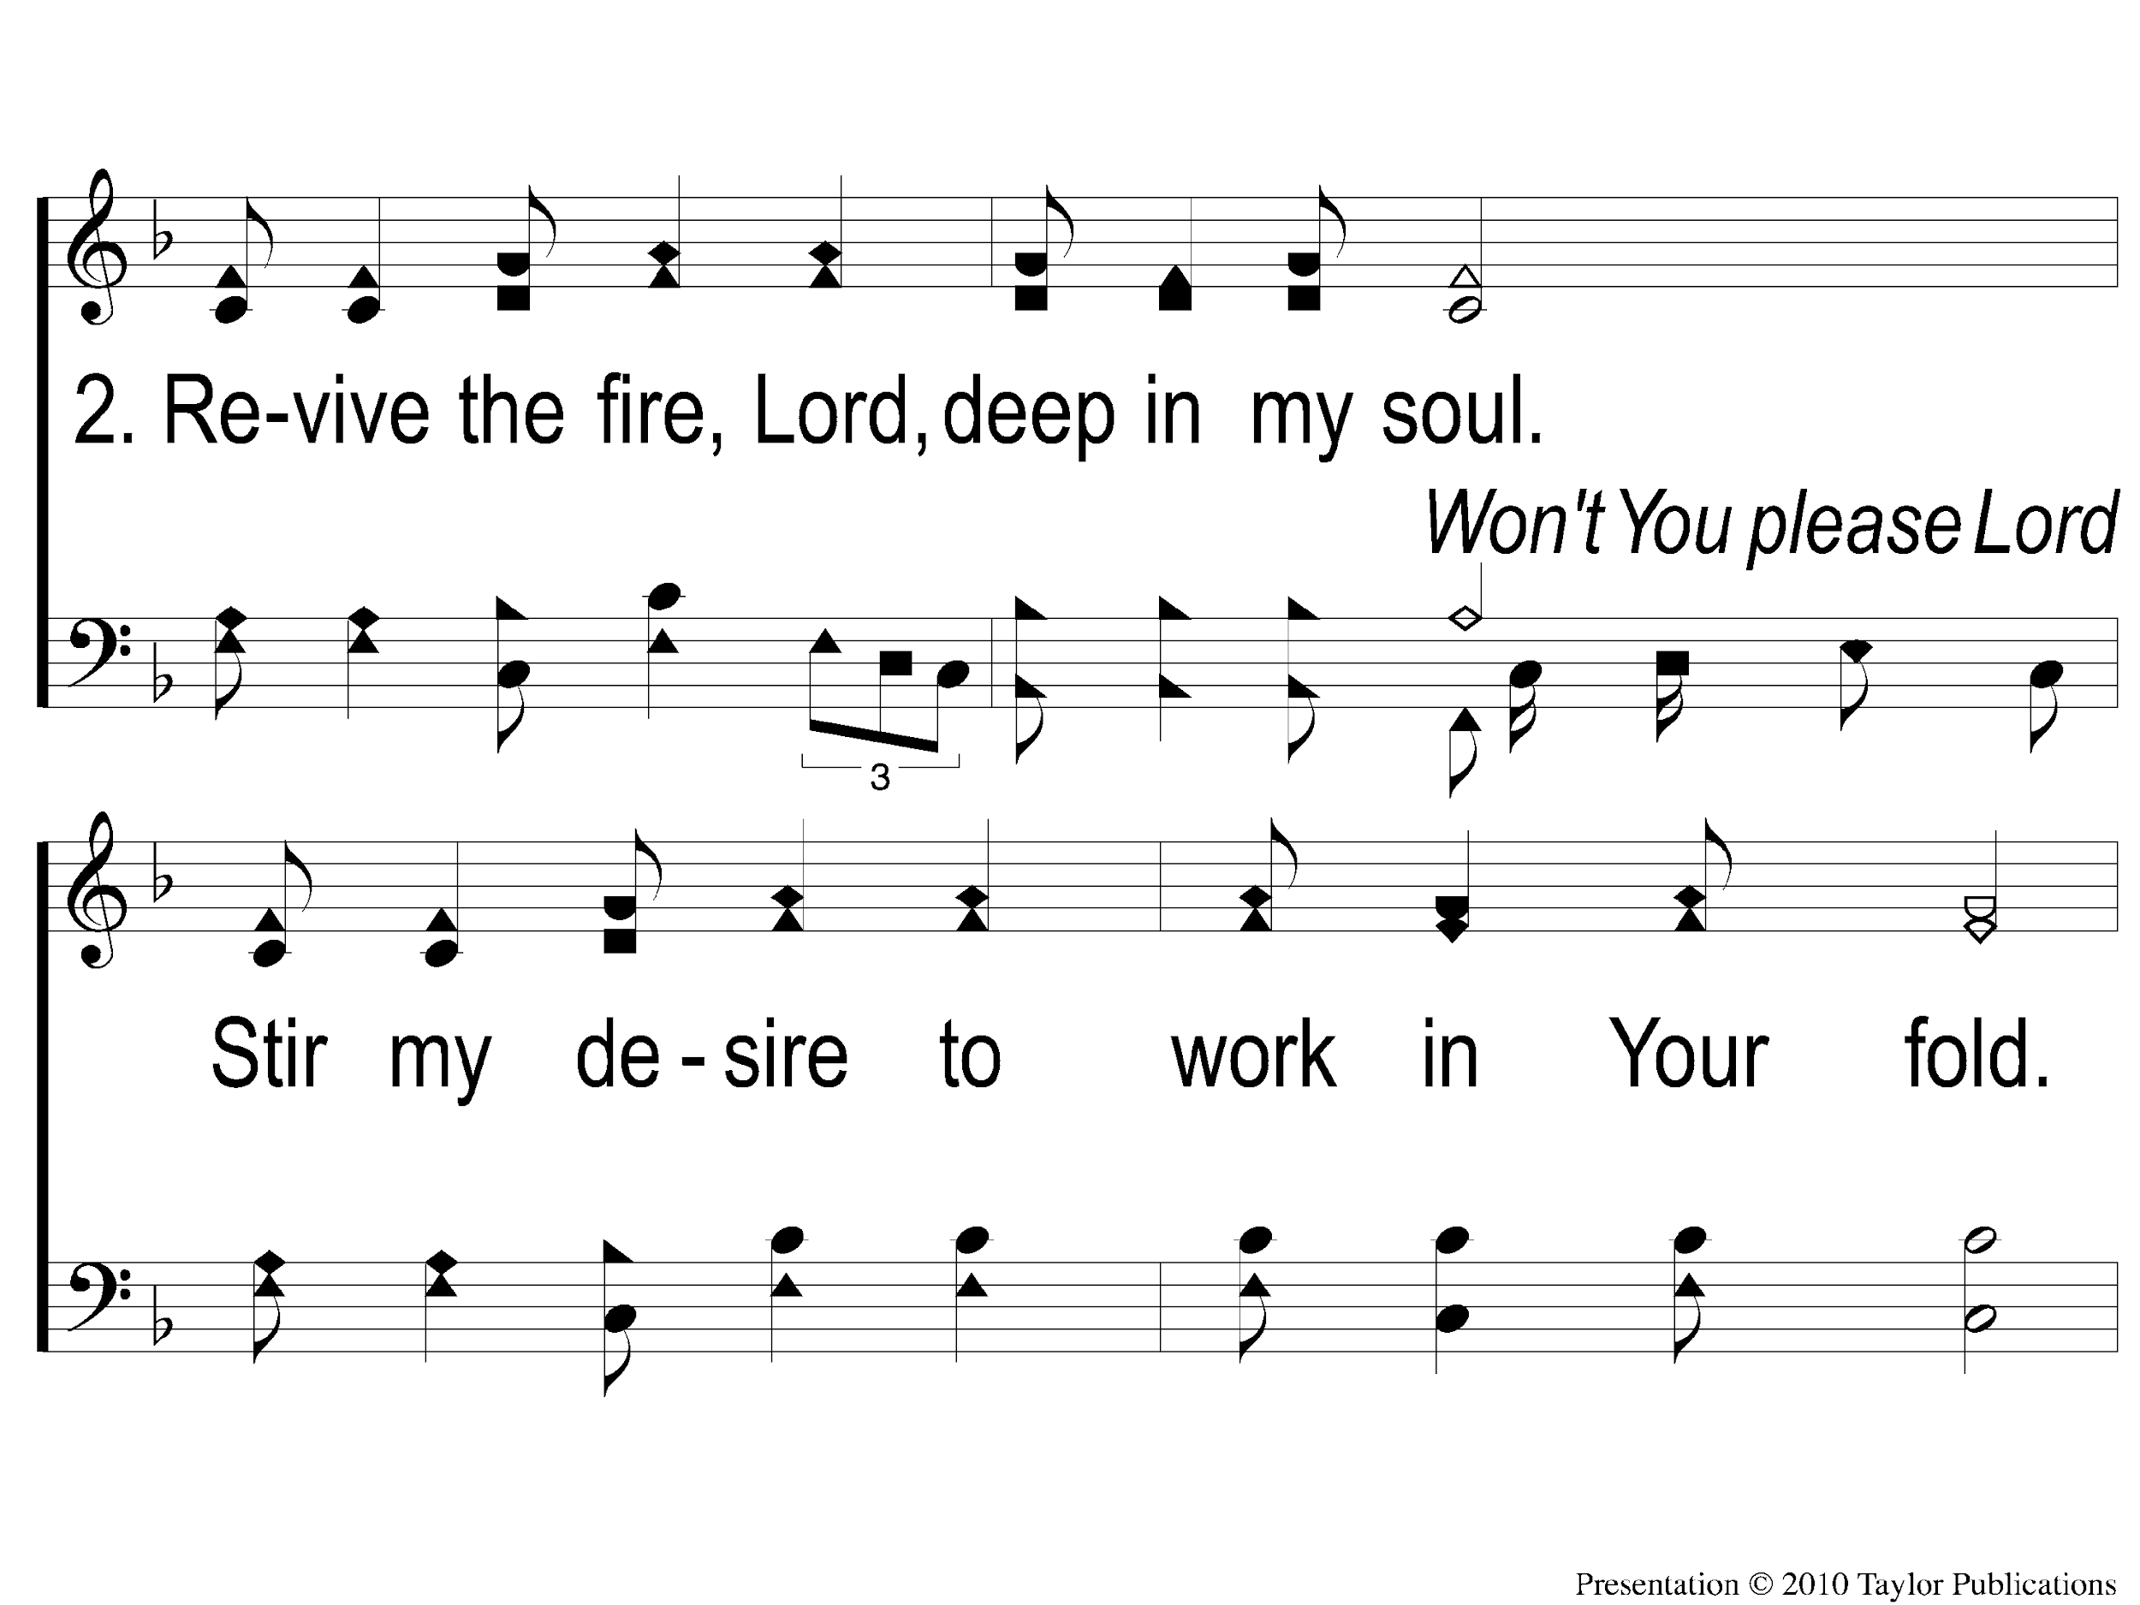
2-1 Restore My Soul
Restore My Soul

Slide 48
2-2 Restore My Soul
Restore My Soul

Slide 49
3-1 Restore My Soul
Restore My Soul

Slide 50
3-2 Restore My Soul
Restore My Soul

Slide 51
tag Restore My Soul
Restore My Soul

Slide 52
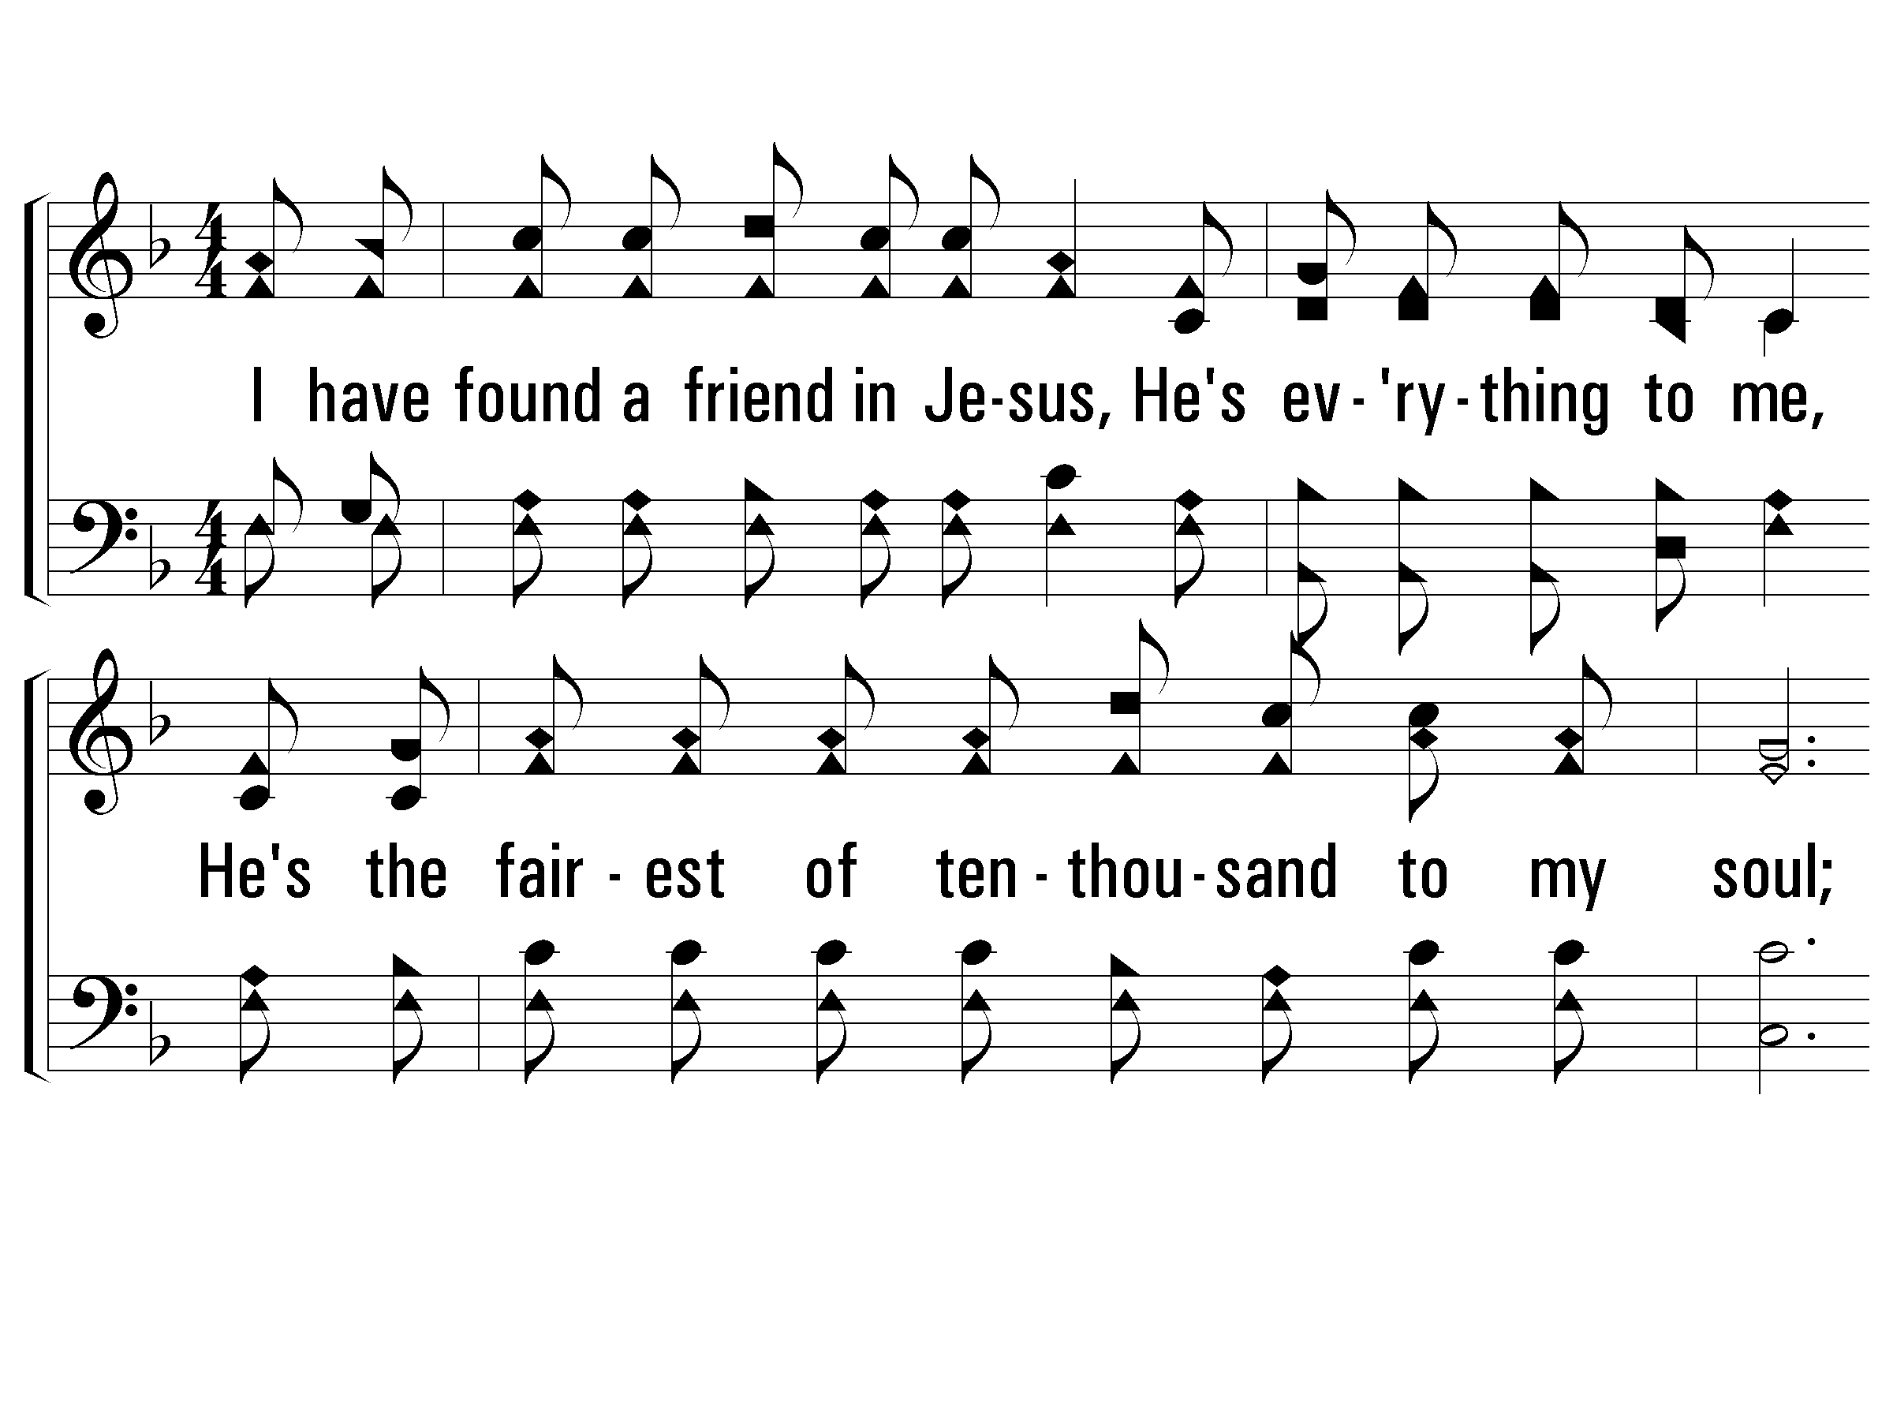
1 – The Lily of the Valley
1.
I have found a friend in Jesus,
He's everything to me,
He's the fairest of ten-thousand to my soul;
The Lily of the Valley, in Him alone I see
All I need to cleanse and make me fully whole.
In sorrow He's my comfort, in trouble He's my stay,
He tells me every care on Him to roll.
Words: Charles W. Fry
Music: William S. Hays / Adapted: Charles W. Fry
© 2002 The Paperless Hymnal™

Slide 53
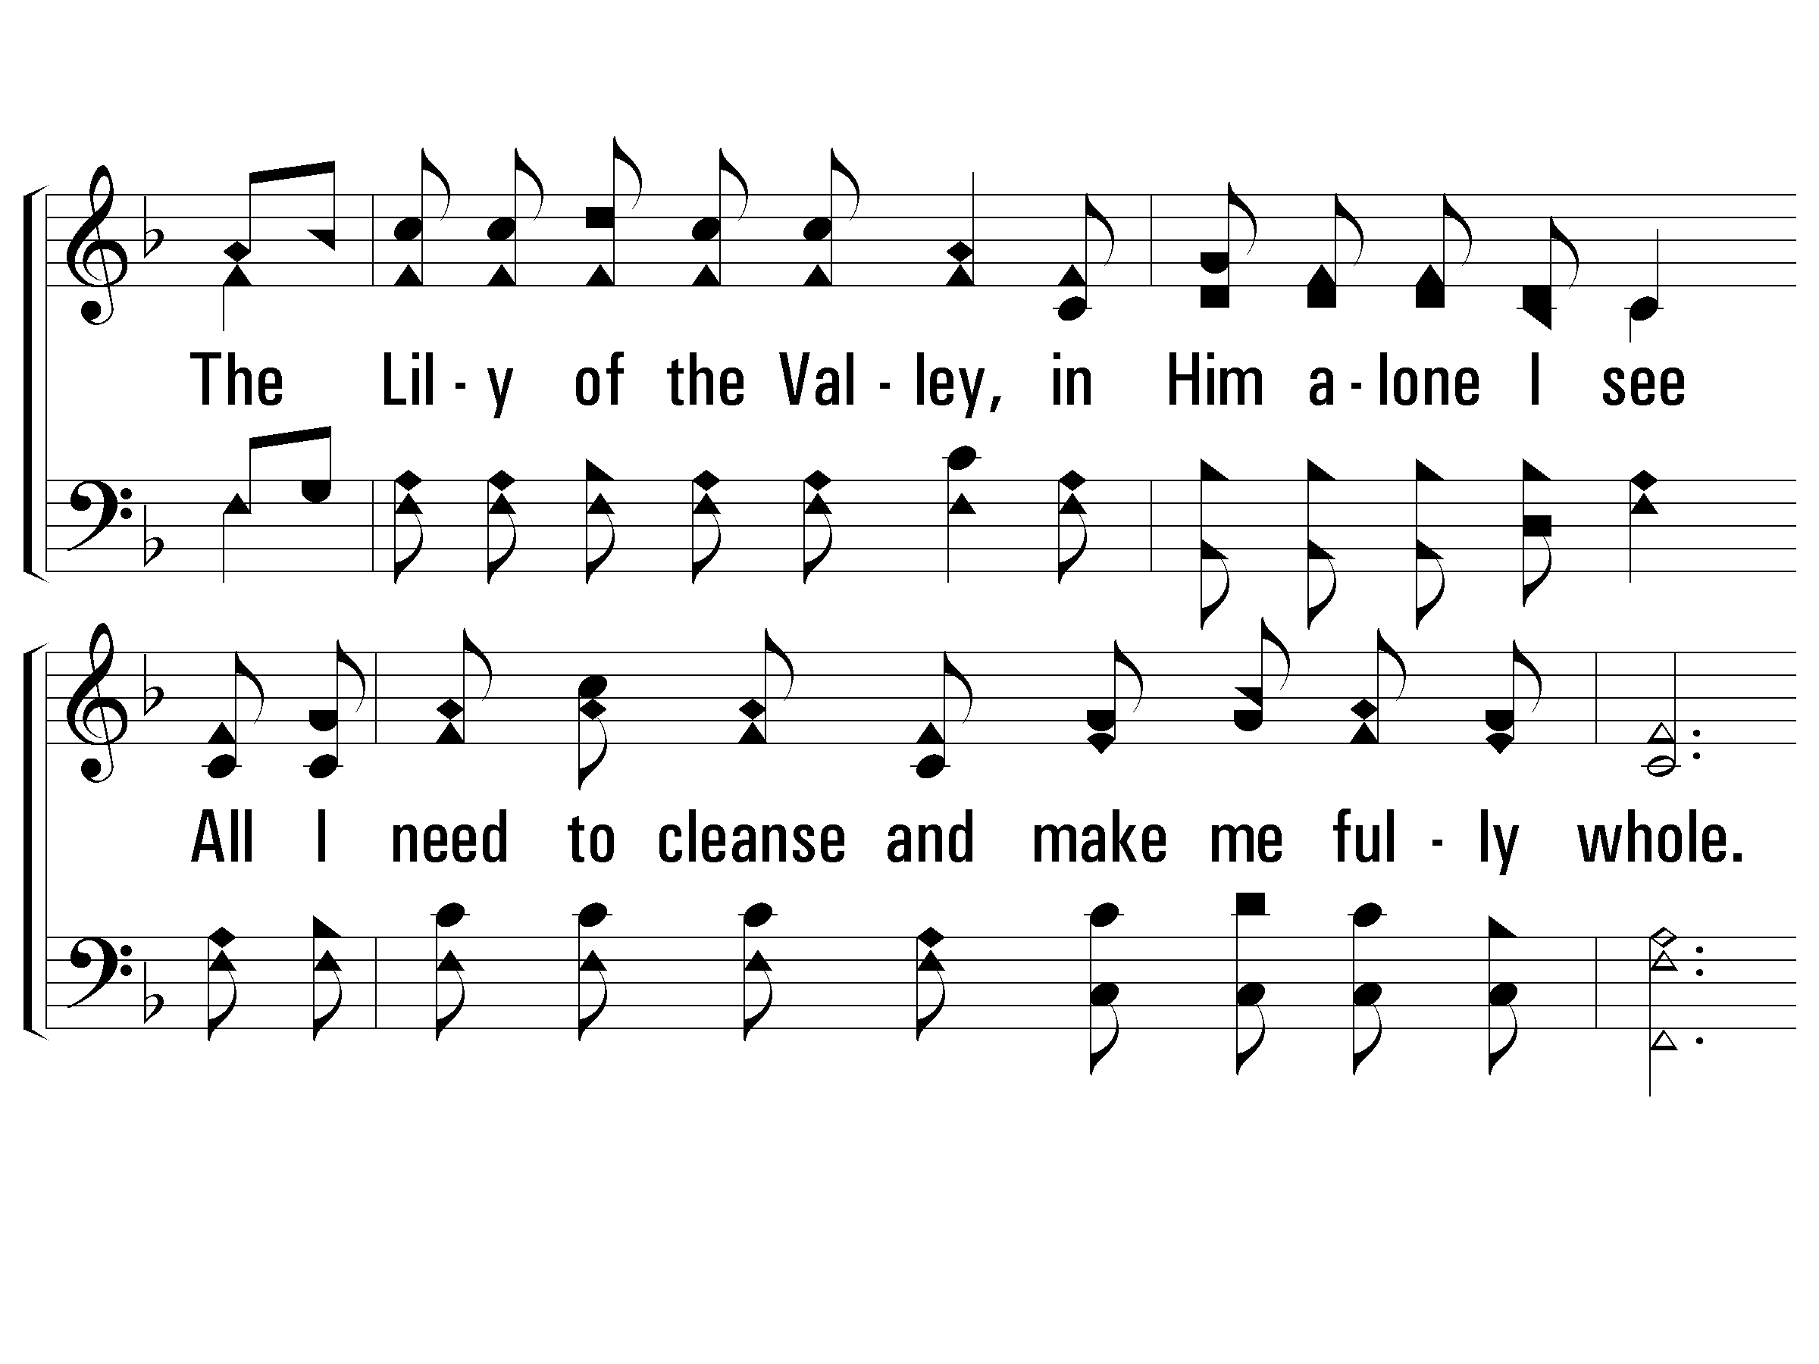
1 – The Lily of the Valley
© 2002 The Paperless Hymnal™

Slide 54
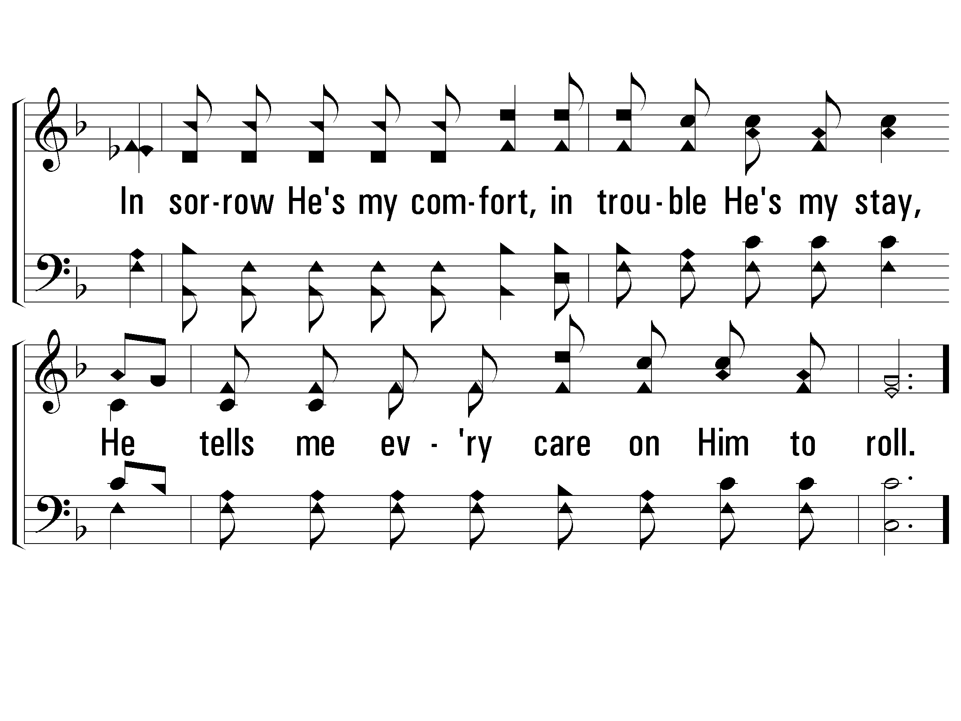
1 – The Lily of the Valley
© 2002 The Paperless Hymnal™

Slide 55
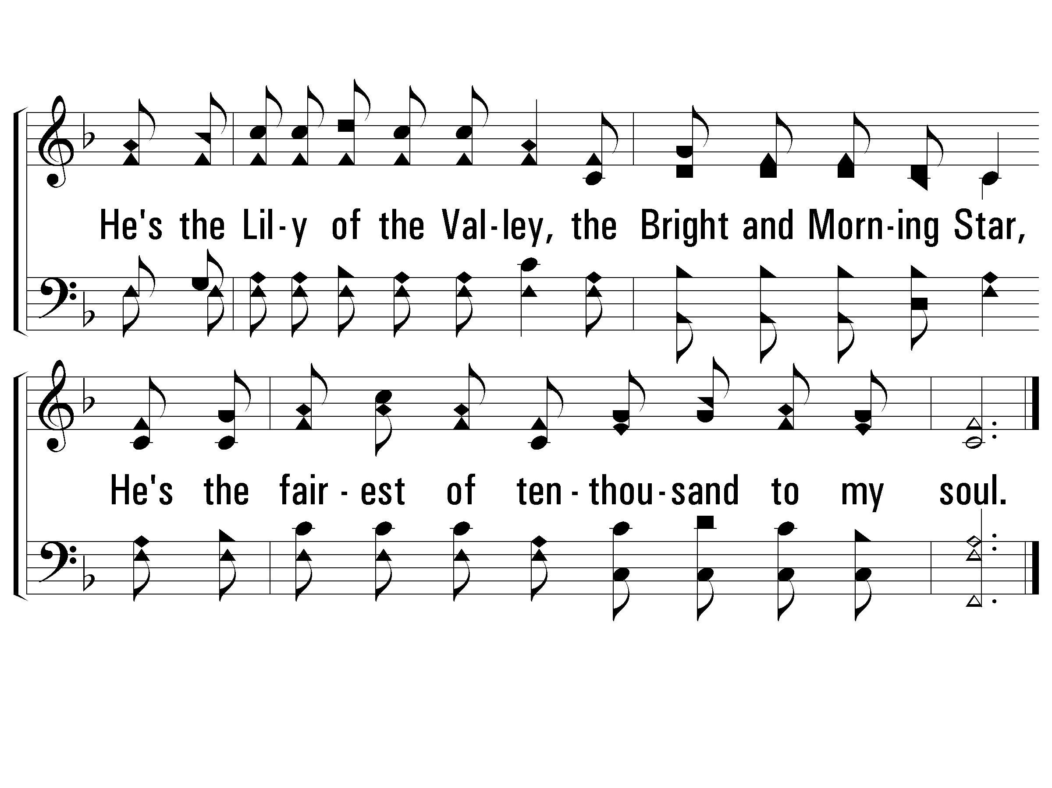
c – The Lily of the Valley
He's the Lily of the Valley,
the Bright and Morning Star,
He's the fairest of ten-thousand to my soul.
© 2002 The Paperless Hymnal™

Slide 56
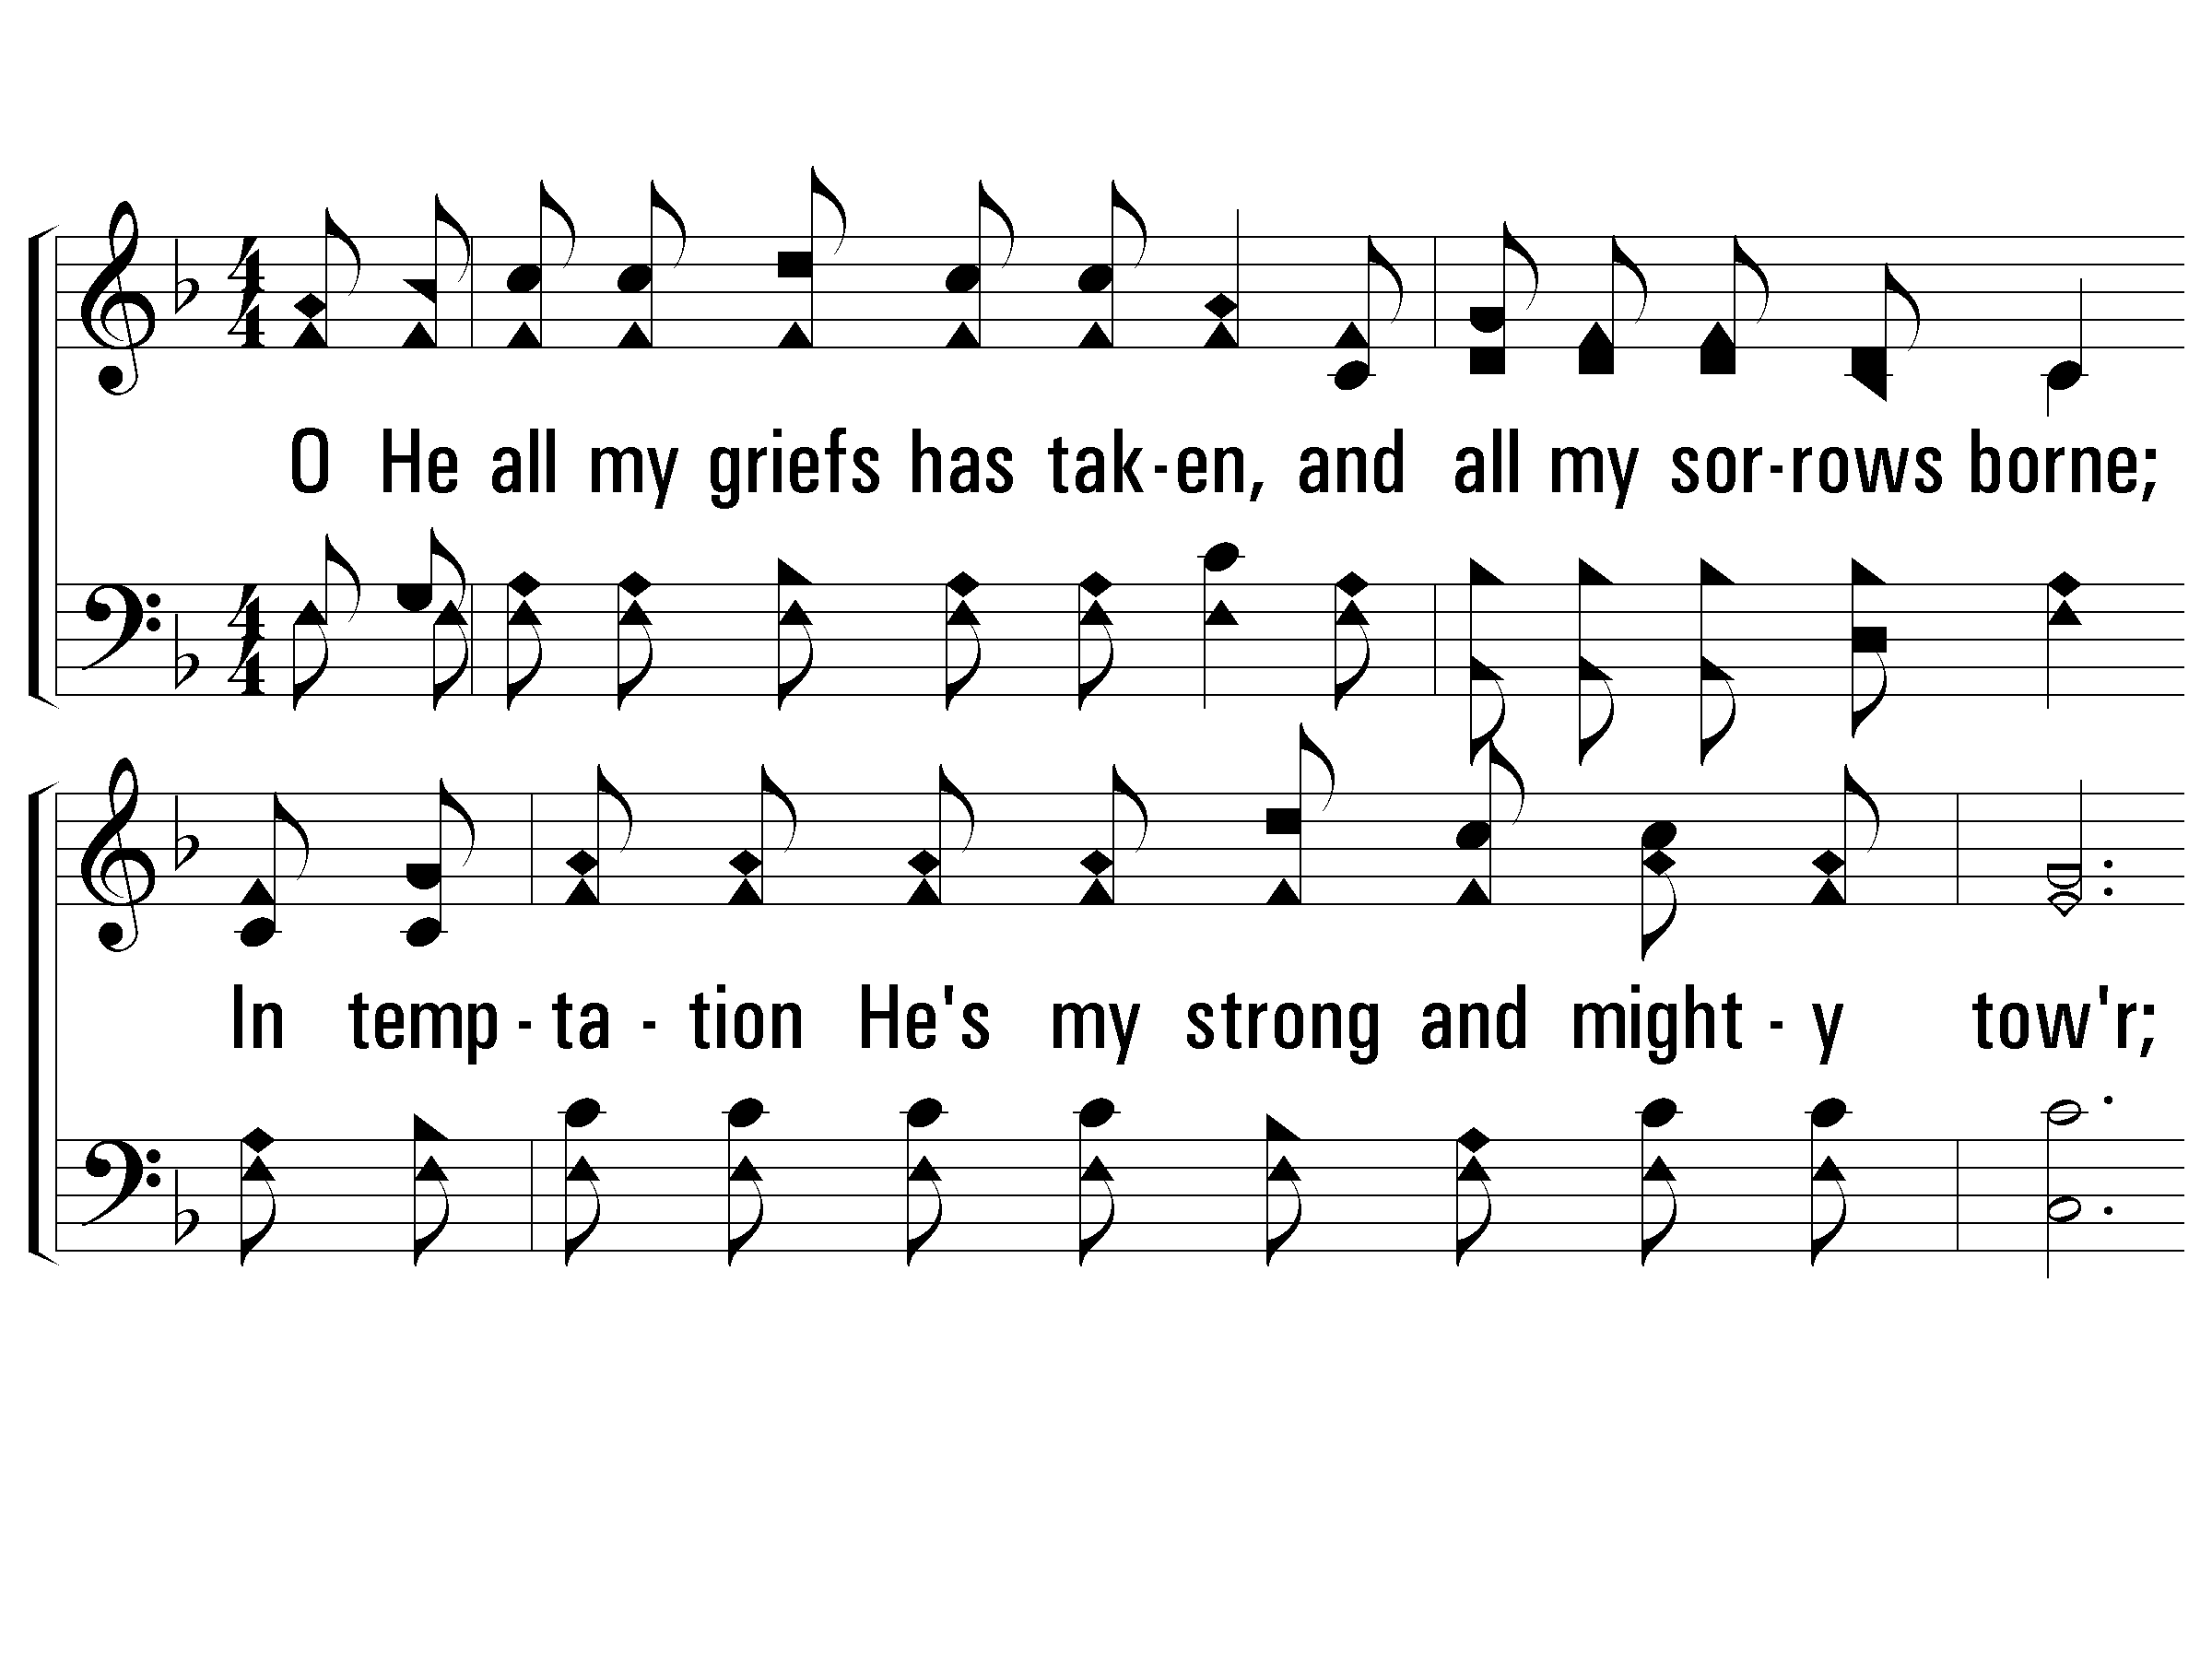
2 – The Lily of the Valley
2.
O He all my griefs has taken,
and all my sorrows borne;
In temptation He's my strong and mighty tower;
I have all for Him forsaken, and all my idols torn
From my heart, and now He keeps me by His power.
Though all the world forsake me, and Satan tempt me sore,
Through Jesus I shall safely reach the goal.
Words: Charles W. Fry
Music: William S. Hays / Adapted: Charles W. Fry
© 2002 The Paperless Hymnal™

Slide 57
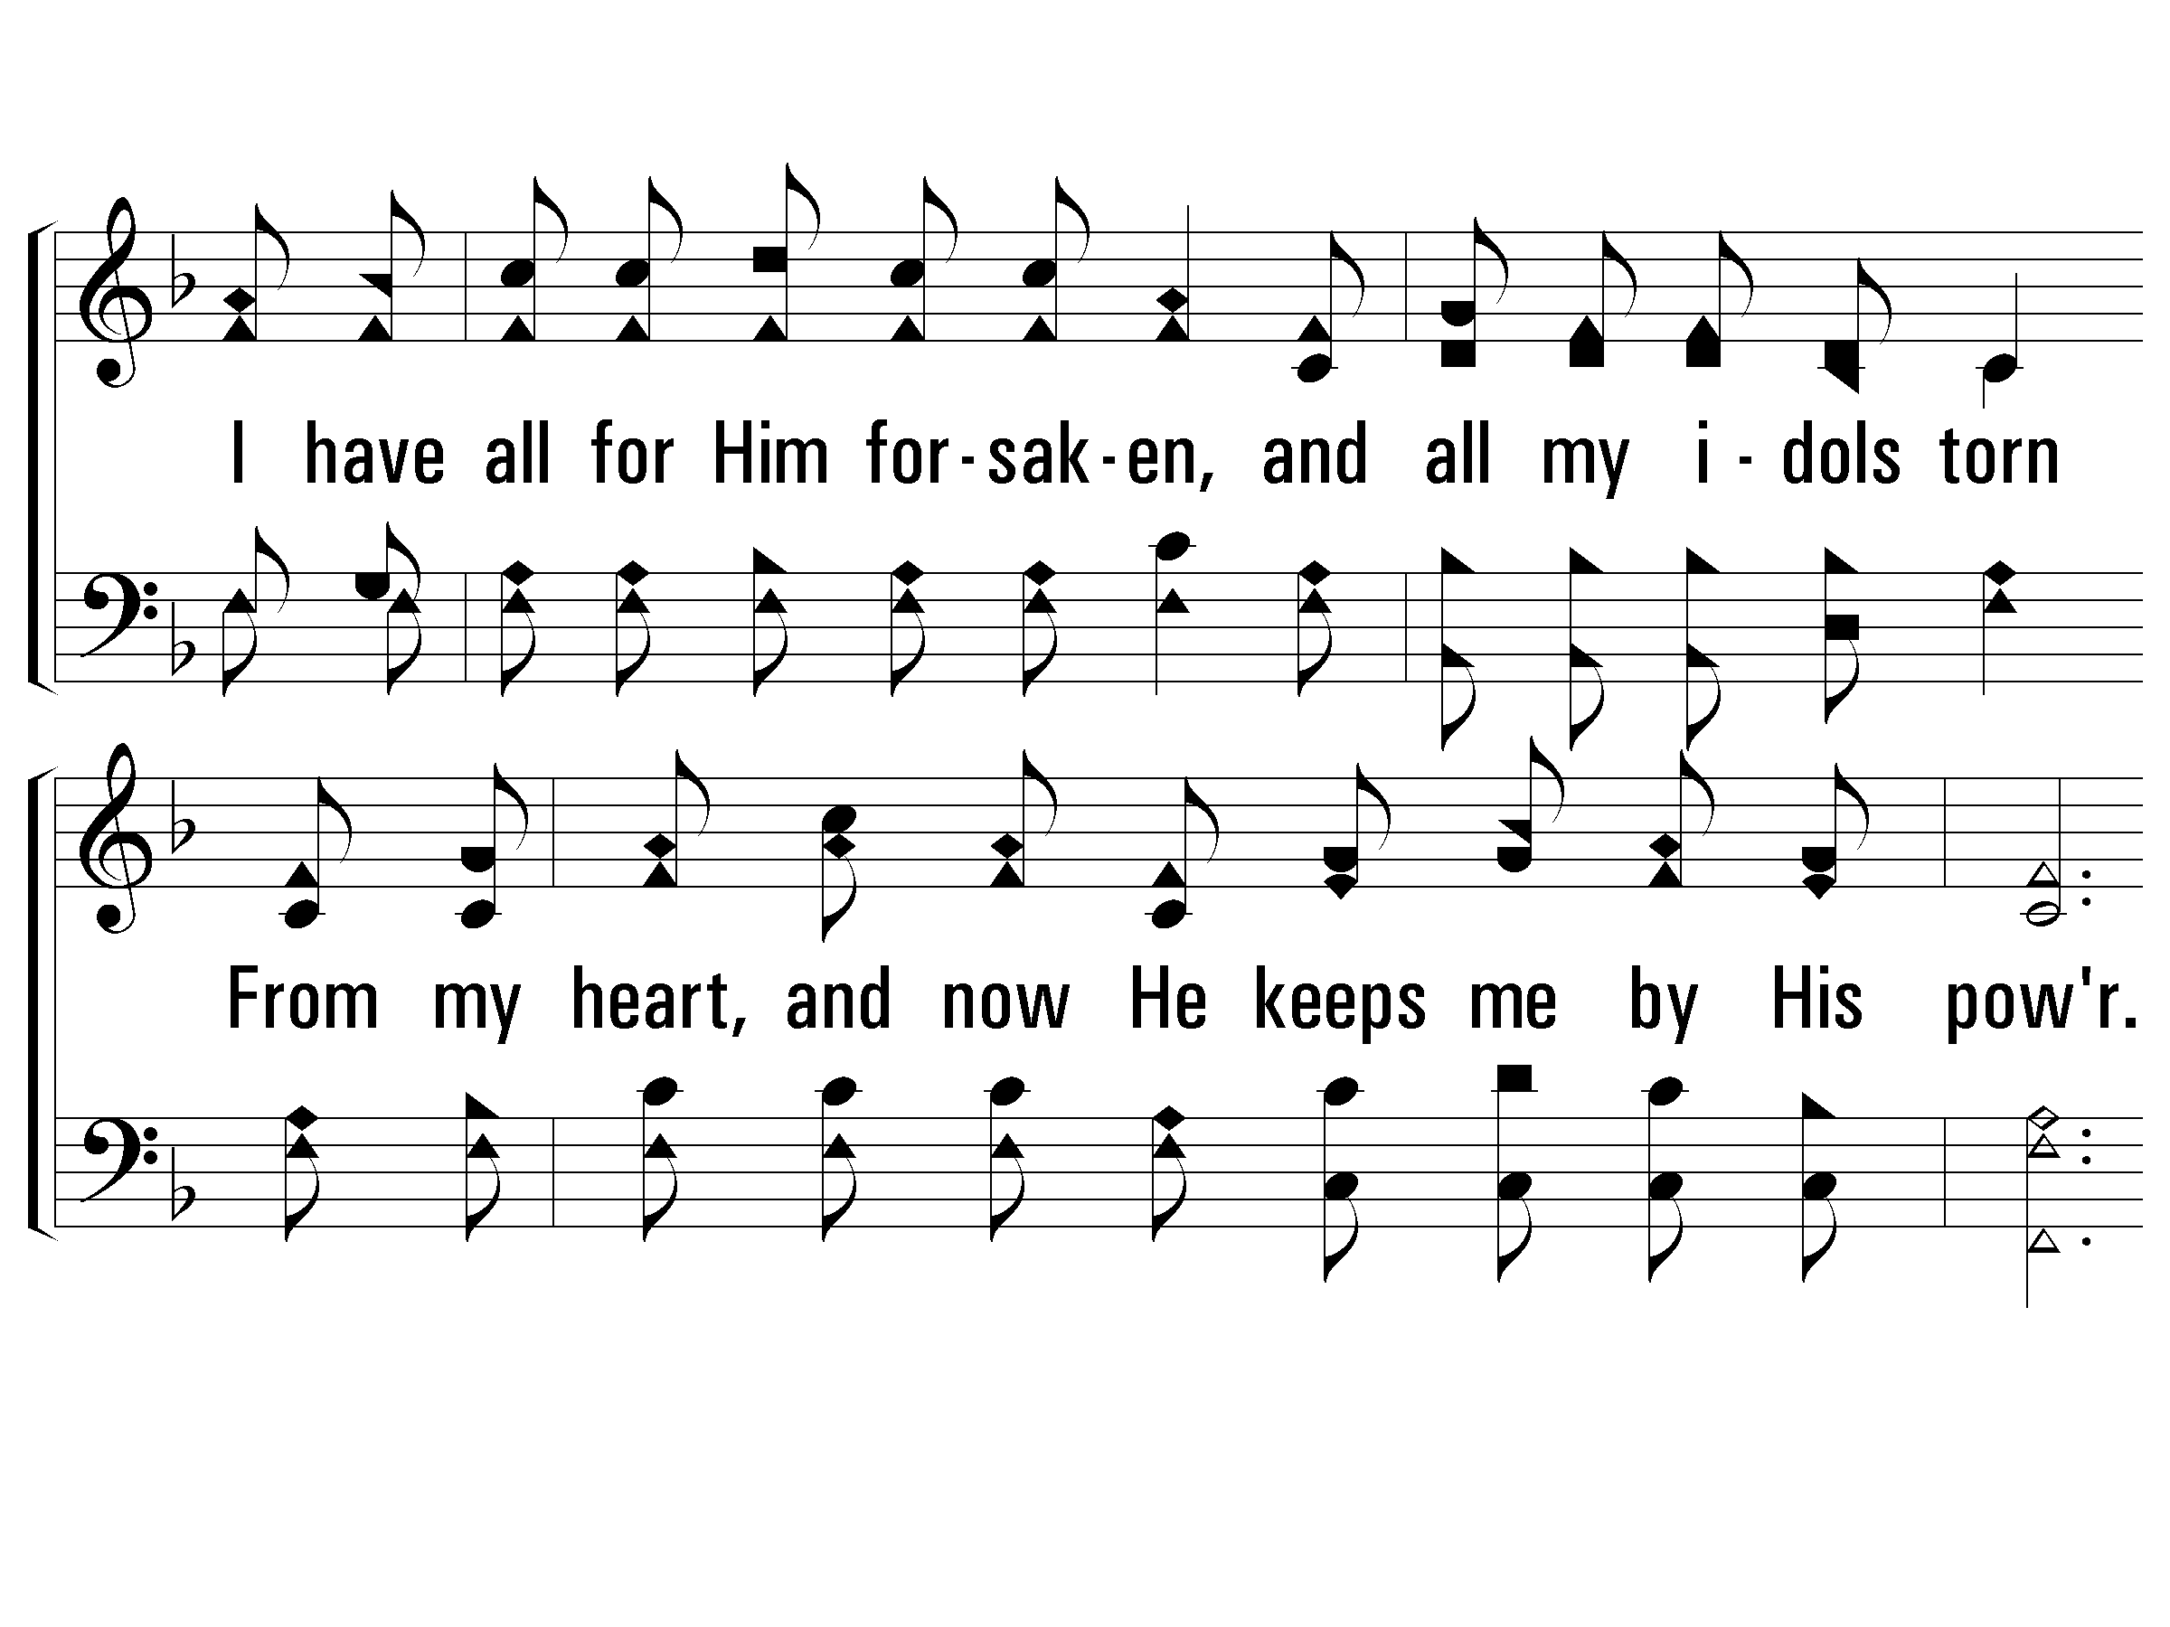
2 – The Lily of the Valley
© 2002 The Paperless Hymnal™

Slide 58
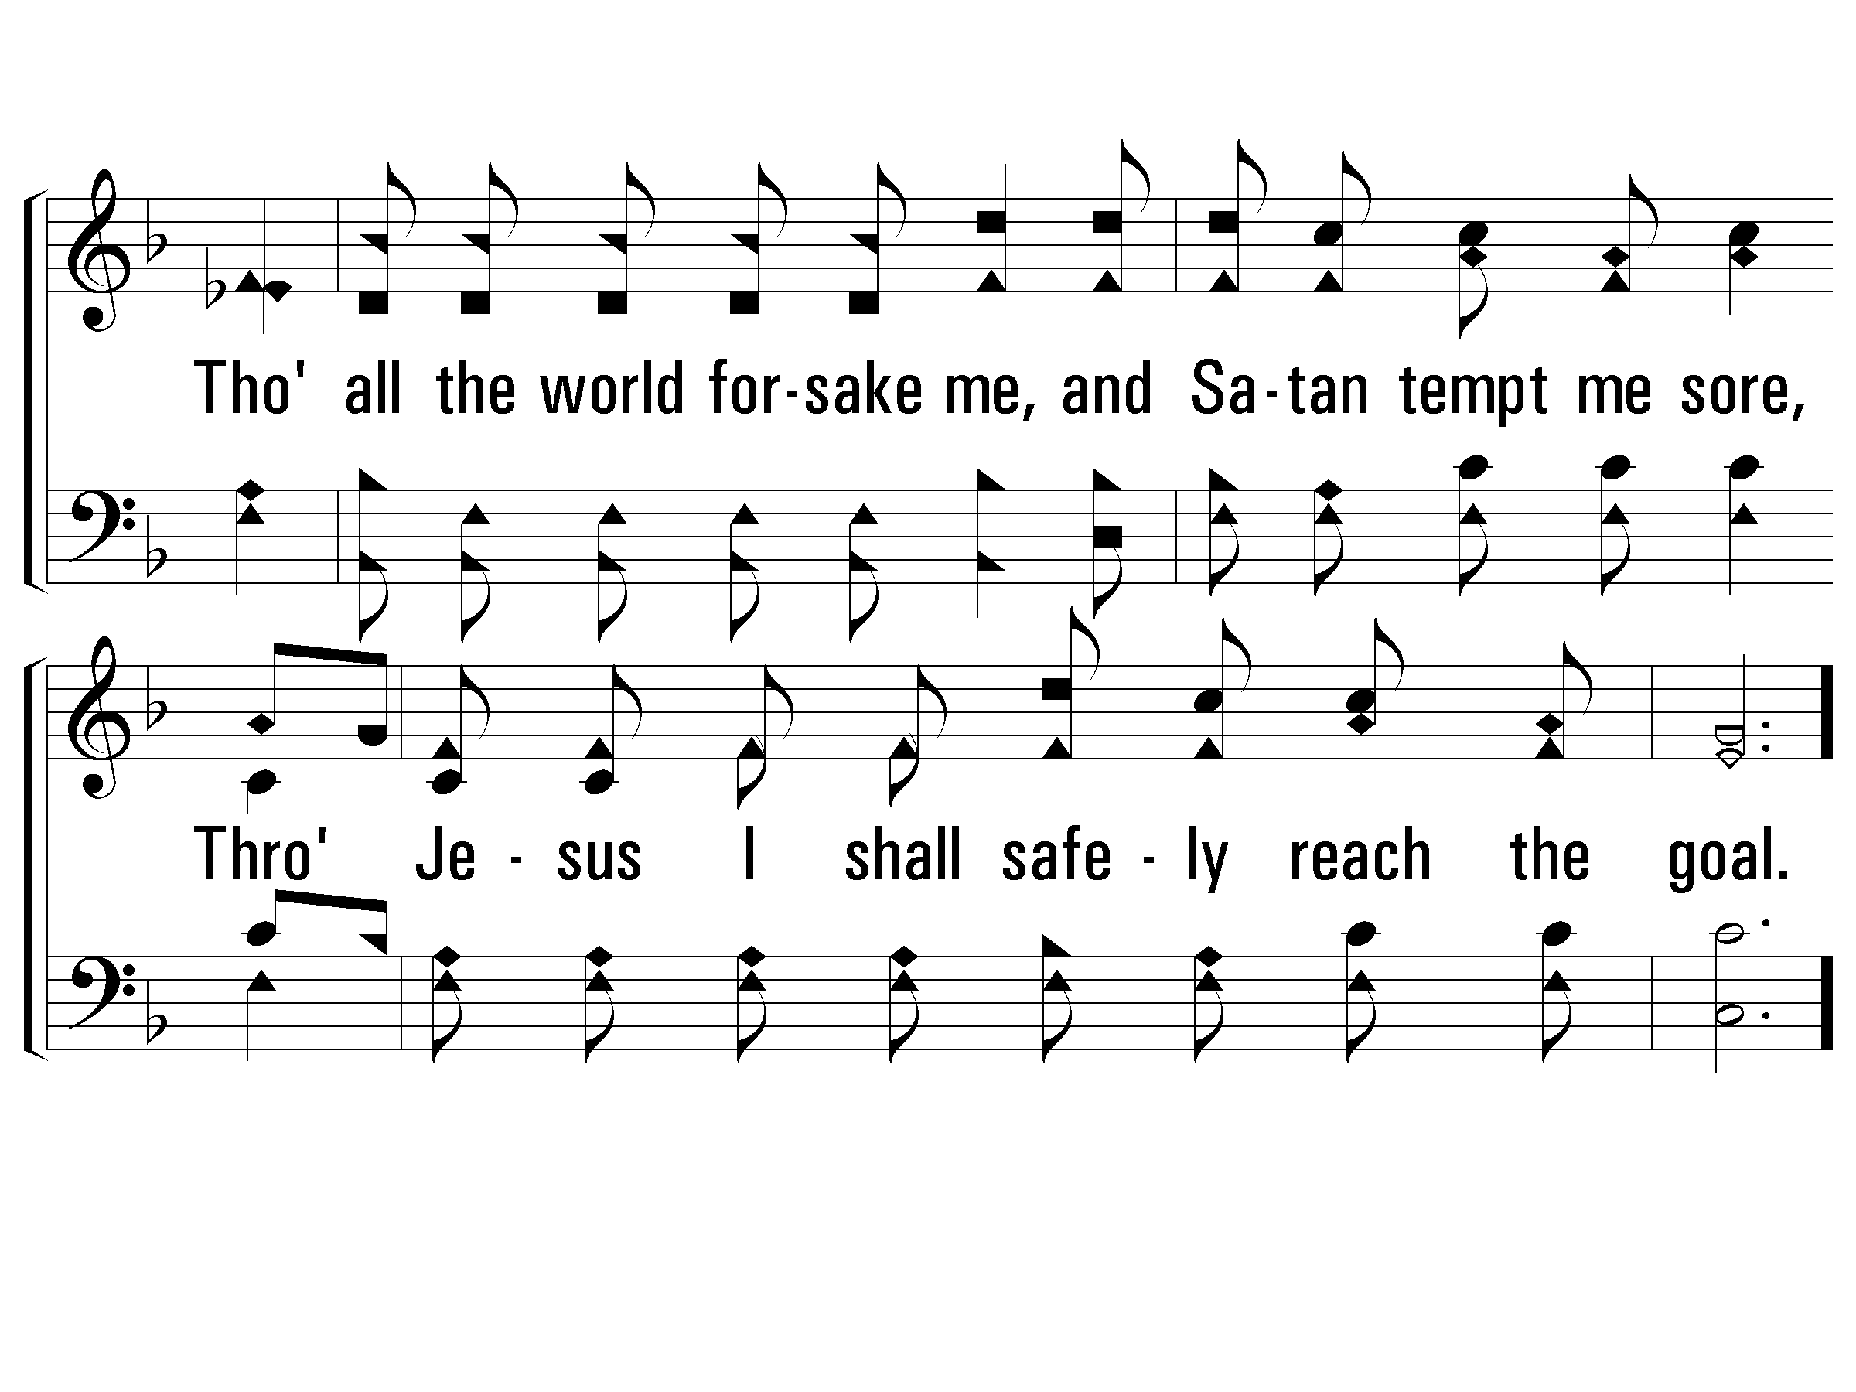
2 – The Lily of the Valley
© 2002 The Paperless Hymnal™

Slide 59
c – The Lily of the Valley
He's the Lily of the Valley,
the Bright and Morning Star,
He's the fairest of ten-thousand to my soul.
© 2002 The Paperless Hymnal™

Slide 60
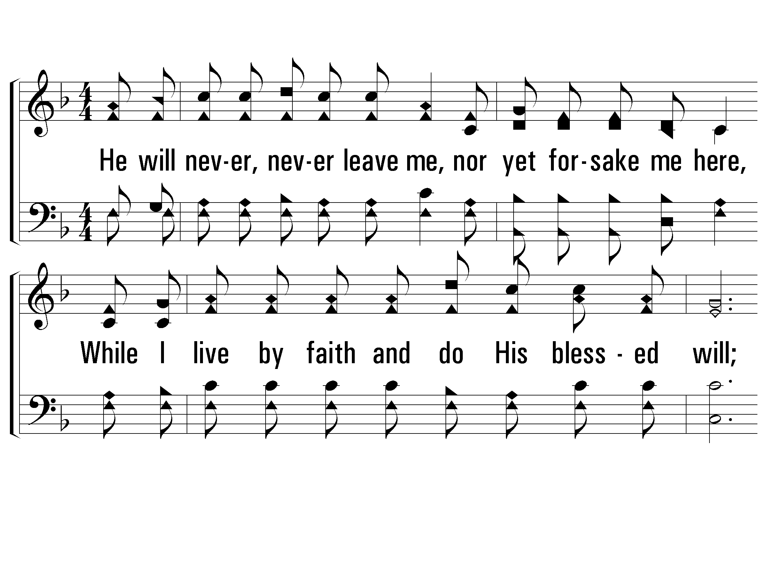
3 – The Lily of the Valley
3.
He will never, never leave me,
nor yet forsake me here,
While I live by faith and do His blessed will;
A wall of fire about me,
I've nothing now to fear,
With His manna He my hungry soul shall fill.
Then sweeping up to glory to see His bless-ed face,
Where rivers of delight shall ever roll.
Words: Charles W. Fry
Music: William S. Hays / Adapted: Charles W. Fry
© 2002 The Paperless Hymnal™

Slide 61
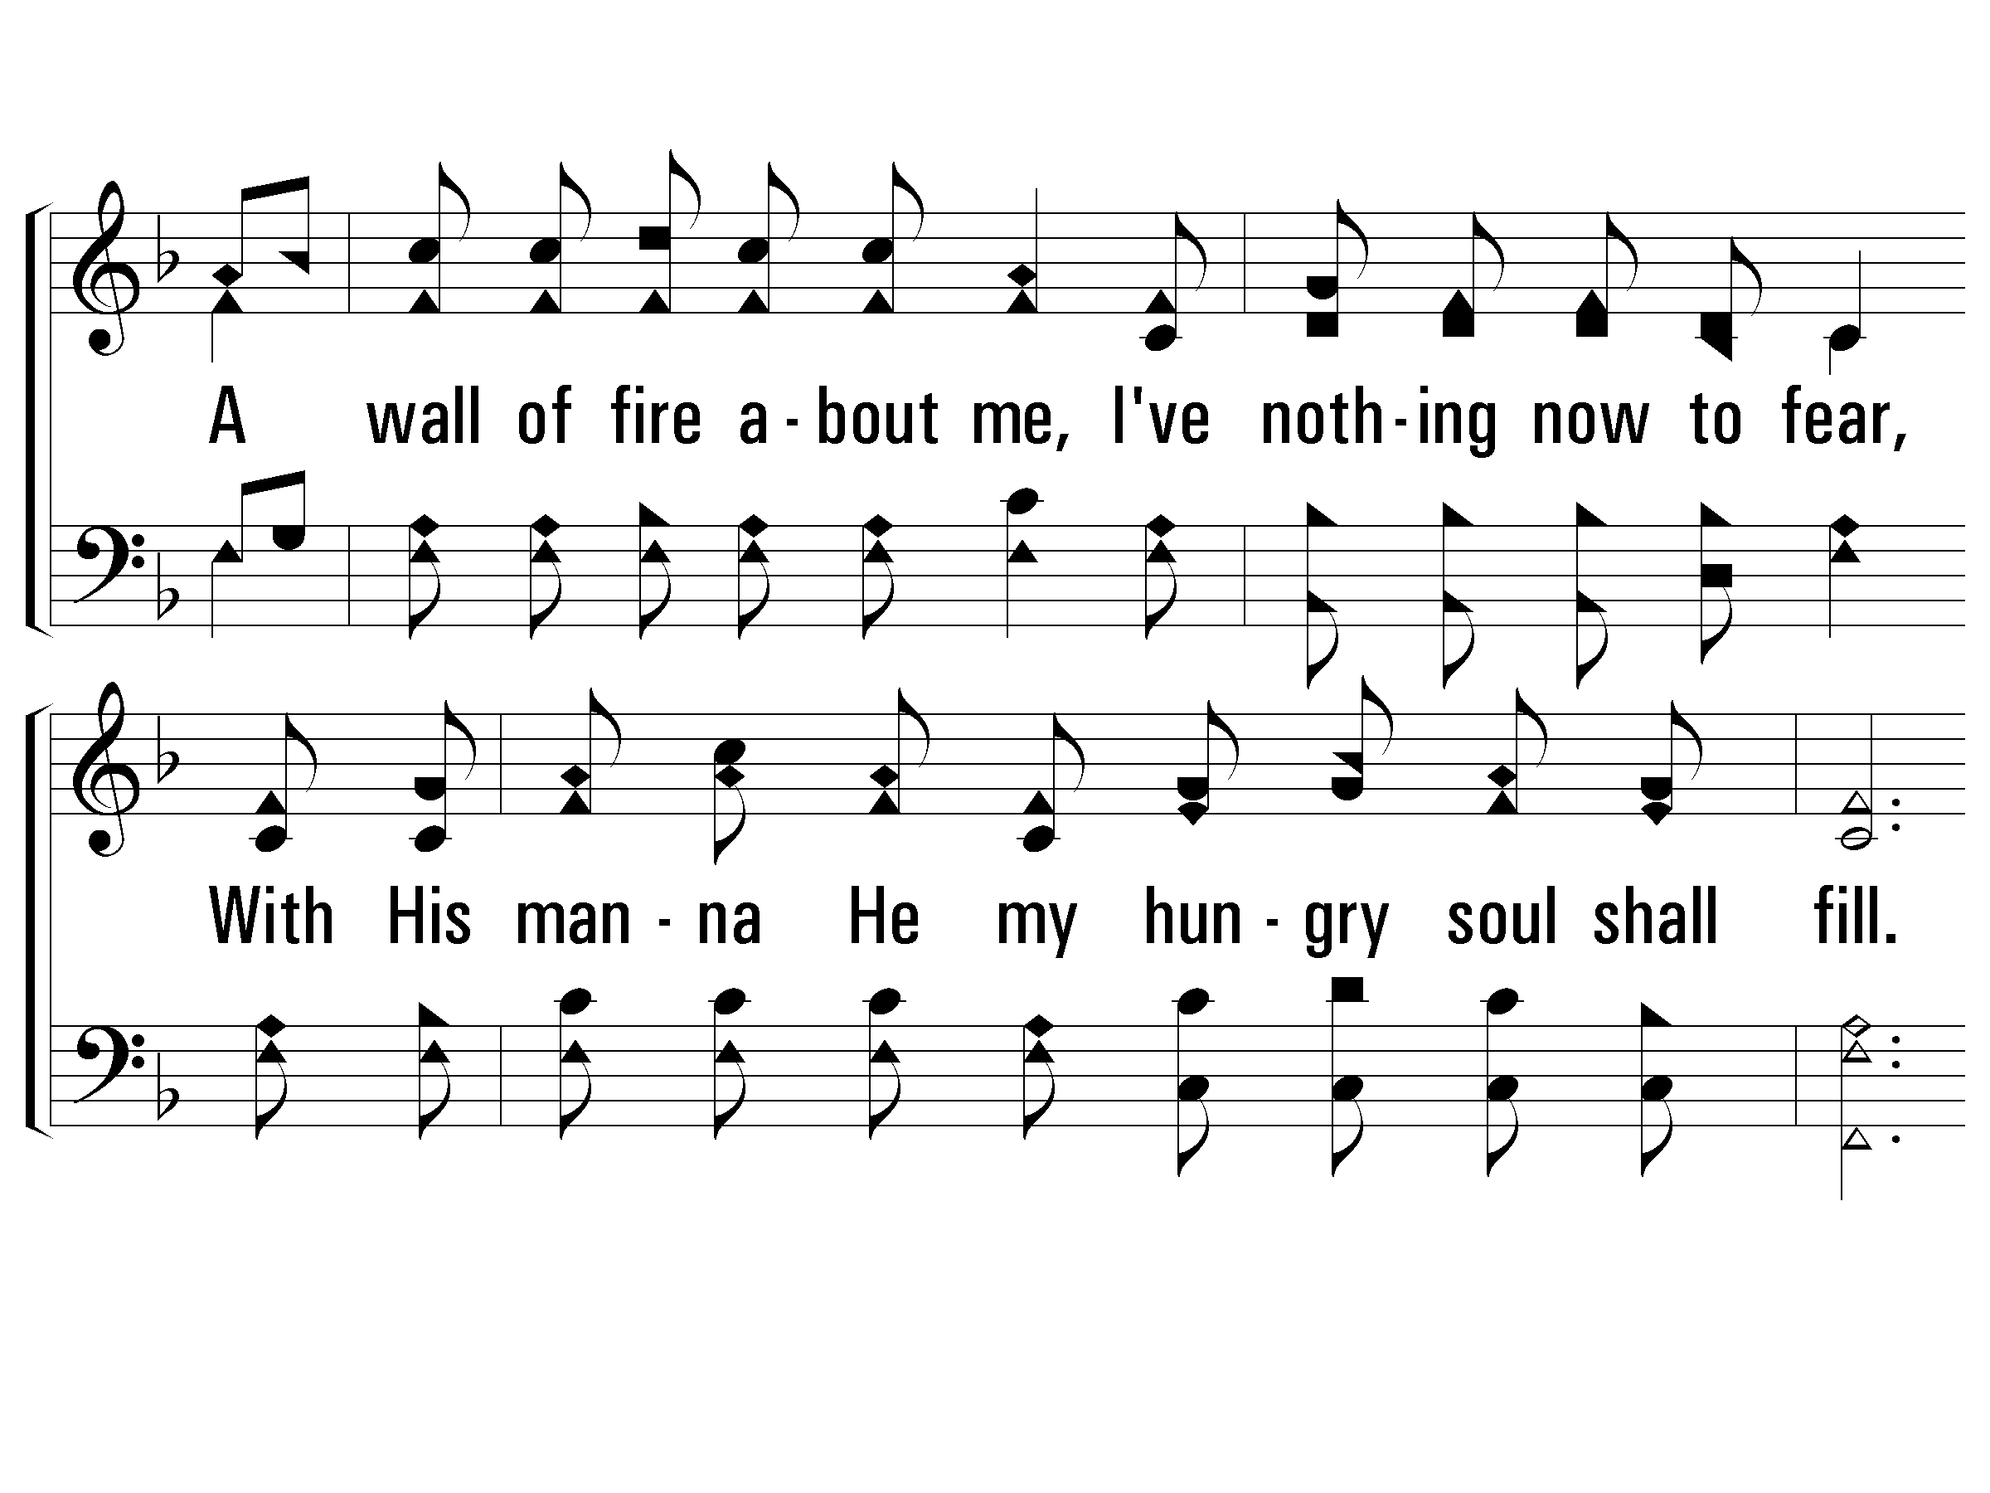
3 – The Lily of the Valley
© 2002 The Paperless Hymnal™

Slide 62
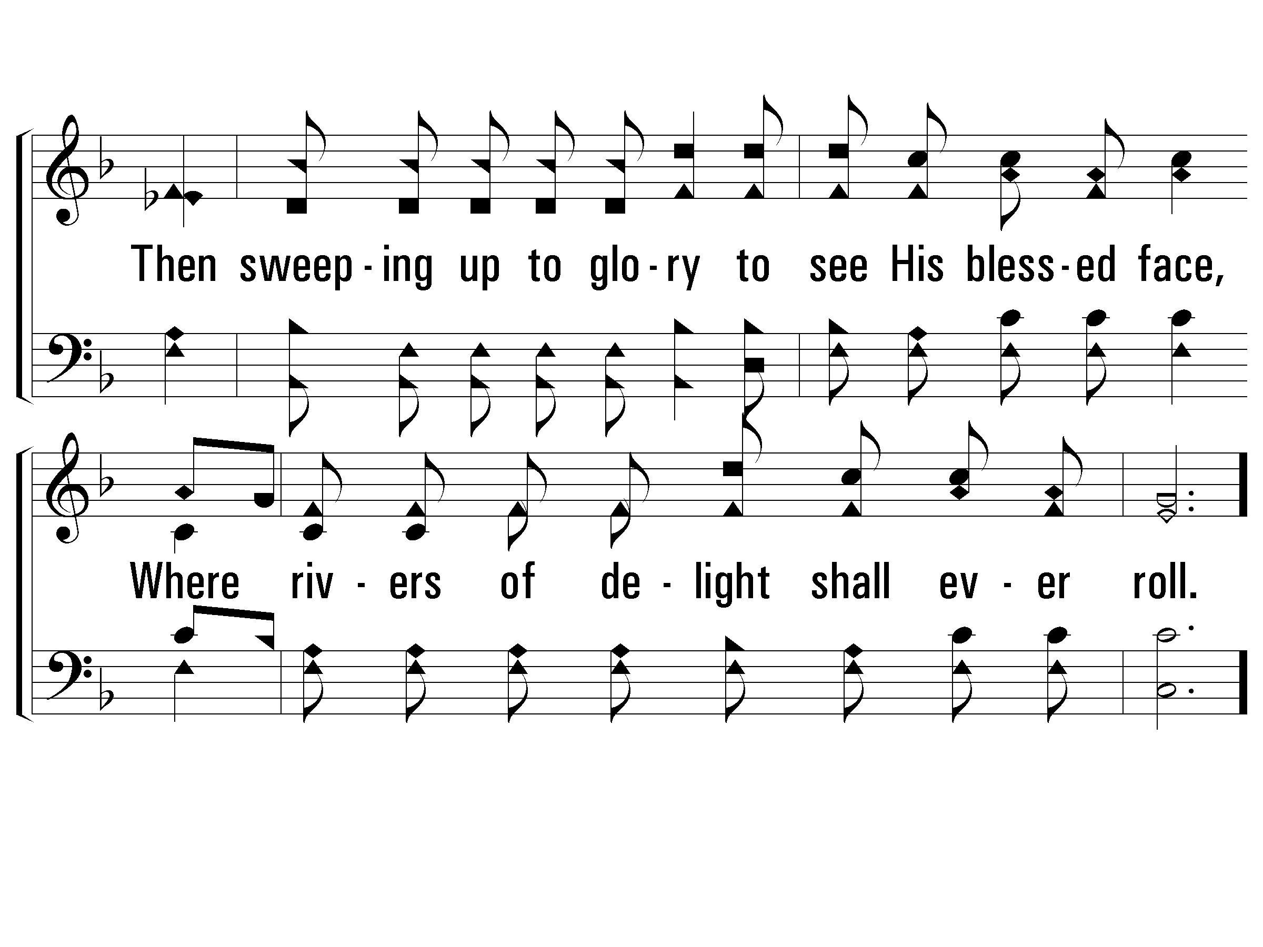
3 – The Lily of the Valley
© 2002 The Paperless Hymnal™

Slide 63
c – The Lily of the Valley
He's the Lily of the Valley,
the Bright and Morning Star,
He's the fairest of ten-thousand to my soul.
© 2002 The Paperless Hymnal™

Slide 64
Father,
I Adore You
#850

Slide 65
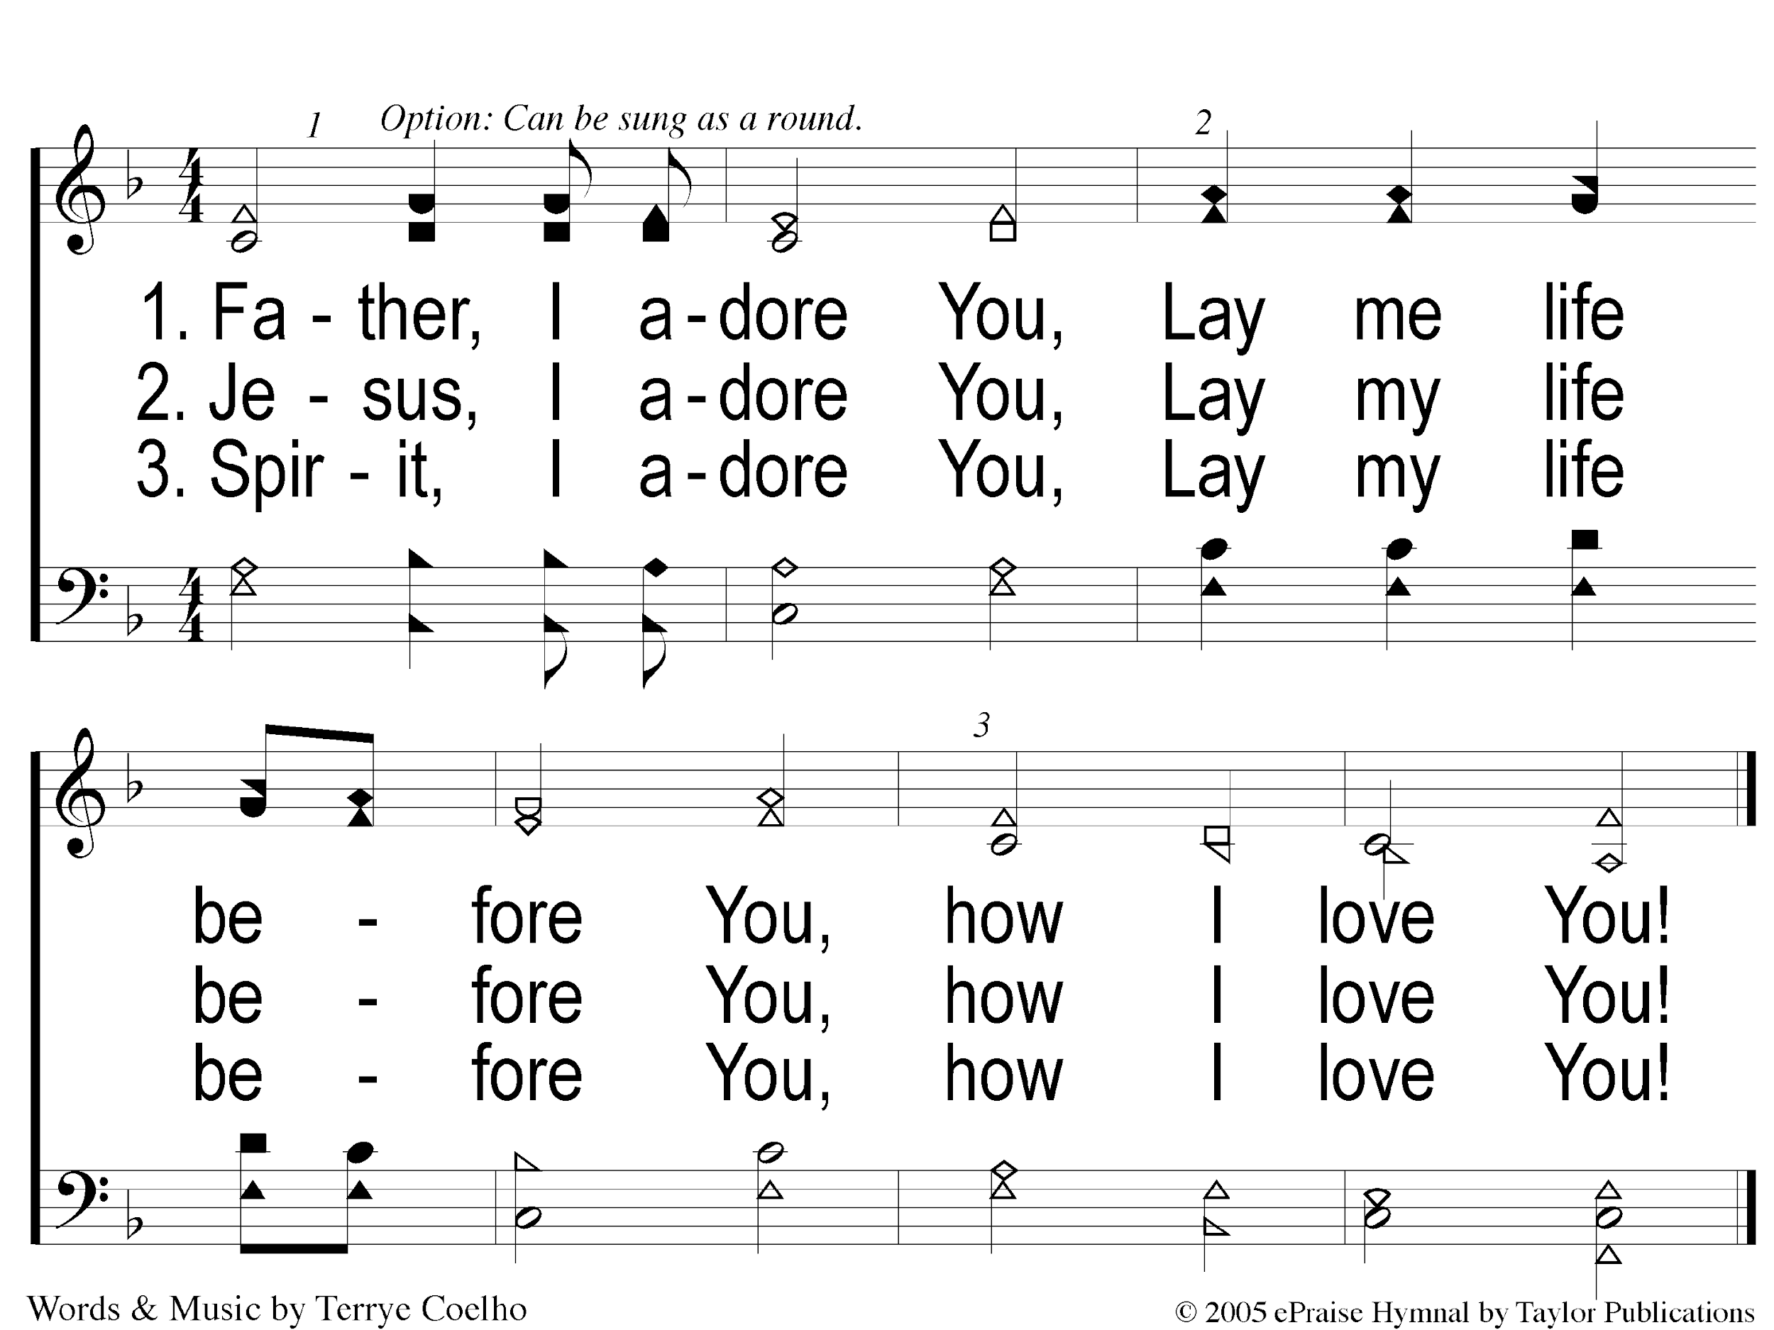
Father I Adore You
Father I Adore You

Slide 66
Prayer

Slide 67
When My Love To Christ Grows Weak
#752

Slide 68
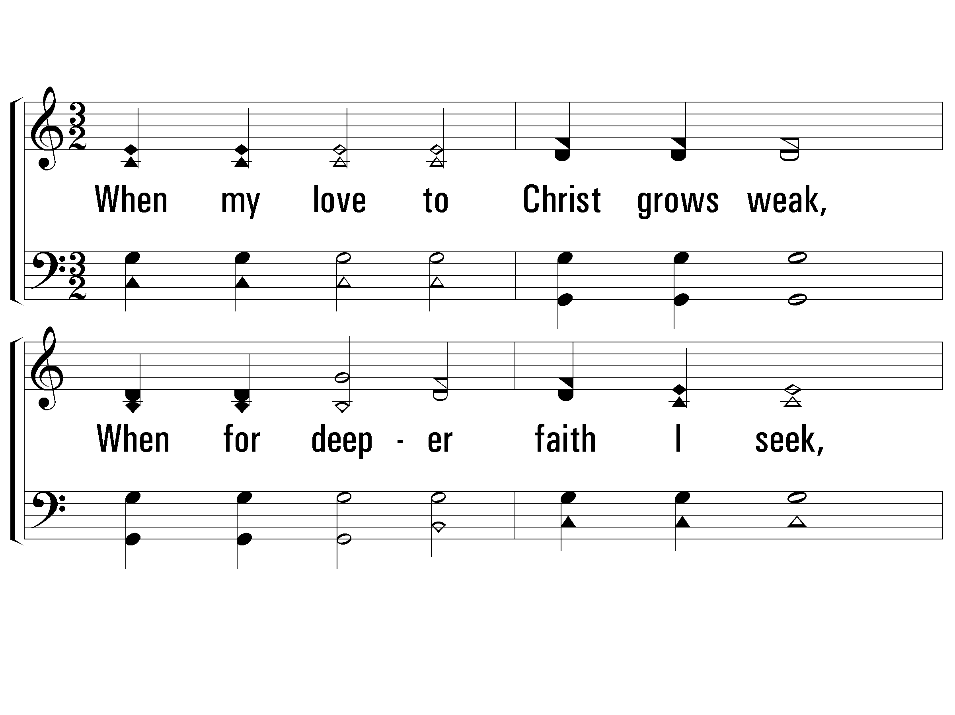
1 – When My Love to Christ Grows Weak
1.
When my love to Christ grows weak,
When for deeper faith I seek,
Then in thought I go to thee,
Garden of Gethsemane!
Words by: J. R. Wreford
Music by: Mrs. Joseph F. Knapp
© 2001 The Paperless Hymnal™

Slide 69
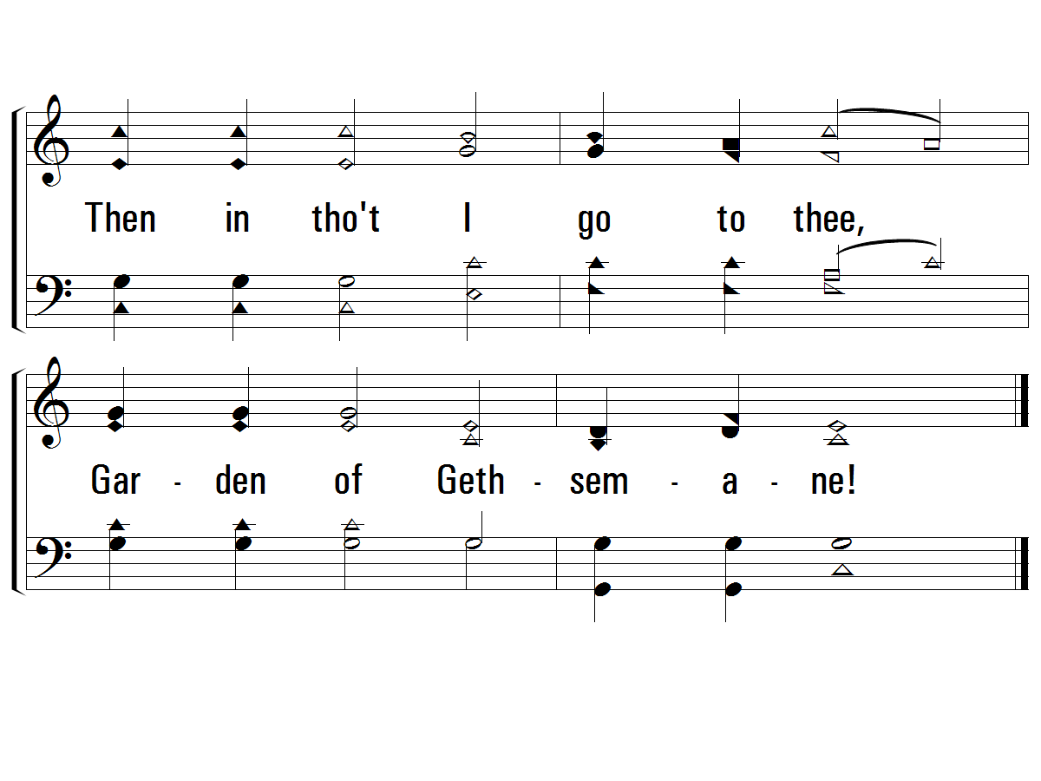
1 – When My Love to Christ Grows Weak
© 2001 The Paperless Hymnal™

Slide 70
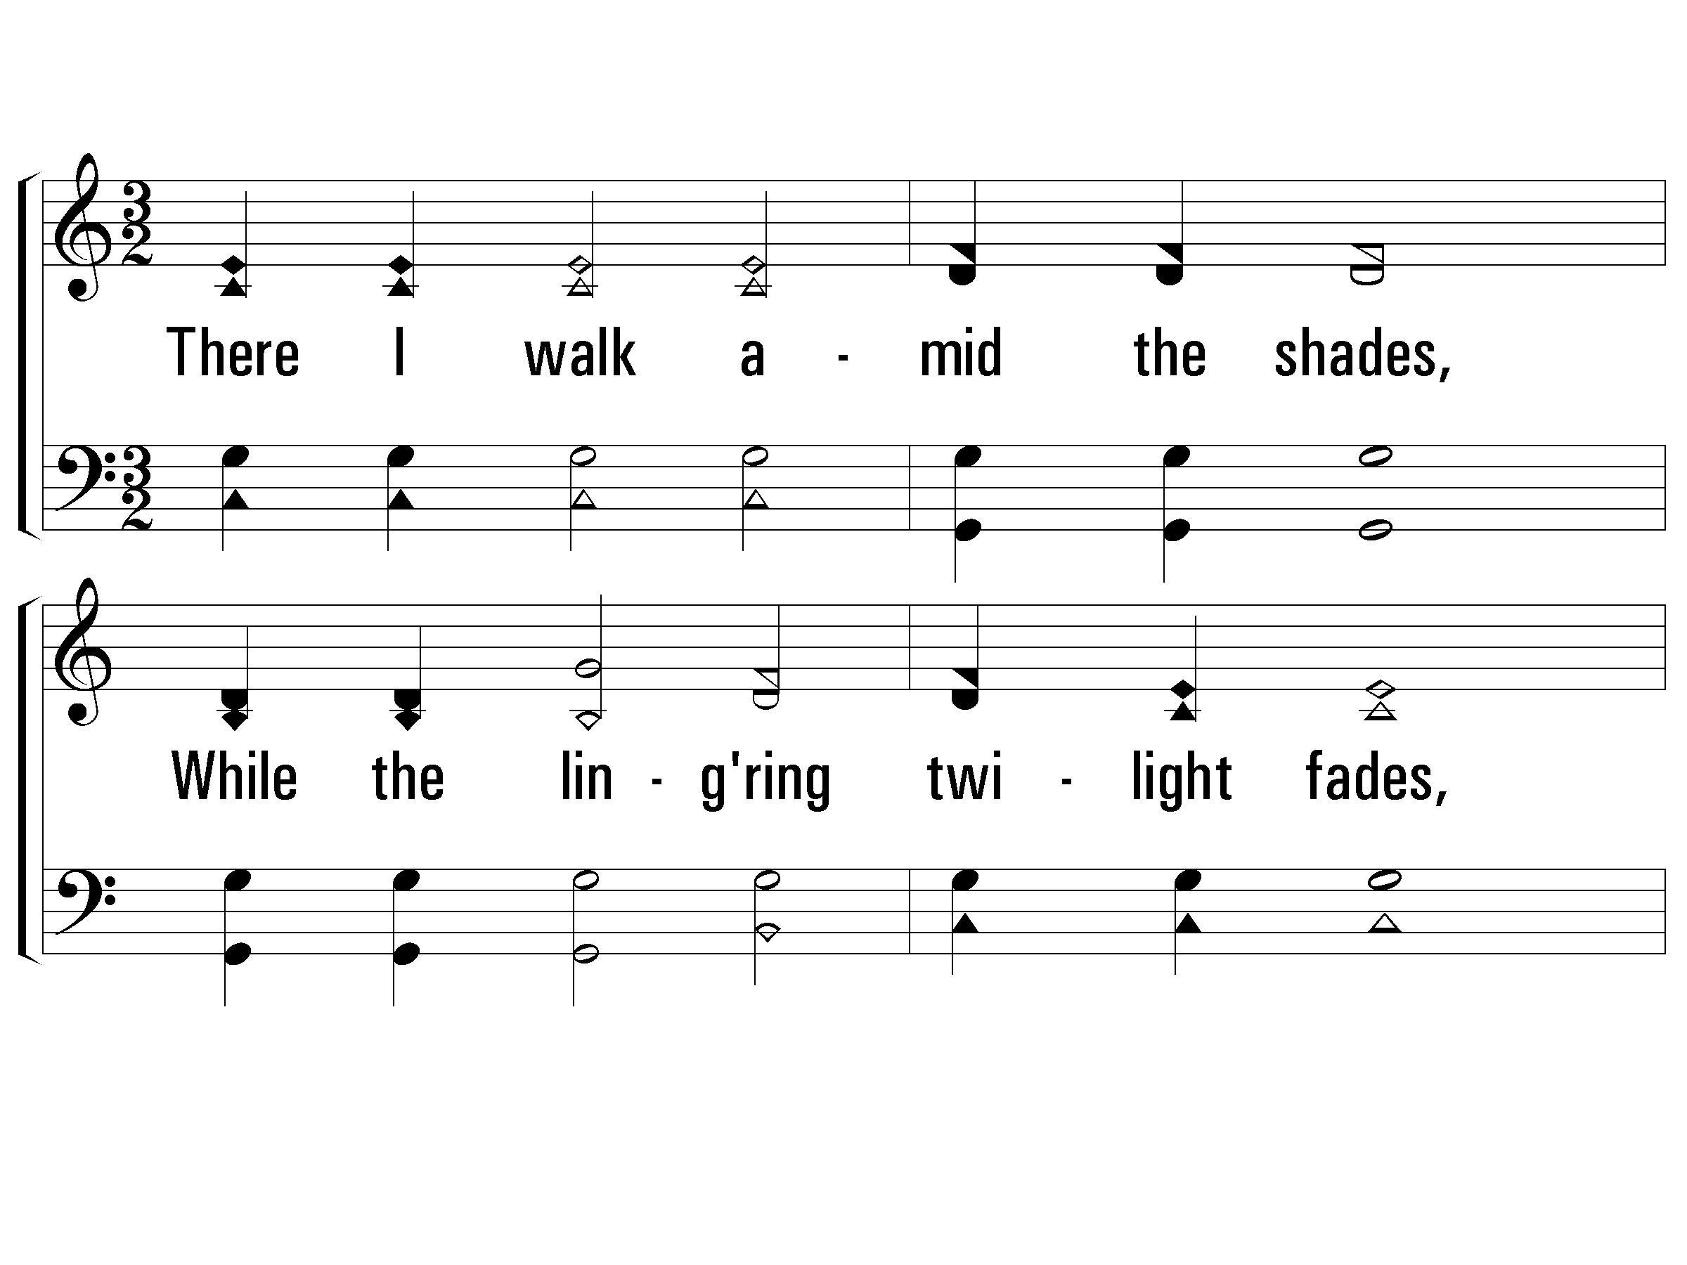
2 – When My Love to Christ Grows Weak
p
2.
There I walk amid the shades,
While the lingering twilight fades,
See that suffering, friendless One,
Weeping, praying there alone.
Words by: J. R. Wreford
Music by: Mrs. Joseph F. Knapp
© 2001 The Paperless Hymnal™

Slide 71
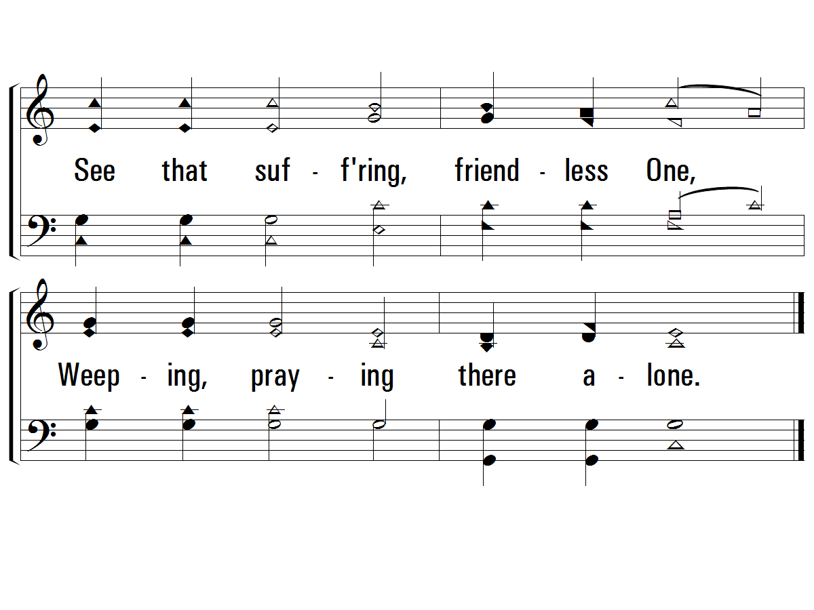
2 – When My Love to Christ Grows Weak
© 2001 The Paperless Hymnal™

Slide 72
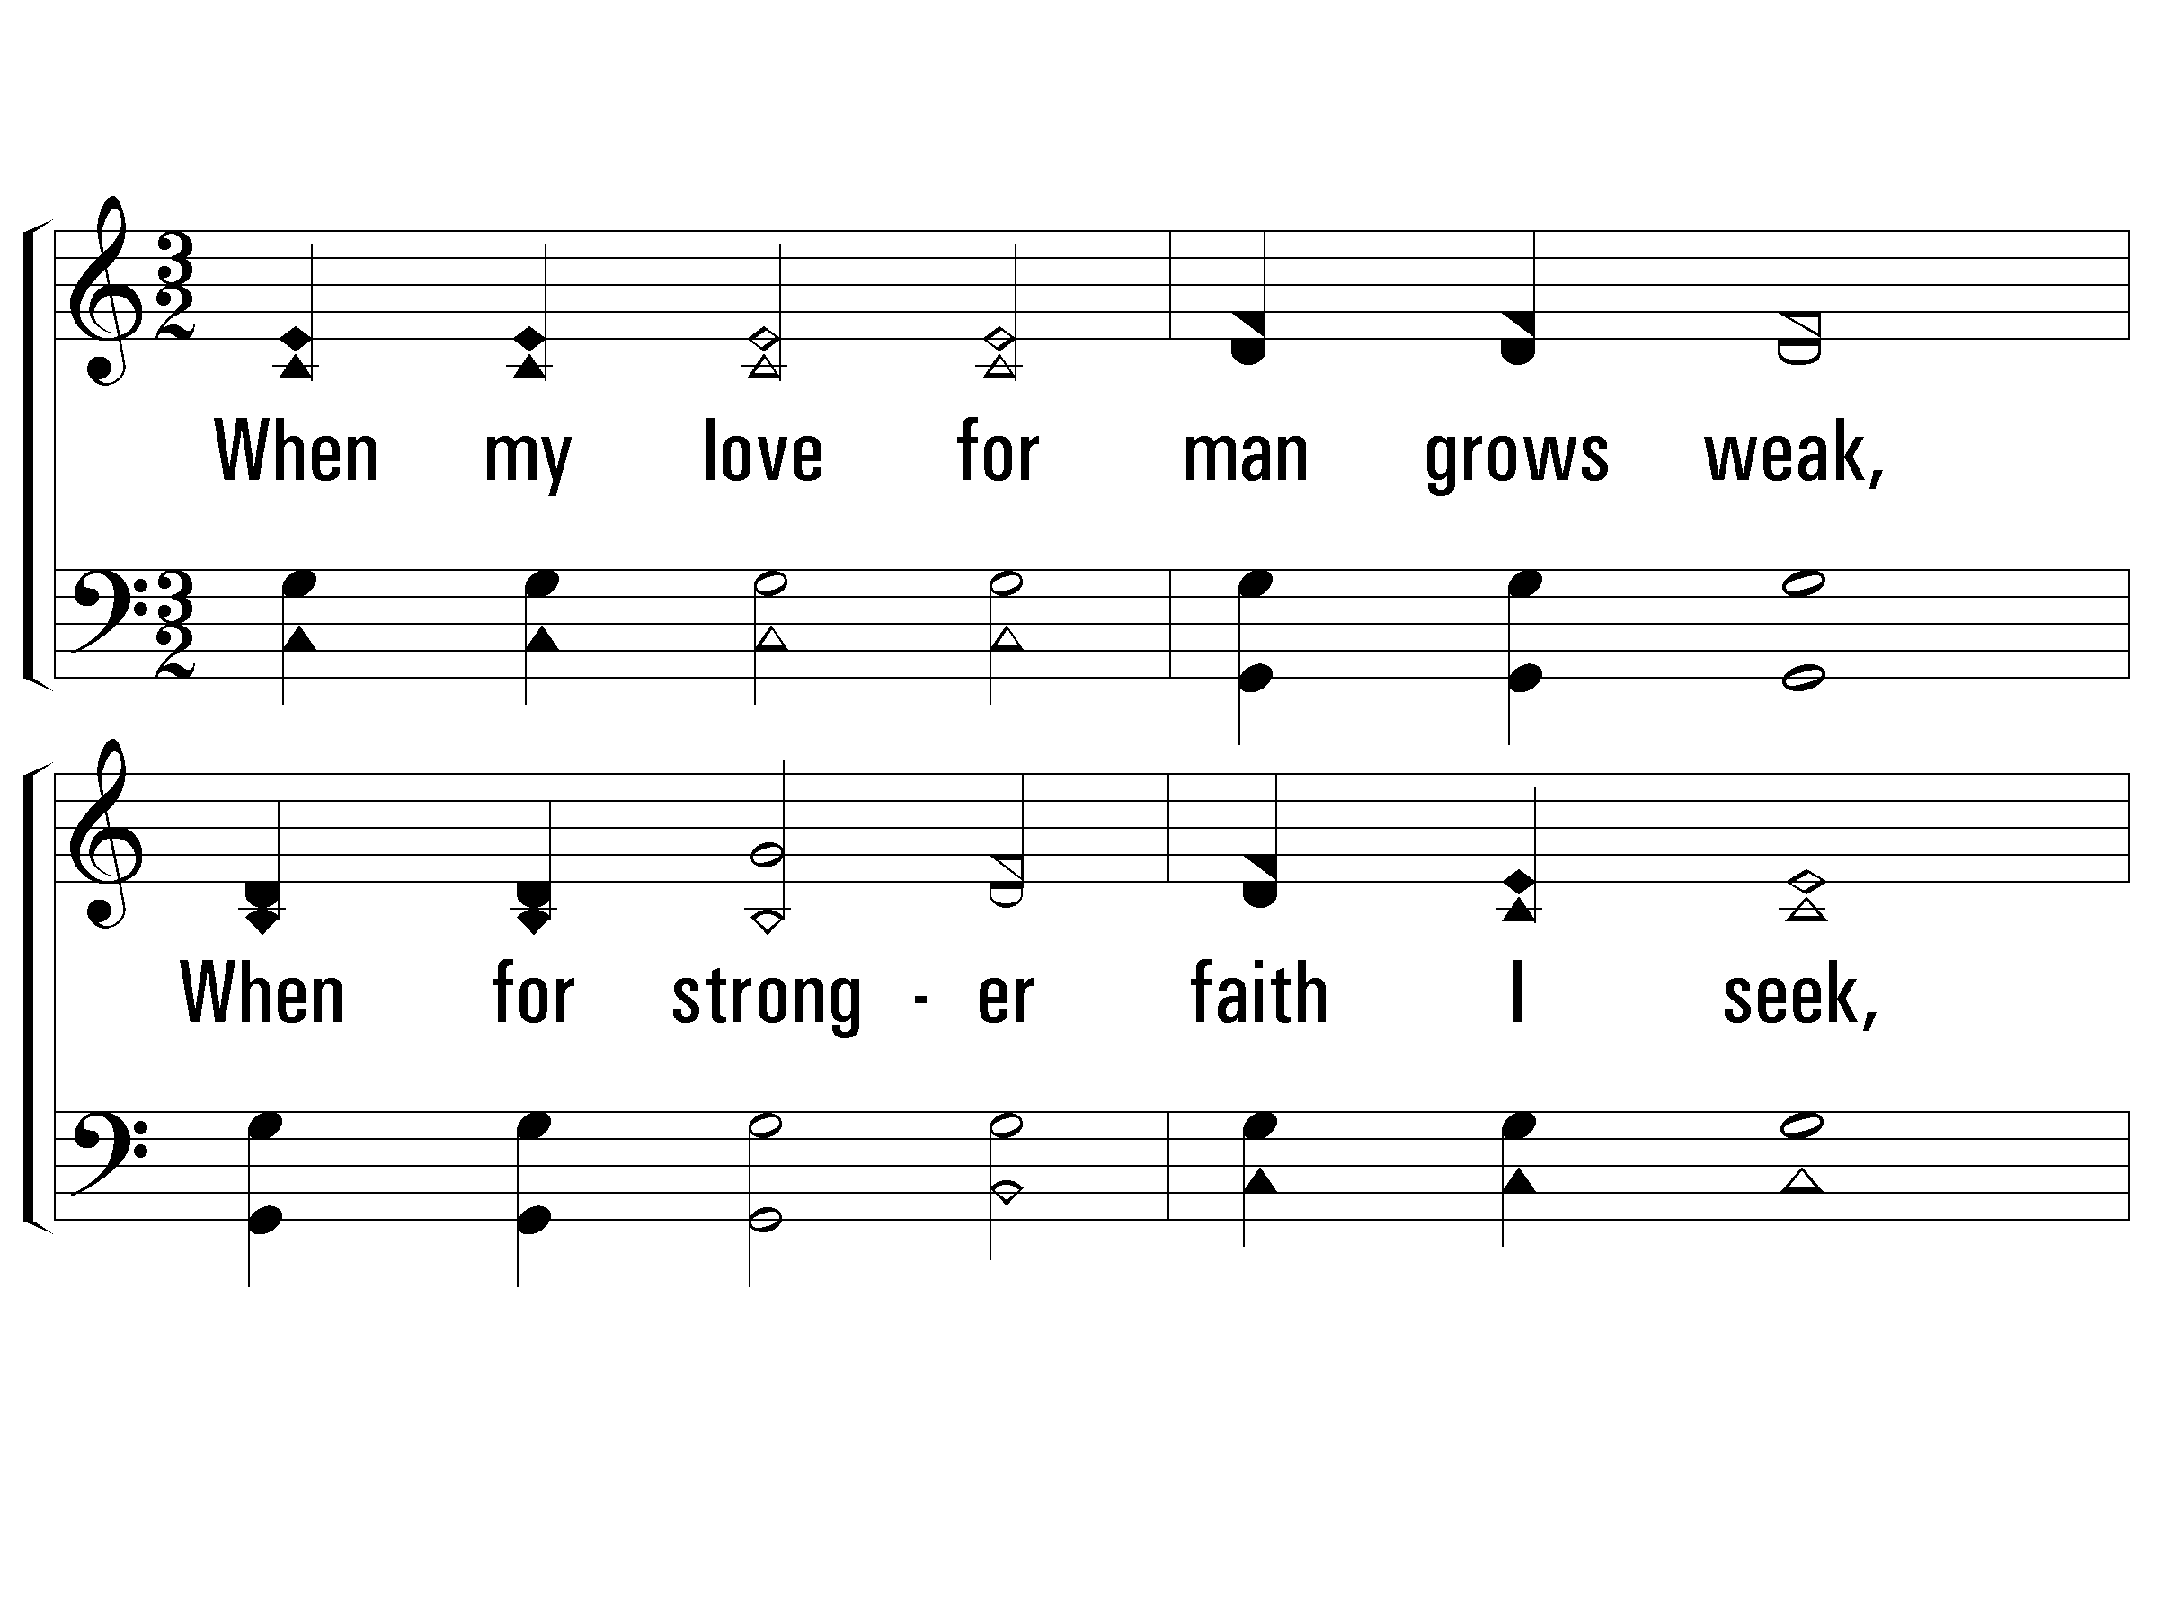
3 – When My Love to Christ Grows Weak
3.
When my love for man grows weak,
When for stronger faith I seek,
Hill of Calvary! I go
To thy scenes of fear and woe.
Words by: J. R. Wreford
Music by: Mrs. Joseph F. Knapp
© 2001 The Paperless Hymnal™

Slide 73
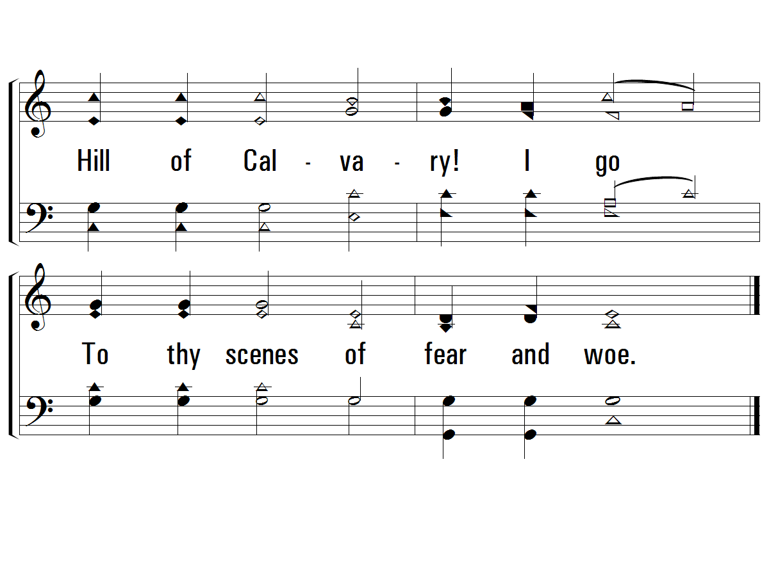
3 – When My Love to Christ Grows Weak
© 2001 The Paperless Hymnal™

Slide 74
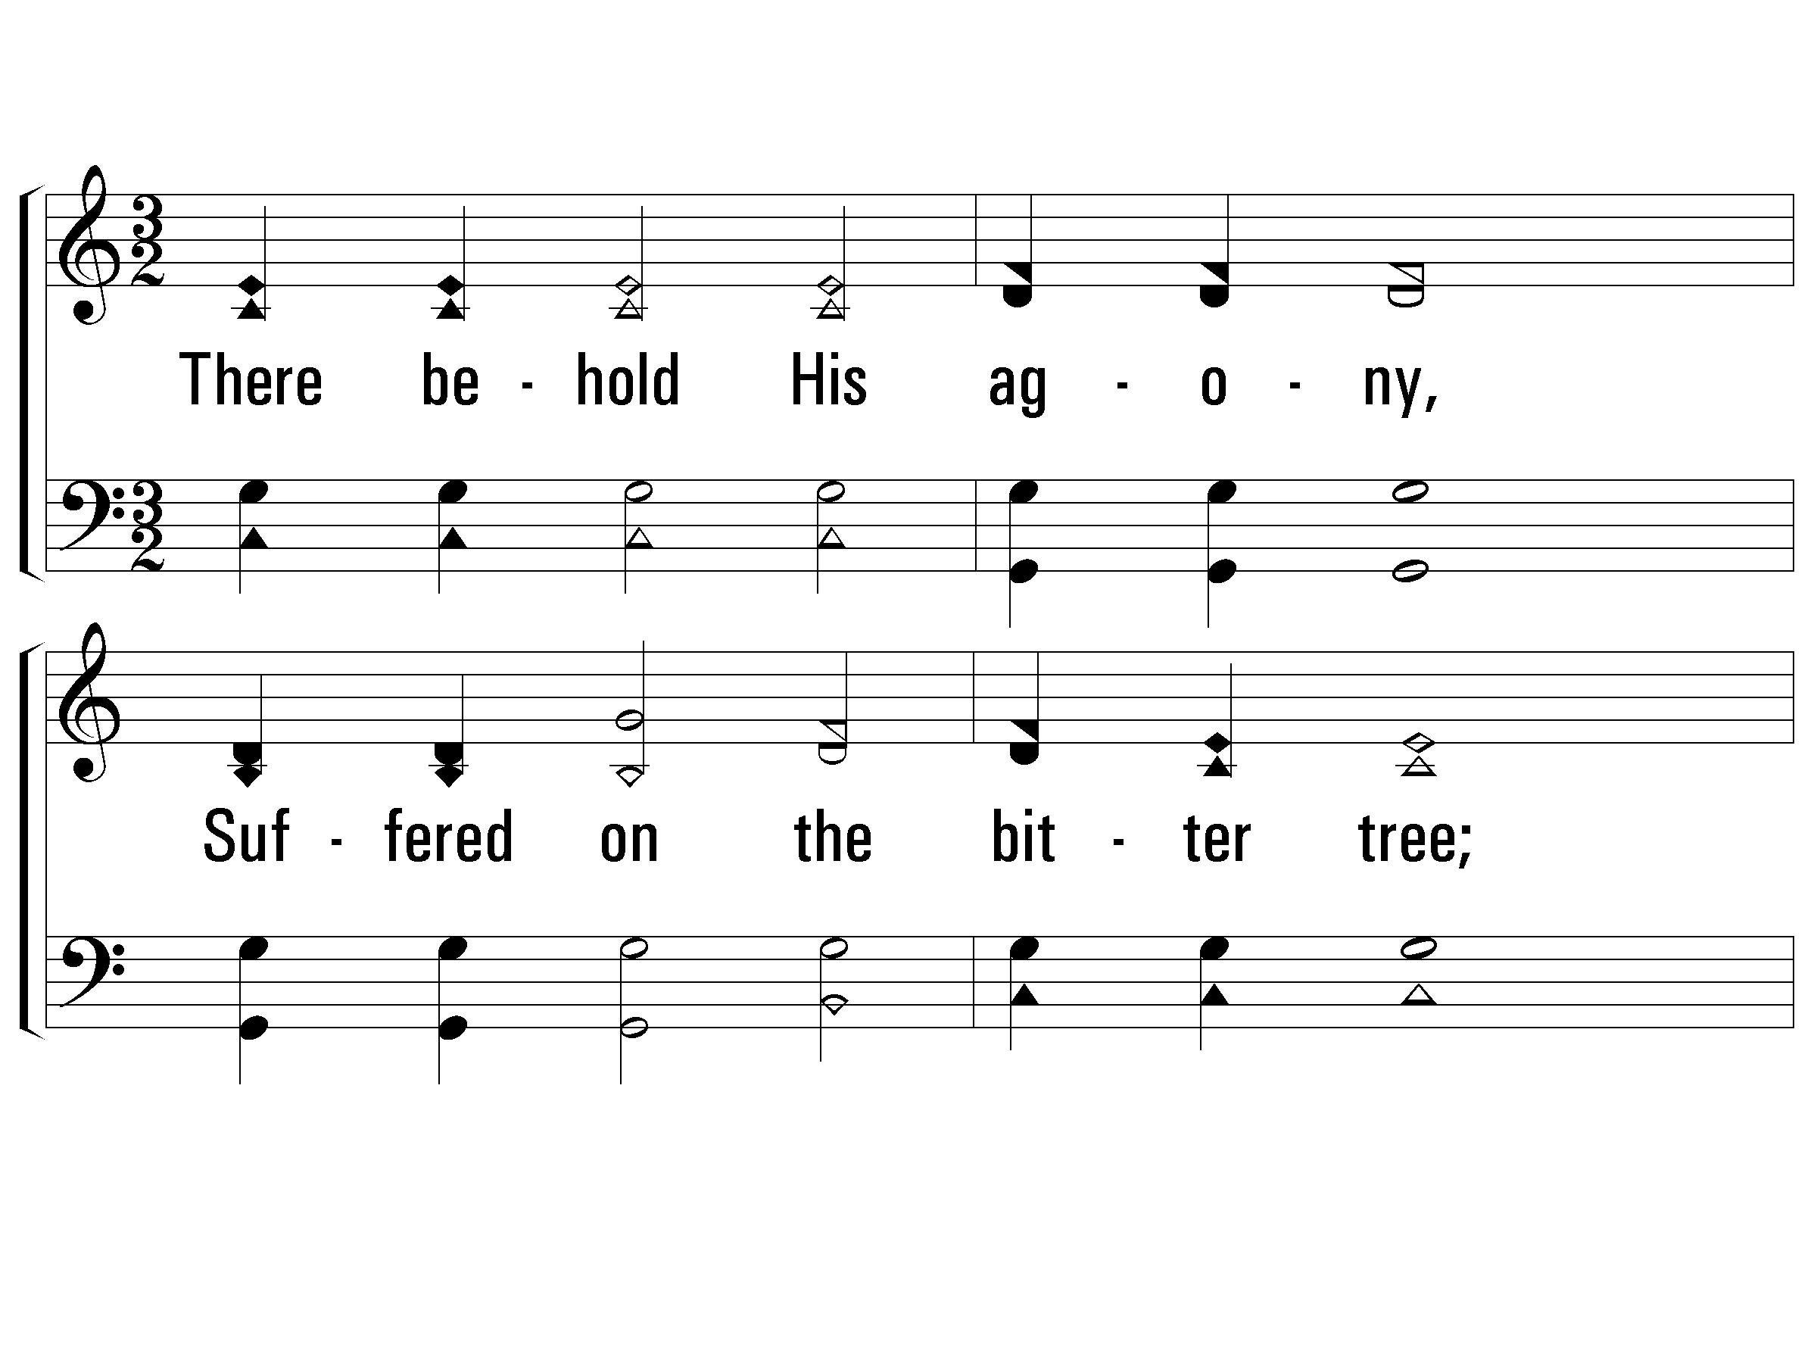
4 – When My Love to Christ Grows Weak
p
4.
There behold His agony,
Suffered on the bitter tree;
See His anguish, see His faith
Love triumphant still in death.
Words by: J. R. Wreford
Music by: Mrs. Joseph F. Knapp
© 2001 The Paperless Hymnal™

Slide 75
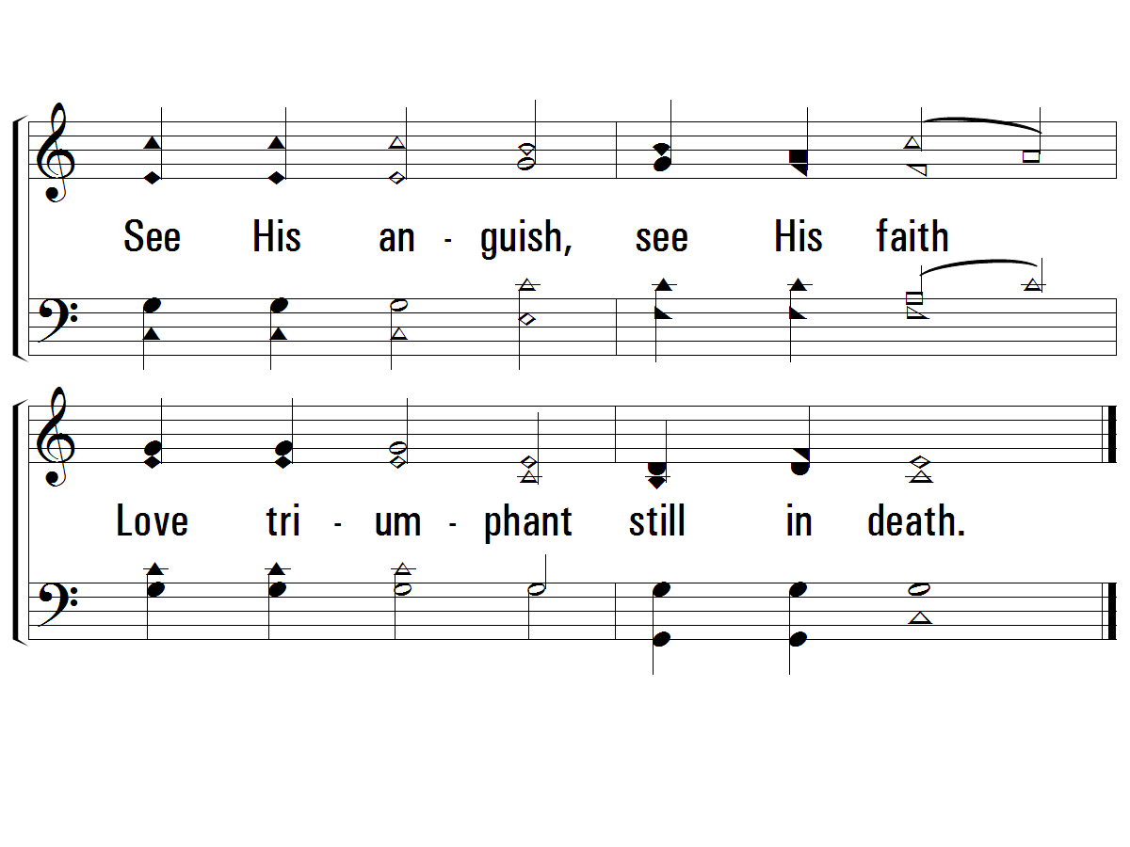
4 – When My Love to Christ Grows Weak
© 2001 The Paperless Hymnal™

Slide 76
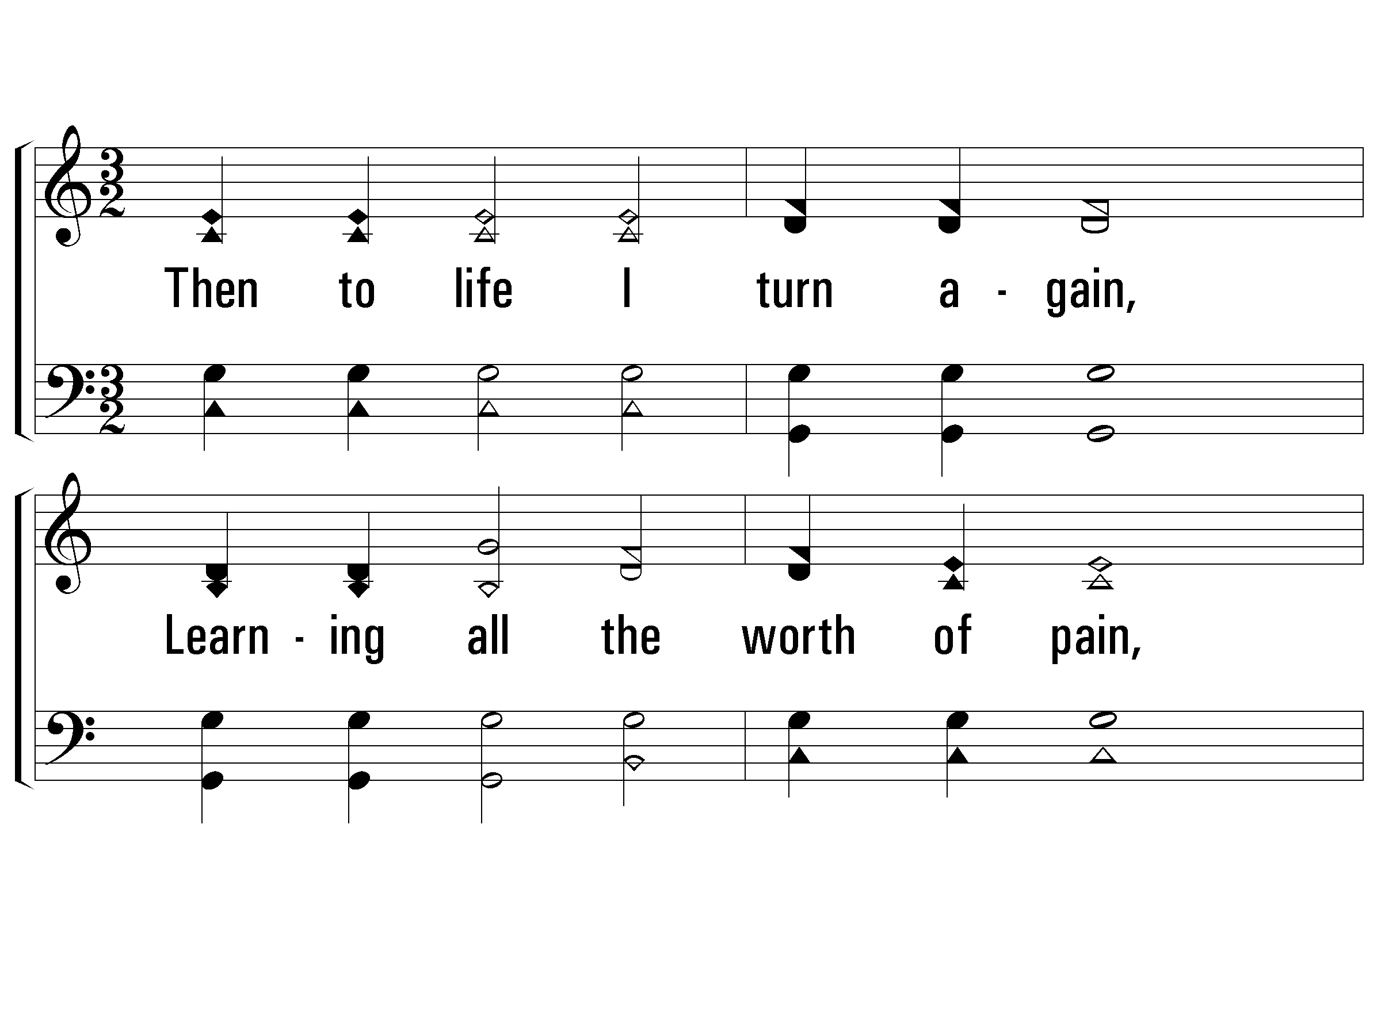
5 – When My Love to Christ Grows Weak
f
5.
Then to life I turn again,
Learning all the worth of pain,
Learning all the might that lies
In a full self sacrifice.
Words by: J. R. Wreford
Music by: Mrs. Joseph F. Knapp
© 2001 The Paperless Hymnal™

Slide 77
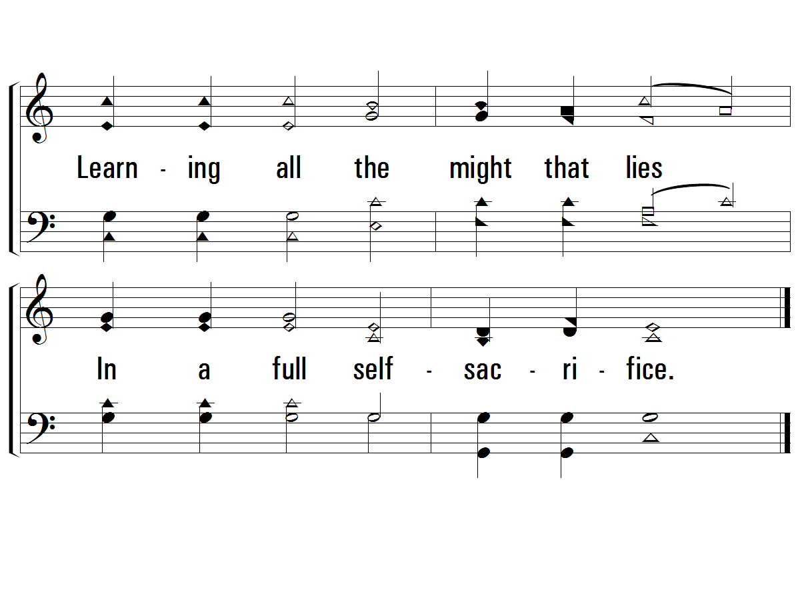
5 – When My Love to Christ Grows Weak
© 2001 The Paperless Hymnal™

Slide 78
Communion

Slide 79
O Thou Fount Of Every Blessing
#500

Slide 80
1 - O Thou Fount of Every Blessing
1.
O Thou Fount of every blessing,
Tune my heart to sing Thy grace;
Streams of mercy, never ceasing,
Call for songs of loudest praise;
Teach me ever to adore Thee;
May I still Thy goodness prove,
While the hope of endless glory
Fills my heart with joy and love.
Words by: Robert Robinson
Music by: A. Nettleton
© 2001 The Paperless Hymnal™

Slide 81
1 - O Thou Fount of Every Blessing
© 2001 The Paperless Hymnal™

Slide 82
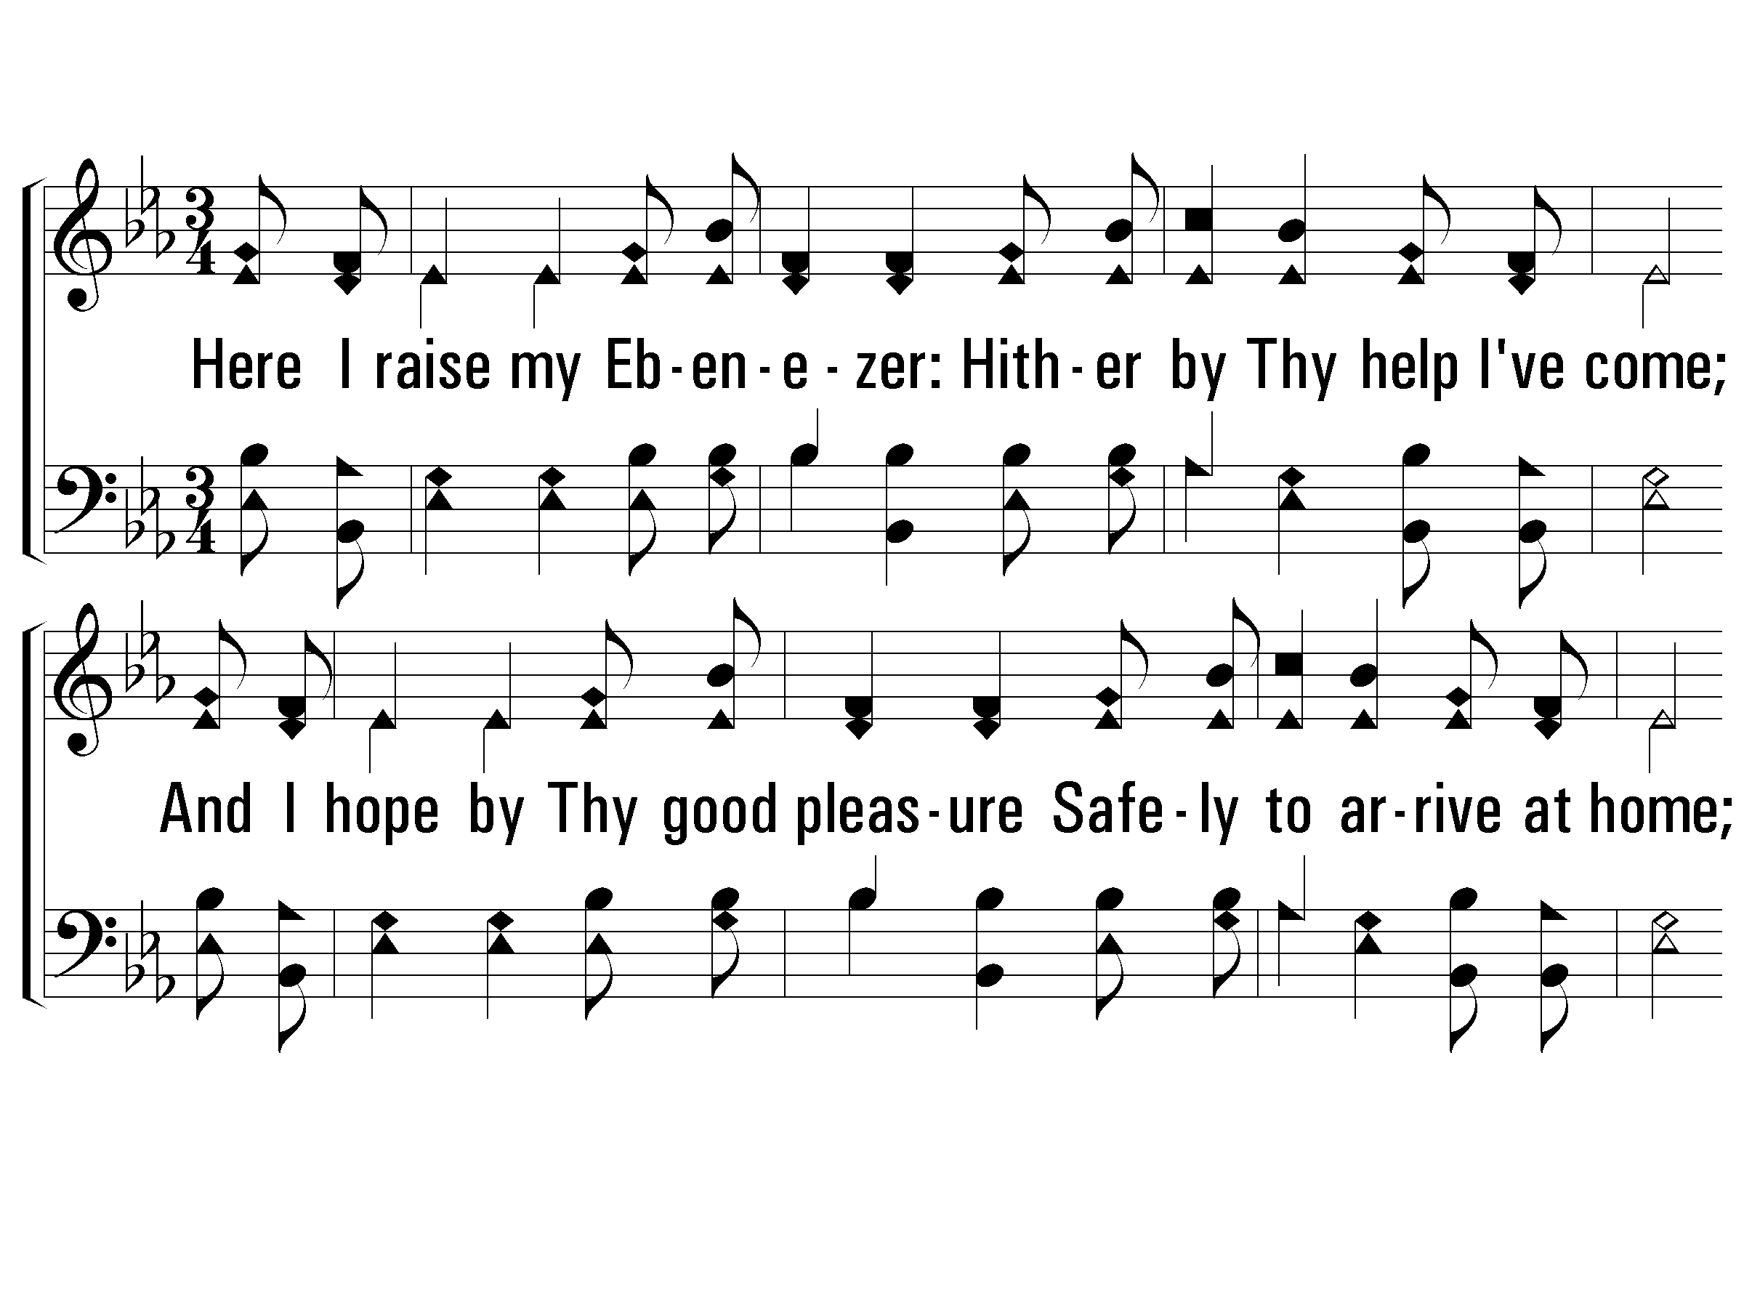
2 - O Thou Fount of Every Blessing
2.
Here I raise my Ebenezer:
Hither by Thy help I've come;
And I hope by Thy good pleasure
Safely to arrive at home;
Jesus sought me when a stranger,
Wandering from the fold of God;
He to rescue me from danger
Interposed His precious blood.
Words by: Robert Robinson
Music by: A. Nettleton
© 2001 The Paperless Hymnal™

Slide 83
2 - O Thou Fount of Every Blessing
© 2001 The Paperless Hymnal™

Slide 84
O to grace how great a debtor, Daily I’m constrained to be! Let that grace now, like a fetter, Bind my wondering heart to Thee.

Slide 85
Prone to wander, Lord, I feel it, Prone to leave the God I love; Here’s my heart; O take and seal it; Seal it for thy courts above.

Slide 86
0-5th Grade
Dismiss to Class

Slide 87
OLD
Church
of Christ
UNION

Slide 88
Acts 19:11-22

Slide 89
¹¹ God was performing extraordinary miracles by the hands of Paul, ¹² so that handkerchiefs or aprons were even carried from his body to the sick, and the diseases left them and the evil spirits went out.

Slide 90
¹³ But also some of the Jewish exorcists, who went from place to place, attempted to name over those who had the evil spirits the name of the Lord Jesus, saying, “I adjure you by Jesus whom Paul preaches.” ¹⁴ Seven sons of one Sceva, a Jewish chief priest, were doing this.

Slide 91
¹⁵ And the evil spirit answered and said to them, “I recognize Jesus, and I know about Paul, but who are you?” ¹⁶ And the man, in whom was the evil spirit, leaped on them and subdued all of them and overpowered them, so that they fled out of that house naked and wounded.

Slide 92
¹⁷ This became known to all, both Jews and Greeks, who lived in Ephesus; and fear fell upon them all and the name of the Lord Jesus was being magnified. ¹⁸ Many also of those who had believed kept coming, confessing and disclosing their practices.

Slide 93
¹⁹ And many of those who practiced magic brought their books together and began burning them in the sight of everyone; and they counted up the price of them and found it fifty thousand pieces of silver. ²⁰ So the word of the Lord was growing mightily and prevailing.

Slide 94
²¹ Now after these things were finished, Paul purposed in the Spirit to go to Jerusalem after he had passed through Macedonia and Achaia, saying, “After I have been there, I must also see Rome.” ²² And having sent into Macedonia two of those who ministered to him, Timothy and Erastus, he himself stayed in Asia for a while.

Slide 95
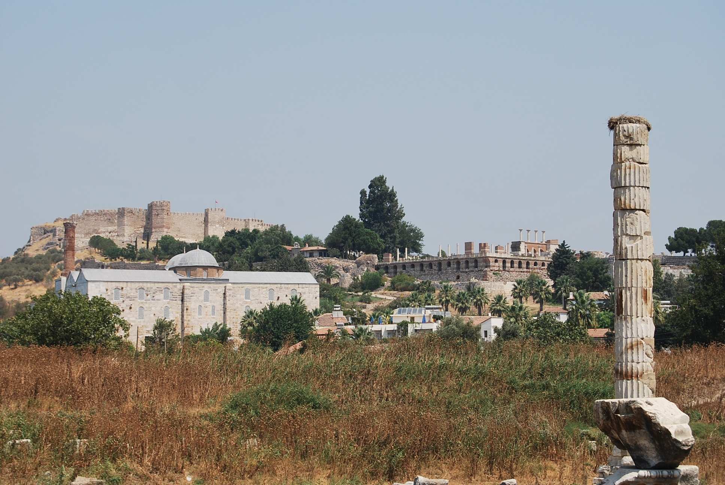
Yet,
Jesus is STILL our King.

Slide 96
God was performing extraordinary miracles by the hands of Paul…So the word was growing mightily and prevailing. - Acts 19:11-22

Slide 97
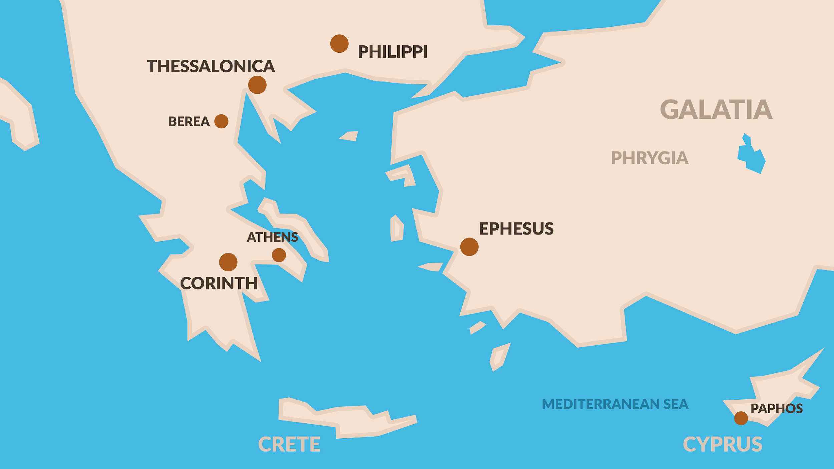

Slide 100
Hail Jesus, You’re My King. Your life frees me to sing. I will praise You all my days. You’re perfect in all Your ways.

Slide 101
Hail Jesus, You’re my Lord. I will obey your word. I want to see Your Kingdom come. Not my will but Yours be done.

Slide 102
So…Glory, Glory to the Lamb! You will take me by the hand! Lead me to the Promised Land! Glory, Glory to the Lamb!

Slide 103
Hail, Hail the Lion of Judah! How powerful You are! Hail, Hail the Lion of Judah! How wonderful You are! (x3) HOW WONDERFUL YOU ARE!

Slide 104
OLD
Church
of Christ
UNION

Slide 105
Hark, The
Gentle Voice
#667

Slide 106
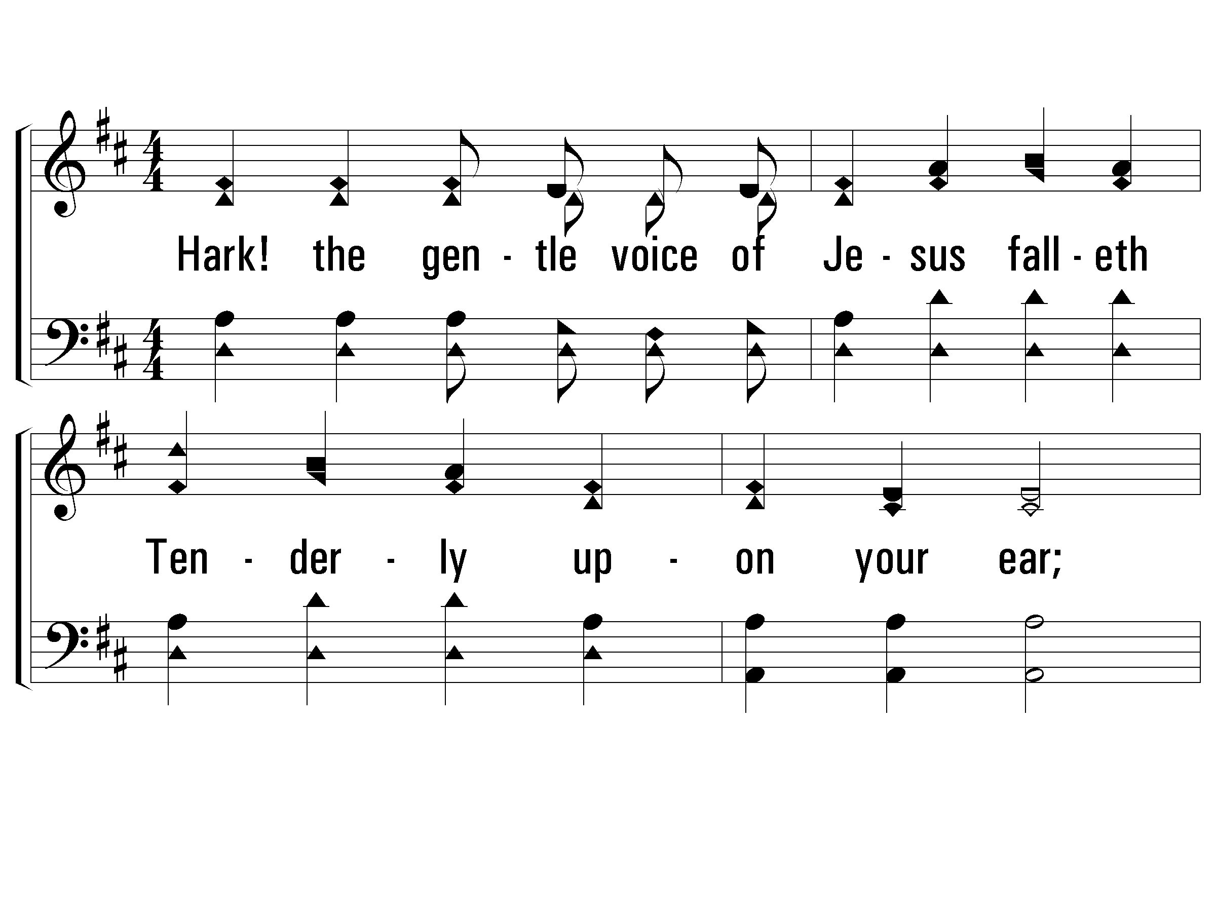
1 - Hark! The Gentle Voice
1.
Hark! the gentle voice of Jesus falleth
Tenderly upon your ear;
Sweet His cry of love and pity calleth:
Turn and listen, stay and hear.
Words: Mary B. C. Slade
Music: Asa B. Everett
© 2001 The Paperless Hymnal™

Slide 107
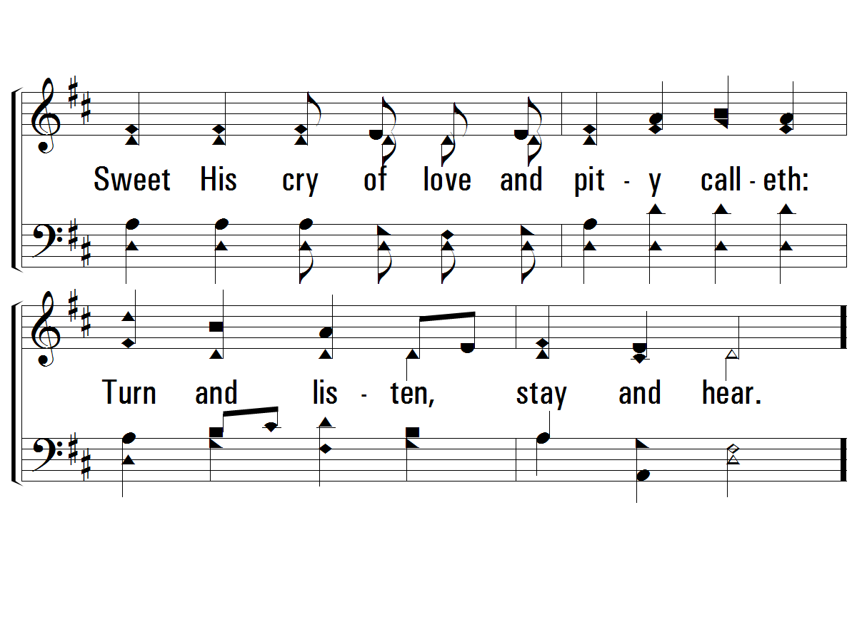
1 - Hark! The Gentle Voice
© 2001 The Paperless Hymnal™

Slide 108
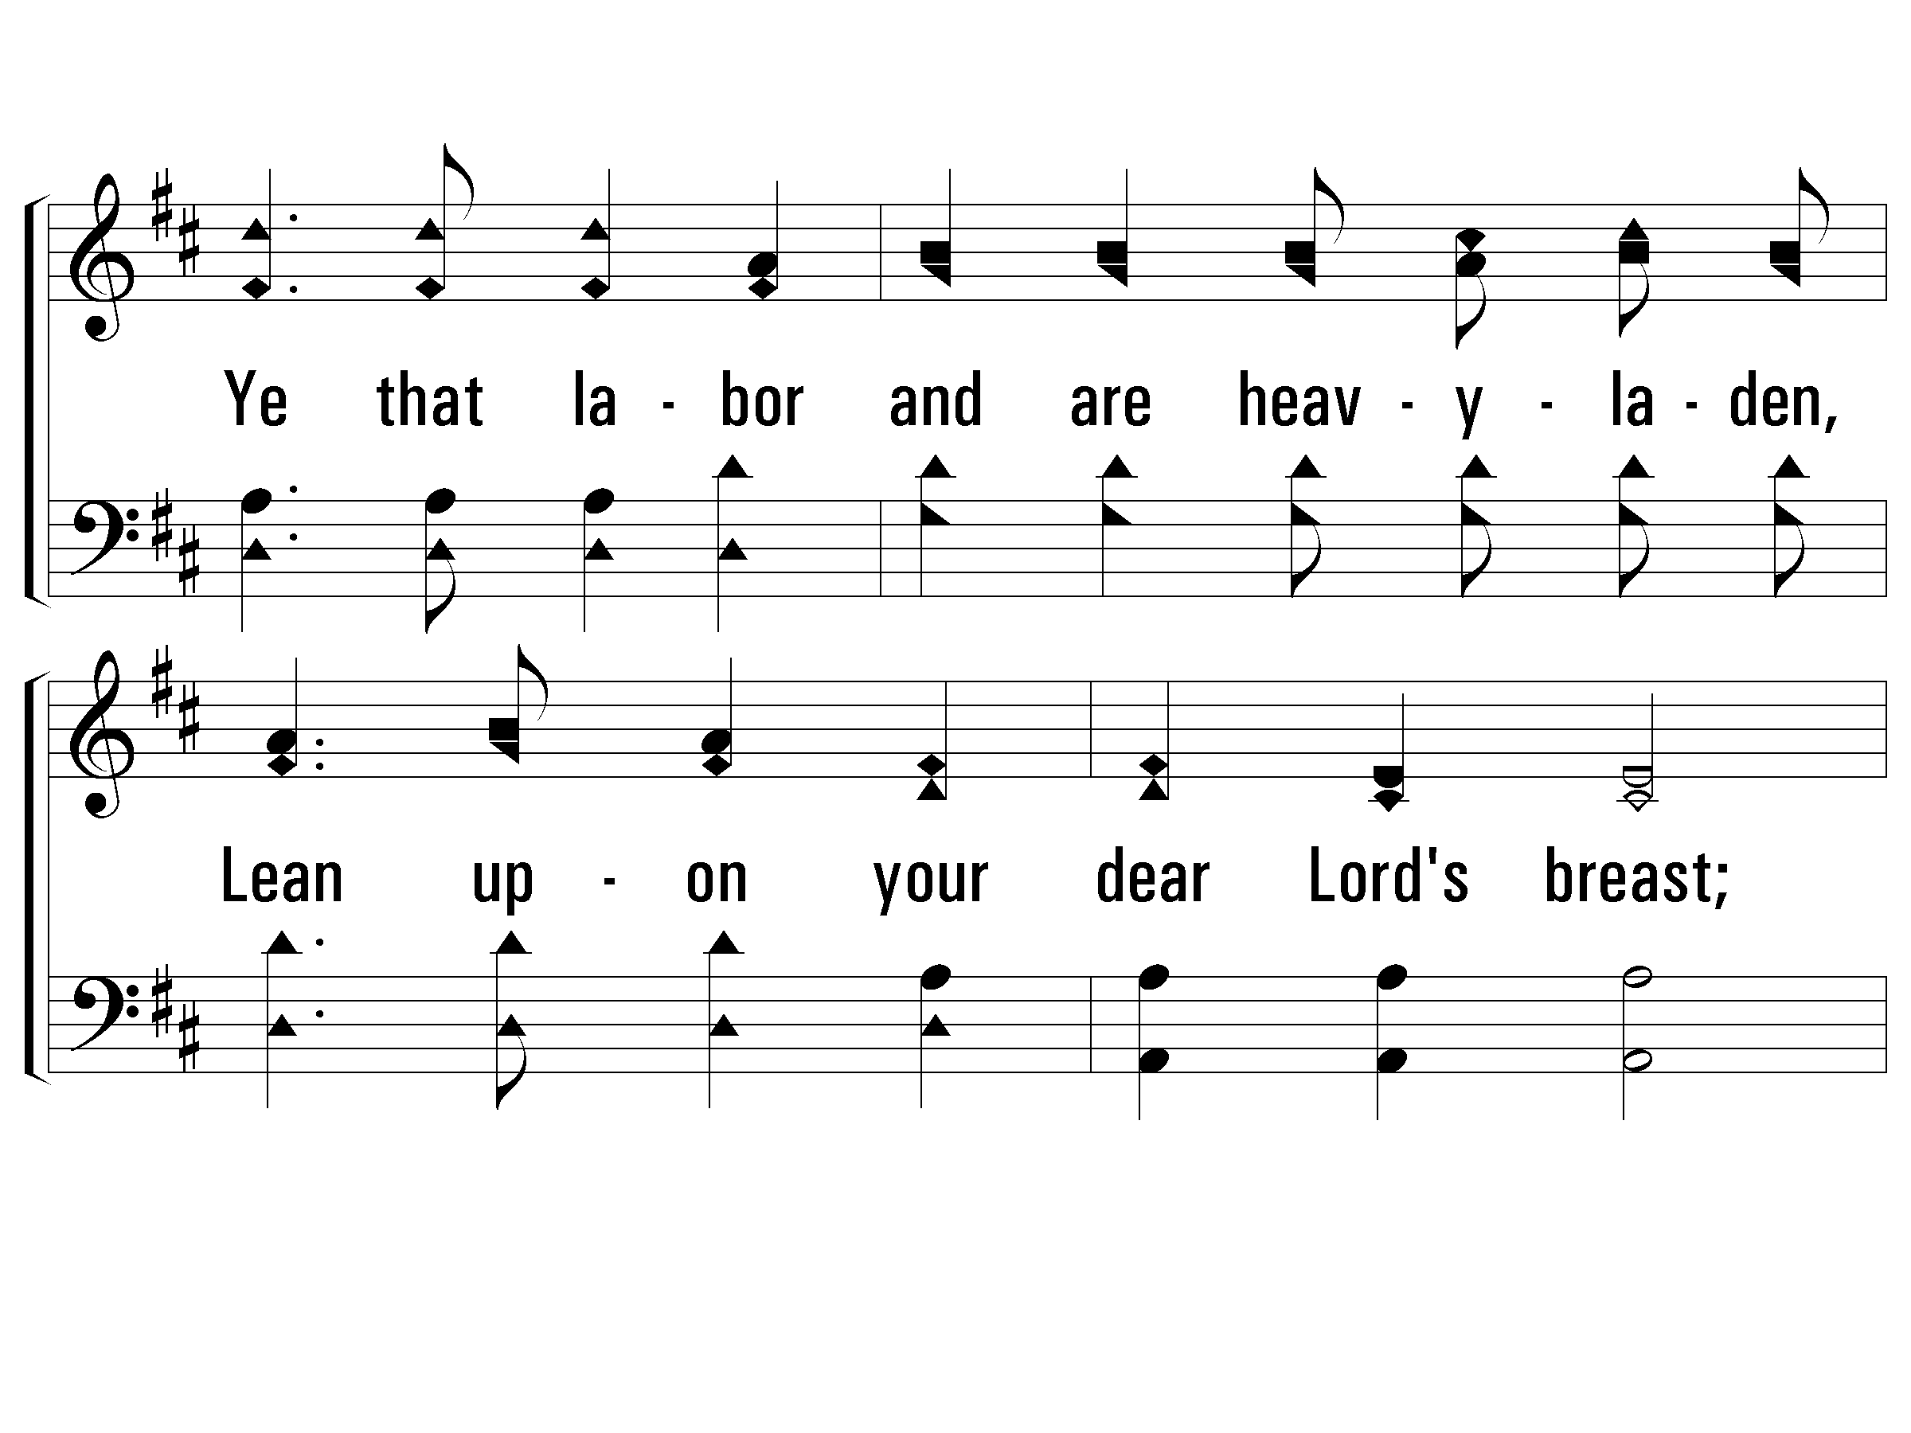
c - Hark! The Gentle Voice
Ye that labor and are heavyladen,
Lean upon your dear Lord's breast;
Ye that labor and are heavyladen,
Come, and I will give you rest.
© 2001 The Paperless Hymnal™

Slide 109
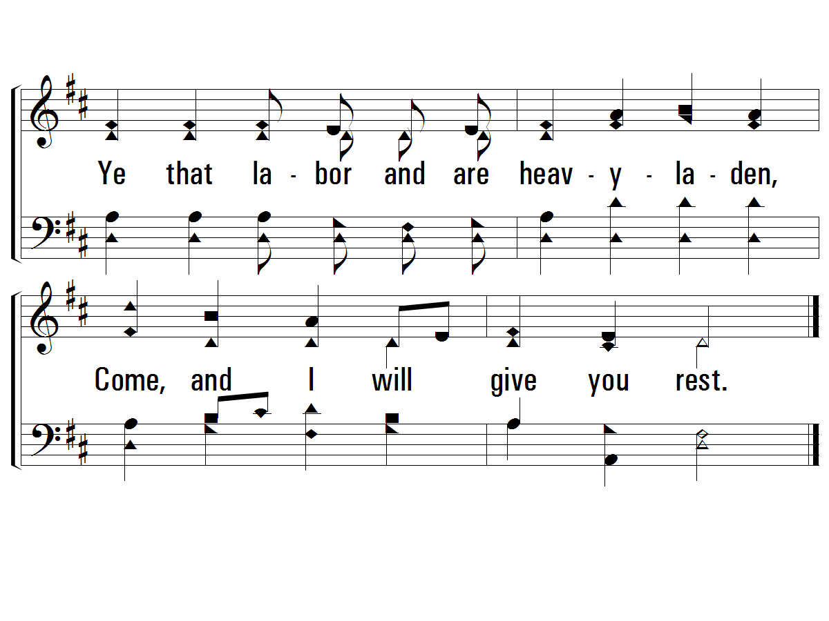
c - Hark! The Gentle Voice
© 2001 The Paperless Hymnal™

Slide 110
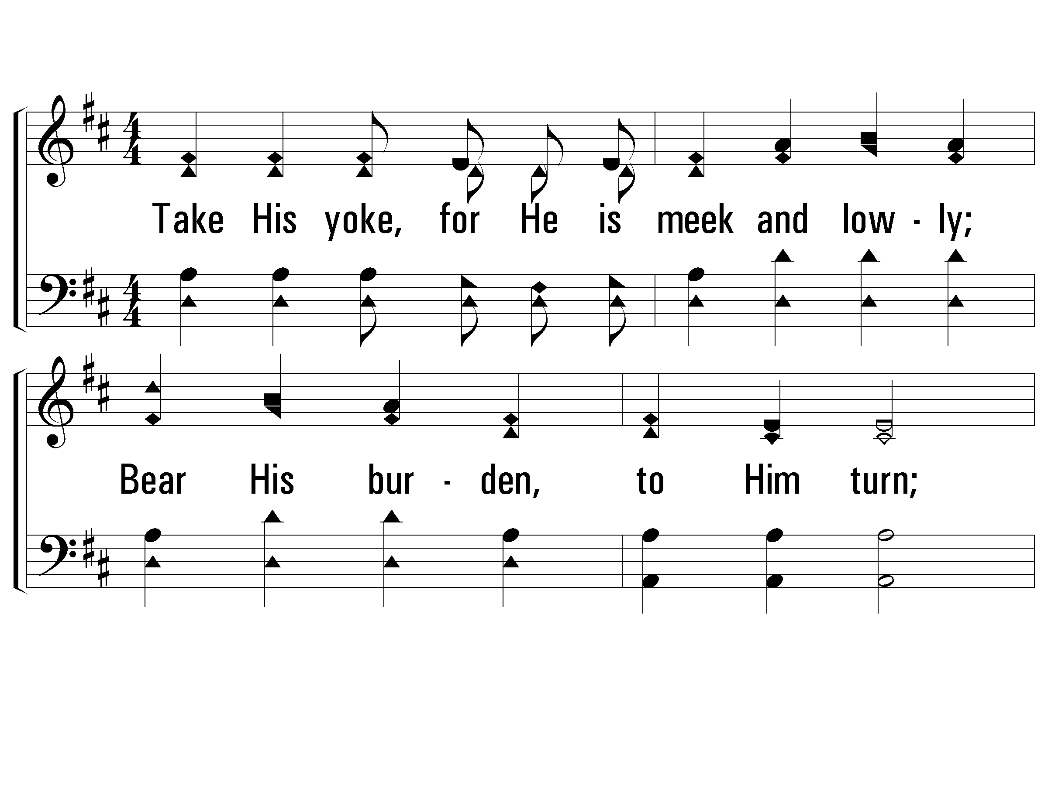
2 - Hark! The Gentle Voice
2.
Take His yoke, for He is meek and lowly;
Bear His burden, to Him turn;
He who calleth is the Master holy:
He will teach if you will learn.
Words: Mary B. C. Slade
Music: Asa B. Everett
© 2001 The Paperless Hymnal™

Slide 111
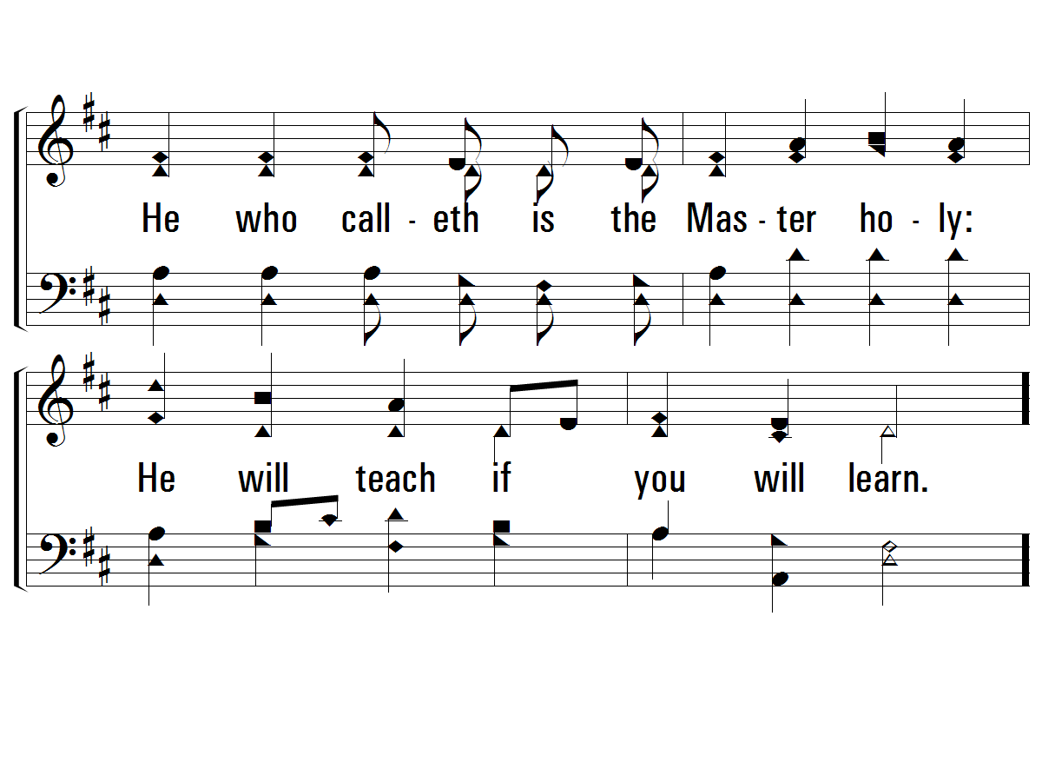
2 - Hark! The Gentle Voice
© 2001 The Paperless Hymnal™

Slide 112
c - Hark! The Gentle Voice
Ye that labor and are heavyladen,
Lean upon your dear Lord's breast;
Ye that labor and are heavyladen,
Come, and I will give you rest.
© 2001 The Paperless Hymnal™

Slide 113
c - Hark! The Gentle Voice
© 2001 The Paperless Hymnal™

Slide 114
3 - Hark! The Gentle Voice
3.
Then, His loving, tender voice obeying,
Bear His yoke, His burden take;
Find the yoke His hand is on you laying,
Light and easy for His sake.
Words: Mary B. C. Slade
Music: Asa B. Everett
© 2001 The Paperless Hymnal™

Slide 115
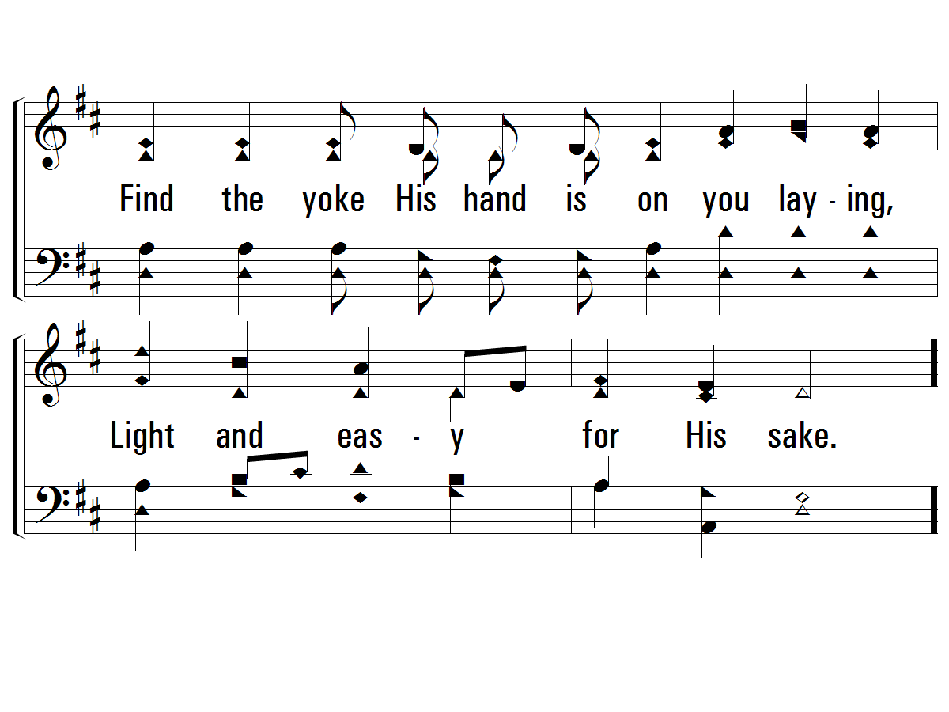
3 - Hark! The Gentle Voice
© 2001 The Paperless Hymnal™

Slide 116
c - Hark! The Gentle Voice
Ye that labor and are heavyladen,
Lean upon your dear Lord's breast;
Ye that labor and are heavyladen,
Come, and I will give you rest.
© 2001 The Paperless Hymnal™

Slide 117
c - Hark! The Gentle Voice
© 2001 The Paperless Hymnal™

Slide 118
Living By Faith
Doxology

Slide 119
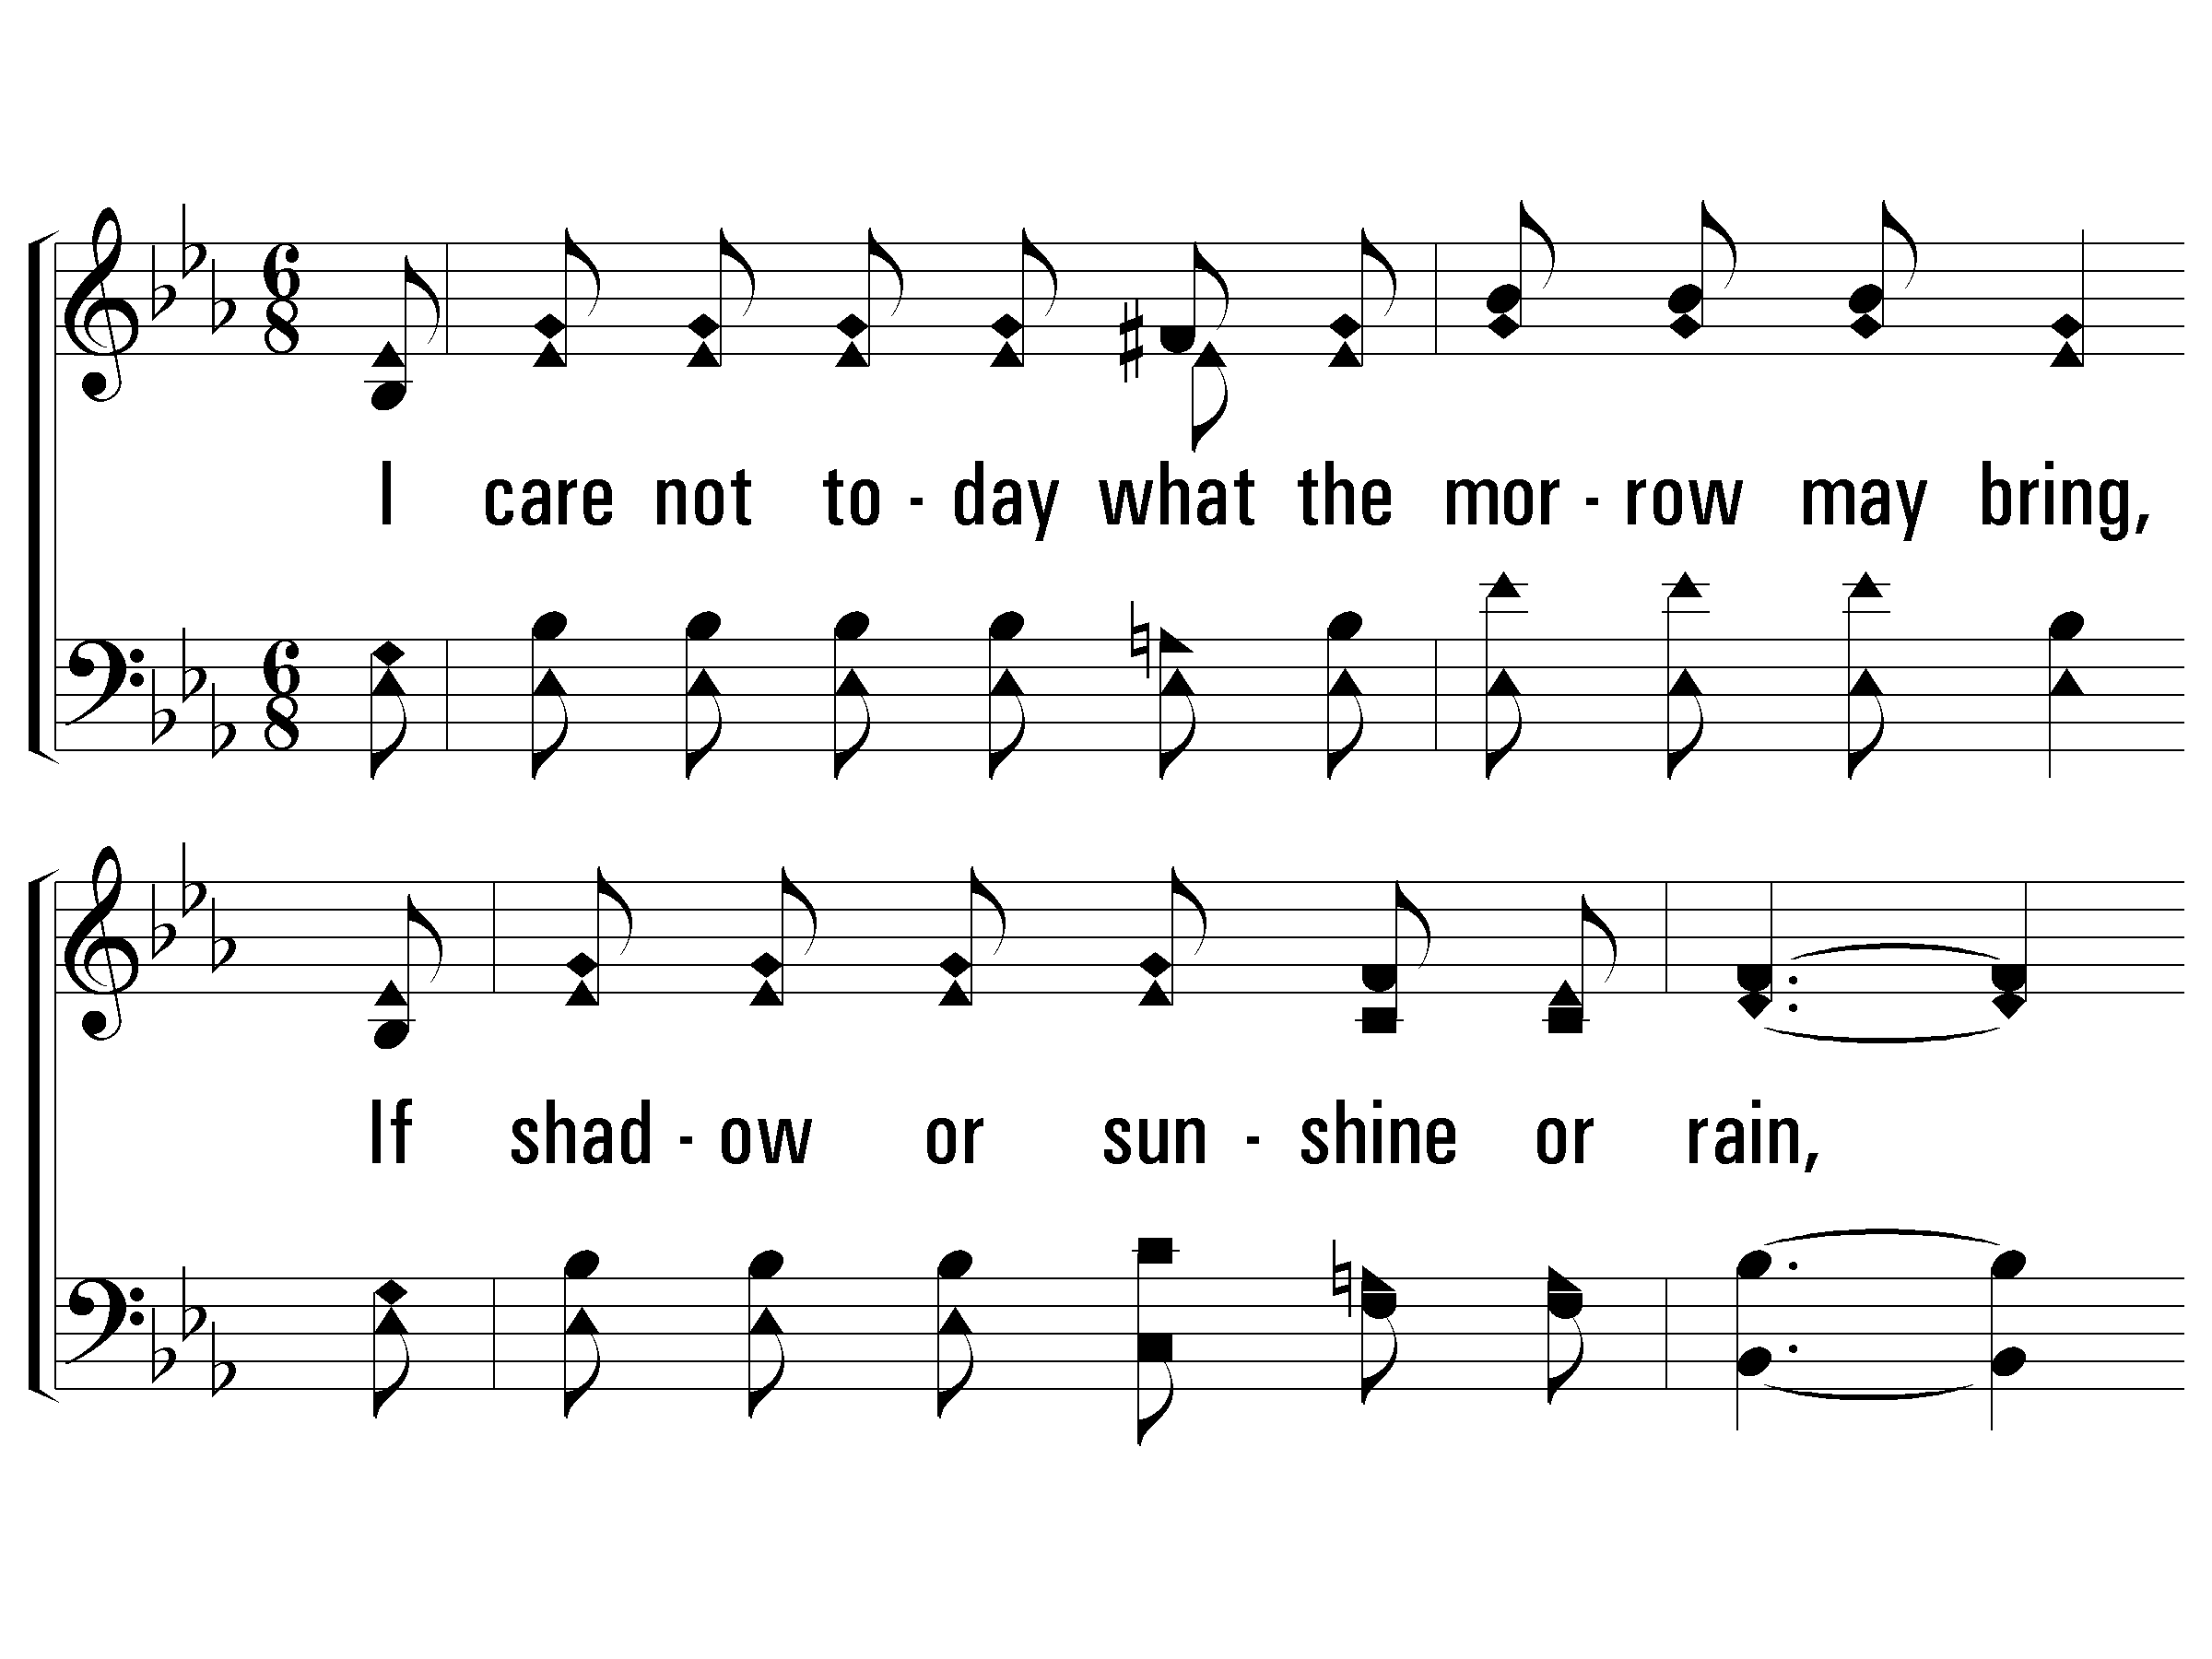
1 - Living by Faith
1.
I care not today what the morrow may bring,
If shadow or sunshine or rain,
The Lord I know ruleth over everything,
And all of my worry is vain.
Words: James S. Wells
Music: J. L. Heath
© 2008 The Paperless Hymnal®

Slide 120
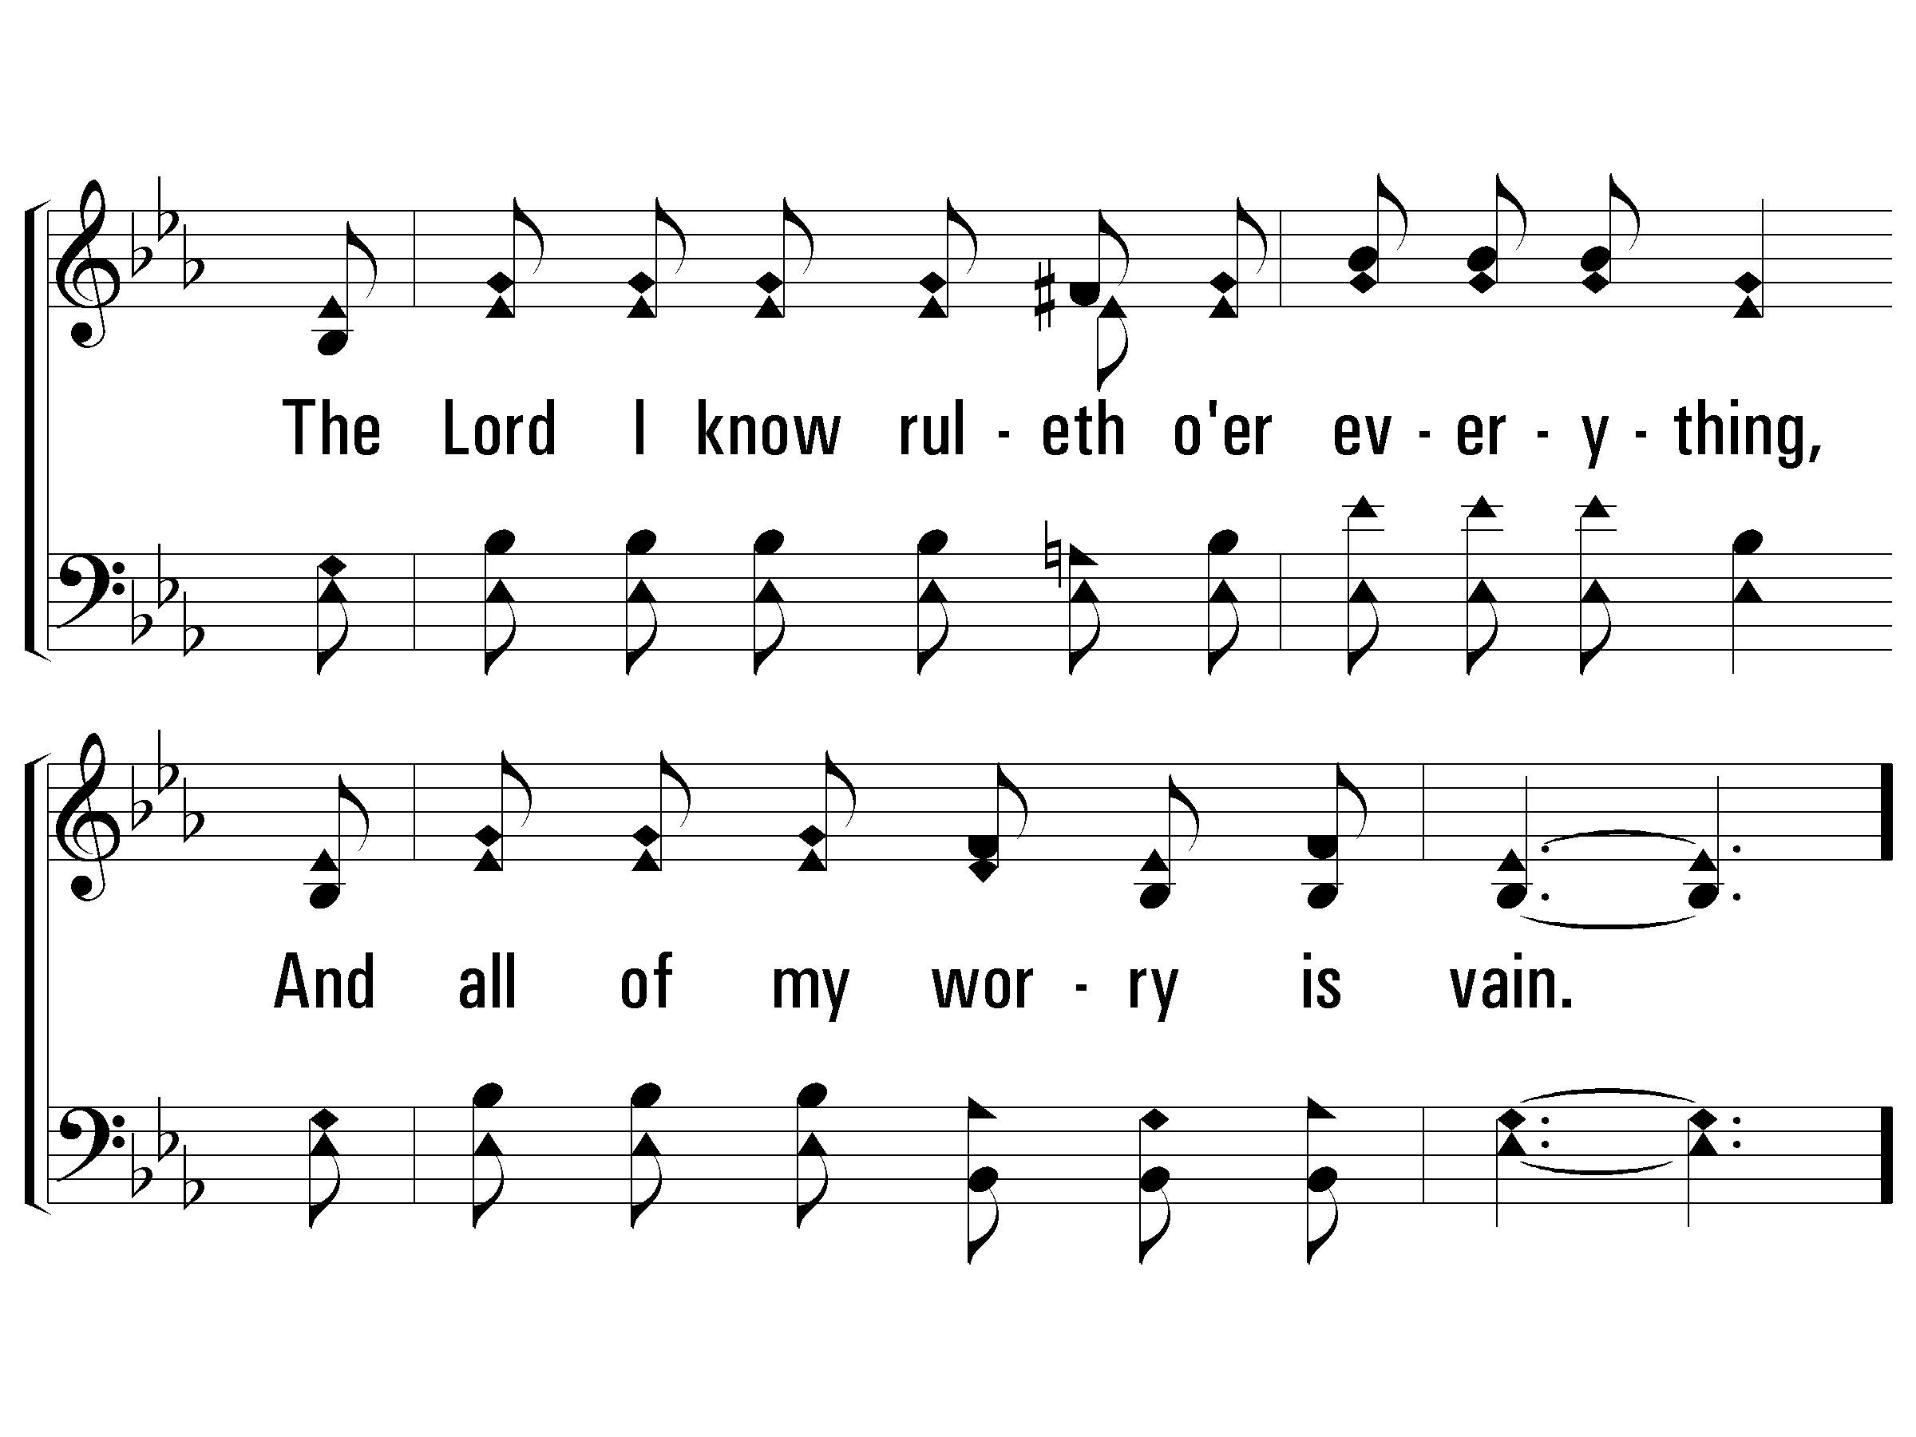
1 - Living by Faith
© 2008 The Paperless Hymnal®

Slide 121
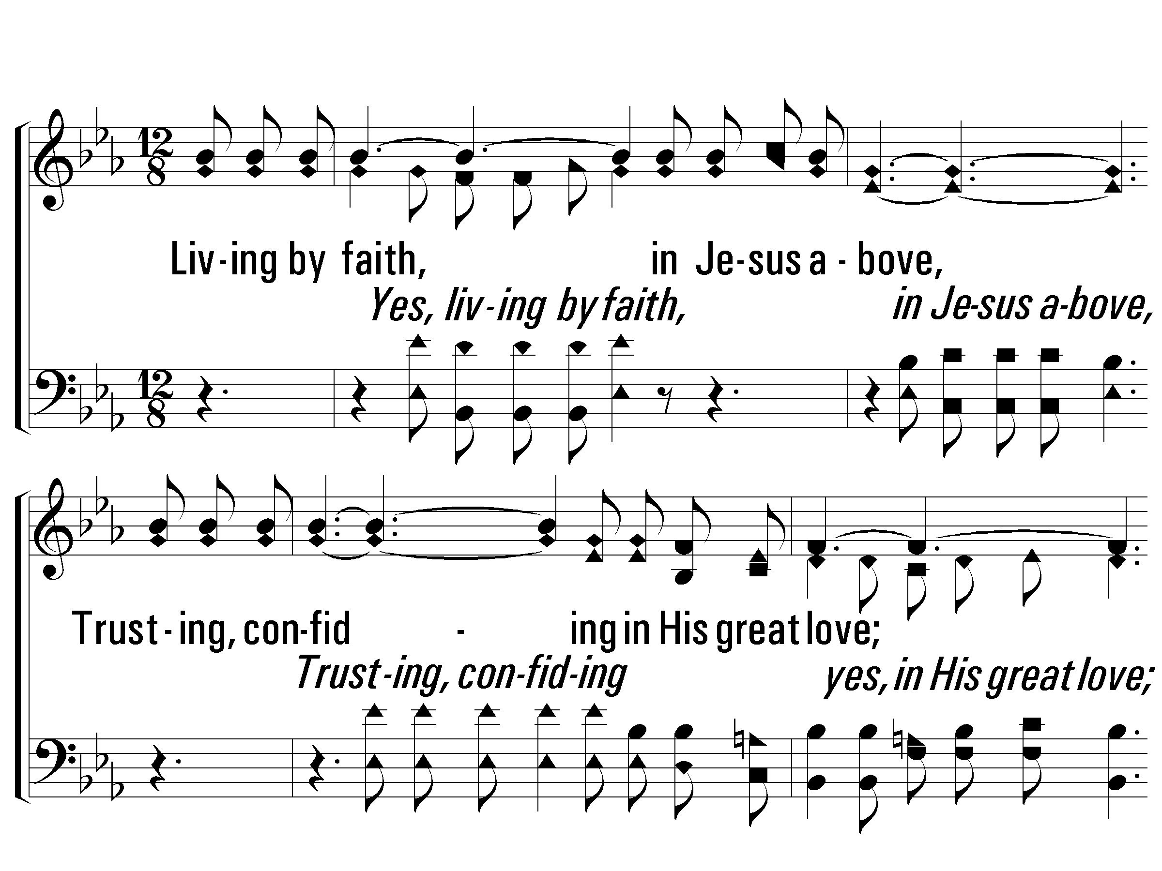
c - Living by Faith
Living by faith, in Jesus above,
Trusting, confiding in His great love;
From all harm safe in His sheltering arm,
I'm living by faith and feel no alarm.
© 2008 The Paperless Hymnal®

Slide 122
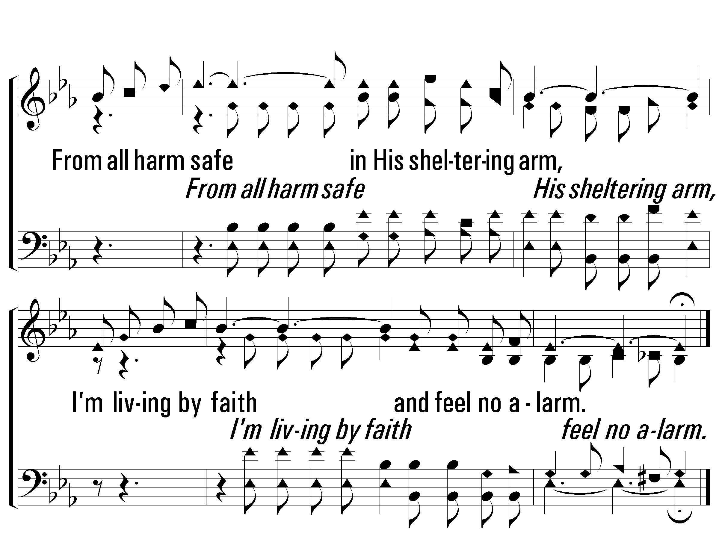
c - Living by Faith
© 2008 The Paperless Hymnal®

Slide 123
2 - Living by Faith
2.
Though tempests may blow and the storm clouds arise,
Obscuring the brightness of life,
I'm never alarmed at the overcast skies,
The Master looks on at the strife.
Words: James S. Wells
Music: J. L. Heath
© 2008 The Paperless Hymnal®

Slide 124
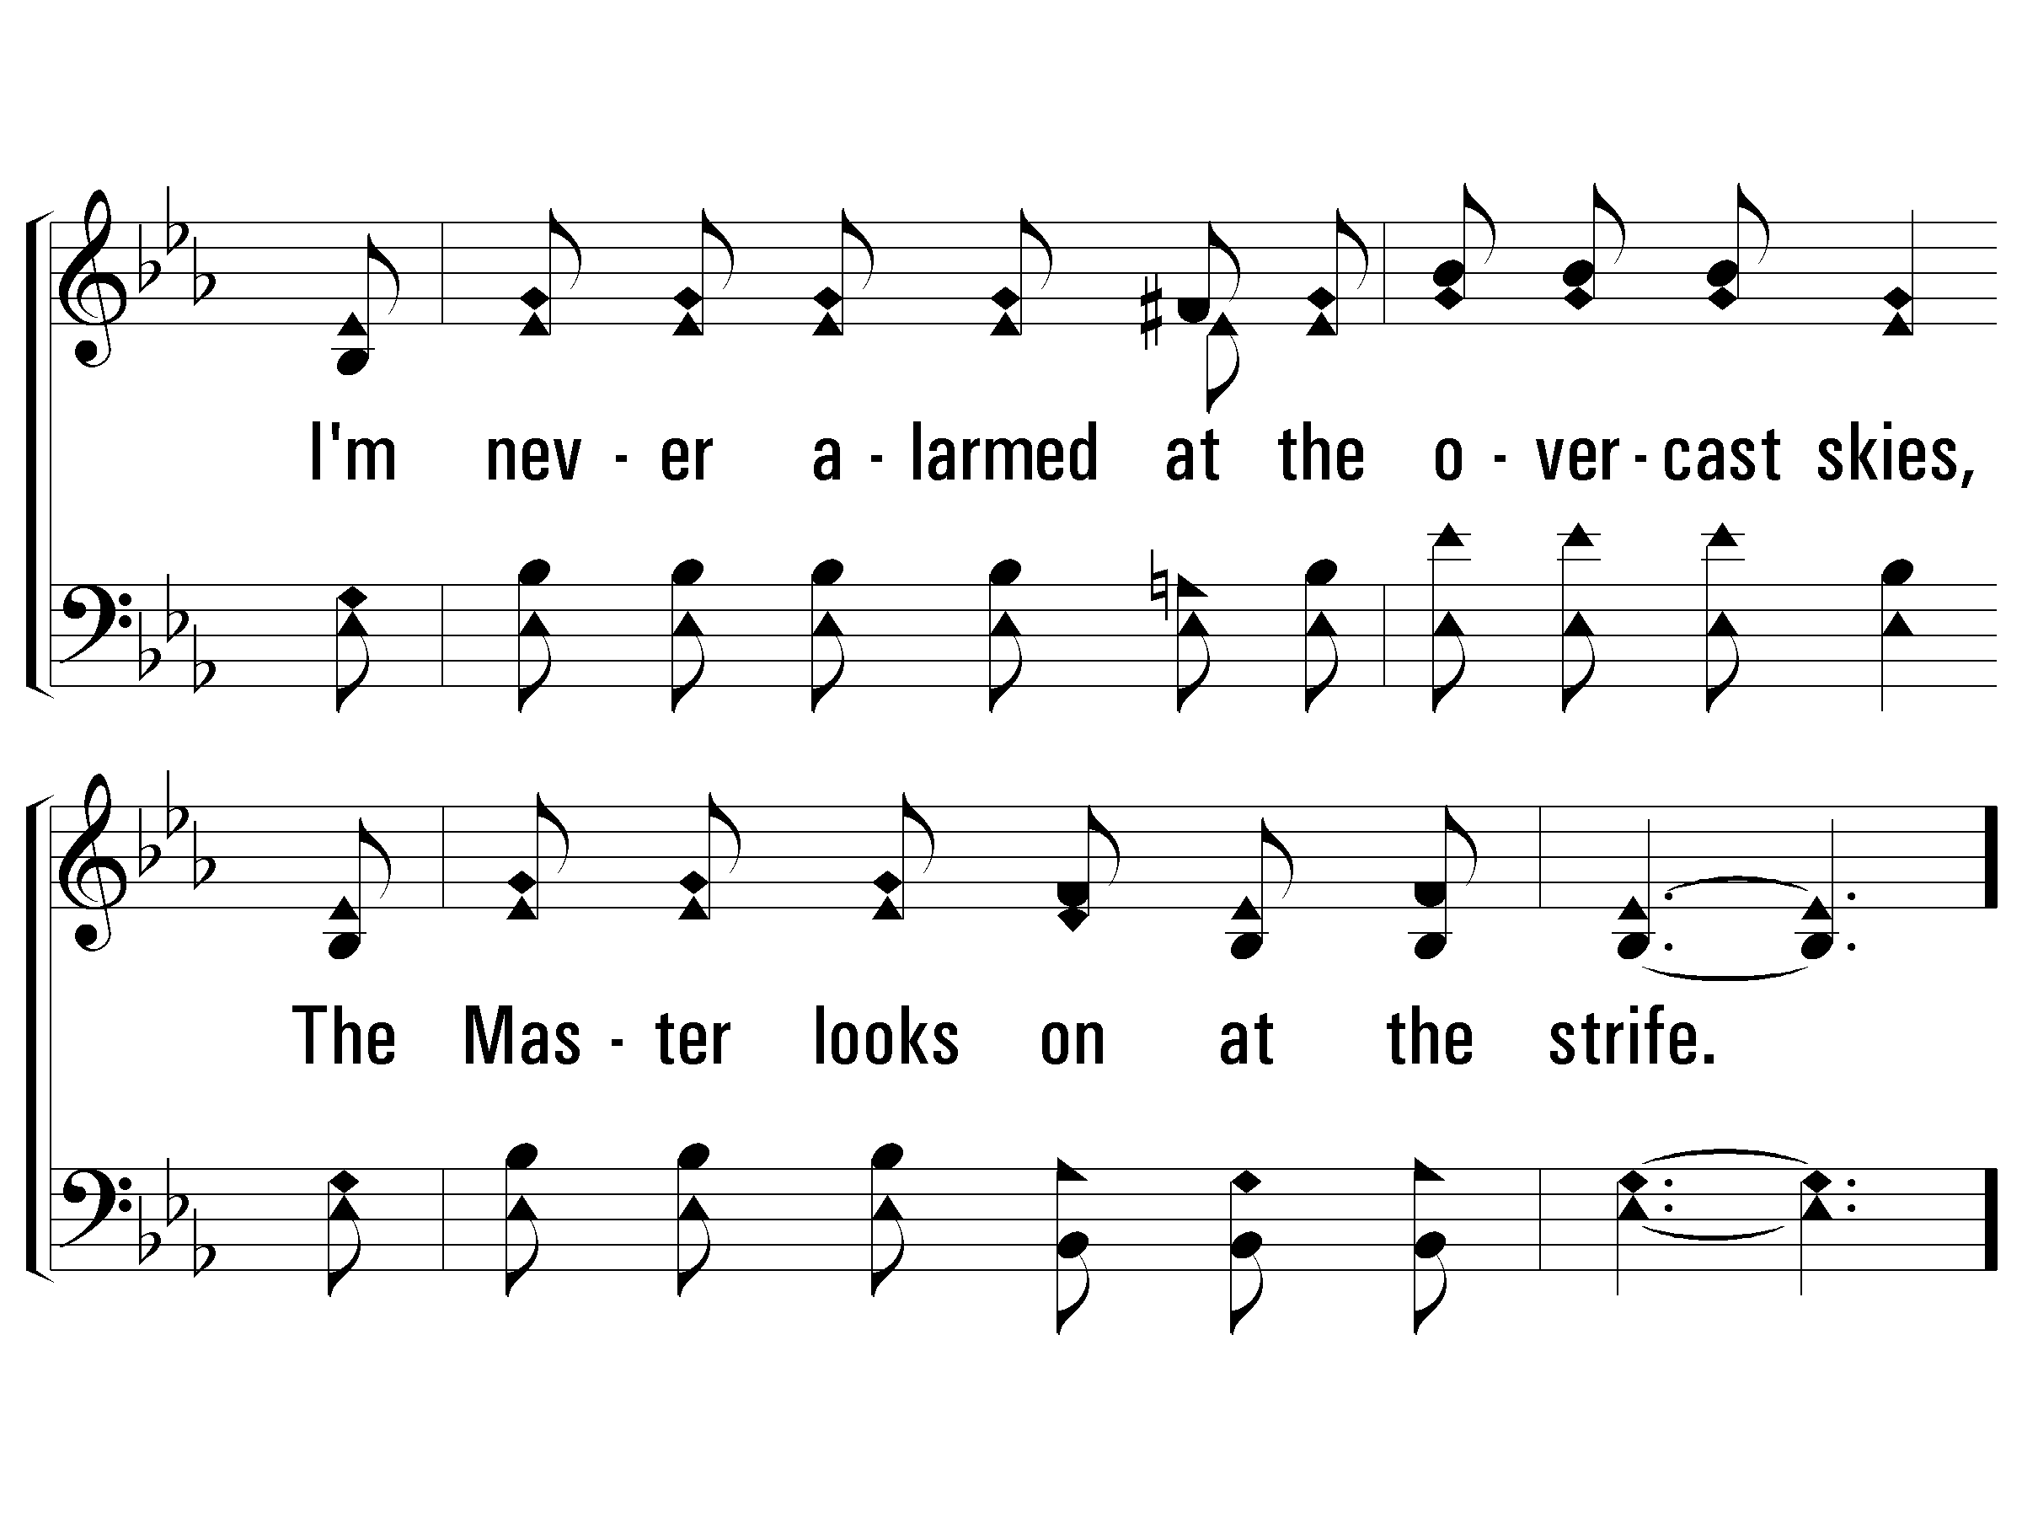
2 - Living by Faith
© 2008 The Paperless Hymnal®

Slide 125
c - Living by Faith
Living by faith, in Jesus above,
Trusting, confiding in His great love;
From all harm safe in His sheltering arm,
I'm living by faith and feel no alarm.
© 2008 The Paperless Hymnal®

Slide 126
c - Living by Faith
© 2008 The Paperless Hymnal®

Slide 127
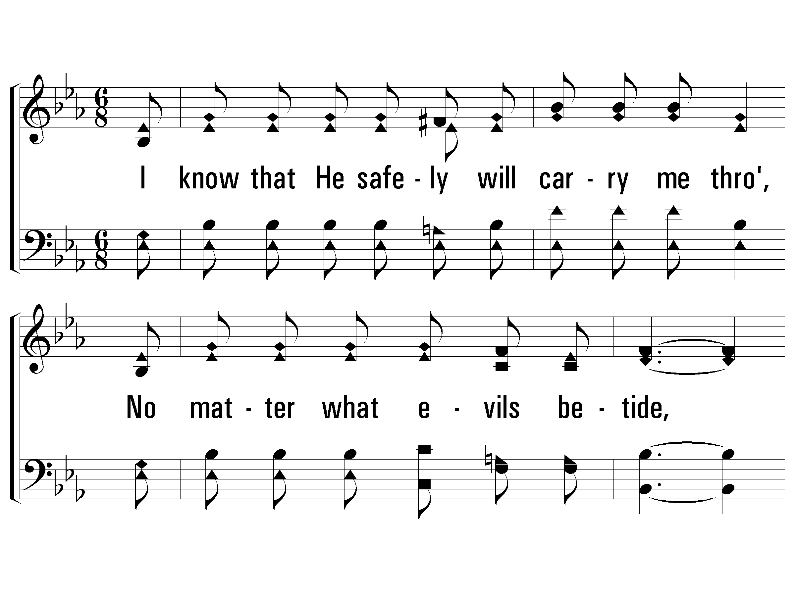
3 - Living by Faith
3.
I know that He safely will carry me through,
No matter what evils betide,
Why should I then care though the tempests may blow,
If Jesus walks close to my side.
Words: James S. Wells
Music: J. L. Heath
© 2008 The Paperless Hymnal®

Slide 128
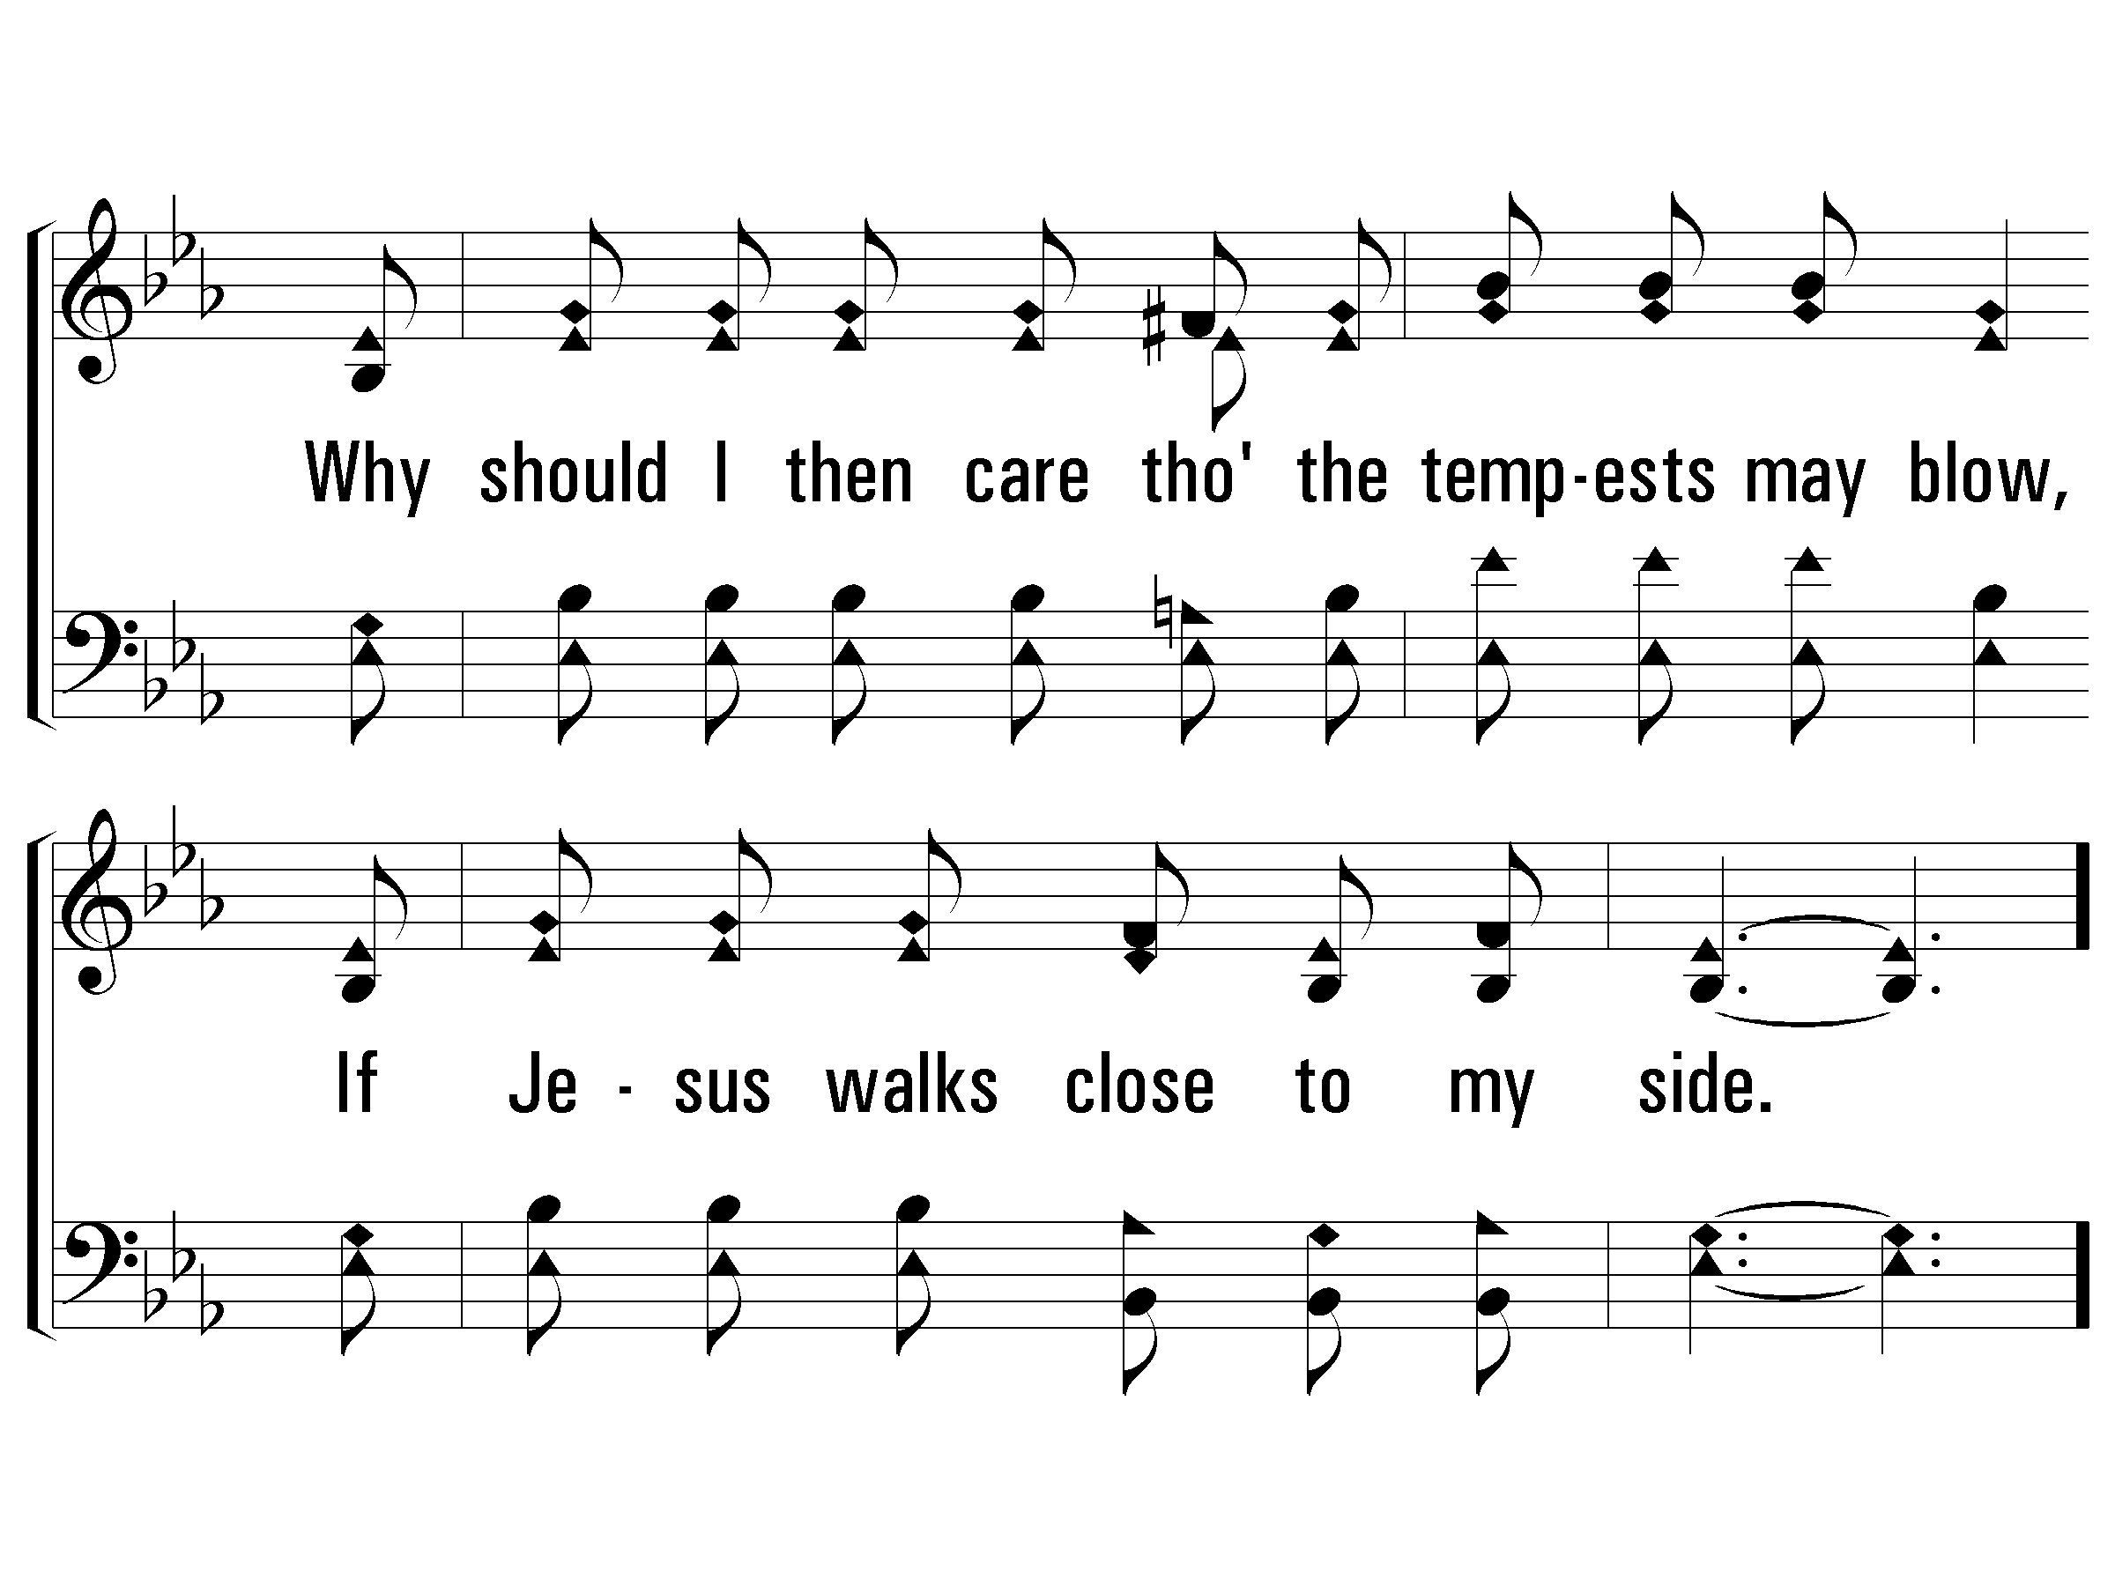
3 - Living by Faith
© 2008 The Paperless Hymnal®

Slide 129
c - Living by Faith
Living by faith, in Jesus above,
Trusting, confiding in His great love;
From all harm safe in His sheltering arm,
I'm living by faith and feel no alarm.
© 2008 The Paperless Hymnal®

Slide 130
c - Living by Faith
© 2008 The Paperless Hymnal®

Slide 131
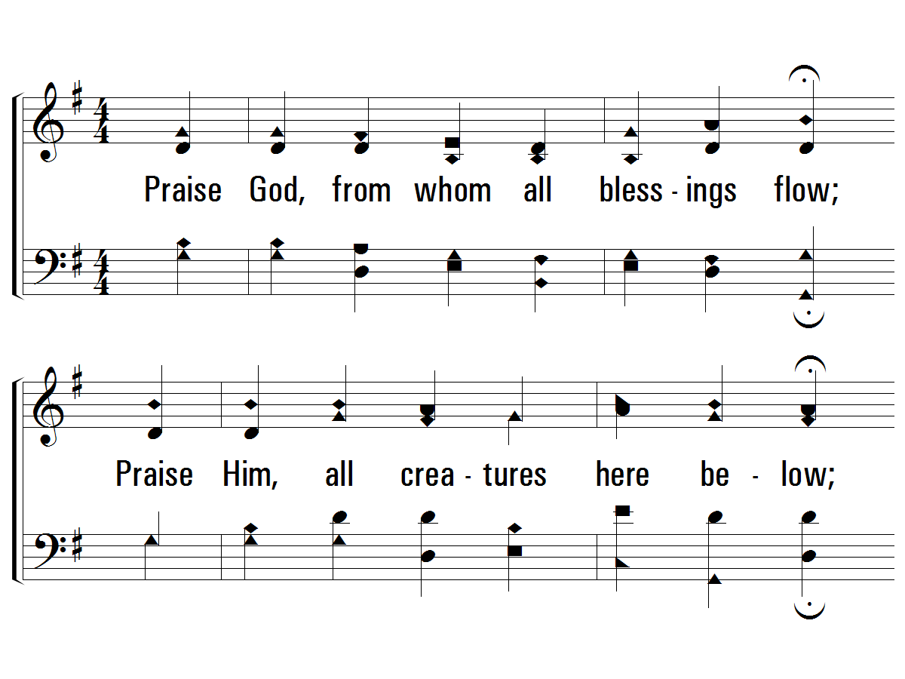
1 - Doxology
Praise God, from whom all blessings flow;
Praise Him, all creatures here be-low;
Praise Him above, ye heavenly host;
Praise Father, Son and Holy Ghost!
Words by: Thomas Ken
Music by: Louis Bourgeois
© 2001 The Paperless Hymnal™

Slide 132
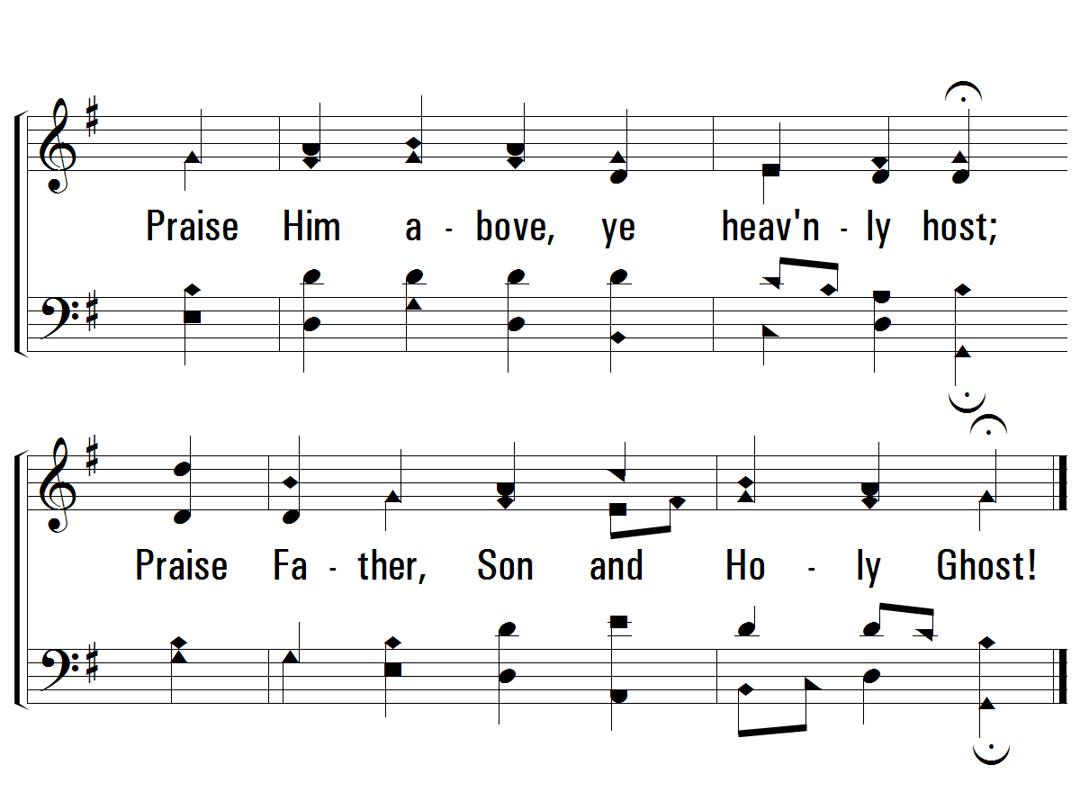
1 - Doxology
© 2001 The Paperless Hymnal™

Slide 133
Prayer

Slide 134
OLD
Church
of Christ
UNION

