Slide 1
Welcome Guests!
OLD UNION
NEW LIFE
Following Jesus changes everything!

Slide 2
Wednesdays @ 7PM Teen Room

Slide 3
Plant. Grow. Become.
Notes:
Meet at the Garden (Teen Room Downstairs)
Wednesdays at 7p.

Slide 5
OLD
Sunday
Nights
UNION

Slide 6
Devotional with Communion Begins at 5pm
Followed By Small Groups:
- Men’s Group Meeting Upstairs
- Card Writing Ministry in the Fellowship Hall
- Visitation Teams (Adults and OUKids)
- Songs with Sam in the Teen Room
- Various Work/Service Projects
- Staffed Nursery
- 1st Sunday Singings
- 3rd Sunday “MOBILE CHURCH”
- all groups meet on location
OLD
Sunday
Nights
UNION

Slide 7
TONIGHT: 3rd Sunday “MOBILE CHURCH”
Our bus will leave OU at 5pm to go
and visit Mr. Carl Dixon at Capstone.
108 Miss B Blvd. Gallatin, TN 37066
OR
All are welcome to meet at Capstone at 5:15pm.
OLD
Sunday
Nights
UNION

Slide 8
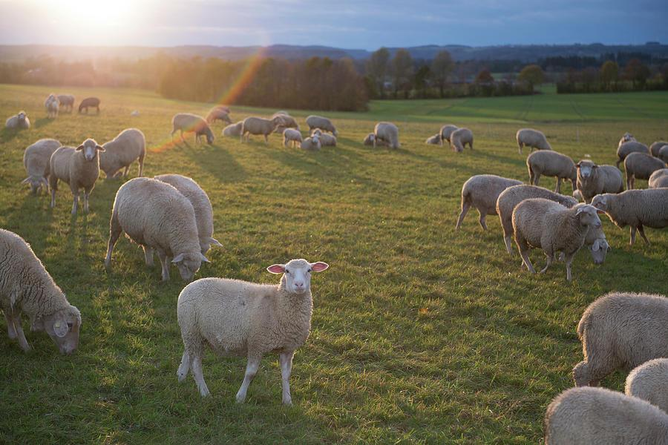
And all the believers were together and had all things in common; and they would sell their property and possessions and share them with all, to the extent that anyone had need. ACTS 2:44-45
Cash/Checks can be given to OU leadership or FHS team
Checks written to “Feeding His Sheep”
Add us as your friend on Venmo!
(Verification code if needed – 9865)

Slide 9
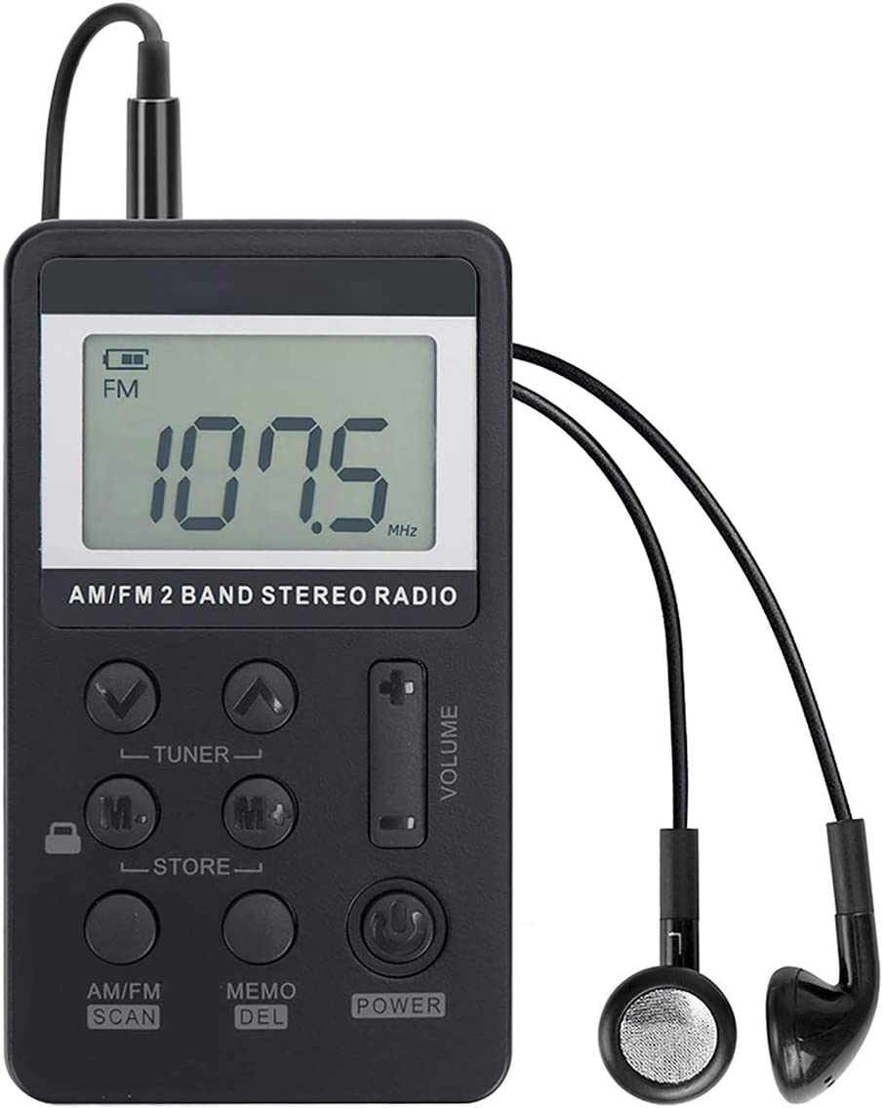
HAVING TROUBLE HEARING? WE HAVE AUDIO AIDS TO HELP YOU.
107.1
See any of our greeters in the foyer.
And THANK YOU for being here!

Slide 11
The Mark 12:31 Project is an effort to love this community as Jesus loves.
“When we see people as God sees people, people see God.”
Join the effort today!

Slide 13
December 14th
10am - Noon

Slide 14
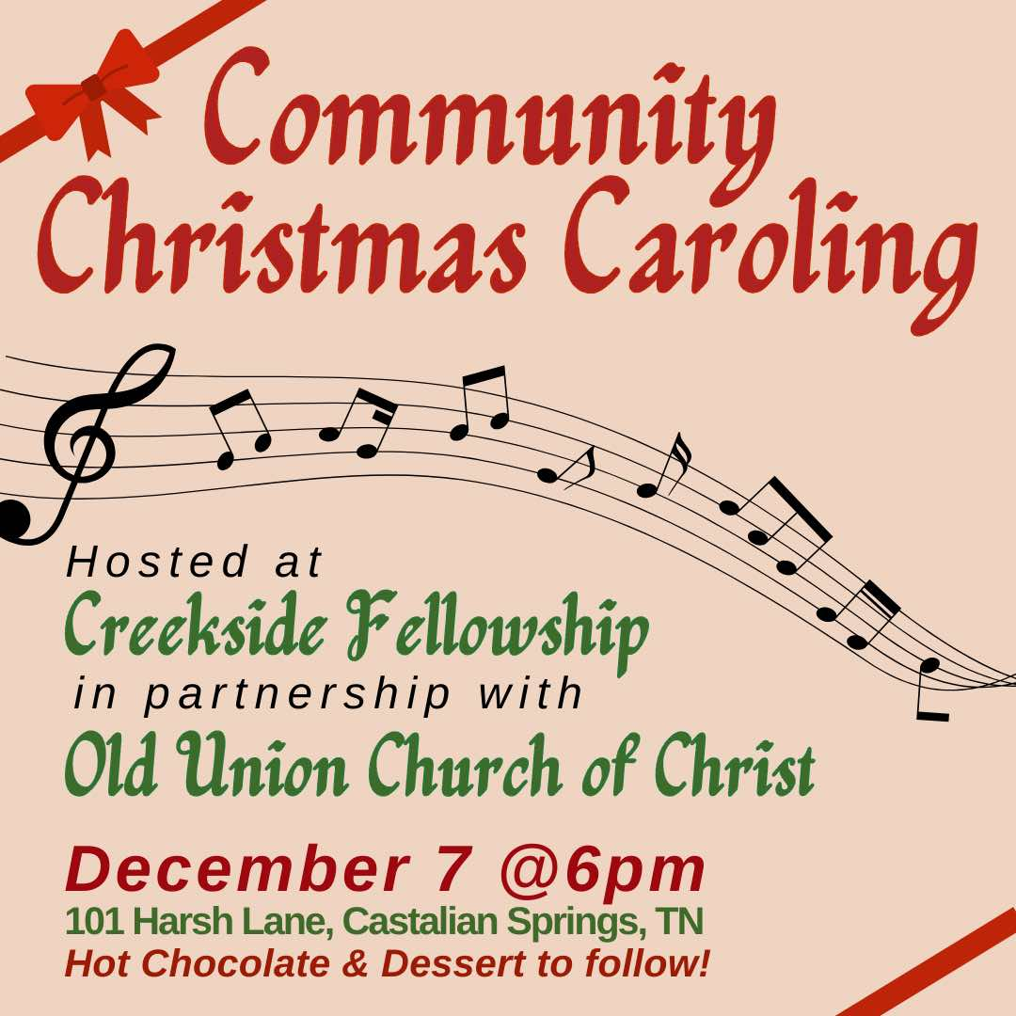
H o t C h o c o l a t e &
D e s s e r t s F o l l o w i n g
December 7th at 6pm
101 Harsh Lane
Castalian Springs
“ O C o m e A l l
Y e F a i t h f u l ”

Slide 16
Congregation Membership is a blessing. If interested see our Shepherds.

Slide 17
ENCOURAGEMENT CARD OF THE WEEK Carlene Smith
Ms. Carlene is having serious health concerns. She will have surgery to remove a brain tumor after recovering from the flu. Let’s send her words of encouragement.

Slide 18
First Sunday Singings
Every first Sunday of
the month at 5PM.
This a great time to sing and also improve our song ministry.
Please consider attending.

Slide 19
Jesus said, “Let the little children come to Me.”

Slide 20
OUKids Time
Sundays 9AM
Memory, Songs,
and Prayer
Sundays 9:30am
(0-5th Grade Classes)
Wednesdays 7PM
(0-5th Grade Classes)

Slide 21
Psalm 95:1-2
Come let us sing with joy to the LORD;
Let us shout aloud,
to the Rock of our salvation.
Let us come before Him with thanksgiving;
And extol Him with music and song.

Slide 22
Psalm 95:3-5
For the LORD is a great God
A great King above all gods,
In His hands are the depths of the earth,
And the mountain peaks belong to Him.
The sea is His, He made it.
And His hands they formed the dry land.

Slide 23
Psalm 95:6-7
Come, let us worship and bow down,
Let us kneel before the LORD our Maker.
For He is our God,
and we are the people of His pasture.
And the sheep of His hand.

Slide 24
Lamentations 3:22-24
The steadfast love of the LORD never ceases;
His mercies never come to an end.
They are new every morning.
Great is Thy faithfulness.
The LORD is my portion says my soul;
Therefore I will hope in Him.

Slide 25
Why did God make us?
Then God said, “Let Us make man in Our image, according to Our likeness; and let them rule over… all the earth...in the image of God He created him; male and female He created them.”
Genesis 1:26-27 (abbr.)
To Share Himself with Us.

Slide 26
How GOOD is our God?
Oh give thanks to the LORD, for He is good,
For His (HESED) lovingkindness is everlasting.
Let the redeemed of the Lord say so,
Psalm 107:1-2a
SO GOOD!!!

Slide 27
What is our PURPOSE?
Praise be to the God and Father of our Lord Jesus Christ, who has blessed us in the heavenly realms with every spiritual blessing in Christ.
Ephesians 1:3-10
To PRAISE and ENJOY God!

Slide 28
What is the Greatest Command?
You shall love the Lord your God
with all your heart and with all your soul and with all your might.
Deuteronomy 6:5

Slide 29
Who is Jesus?
Simon Peter answered,
“You are the Christ,
the Son of the living God.”
Matthew 16:16
The Christ, the Son of the Living God

Slide 30
Psalm 25
Unto Thee, O LORD, do I lift up my soul!
Unto Thee, O LORD, do I lift up my soul!
Oh my God, I trust in Thee;
Let me not be ashamed,
Let not my enemies triumph over me!

Slide 31
Genesis 1:27-28
“God created man in His own image…”
Memory Heart Verse

Slide 32
²⁷ God created man in His own image, in the image of God He created him; male and female He created them.
²⁸ God blessed them; and God said to them, “Be fruitful and multiply, and fill the earth, and subdue it; and rule over the fish of the sea and over the birds of the sky and over every living thing that moves on the earth.”
Genesis 1:27-28

Slide 33
Where can we find Jesus’ Sermon on the Mount?
The Gospel of Matthew
Chapters 5, 6, and 7

Slide 35
Matthew 5:3
“BLESSED are the POOR IN SPIRIT…for theirs is…”
Memory Heart Verse

Slide 36
³ Blessed are the poor in spirit,
for theirs is the kingdom of heaven.
⁴ Blessed are those who mourn,
for they shall be comforted.
⁵ Blessed are the gentle,
for they shall inherit the earth.
Matthew 5:3-5

Slide 37
Philippians 4:4
Rejoice in the Lord always;
And again I say rejoice!

Slide 38
What is God doing?
And He who sits on the throne said, “Behold I am making all things new.”
Revelation 21:5
Making all things new.

Slide 39
How Did Jesus Teach Us To Pray?
“Our Father in heaven, hallowed be Your name,
Your kingdom come, Your will be done,
on earth as it is in heaven.
Give us today our daily bread.
And forgive us our debts,
as we also have forgiven our debtors.
And lead us not into temptation,
but deliver us from the evil one.”

Slide 40
Psalm 3:3
Thou, O LORD,
Are a shield about me.
You’re my glory,
You’re the lifter of my head.
(Hallelujah)

Slide 41
How does God save us?
For by grace you have been saved through faith; and that not of yourselves, it is the gift of God;
Ephesians 2:8
By GRACE through FAITH.

Slide 42
What does God want from us?
He has shown you, O mortal, what is good.
And what does the Lord require of you?
To act justly and to love mercy
and to walk humbly with your God.
Micah 6:8
To Act Justly, Love Mercy, and Walk Humbly

Slide 43
How does God show us love?
“But God demonstrates His own love toward us, in that while we were yet sinners, Christ died for us.”
Romans 8:5
By Christ dying for us.

Slide 44
The Books of the New Testament
Acts
Romans
1 2 Corinthians
Galatians
Ephesians
Philippians
Colossians
1 2 Thessalonians
1 2 Timothy
Titus
Philemon
Hebrews
James
1 2 Peter
Matthew
Mark
Luke
John
1 2 3 John
Jude
Revelation

Slide 45
The Books of the Old Testament
Genesis
Exodus
Leviticus
Numbers
Deuteronomy
Joshua
Judges
Ruth
1 2 Samuel
1 2 Kings
1 2 Chronicles
Ezra
Nehemiah
Esther
Job
Psalms
Proverbs
Ecclesiastes
Songs of Solomon
Isaiah
Jeremiah
Lamentations
Ezekiel
Daniel
Hosea, Joel
Amos, Obadiah
Jonah, Micah
Nahum
Habakkuk
Zephaniah
Haggai
Zechariah
Malachi

Slide 46
What is Success?
“How blessed is the man…
Who delights in the law of the LORD.
He will be like a tree planted firmly…
And in whatever he does, he prospers.”
Psalm 1
Living with God, Now and Forever!

Slide 47
What is the Bible?
All Scripture is (God-breathed) and profitable for teaching, for reproof, for correction, for training in righteousness; so that the man of God may be adequate, equipped for every good work.
2 Timothy 3:16-17
Scripture, Inspired by God.

Slide 48
What is the 2nd Greatest Command?
Love your neighbor as yourself.
Mark 12:31

Slide 49
The Fruit of the Spirit
LOVE
JOY
PEACE
PATIENCE
KINDNESS
GOODNESS
FAITHFULNESS
GENTLENESS
SELF-CONTROL
“Against such things there is no law.”
Galatians 5:22-23

Slide 50
Welcome Guests!
OLD UNION
NEW LIFE
Following Jesus changes everything!

Slide 51
Live For Jesus
401

Slide 52
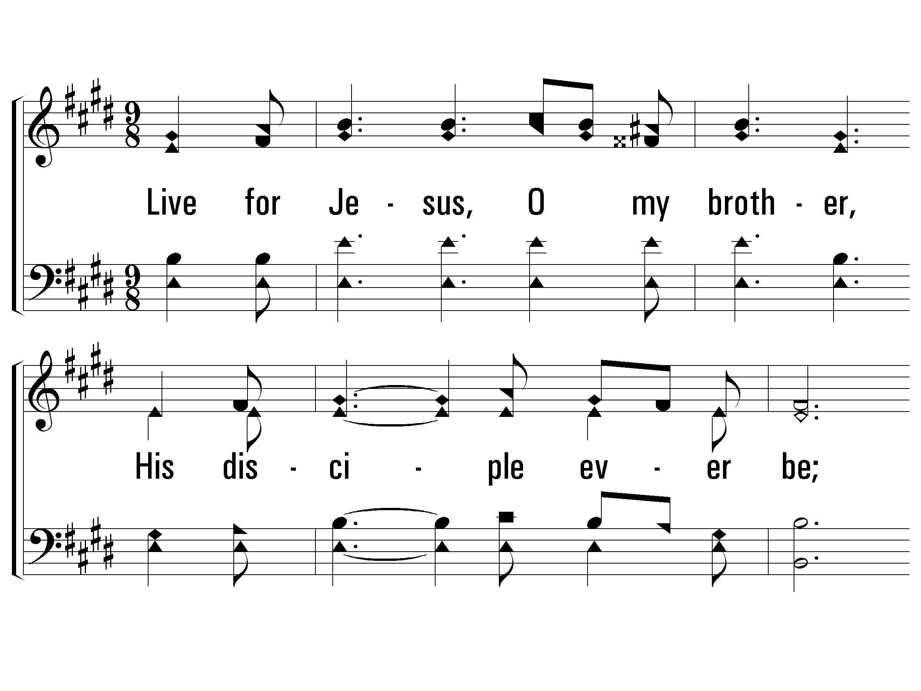
1 – Live For Jesus
1.
Live for Jesus, O my brother,
His disciple ever be;
Render not to any other,
What alone the Lord's should be.
Words: E. R. Latta
Music: Frank M. Davis
© 2005 The Paperless Hymnal™

Slide 53
1 – Live For Jesus
© 2005 The Paperless Hymnal™

Slide 54
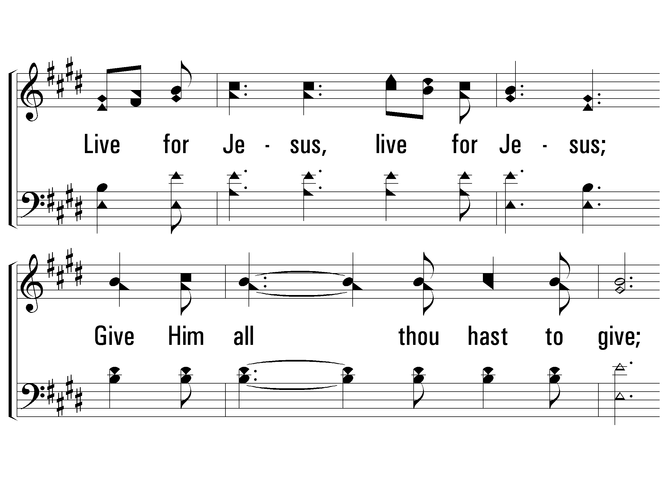
c – Live For Jesus
Live for Jesus, live for Jesus;
Give Him all thou hast to give;
On the cross the world's Redeemer,
Gave His life that thou mightst live.
© 2005 The Paperless Hymnal™

Slide 55
c – Live For Jesus
© 2005 The Paperless Hymnal™

Slide 56
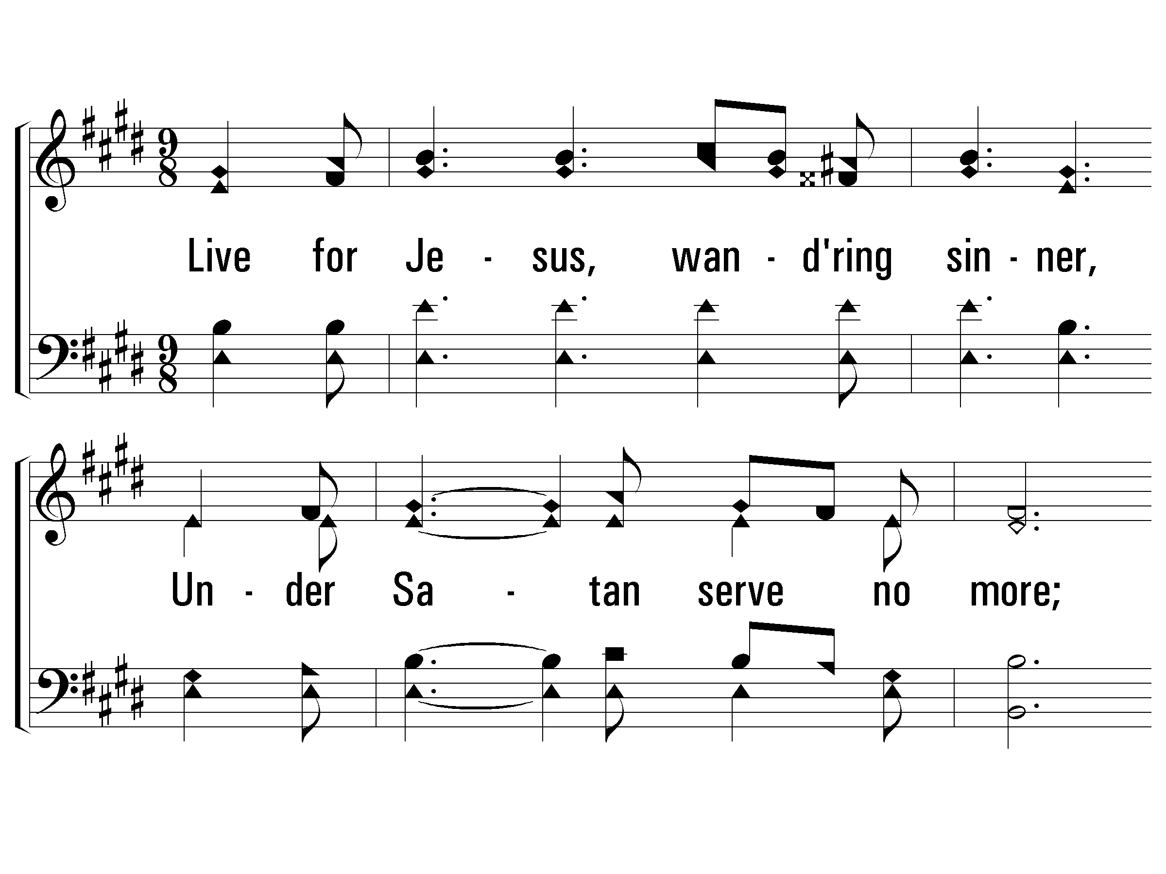
2 – Live For Jesus
2.
Live for Jesus, wandering sinner,
Under Satan serve no more;
Of the promised prize a winner
Thou may’st be, when life is over.
Words: E. R. Latta
Music: Frank M. Davis
© 2005 The Paperless Hymnal™

Slide 57
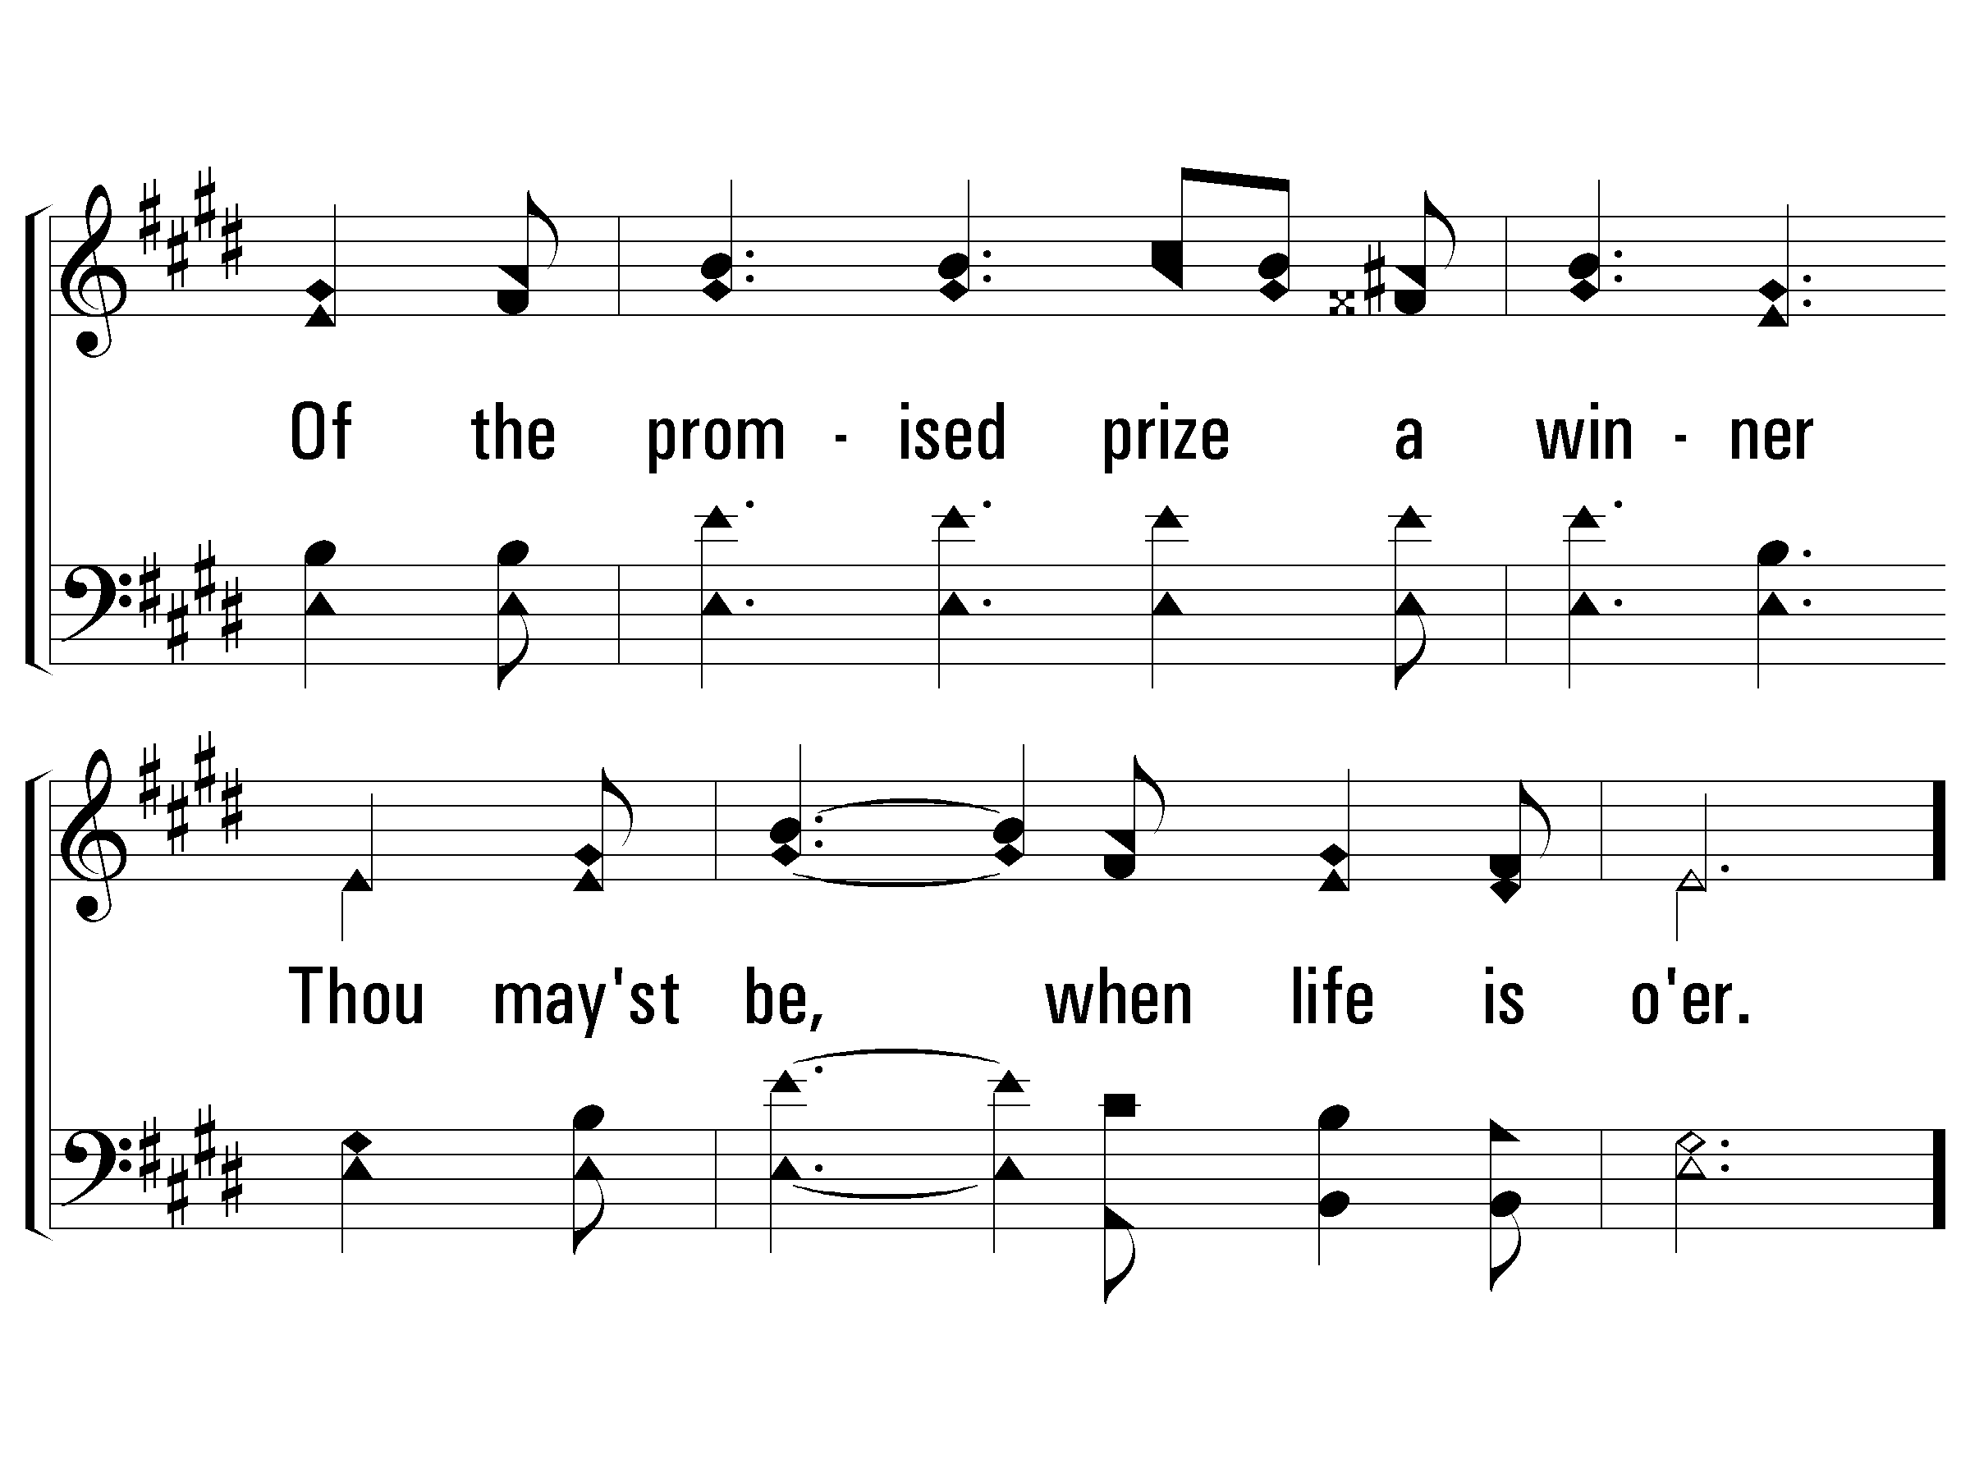
2 – Live For Jesus
© 2005 The Paperless Hymnal™

Slide 58
c – Live For Jesus
Live for Jesus, live for Jesus;
Give Him all thou hast to give;
On the cross the world's Redeemer,
Gave His life that thou mightst live.
© 2005 The Paperless Hymnal™

Slide 59
c – Live For Jesus
© 2005 The Paperless Hymnal™

Slide 60
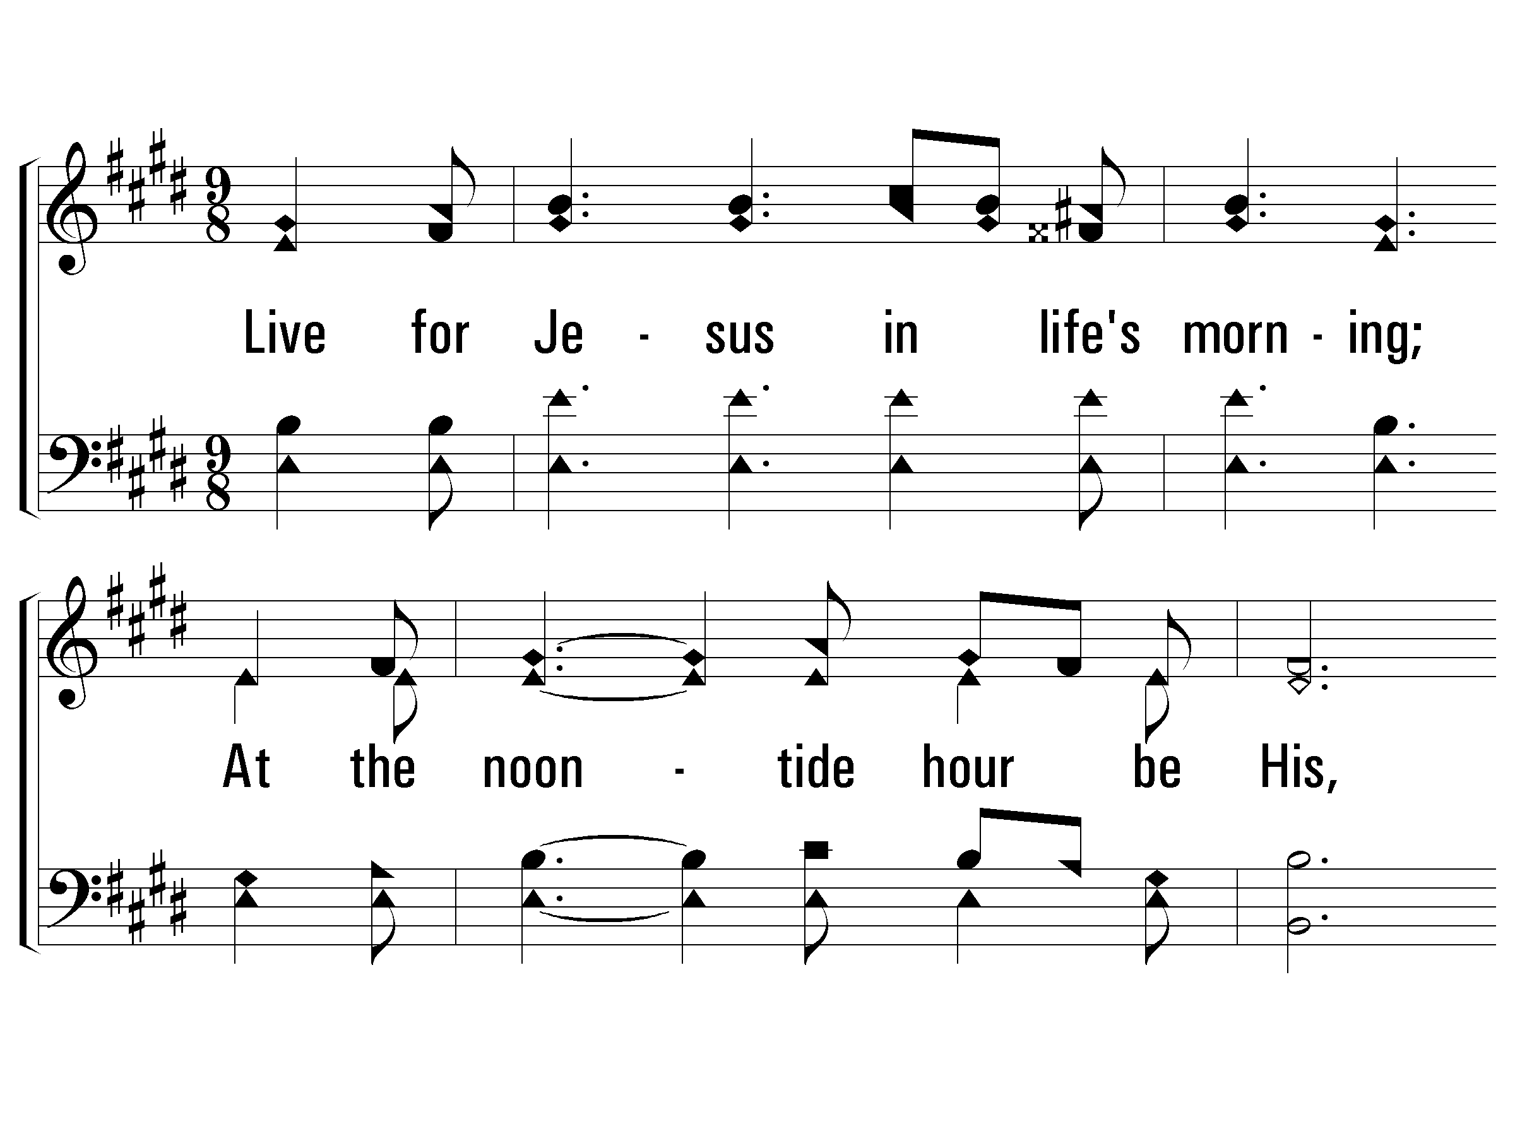
3 – Live For Jesus
3.
Live for Jesus in life's morning;
At the noontide hour be His,
And at eve, when day is turning,
And inherit endless bliss.
Words: E. R. Latta
Music: Frank M. Davis
© 2005 The Paperless Hymnal™

Slide 61
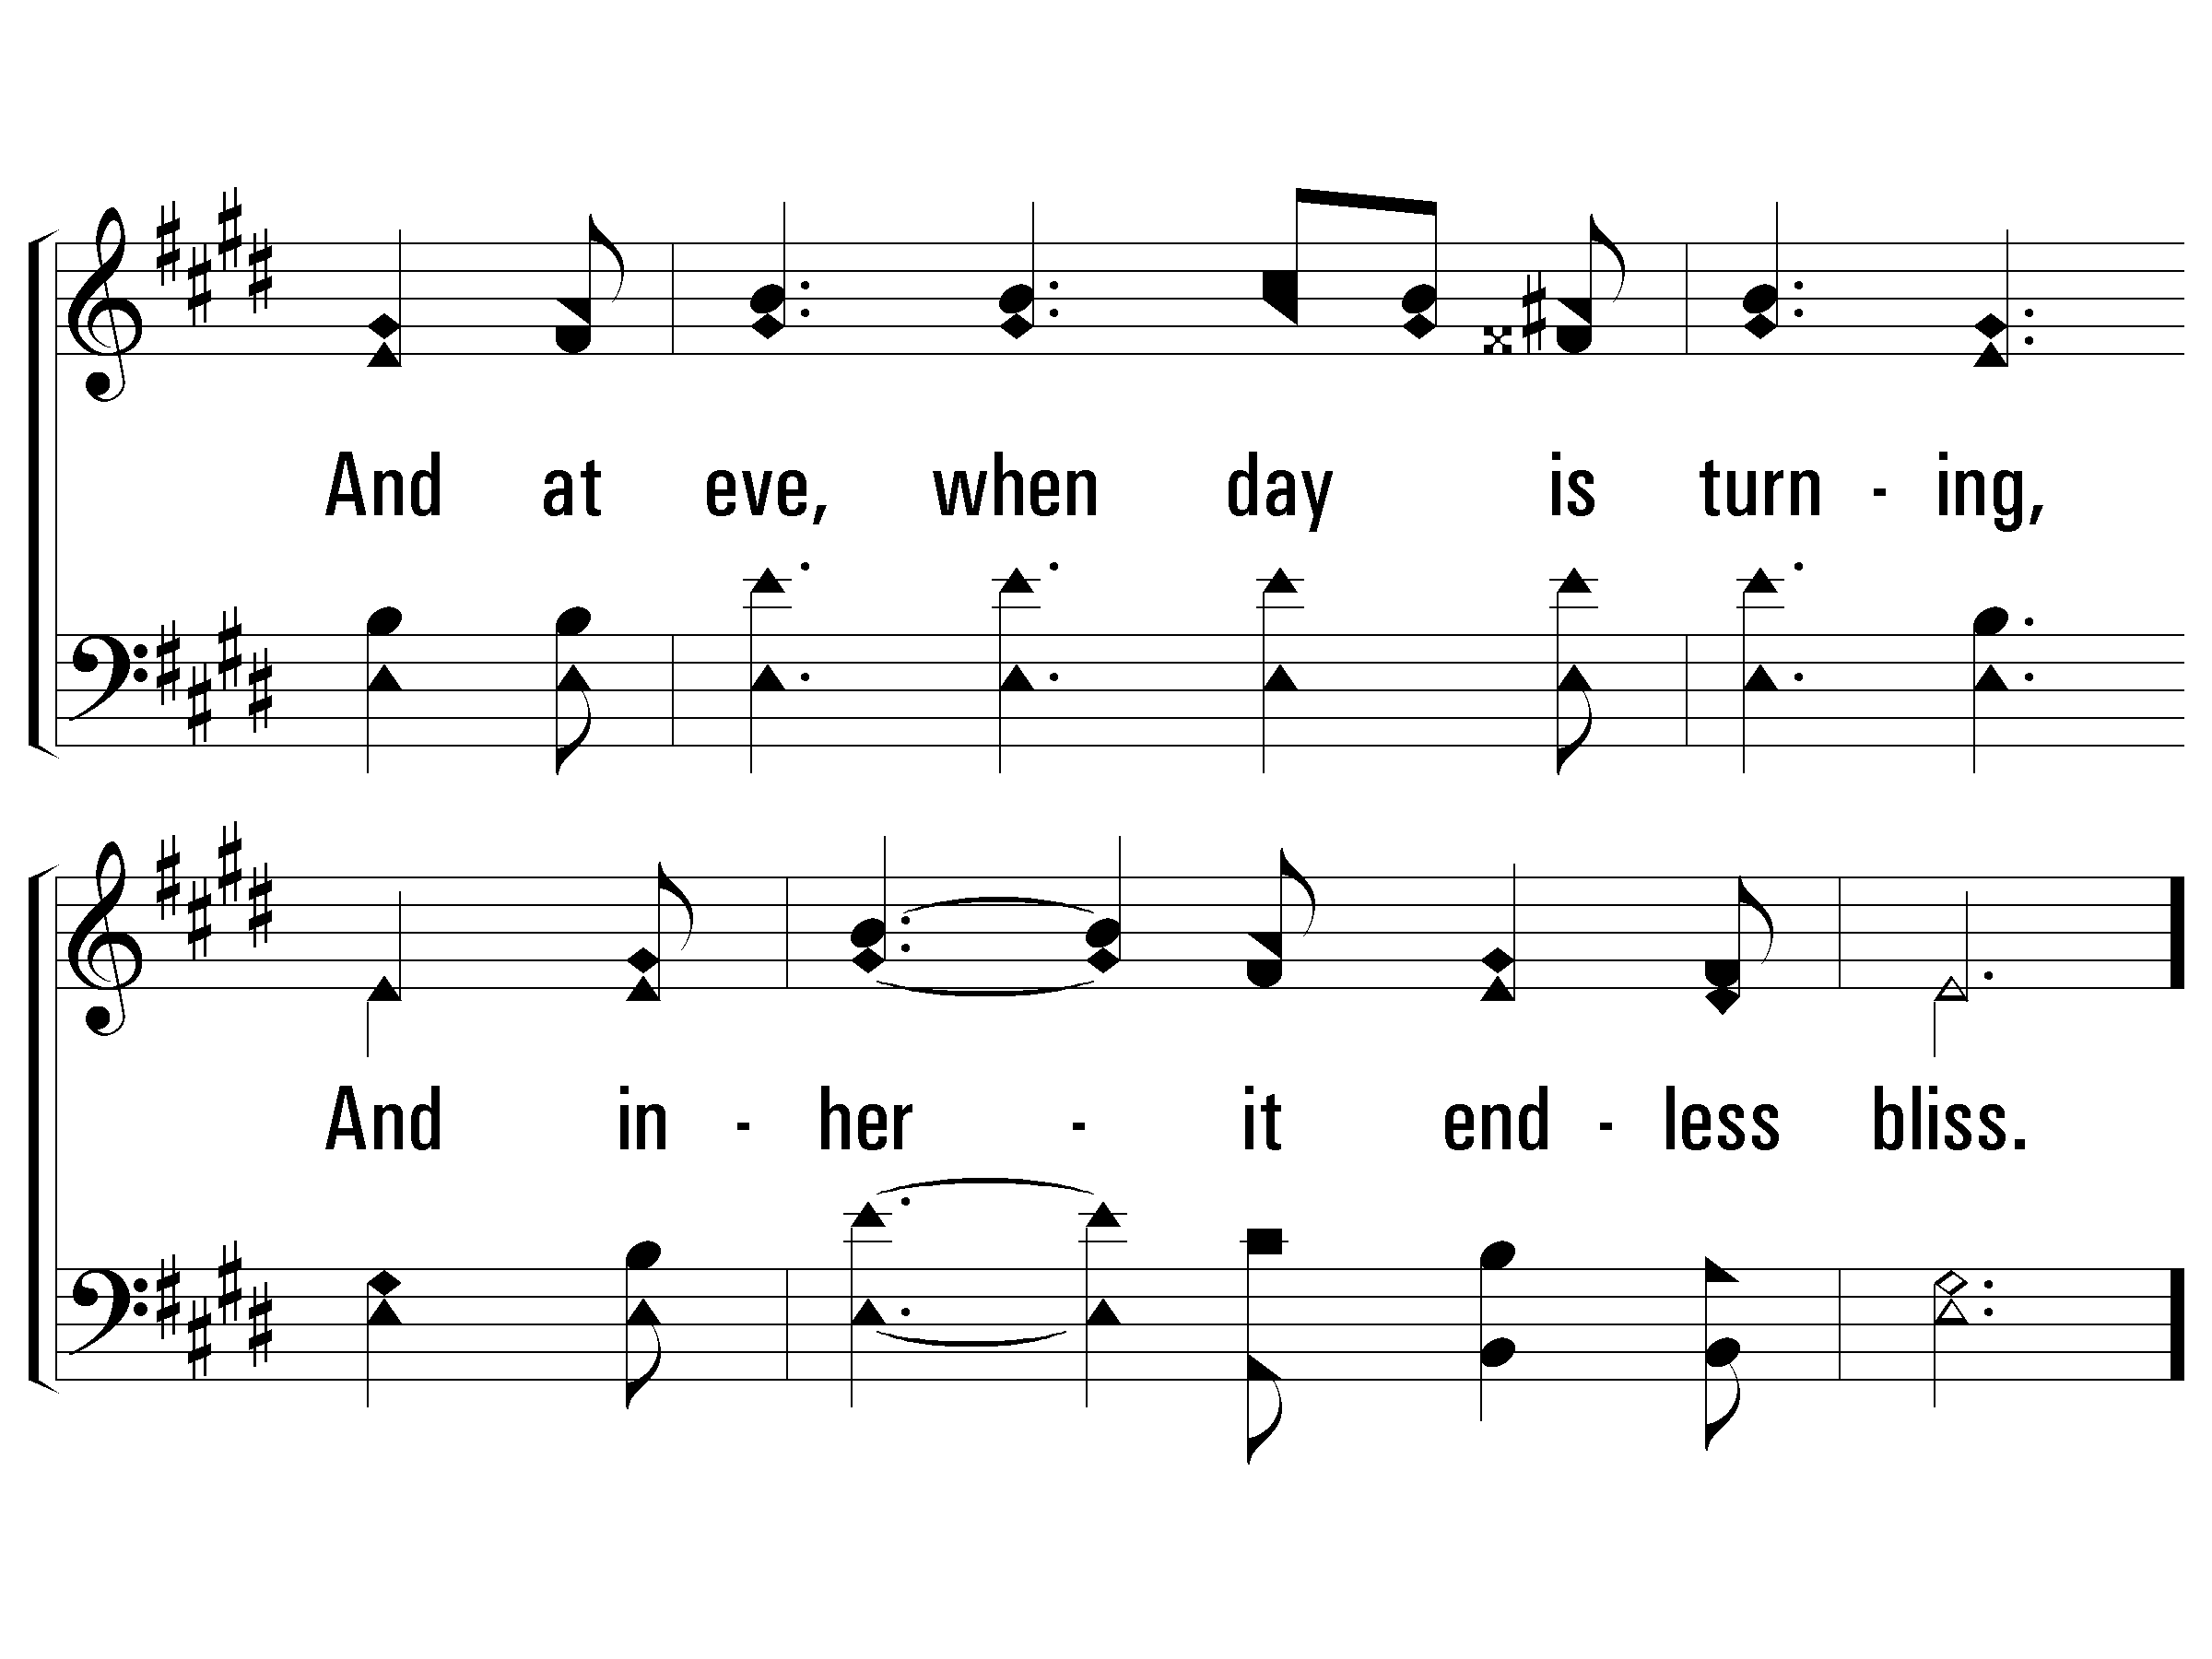
3 – Live For Jesus
© 2005 The Paperless Hymnal™

Slide 62
c – Live For Jesus
Live for Jesus, live for Jesus;
Give Him all thou hast to give;
On the cross the world's Redeemer,
Gave His life that thou mightst live.
© 2005 The Paperless Hymnal™

Slide 63
c – Live For Jesus
Here I Am To Worship (Chorus)
© 2005 The Paperless Hymnal™

Slide 64
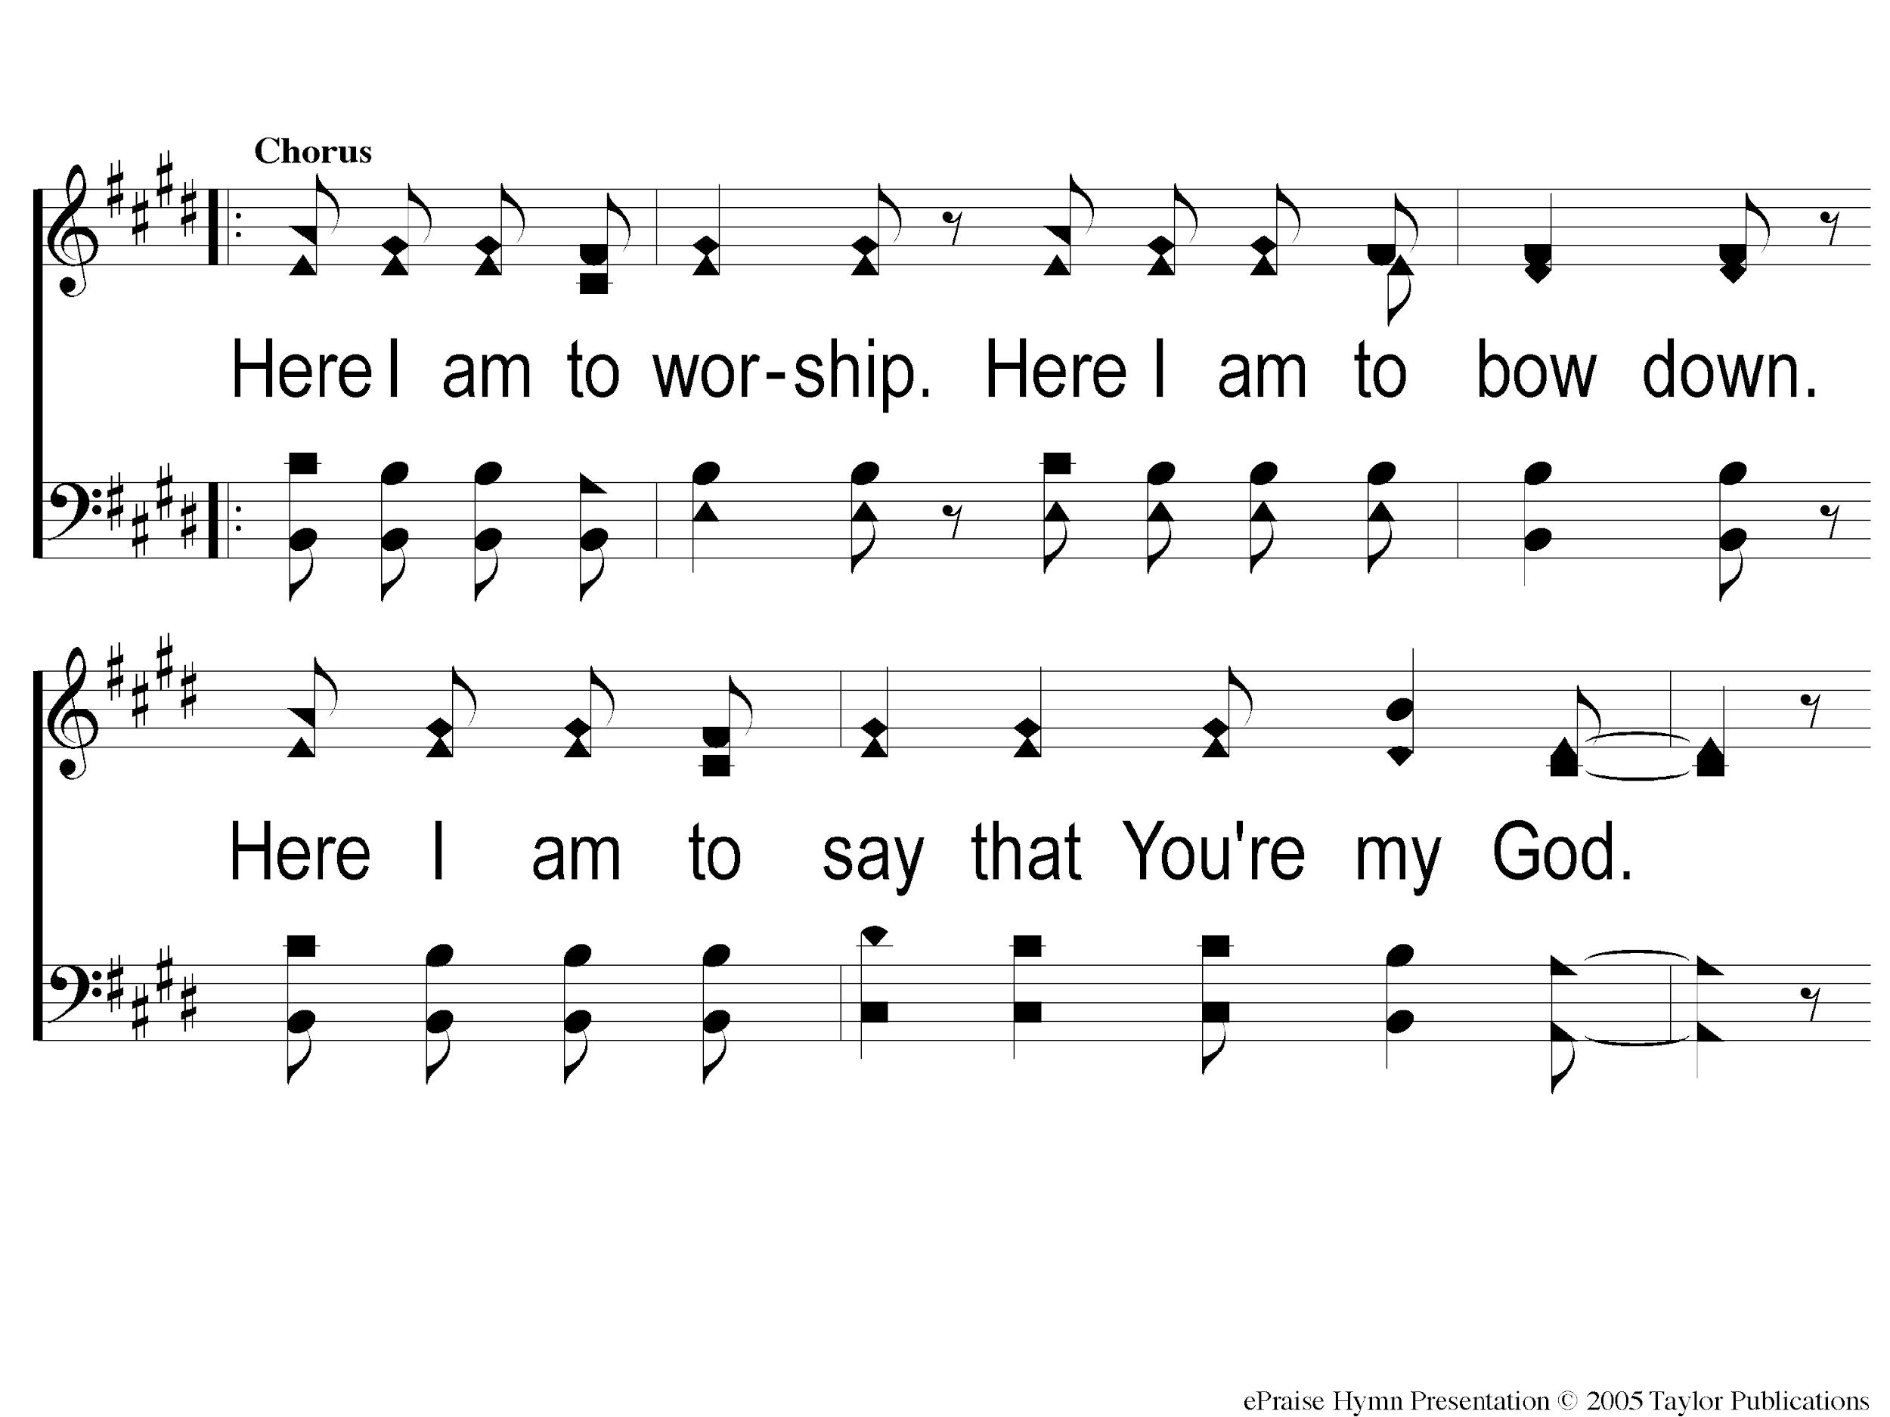
C-1 Here I Am To Worship
Here I Am To Worship

Slide 65
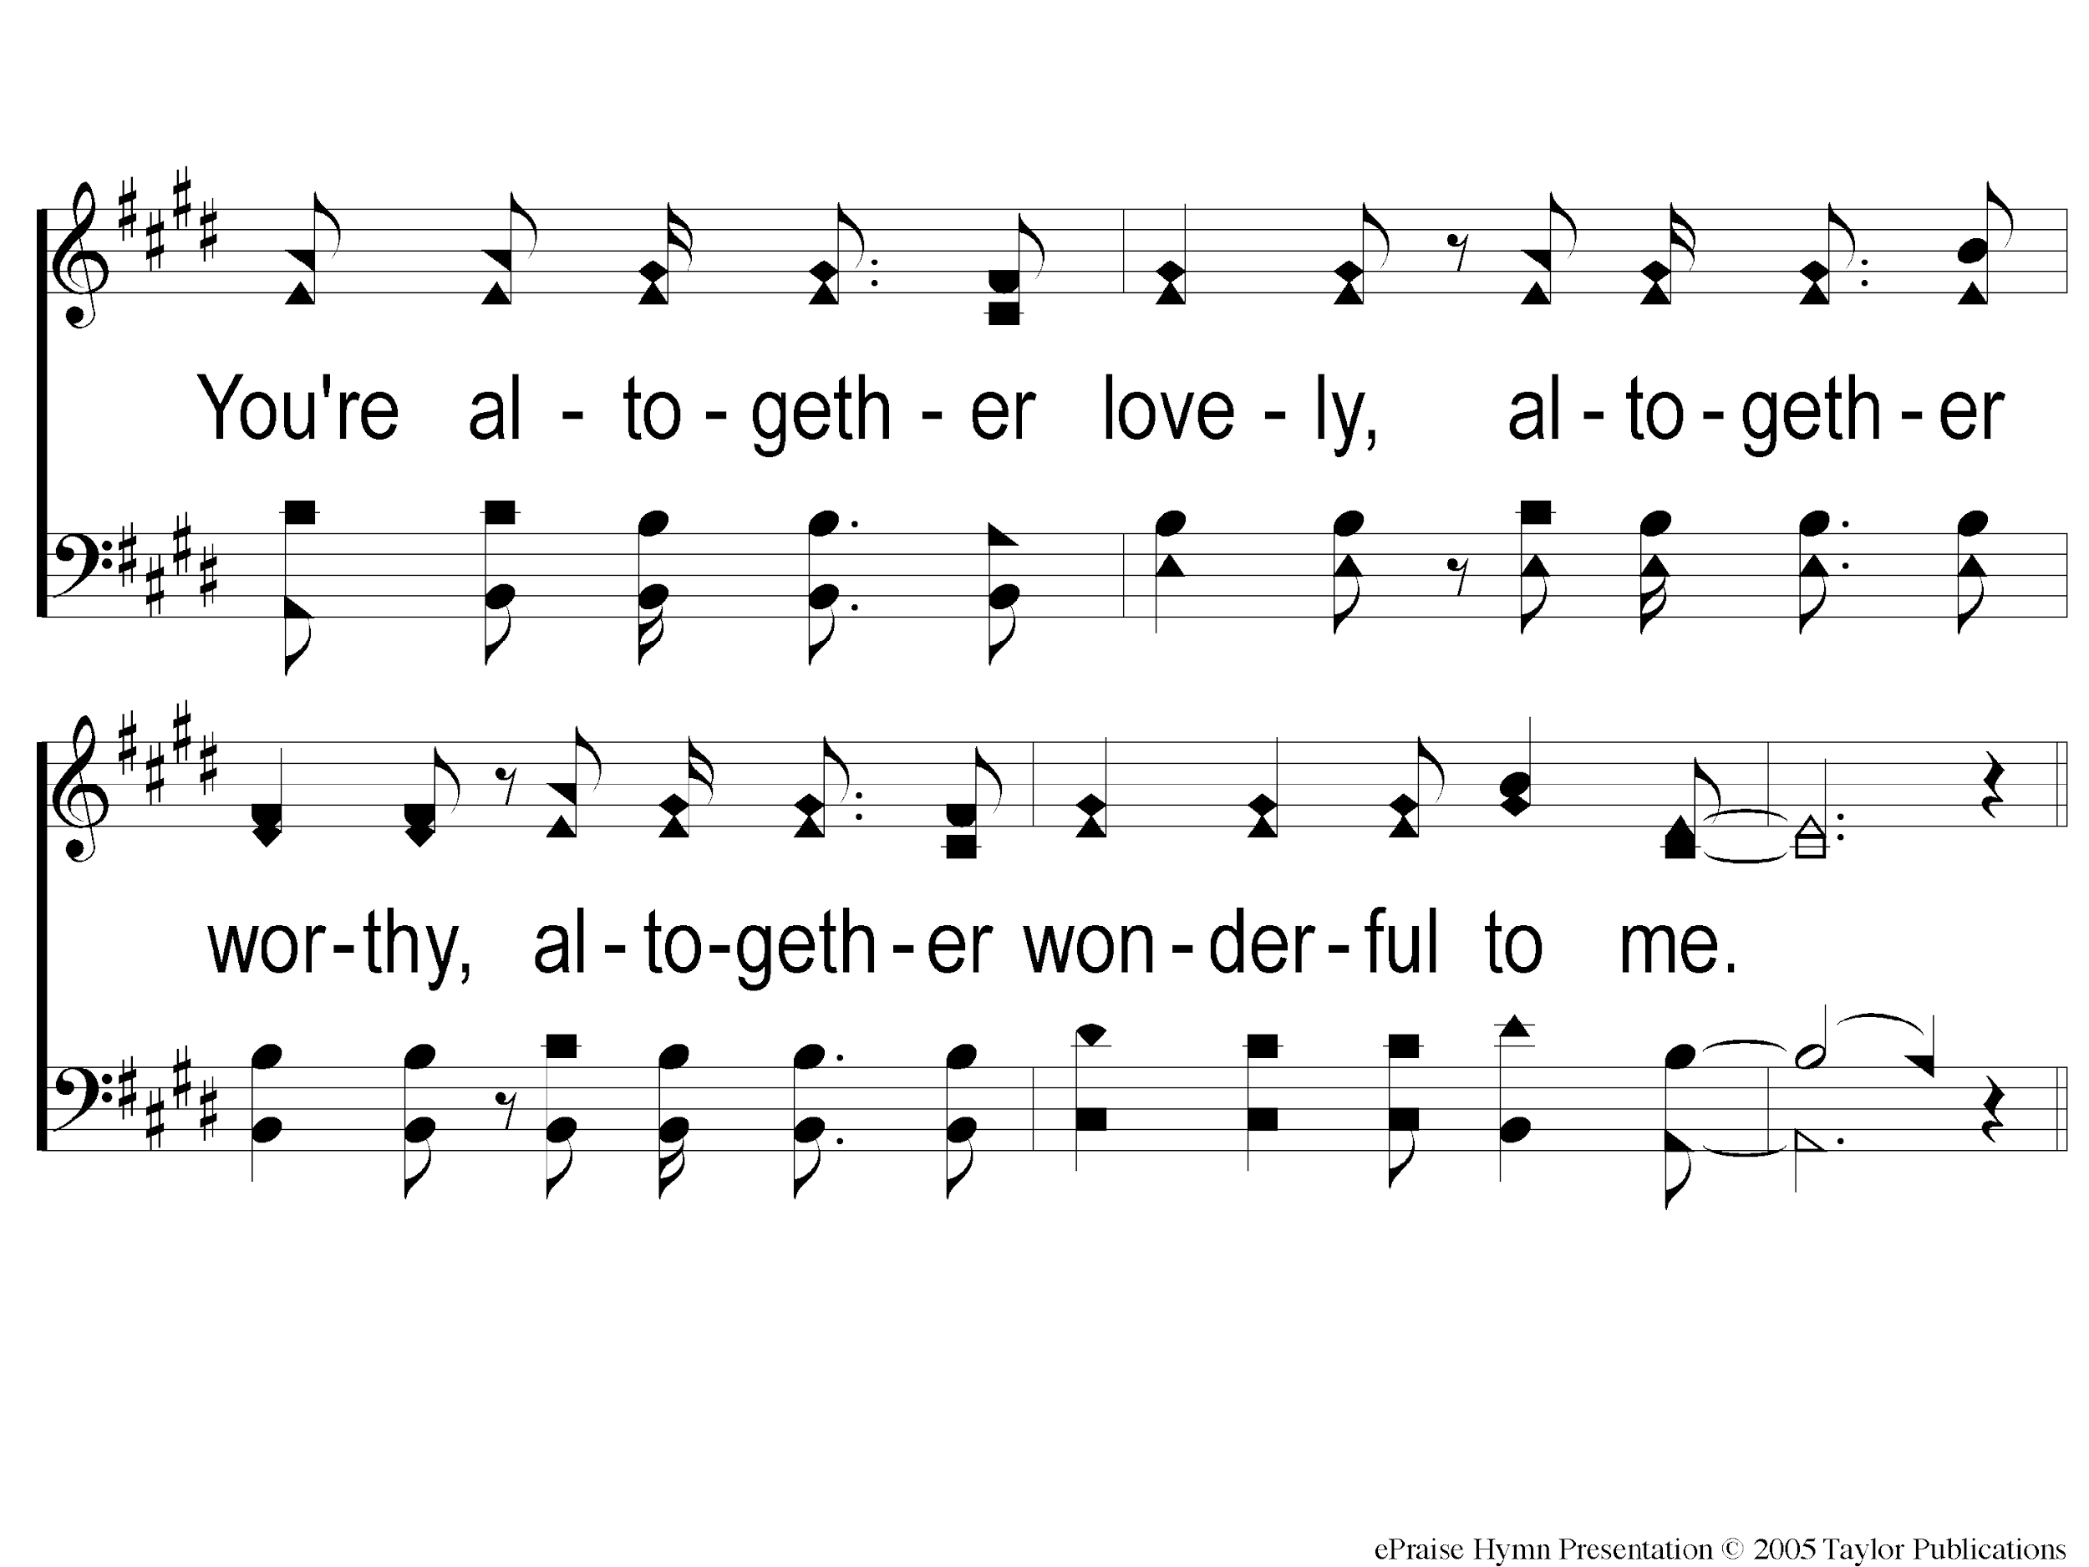
C-2 Here I Am To Worship
Here I Am To Worship

Slide 66
1-1 Here I Am To Worship
Here I Am To Worship

Slide 67
1-2 Here I Am To Worship
Here I Am To Worship

Slide 68
C-1 Here I Am To Worship
Here I Am To Worship

Slide 69
C-2 Here I Am To Worship
Here I Am To Worship

Slide 70
2-1 Here I Am To Worship
Here I Am To Worship

Slide 71
2-2 Here I Am To Worship
Here I Am To Worship

Slide 72
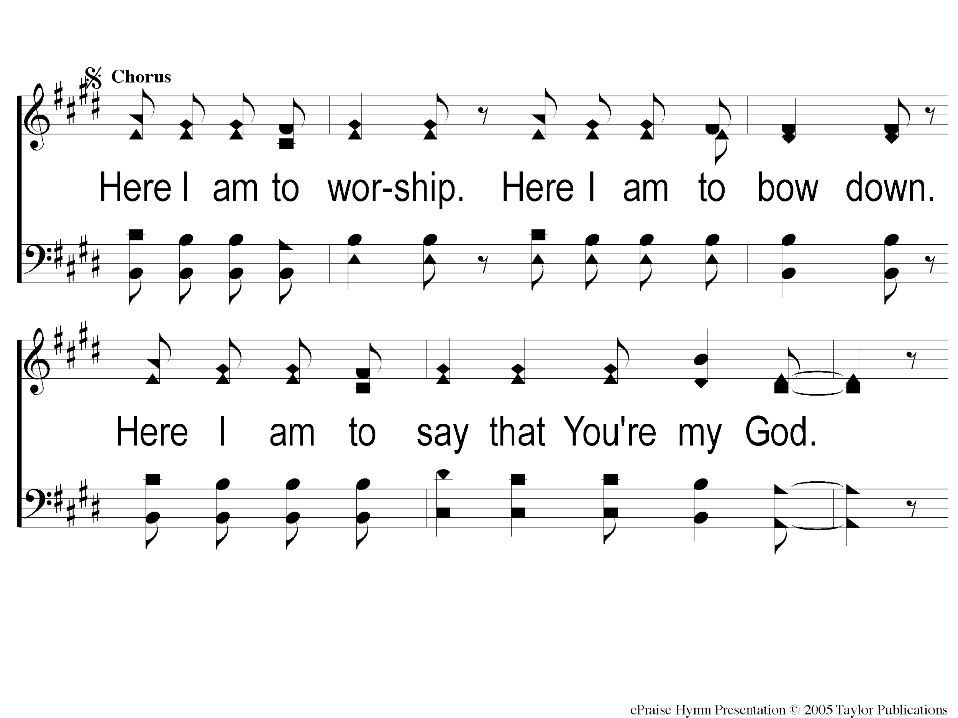
C2-1 Here I Am To Worship
Here I Am To Worship

Slide 73
C2-2 Here I Am To Worship
Here I Am To Worship

Slide 74
Bridge1 Here I Am To Worship
Here I Am To Worship

Slide 75
Bridge2 Here I Am To Worship
Here I Am To Worship

Slide 76
C2-1 Here I Am To Worship
Here I Am To Worship

Slide 77
C2-2 Here I Am To Worship
Here I Am To Worship

Slide 78
tag Here I Am To Worship
Here I Am To Worship

Slide 79
Prayer

Slide 80
Blessed Be The Tie That Binds
76 (Followed By Communion)

Slide 81
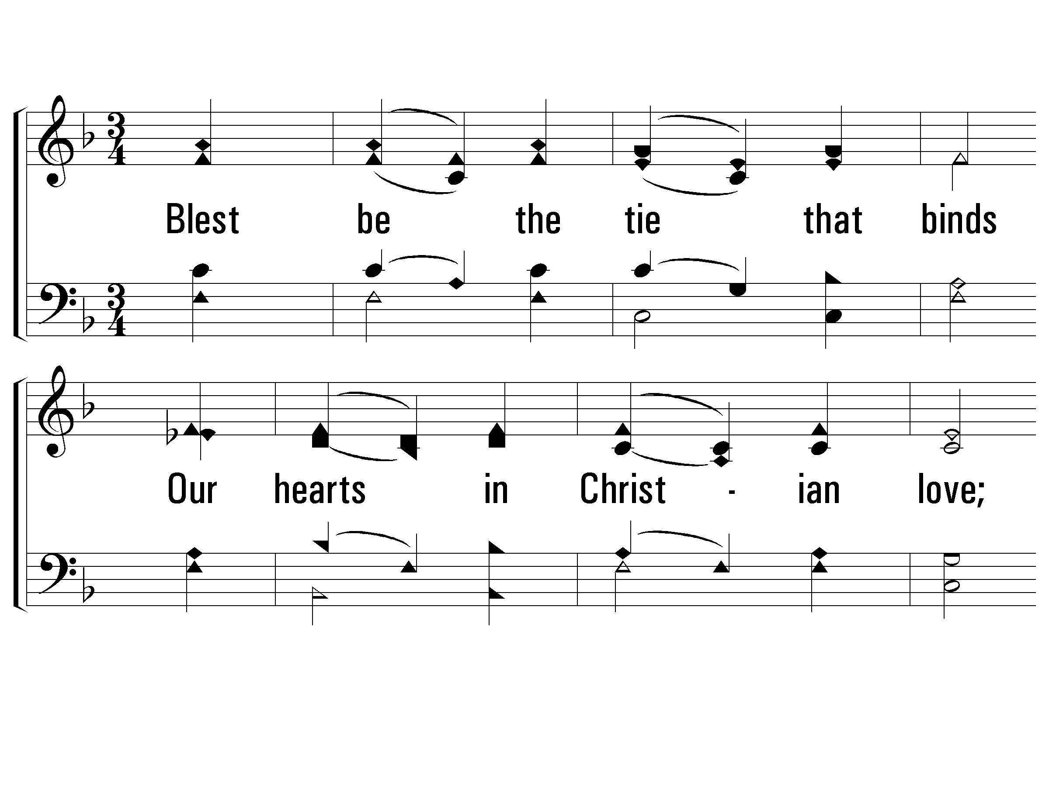
1 – Blest Be the Tie That Binds
1.
Blest be the tie that binds
Our hearts in Christian love;
The fellow-ship of kindred minds
Is like to that above.
Words by: John Fawcett
Music by: Johann George Nägeli / Arr.: Lowell Mason
© 2001 The Paperless Hymnal™

Slide 82
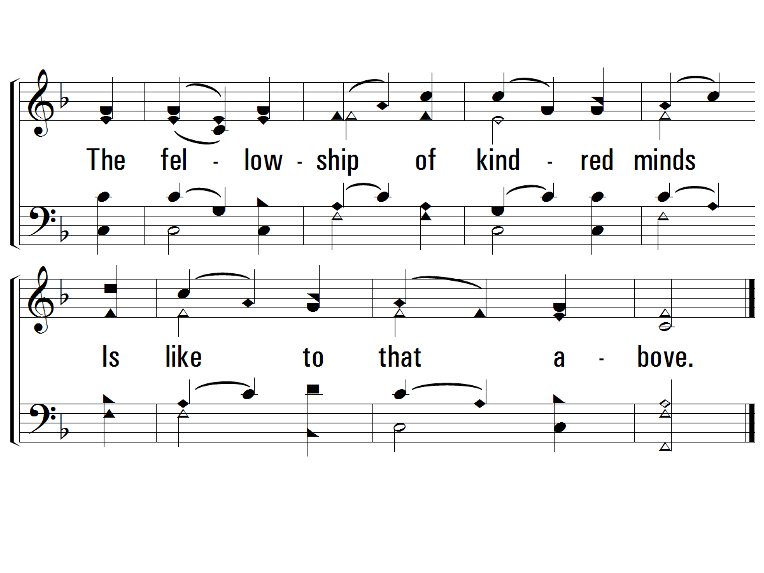
1 – Blest Be the Tie That Binds
© 2001 The Paperless Hymnal™

Slide 83
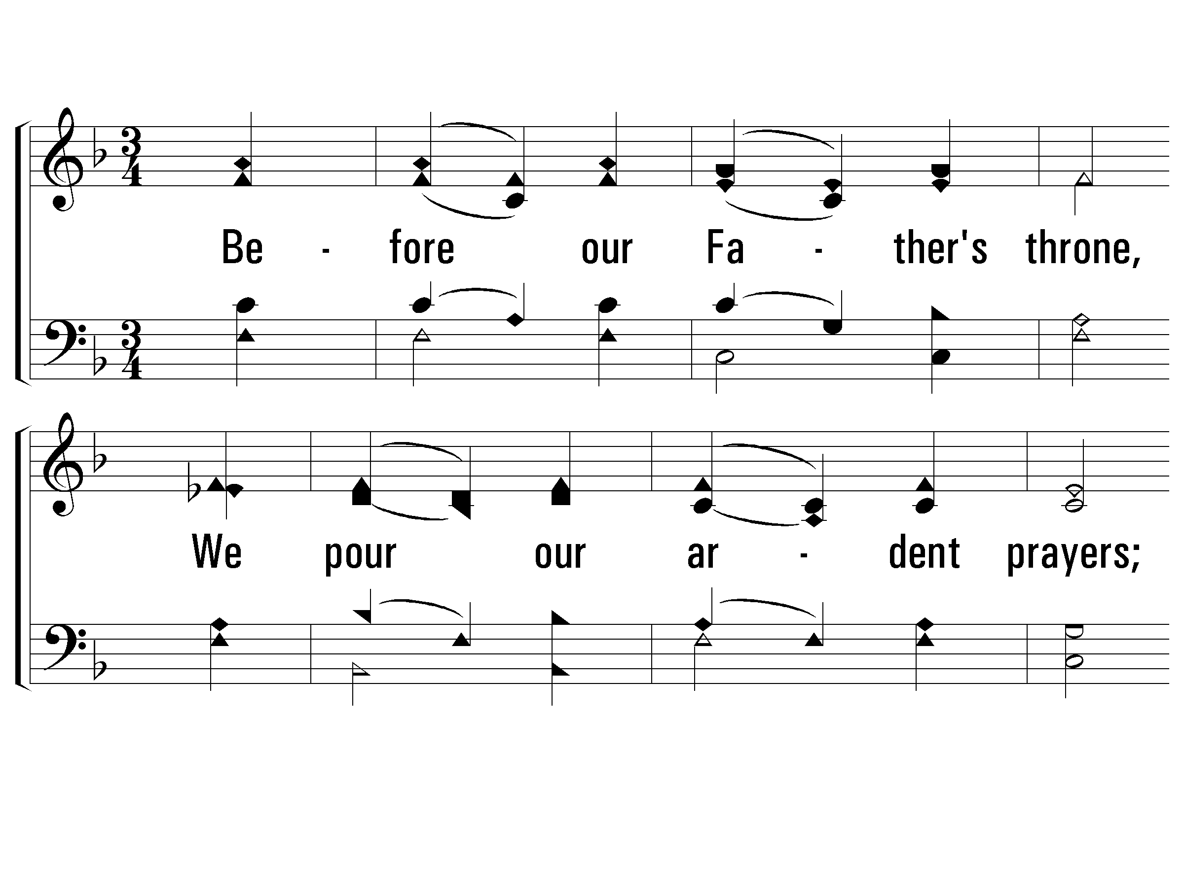
2 – Blest Be the Tie That Binds
2.
Before our Father's throne,
We pour our ardent prayers;
Our fears, our hopes, our aims are one,
Our com-forts and our cares.
Words by: John Fawcett
Music by: Johann George Nägeli / Arr.: Lowell Mason
© 2001 The Paperless Hymnal™

Slide 84
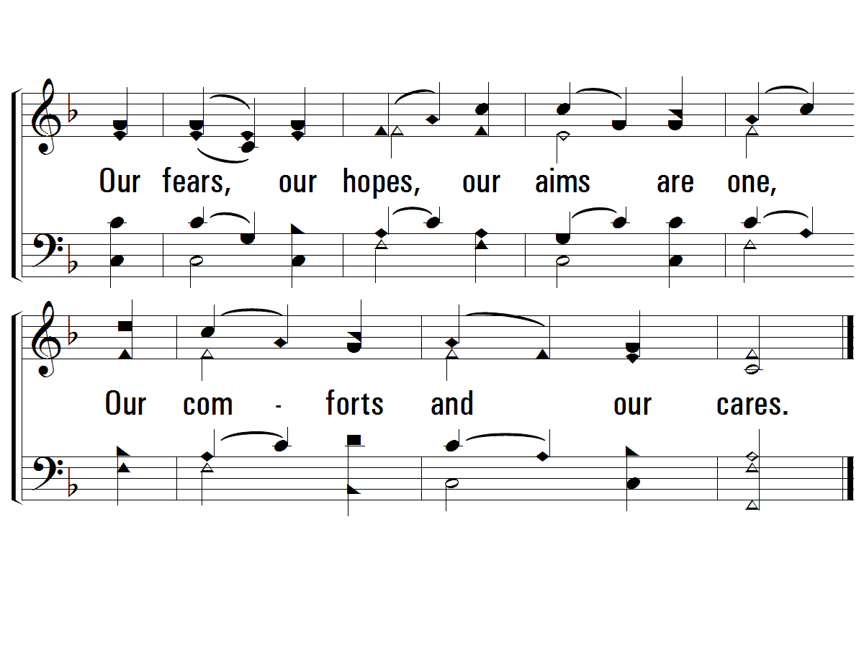
2 – Blest Be the Tie That Binds
© 2001 The Paperless Hymnal™

Slide 85
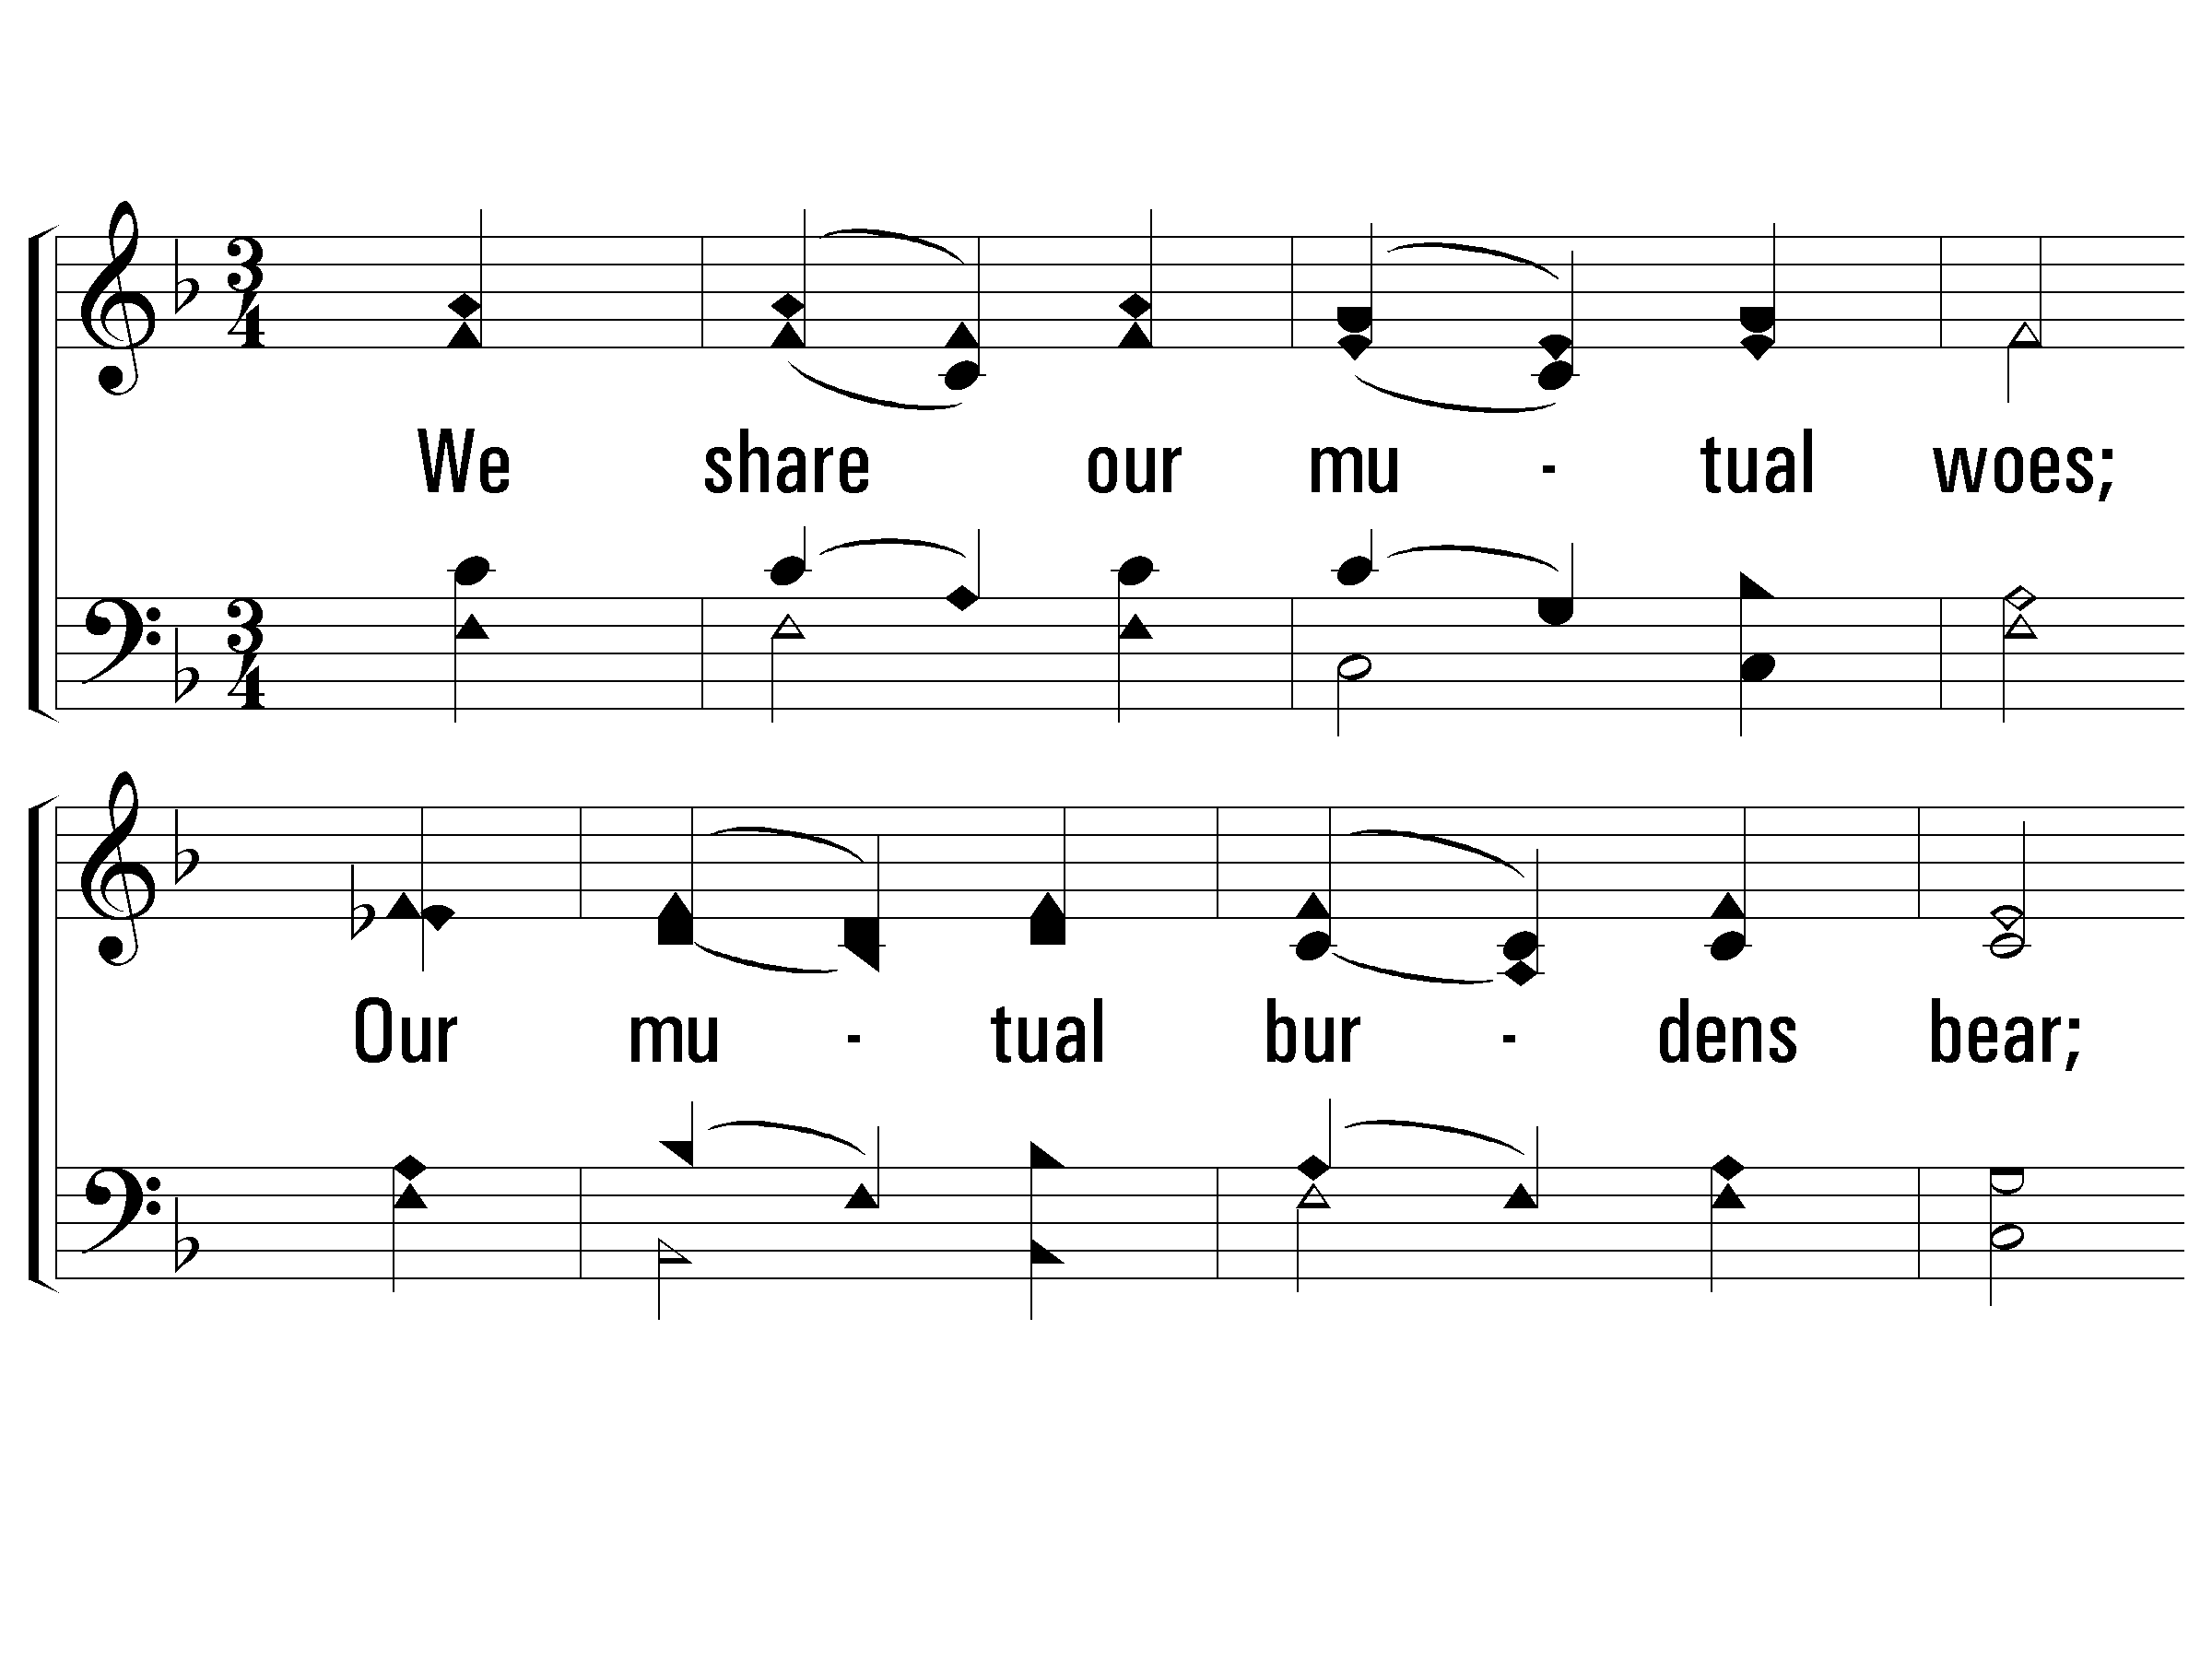
3 – Blest Be the Tie That Binds
3.
We share our mutual woes;
Our mutual burdens bear;
And often for each other flows
The sympathizing tear.
Words by: John Fawcett
Music by: Johann George Nägeli / Arr.: Lowell Mason
© 2001 The Paperless Hymnal™

Slide 86
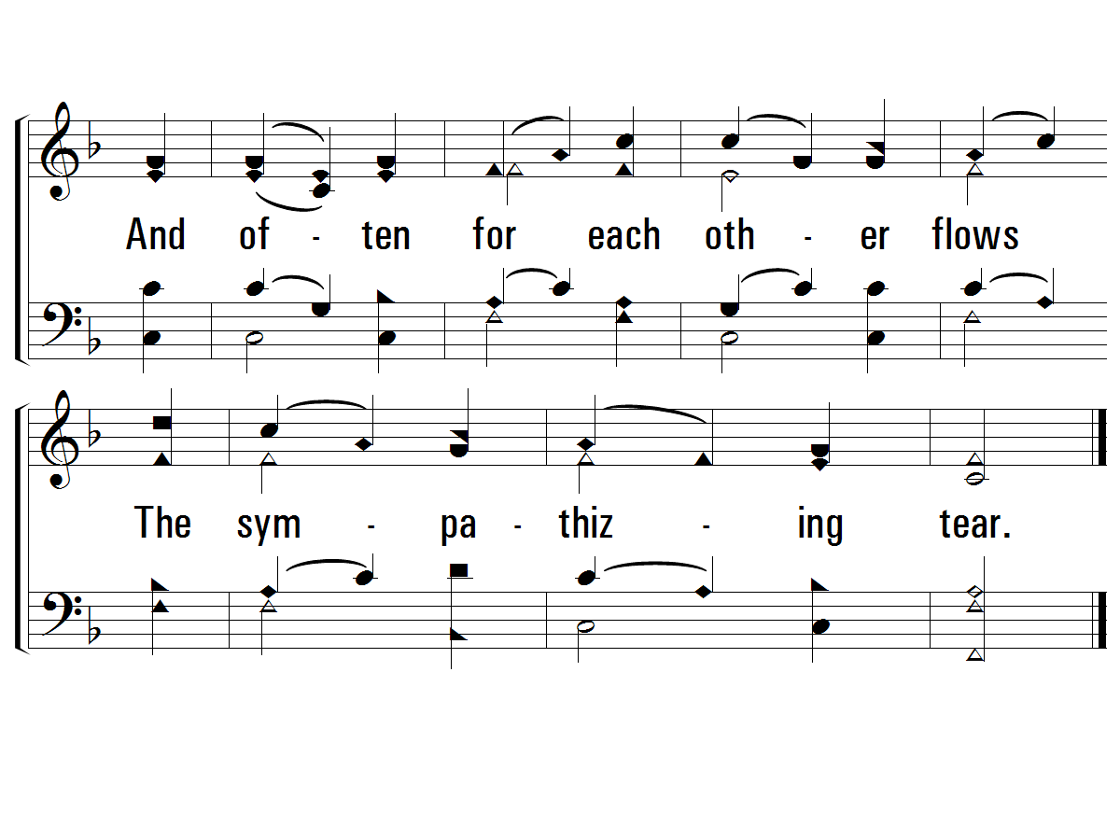
3 – Blest Be the Tie That Binds
© 2001 The Paperless Hymnal™

Slide 87
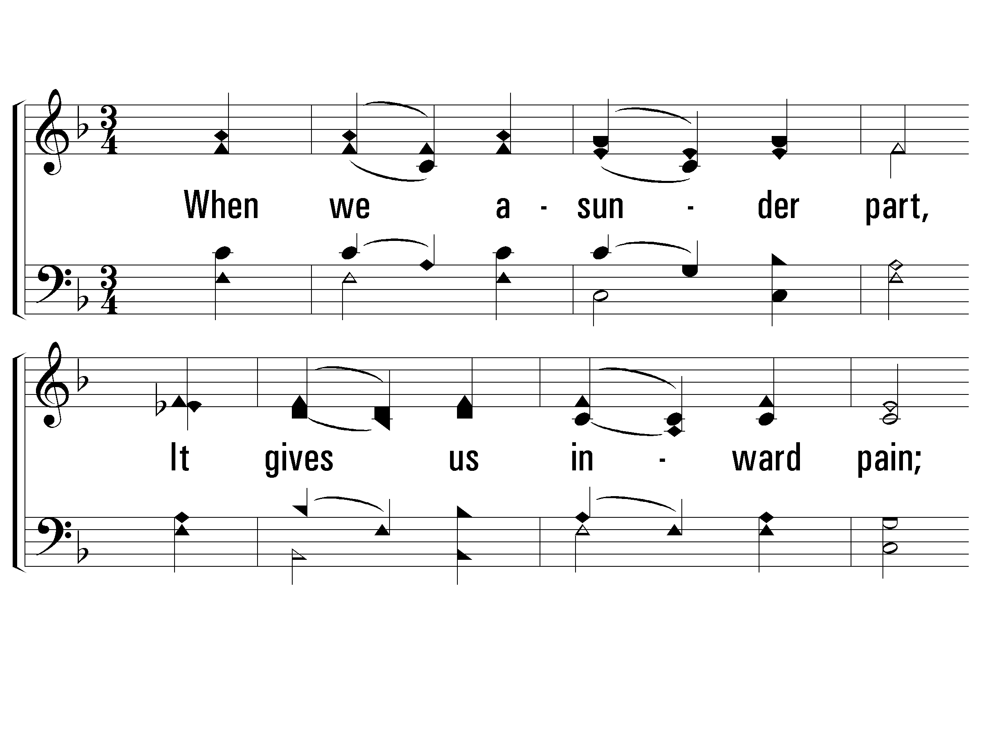
4 – Blest Be the Tie That Binds
4.
When we asunder part,
It gives us inward pain;
But we shall still be joined in heart,
And hope to meet again.
Words by: John Fawcett
Music by: Johann George Nägeli / Arr.: Lowell Mason
© 2001 The Paperless Hymnal™

Slide 88
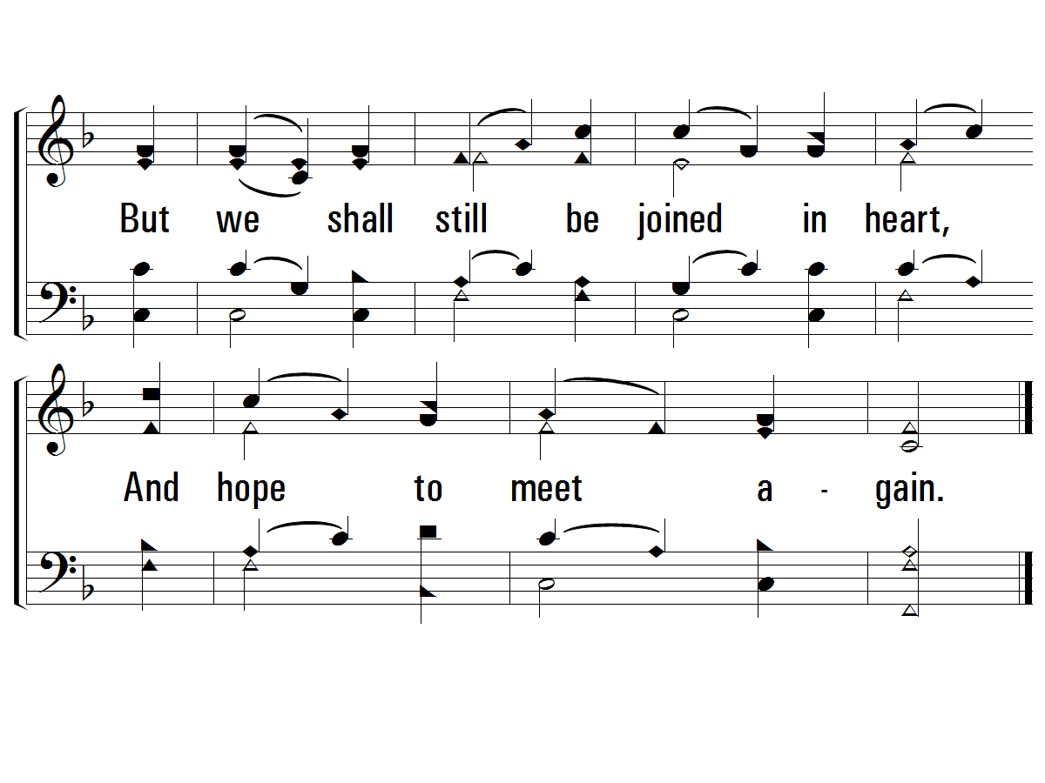
4 – Blest Be the Tie That Binds
© 2001 The Paperless Hymnal™

Slide 89
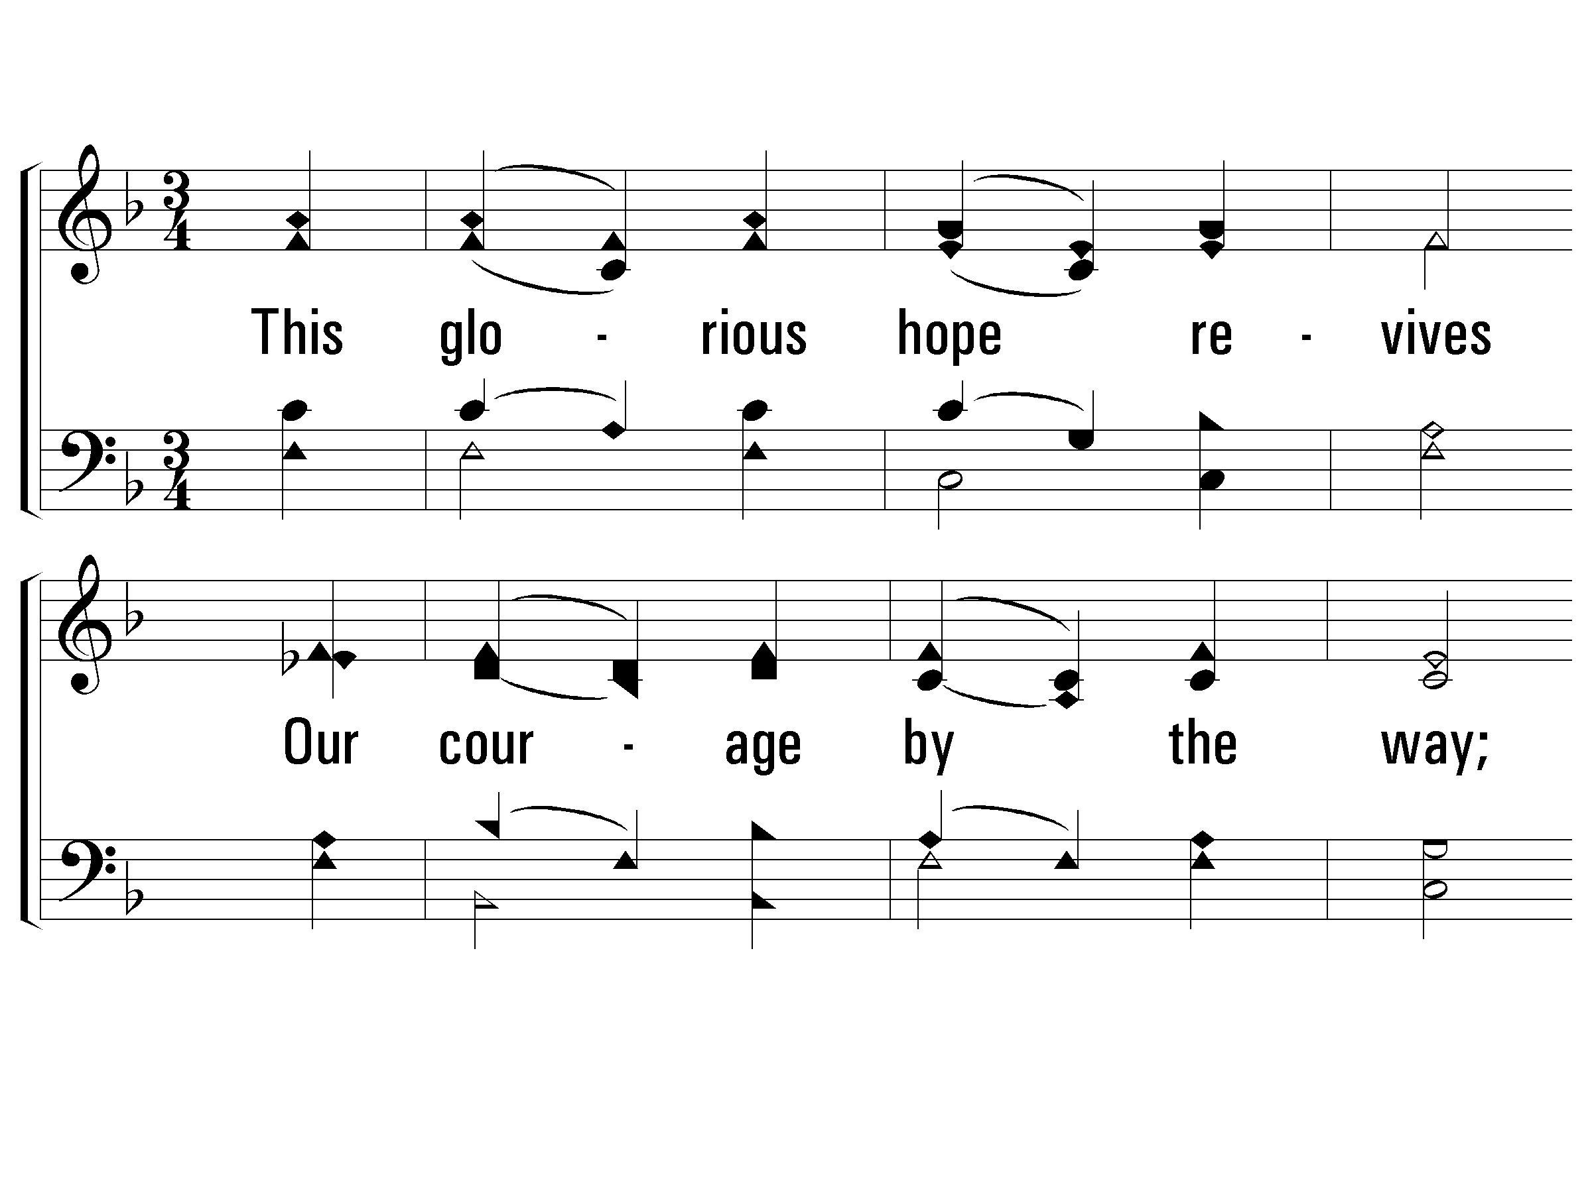
5 – Blest Be the Tie That Binds
5.
This glorious hope revives
Our courage by the way;
While each in expectation lives,
And longs to see the day.
Words by: John Fawcett
Music by: Johann George Nägeli / Arr.: Lowell Mason
© 2001 The Paperless Hymnal™

Slide 90
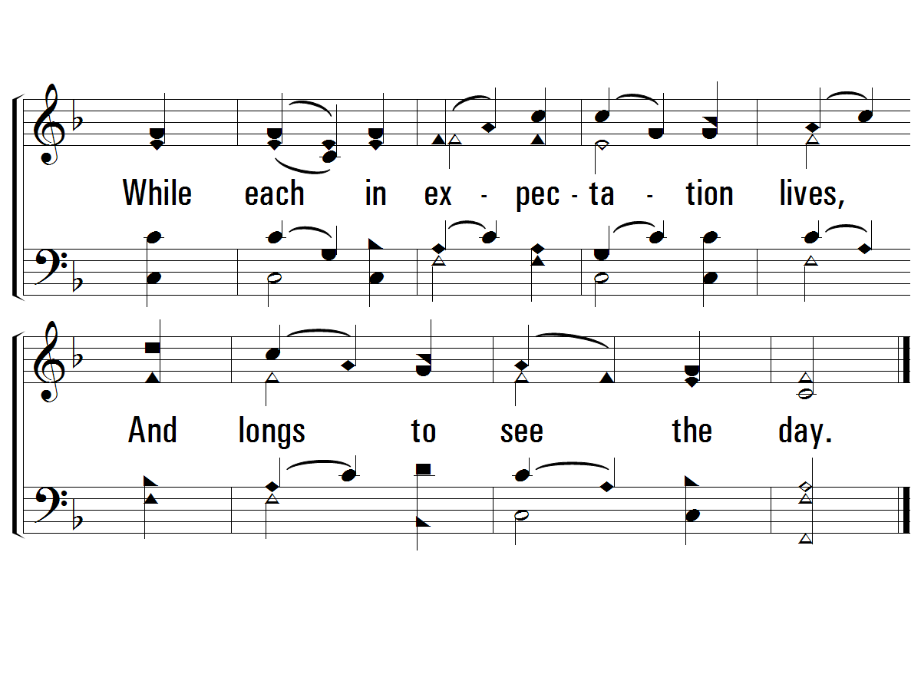
5 – Blest Be the Tie That Binds
© 2001 The Paperless Hymnal™

Slide 91
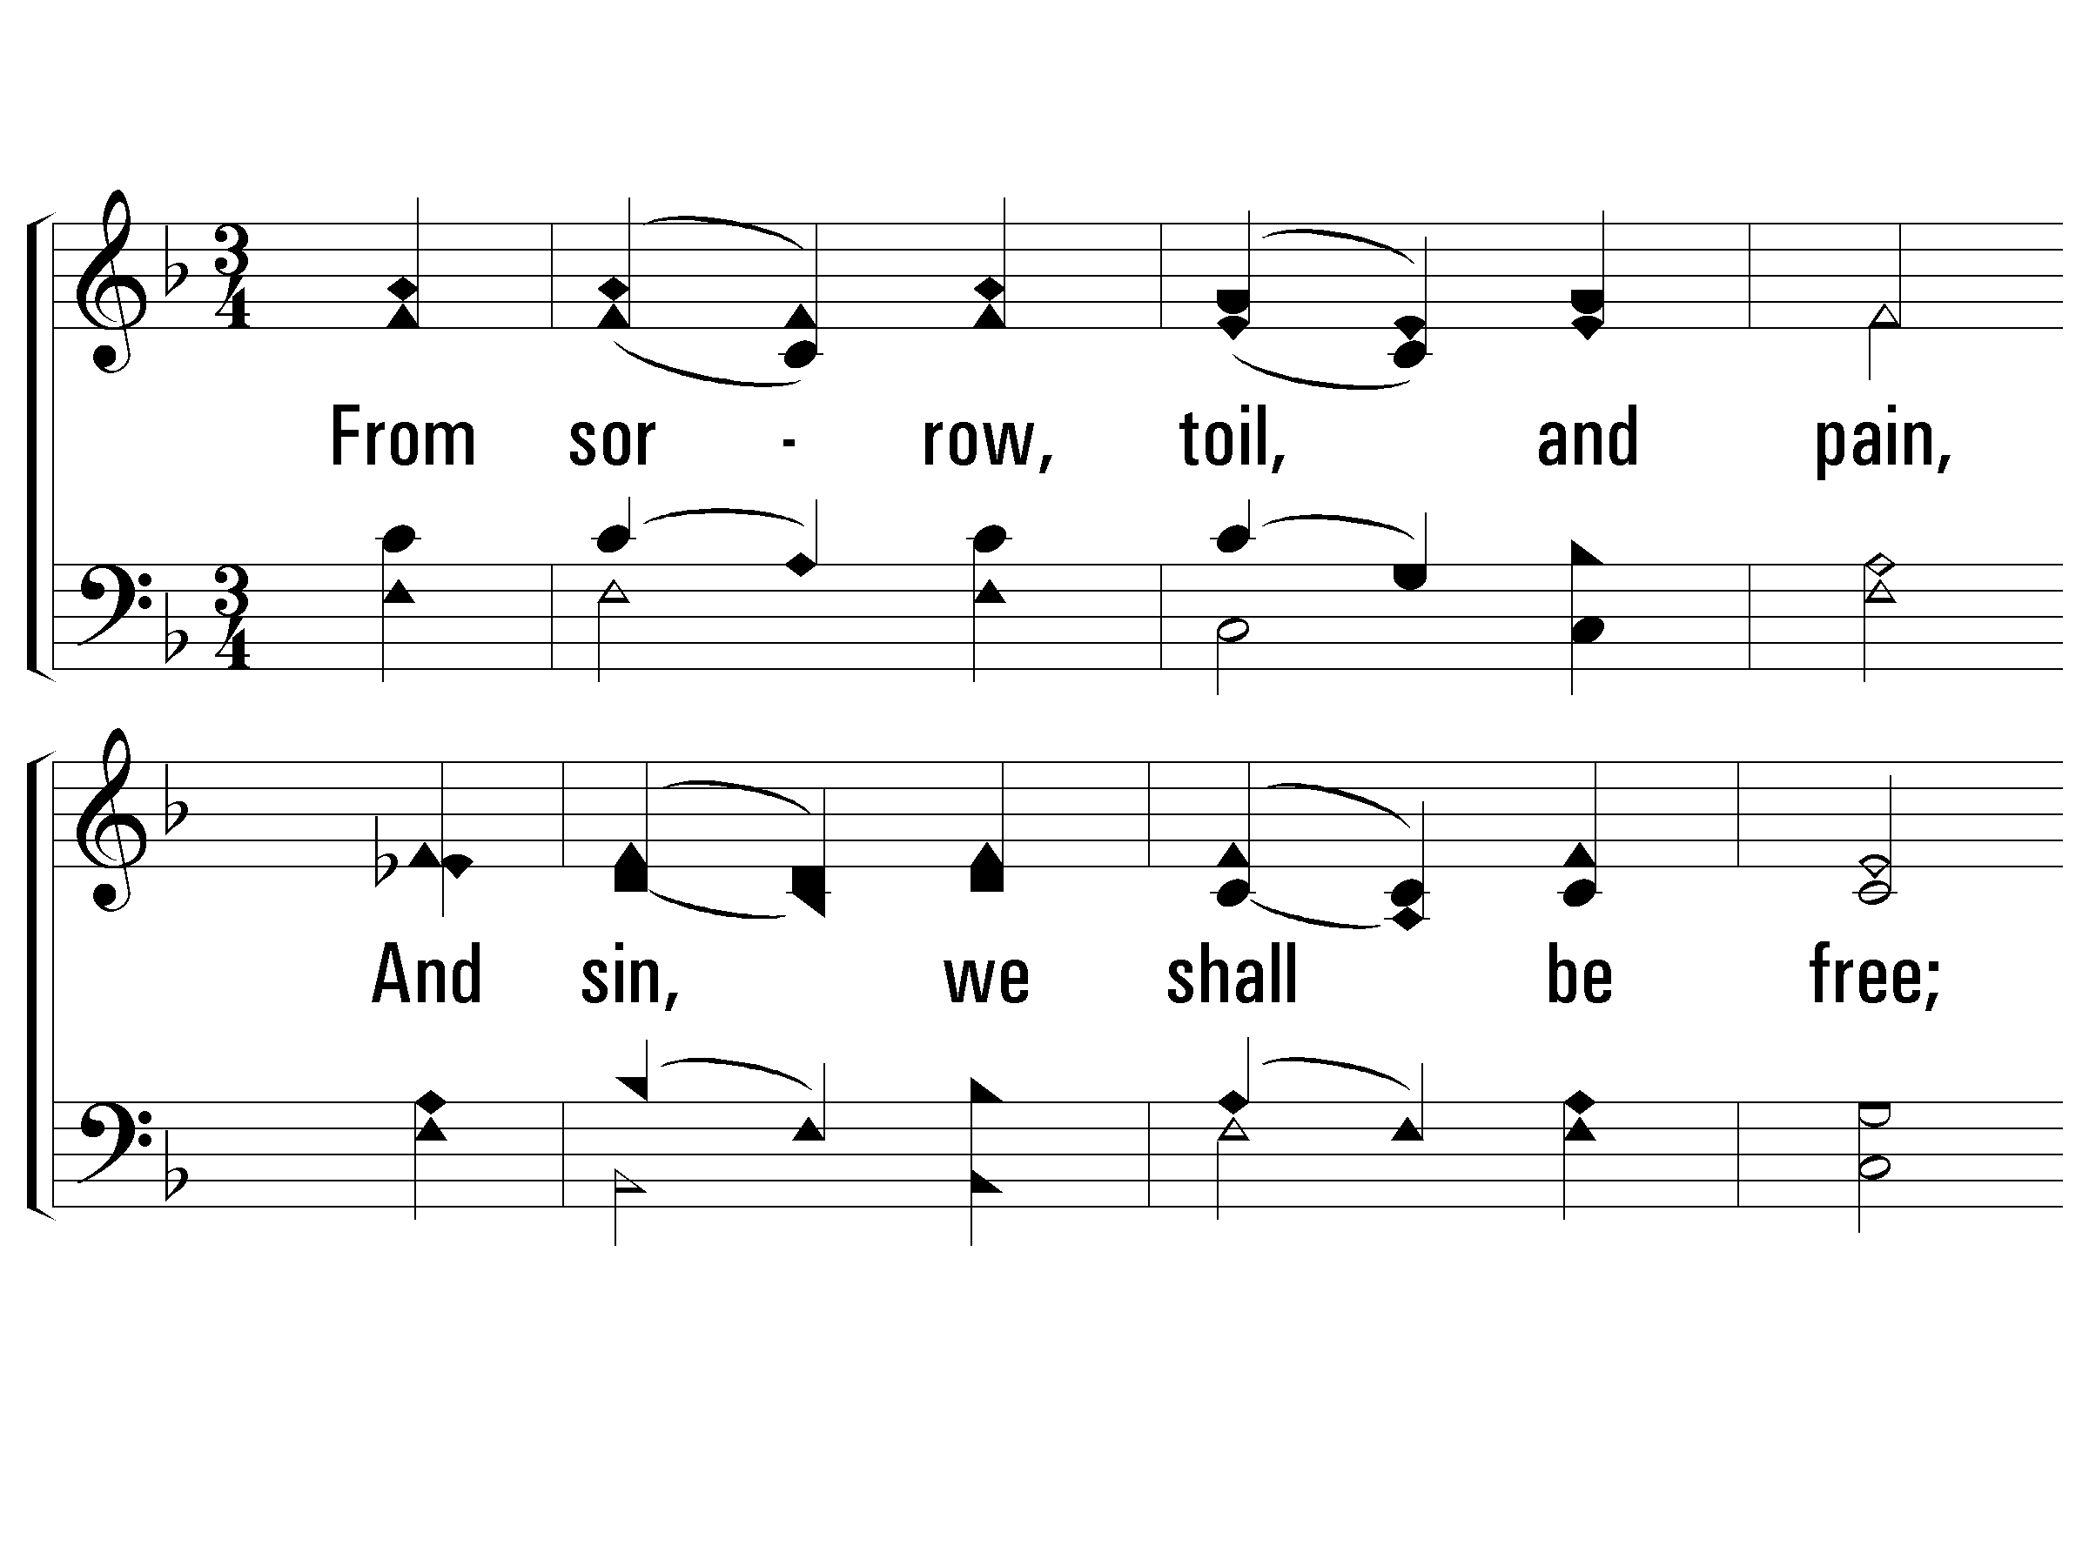
6 – Blest Be the Tie That Binds
6.
From sorrow, toil, and pain,
And sin, we shall be free;
And perfect love and friendship reign
Thro' all eternity.
Words by: John Fawcett
Music by: Johann George Nägeli / Arr.: Lowell Mason
© 2001 The Paperless Hymnal™

Slide 92
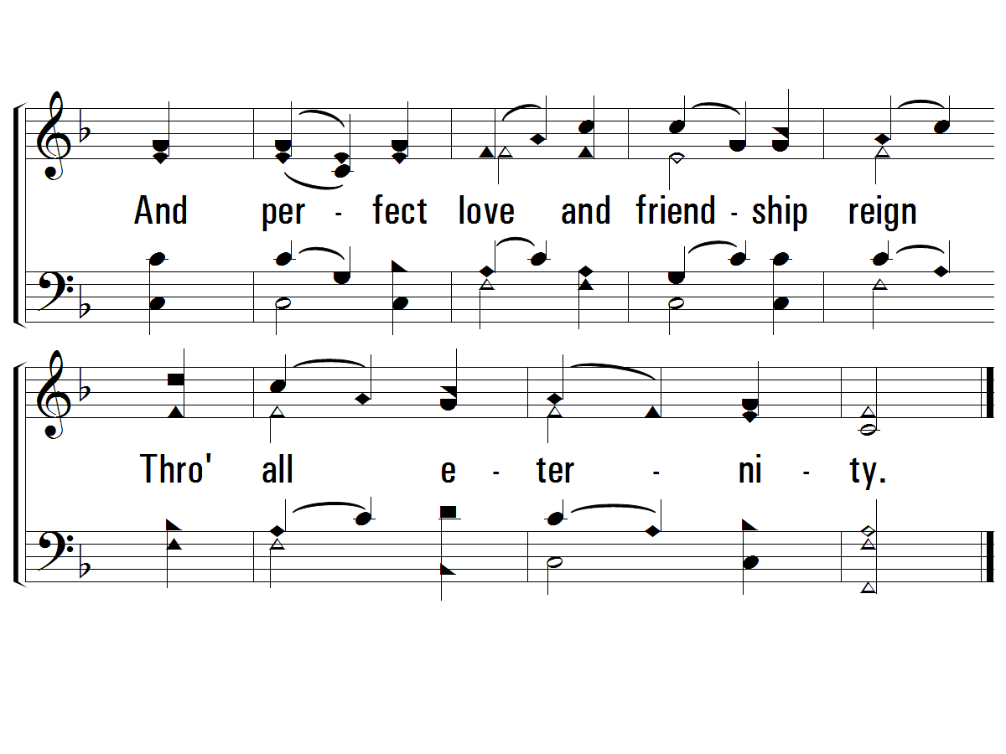
6 – Blest Be the Tie That Binds
© 2001 The Paperless Hymnal™

Slide 93
Communion

Slide 94
My Hope Is Built
438

Slide 95
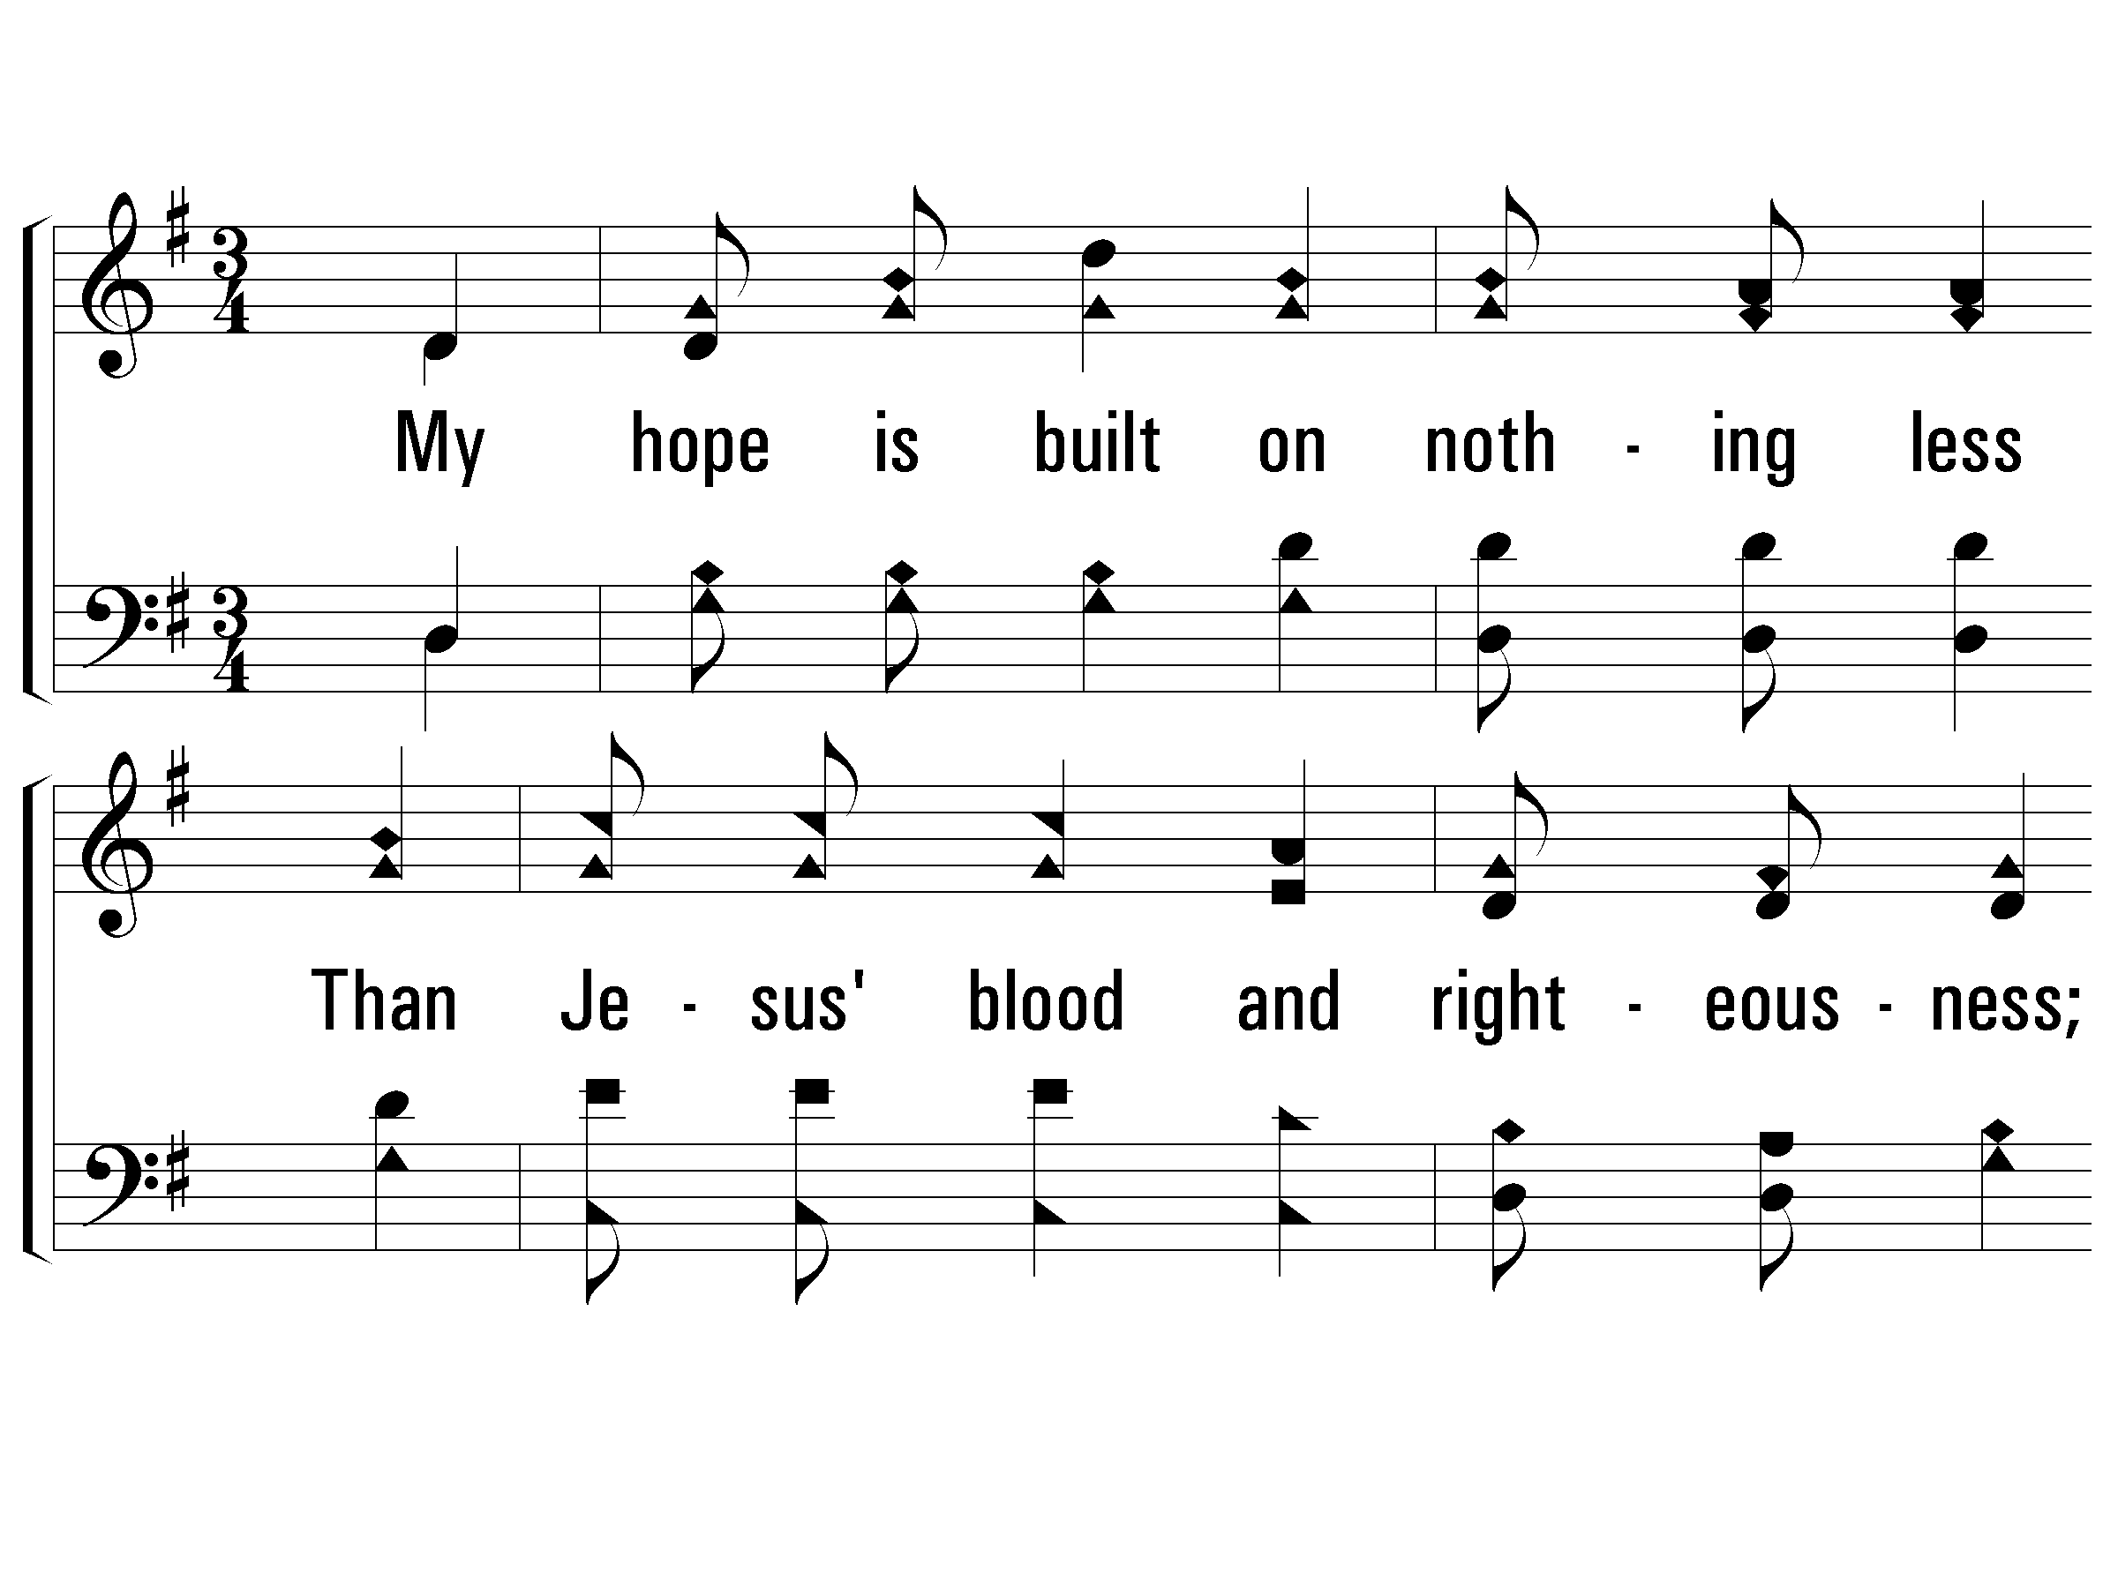
1 - My Hope is Built on Nothing Less
1.
My hope is built on nothing less
Than Jesus' blood and righteousness;
I dare not trust the sweetest frame,
But wholly lean on Jesus' name.
Words by: Edward Mote
Music by: William B. Bradbury
© 2001 The Paperless Hymnal™

Slide 96
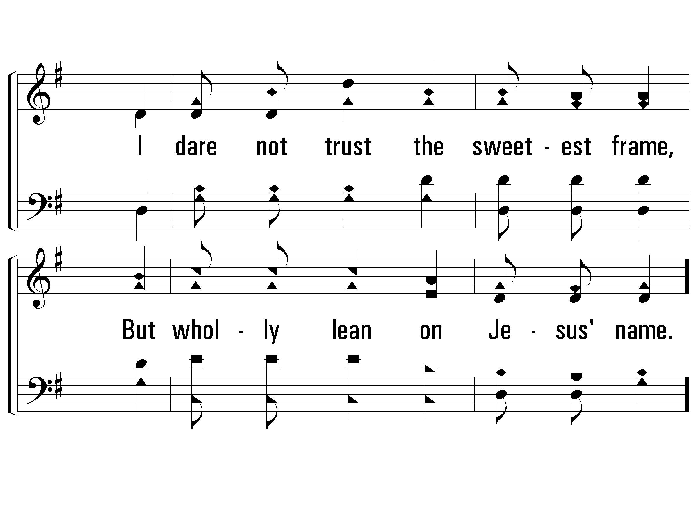
1 - My Hope is Built on Nothing Less
© 2001 The Paperless Hymnal™

Slide 97
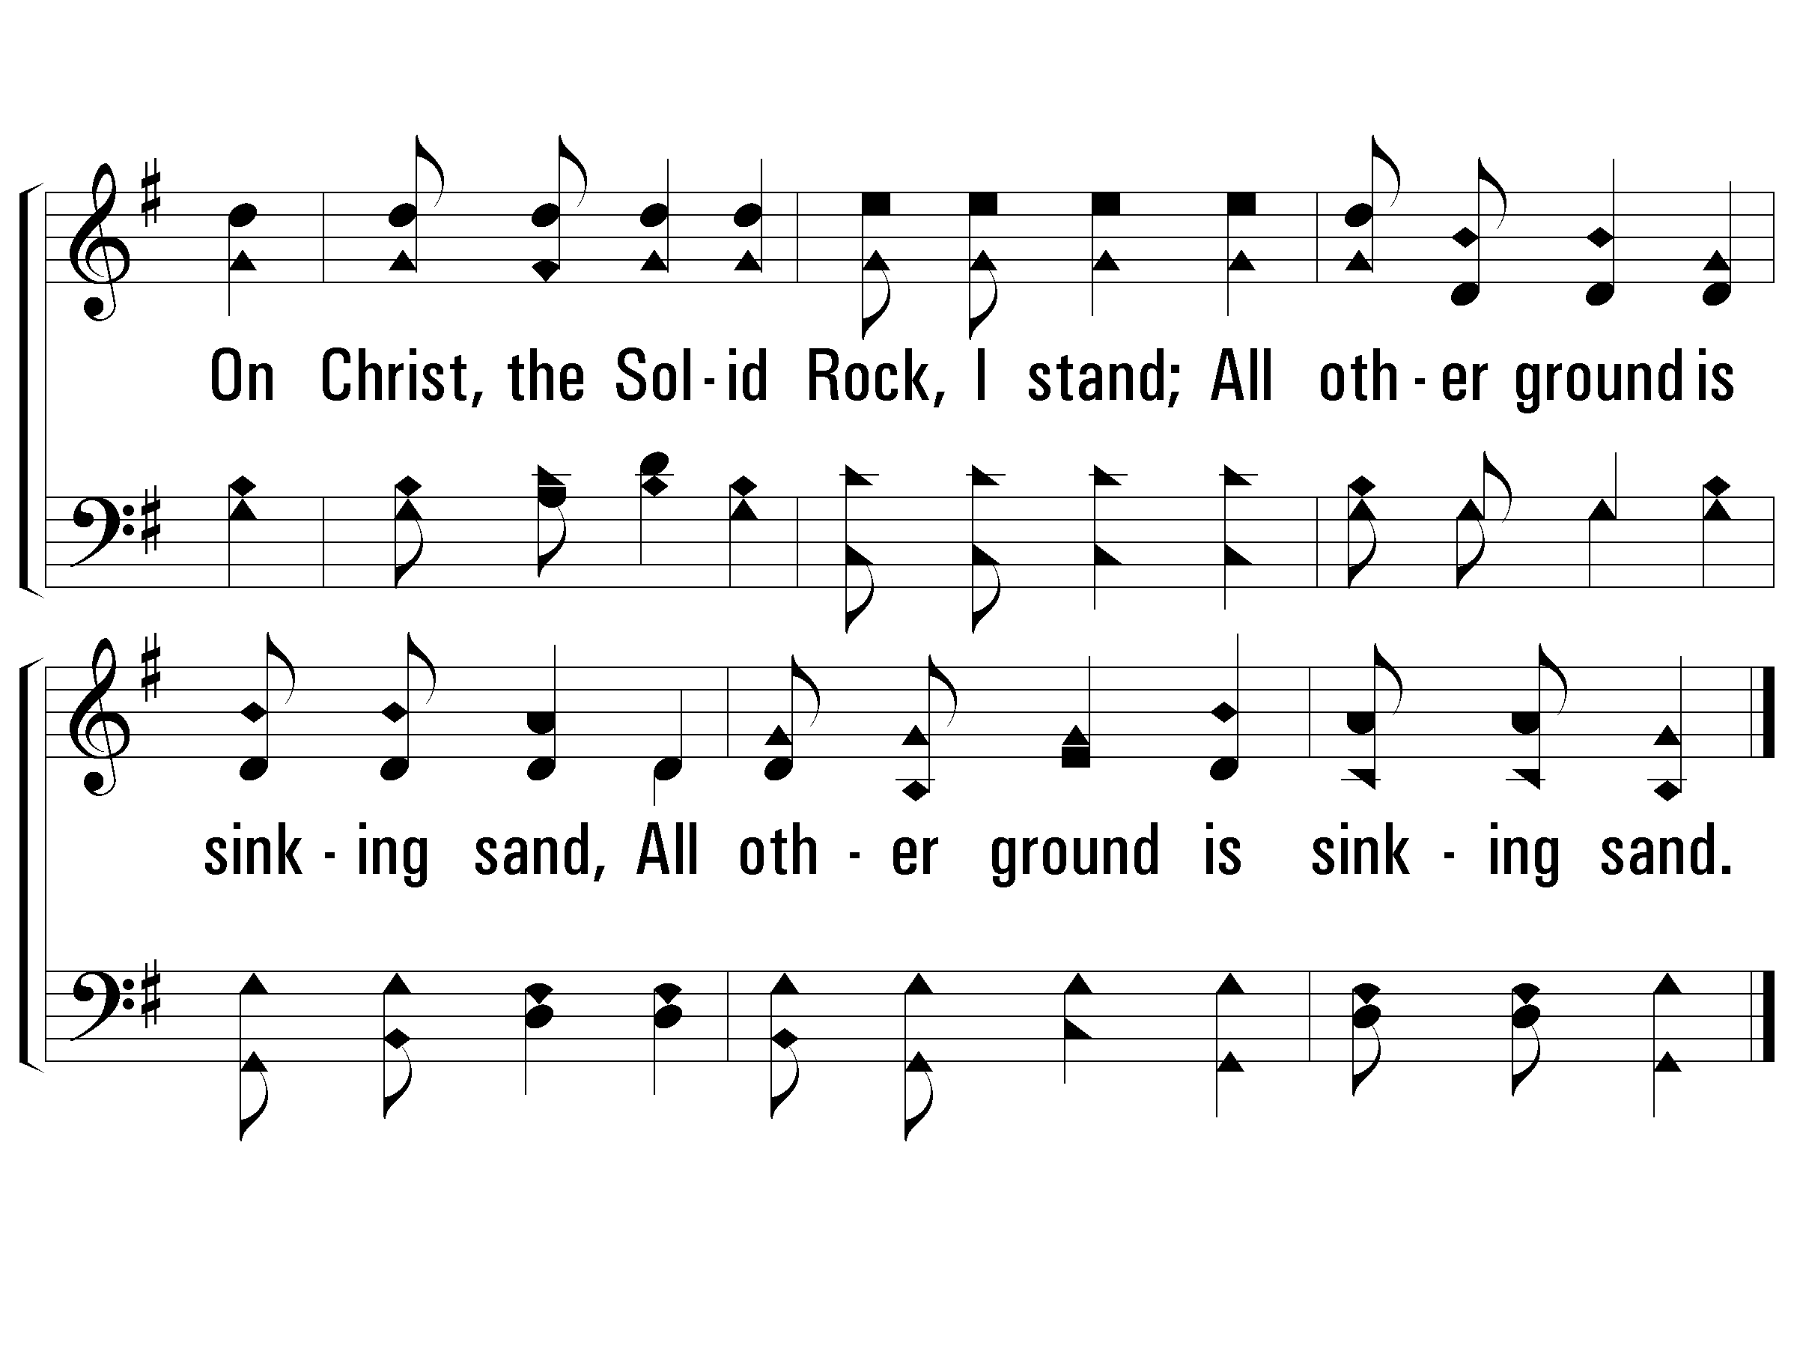
c - My Hope is Built on Nothing Less
On Christ, the Solid Rock, I stand;
All other ground is sinking sand,
All other ground is sinking sand.
© 2001 The Paperless Hymnal™

Slide 98
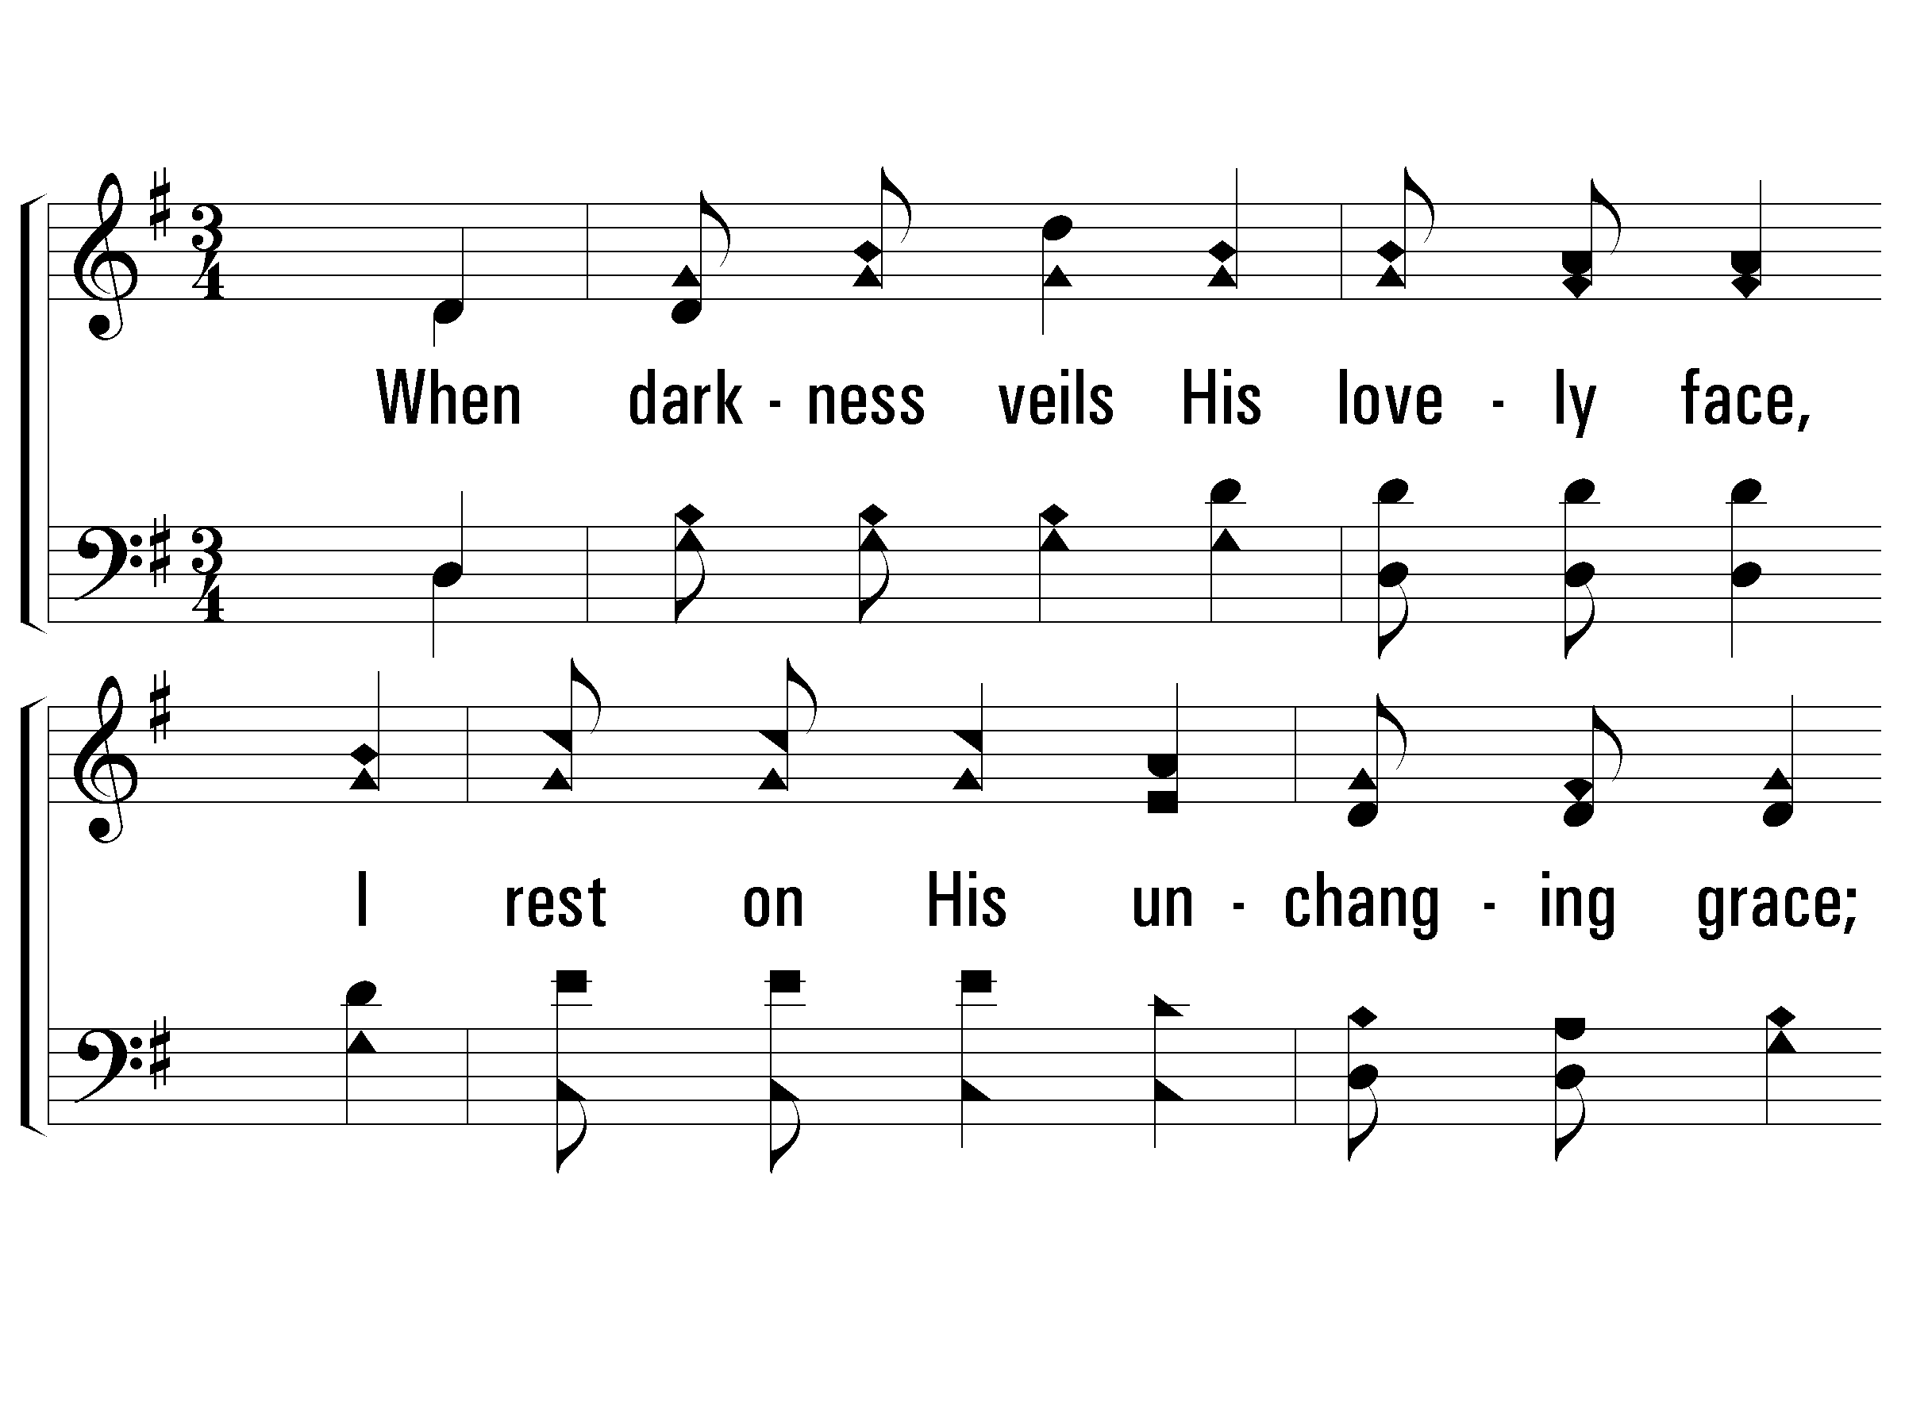
2 - My Hope is Built on Nothing Less
2.
When darkness veils His lovely face,
I rest on His unchanging grace;
In every high and stormy gale,
My anchor holds within the veil.
Words by: Edward Mote
Music by: William B. Bradbury
© 2001 The Paperless Hymnal™

Slide 99
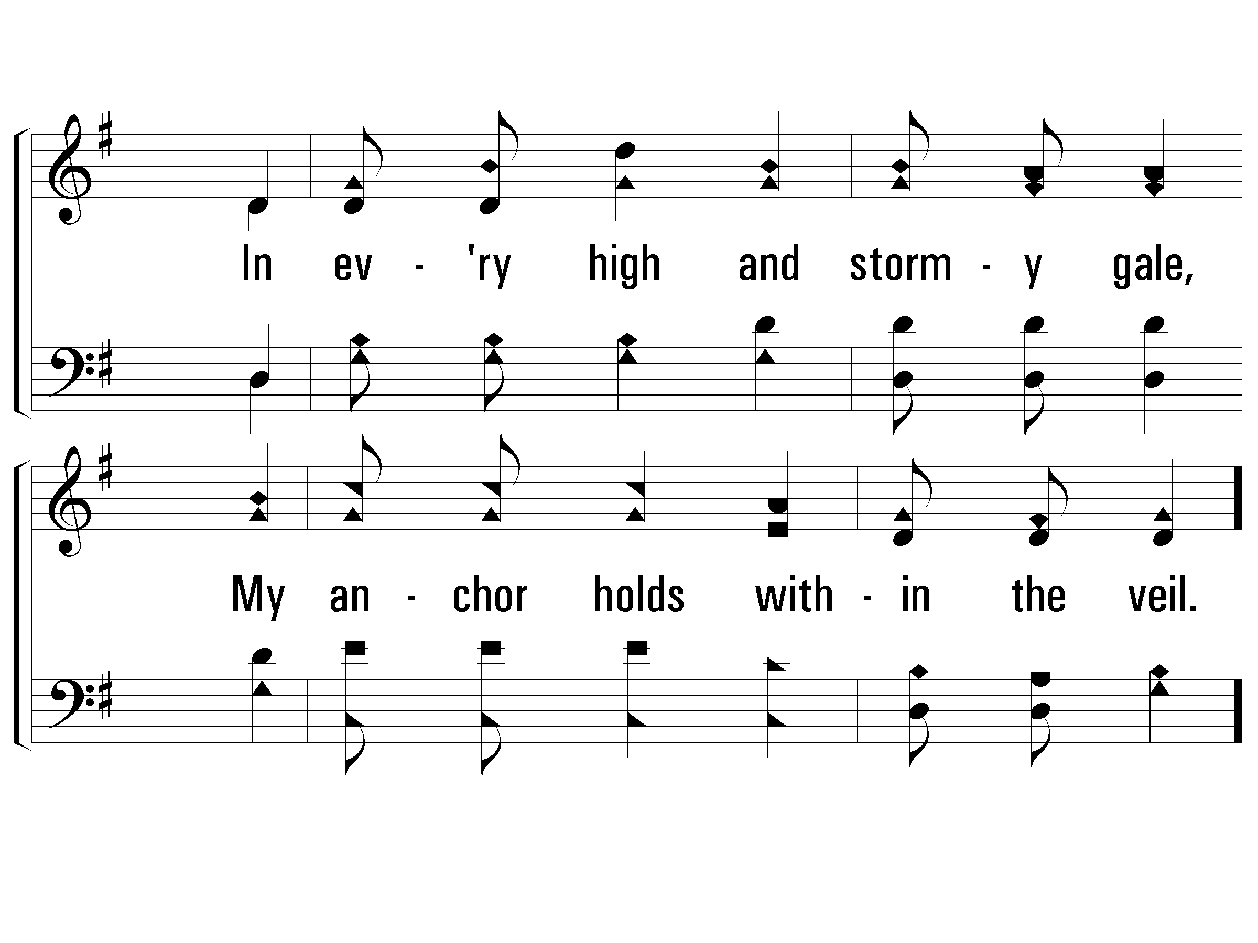
2 - My Hope is Built on Nothing Less
© 2001 The Paperless Hymnal™

Slide 100
c - My Hope is Built on Nothing Less
On Christ, the Solid Rock, I stand;
All other ground is sinking sand,
All other ground is sinking sand.
© 2001 The Paperless Hymnal™

Slide 101
Verse 3 (My Hope Is Built on Nothing Less)
His oath, His covenant, His blood,
Support me in the whelming flood.
When all around my soul gives way,
He then is all my hope and stay.

Slide 102
c - My Hope is Built on Nothing Less
On Christ, the Solid Rock, I stand;
All other ground is sinking sand,
All other ground is sinking sand.
© 2001 The Paperless Hymnal™

Slide 103
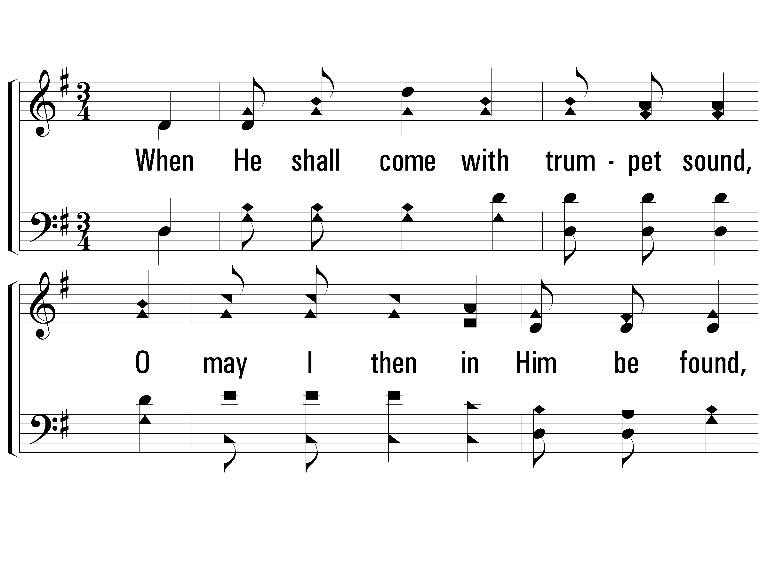
4 - My Hope is Built on Nothing Less
4.
When He shall come with trumpet sound,
O may I then in Him be found,
Dressed in His righteousness alone,
Faultless to stand before the throne.
Words by: Edward Mote
Music by: William B. Bradbury
© 2001 The Paperless Hymnal™

Slide 104
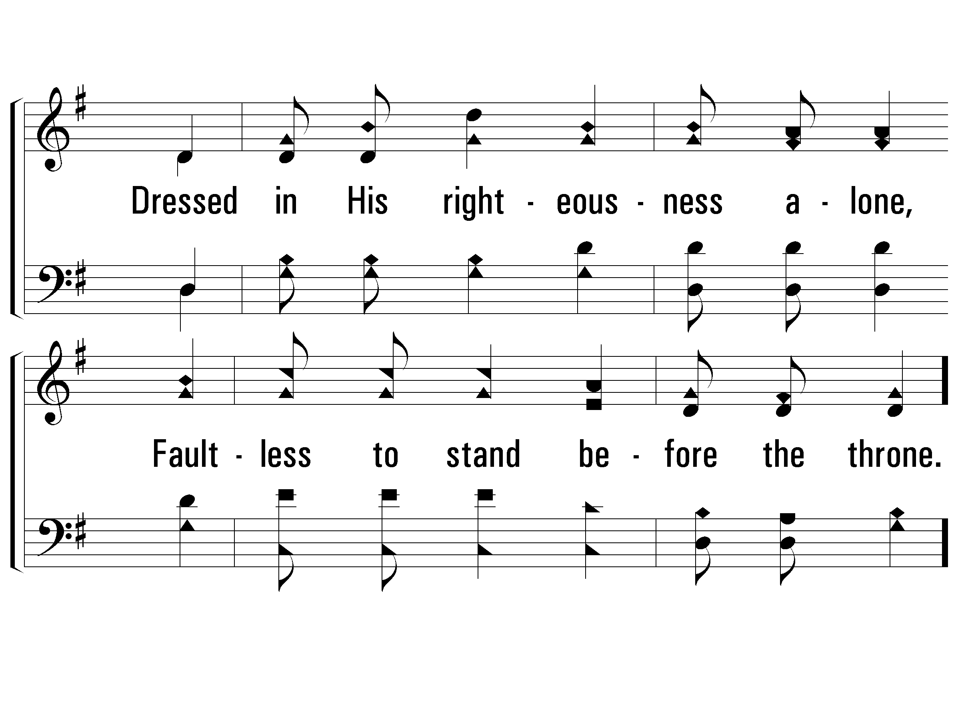
4 - My Hope is Built on Nothing Less
© 2001 The Paperless Hymnal™

Slide 105
c - My Hope is Built on Nothing Less
On Christ, the Solid Rock, I stand;
All other ground is sinking sand,
All other ground is sinking sand.
© 2001 The Paperless Hymnal™

Slide 106
Sing To Me of Heaven
583

Slide 107
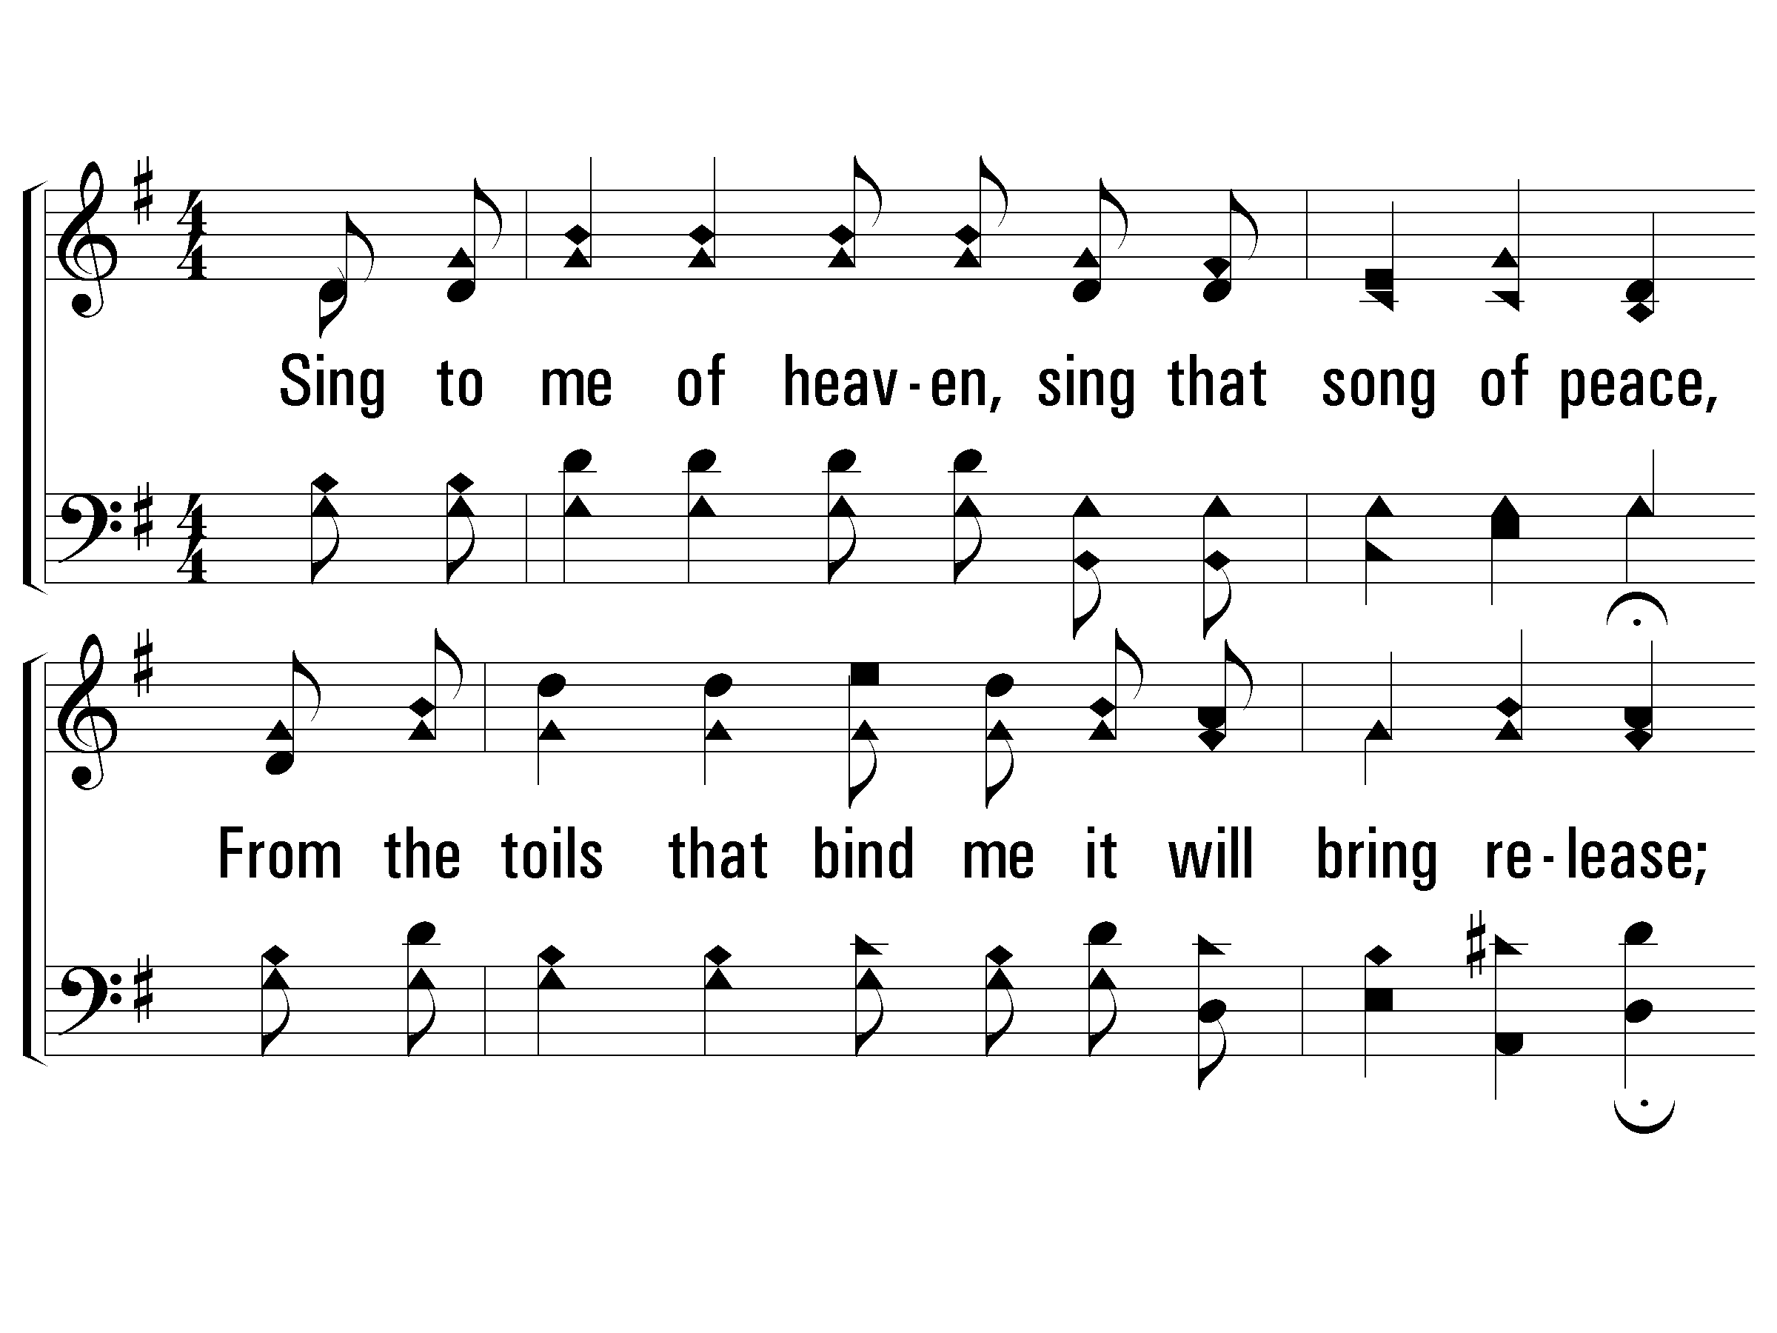
1 - Sing to Me of Heaven
1.
Sing to me of heaven, sing that song of peace,
From the toils that bind me it will bring release;
Burdens will be lifted that are pressing so,
Showers of great blessing o'er my heart will flow.
Words by: Ada Powell
Music by: B. B. Beall
© 2001 The Paperless Hymnal™

Slide 108
1 - Sing to Me of Heaven
© 2001 The Paperless Hymnal™

Slide 109
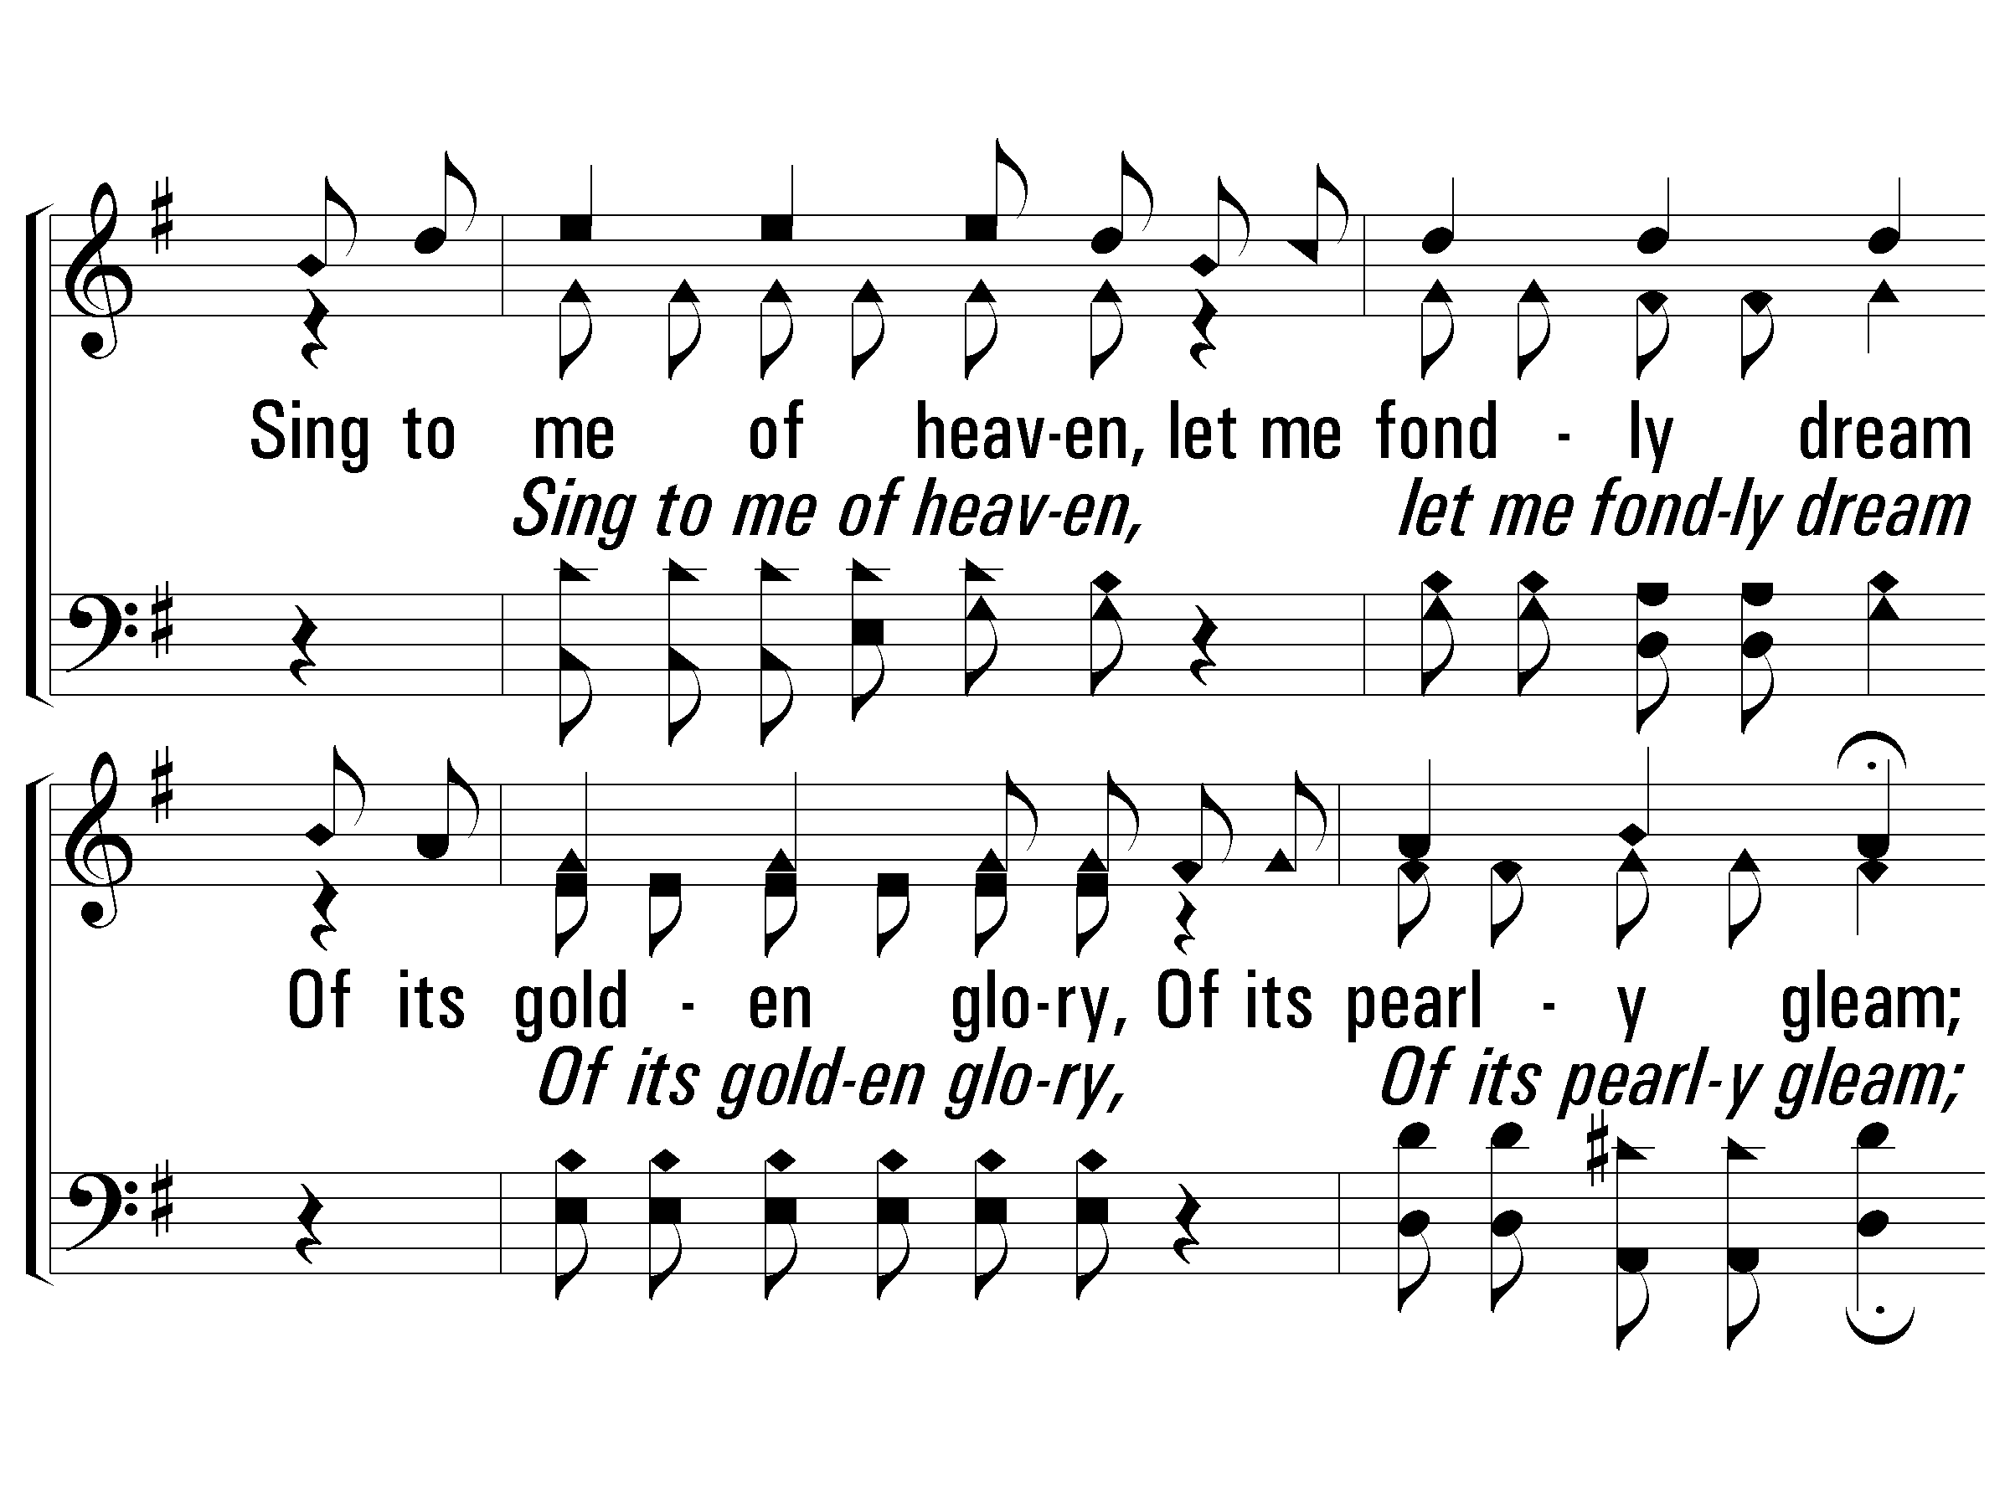
c - Sing to Me of Heaven
Sing to me of heaven, let me fondly dream
Of its golden glory, Of its pearly gleam;
Sing to me when shadows of the evening fall,
Sing to me of heaven, Sweetest song of all.
© 2001 The Paperless Hymnal™

Slide 110
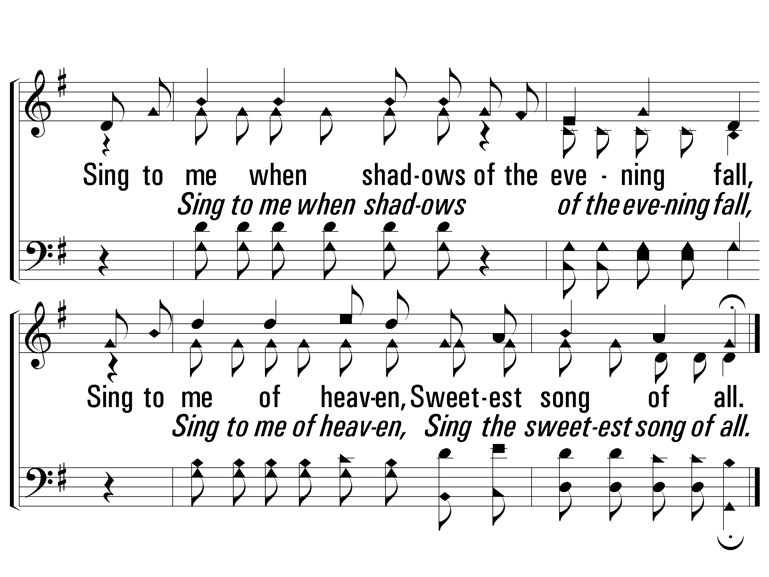
c - Sing to Me of Heaven
© 2001 The Paperless Hymnal™

Slide 111
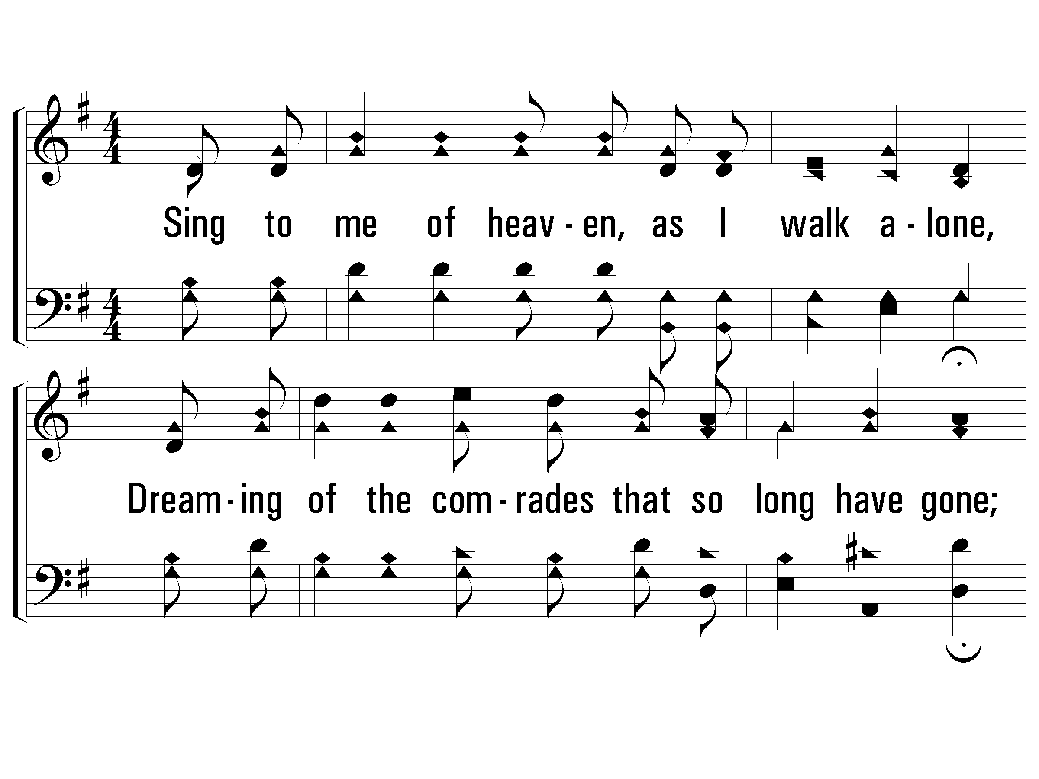
2 - Sing to Me of Heaven
2.
Sing to me of heaven, as I walk alone,
Dreaming of the comrades that so long have gone;
In a fairer region among the angel throng,
They are happy as they sing that old, sweet song.
Words by: Ada Powell
Music by: B. B. Beall
© 2001 The Paperless Hymnal™

Slide 112
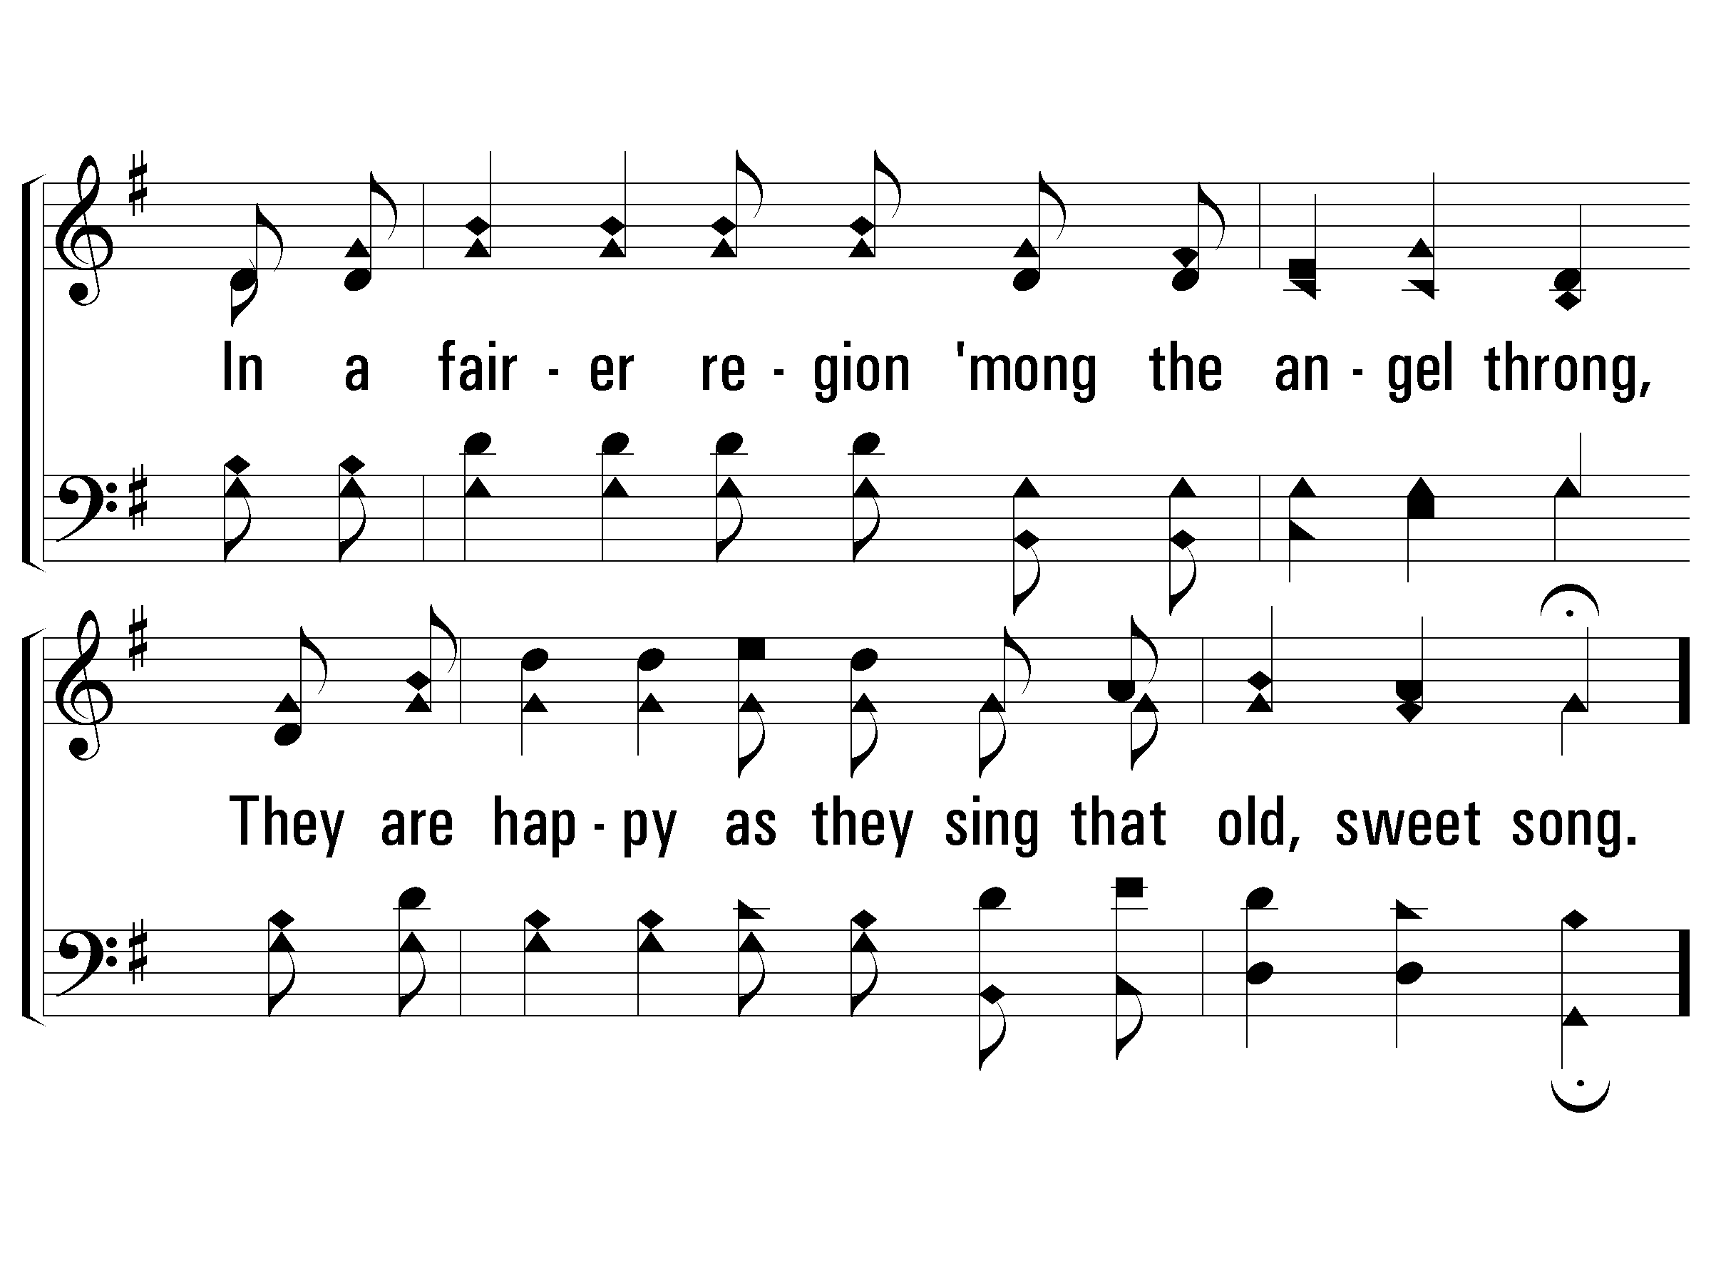
2 - Sing to Me of Heaven
© 2001 The Paperless Hymnal™

Slide 113
c - Sing to Me of Heaven
Sing to me of heaven, let me fondly dream
Of its golden glory, Of its pearly gleam;
Sing to me when shadows of the evening fall,
Sing to me of heaven, Sweetest song of all.
© 2001 The Paperless Hymnal™

Slide 114
c - Sing to Me of Heaven
© 2001 The Paperless Hymnal™

Slide 115
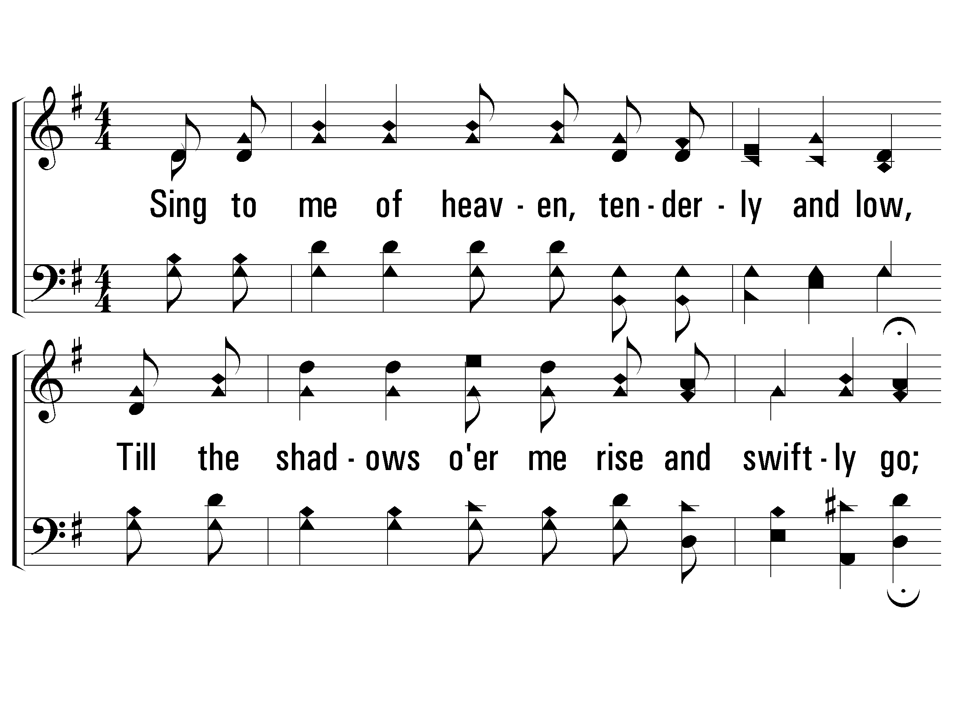
3 - Sing to Me of Heaven
3.
Sing to me of heaven, tenderly and low,
Till the shadows o'er me rise and swiftly go;
When my heart is weary, when the day is long,
Sing to me of heaven, sing that old, sweet song.
Words by: Ada Powell
Music by: B. B. Beall
© 2001 The Paperless Hymnal™

Slide 116
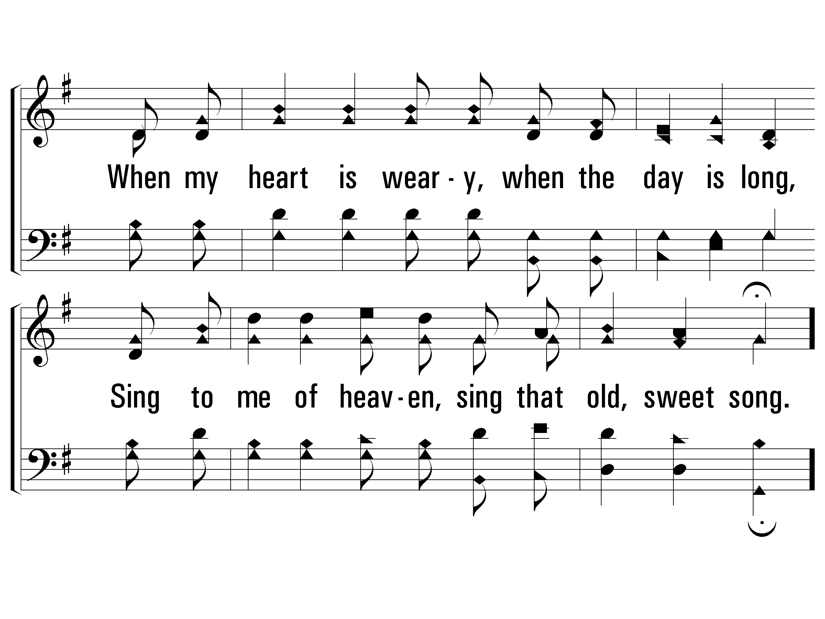
3 - Sing to Me of Heaven
© 2001 The Paperless Hymnal™

Slide 117
c - Sing to Me of Heaven
Sing to me of heaven, let me fondly dream
Of its golden glory, Of its pearly gleam;
Sing to me when shadows of the evening fall,
Sing to me of heaven, Sweetest song of all.
© 2001 The Paperless Hymnal™

Slide 118
c - Sing to Me of Heaven
© 2001 The Paperless Hymnal™

Slide 119
0-5th Classes

Slide 120
Acts 23:1-11

Slide 121
H o t C h o c o l a t e &
D e s s e r t s F o l l o w i n g
December 7th at 6pm
101 Harsh Lane
Castalian Springs
“ O C o m e A l l
Y e F a i t h f u l ”

Slide 122
December 14th
10am - Noon

Slide 124
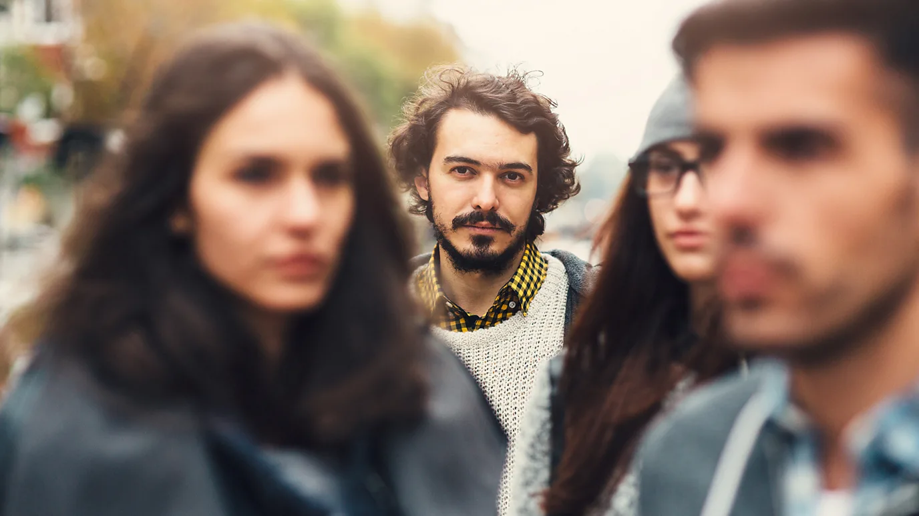

Slide 125
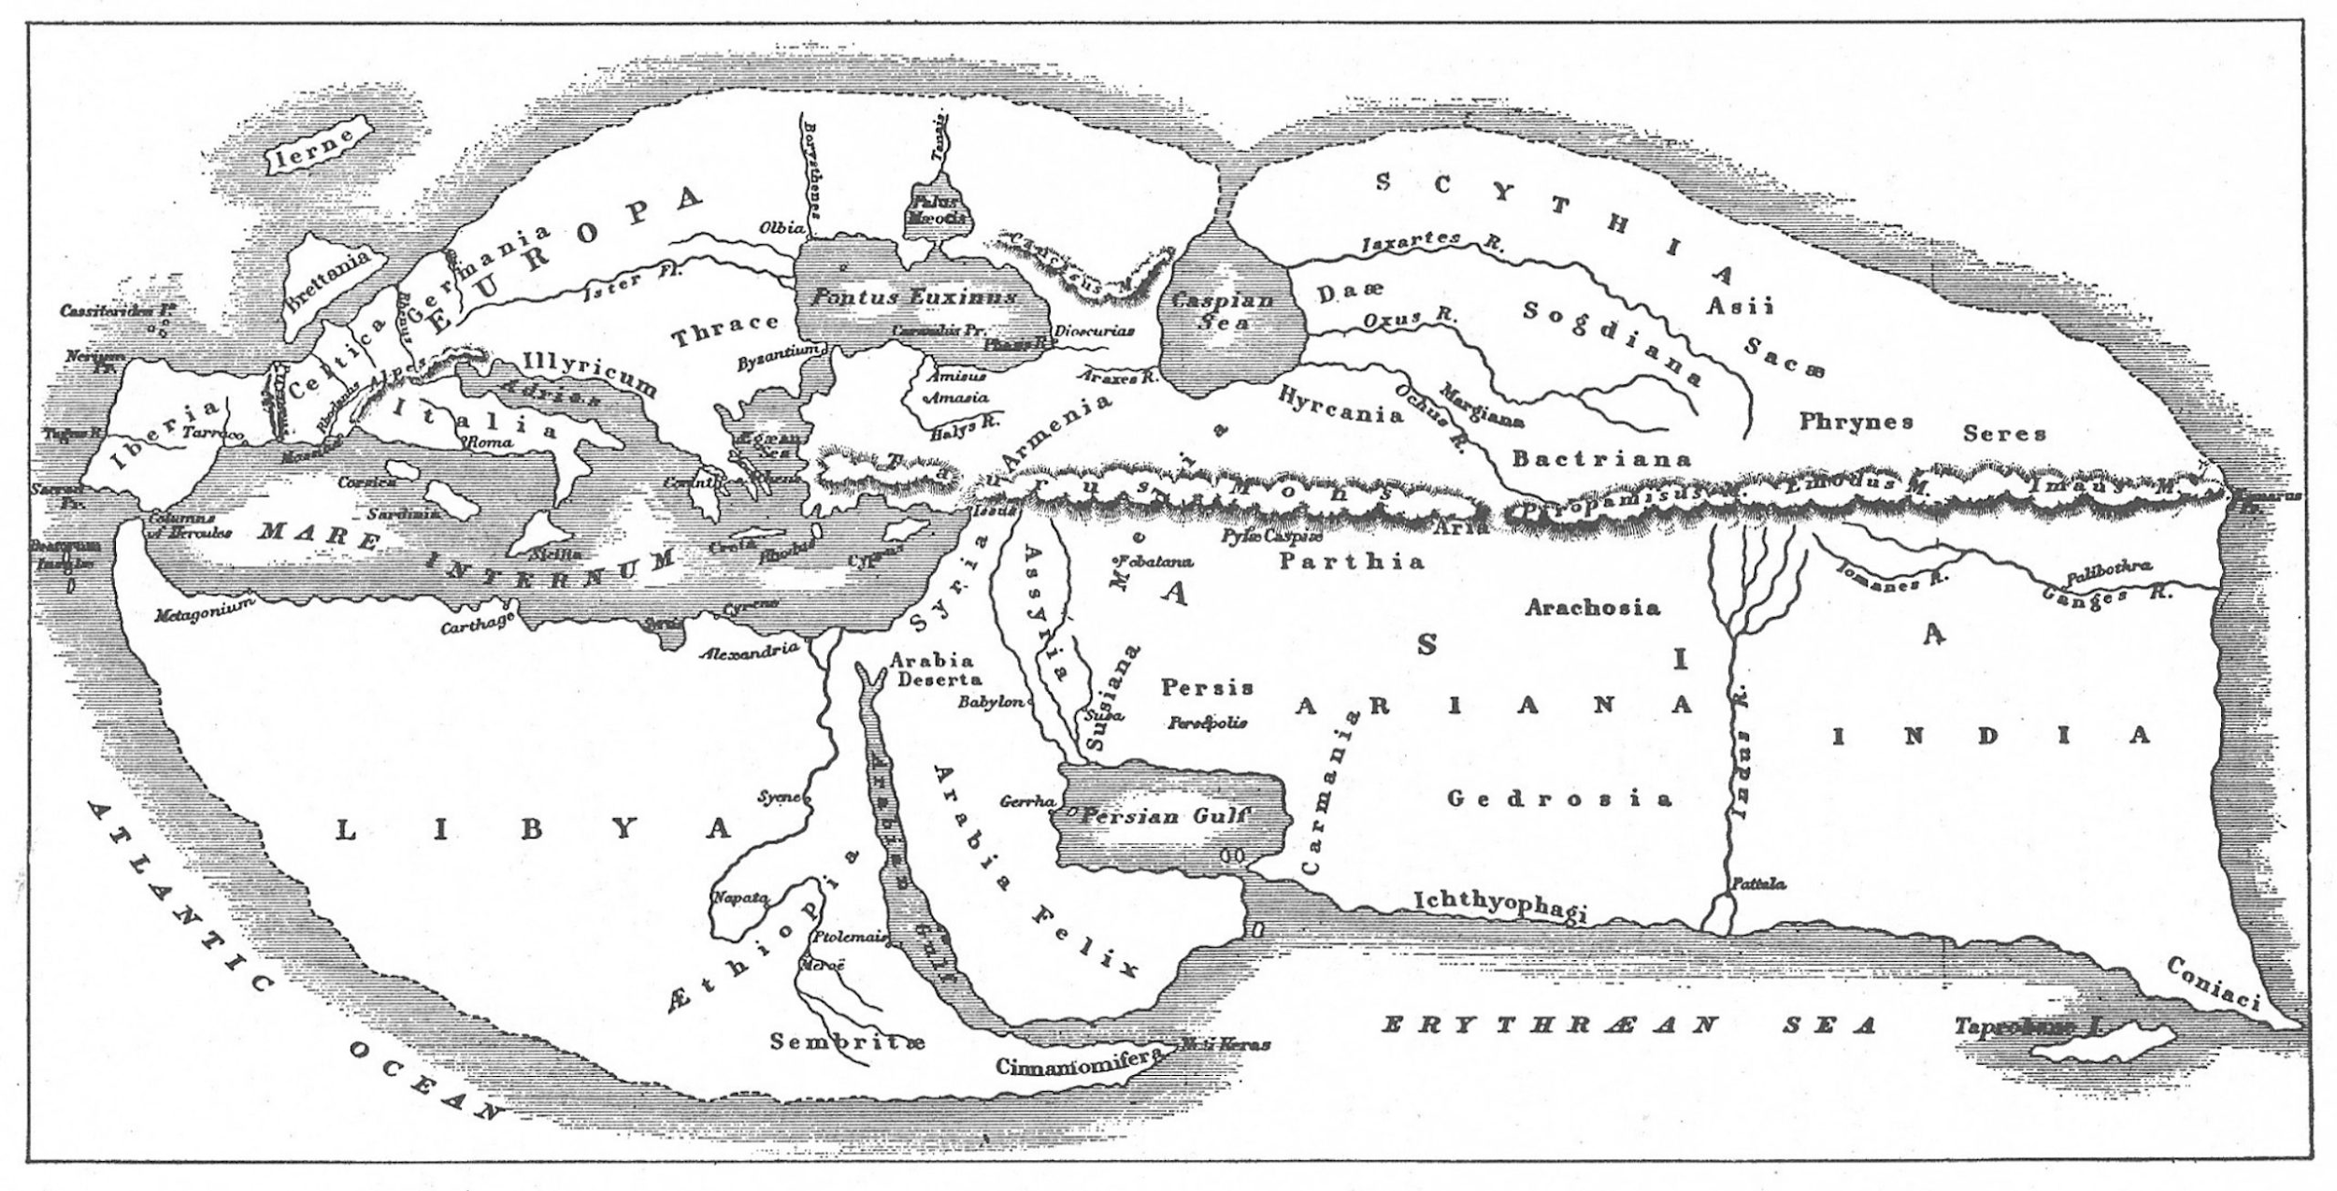
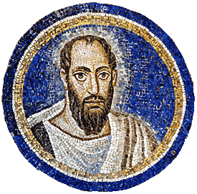
“Paul, looking intently
at the Council,
said, ‘Brethren…’”
Acts 23:1

Slide 126
Acts 21-28
Paul’s Arrest in Jerusalem, Incarceration in Caesarea, and Arrival in Rome
Paul is received “gladly” in Jerusalem. – 21:17
He follows Jewish Temple customs. – 21:26
Paul is seized and removed from the Temple. – 21:30
He is beaten by the crowd but rescued by Roman soldiers. – 21:32
Paul “defends” himself before angry crowd. – 22:1-21
Before being “scourged” he reveals his Roman citizenship. – 22:25
The Roman Commander brings Paul before the Sanhedrin. – 22:30

Slide 127
He witnesses about the resurrected Christ. – 23:6
The Lord tells Paul that he will witness in Rome. 23:11
Because of a plan to kill Paul, he is moved to Caesarea. – 23:12-35
Paul faces trial before Felix, the governor of Judea Province – 24
Two years pass, during which Paul stays incarcerated. – 24:27
Paul is tried before the new governor of Judea, Festus. – 25:1-8
Paul appeals to Caesar in Rome. – 25:11
While still in Caesarea, Paul is also heard by King Agrippa. – 26
Paul is sent to Rome by ship, and suffers shipwreck. – 27
He survives and finds safety on the island of Malta. – 28
Paul arrives in Rome and spends two years preaching and teaching about the kingdom of God. – 28:11-31

Slide 128
Acts 23:1-11

Slide 129
Paul, looking intently at the Council, said, “Brethren, I have lived my life with a perfectly good conscience before God up to this day.” 2 The high priest Ananias commanded those standing beside him to strike him on the mouth. 3 Then Paul said to him, “God is going to strike you, you whitewashed wall! Do you sit to try me according to the Law, and in violation of the Law order me to be struck?”
Acts 23:1-3

Slide 130
4 But the bystanders said, “Do you revile God’s high priest?”
5 And Paul said, “I was not aware, brethren, that he was high priest; for it is written, ‘You shall not speak evil of a ruler of your people.’” 6 But perceiving that one group were Sadducees and the other Pharisees, Paul began crying out in the Council, “Brethren, I am a Pharisee, a son of Pharisees; I am on trial for the hope and resurrection of the dead!”
Acts 23:4-6

Slide 131
7 As he said this, there occurred a dissension between the Pharisees and Sadducees, and the assembly was divided. 8 For the Sadducees say that there is no resurrection, nor an angel, nor a spirit, but the Pharisees acknowledge them all. 9 And there occurred a great uproar; and some of the scribes of the Pharisaic party stood up and began to argue heatedly, saying, “We find nothing wrong with this man; suppose a spirit or an angel has spoken to him?”
Acts 23:7-9

Slide 132
10 And as a great dissension was developing, the commander was afraid Paul would be torn to pieces by them and ordered the troops to go down and take him away from them by force, and bring him into the barracks.
11 But on the night immediately following, the Lord stood at his side and said, “Take courage; for as you have solemnly witnessed to My cause at Jerusalem, so you must witness at Rome also.”
Acts 23:10-11

Slide 133
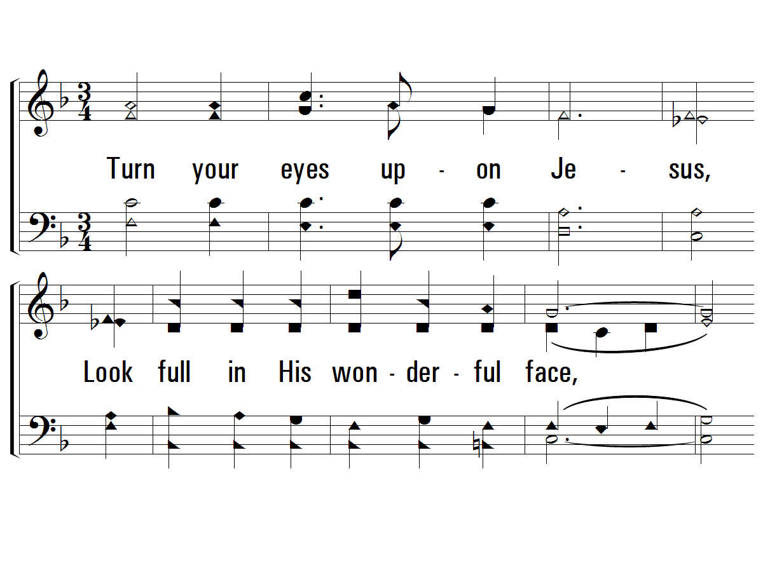
c – Turn Your Eyes Upon Jesus
Turn your eyes upon Jesus,
Look full in His wonderful face,
And the things of earth will grow strangely dim
In the light of His glory and grace.
© 2003 The Paperless Hymnal™

Slide 134
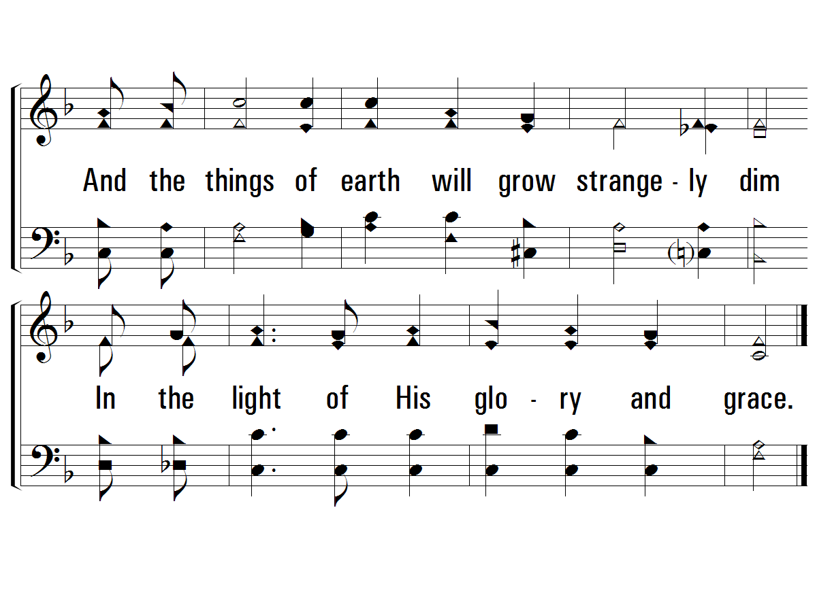
c – Turn Your Eyes Upon Jesus
© 2003 The Paperless Hymnal™

Slide 135
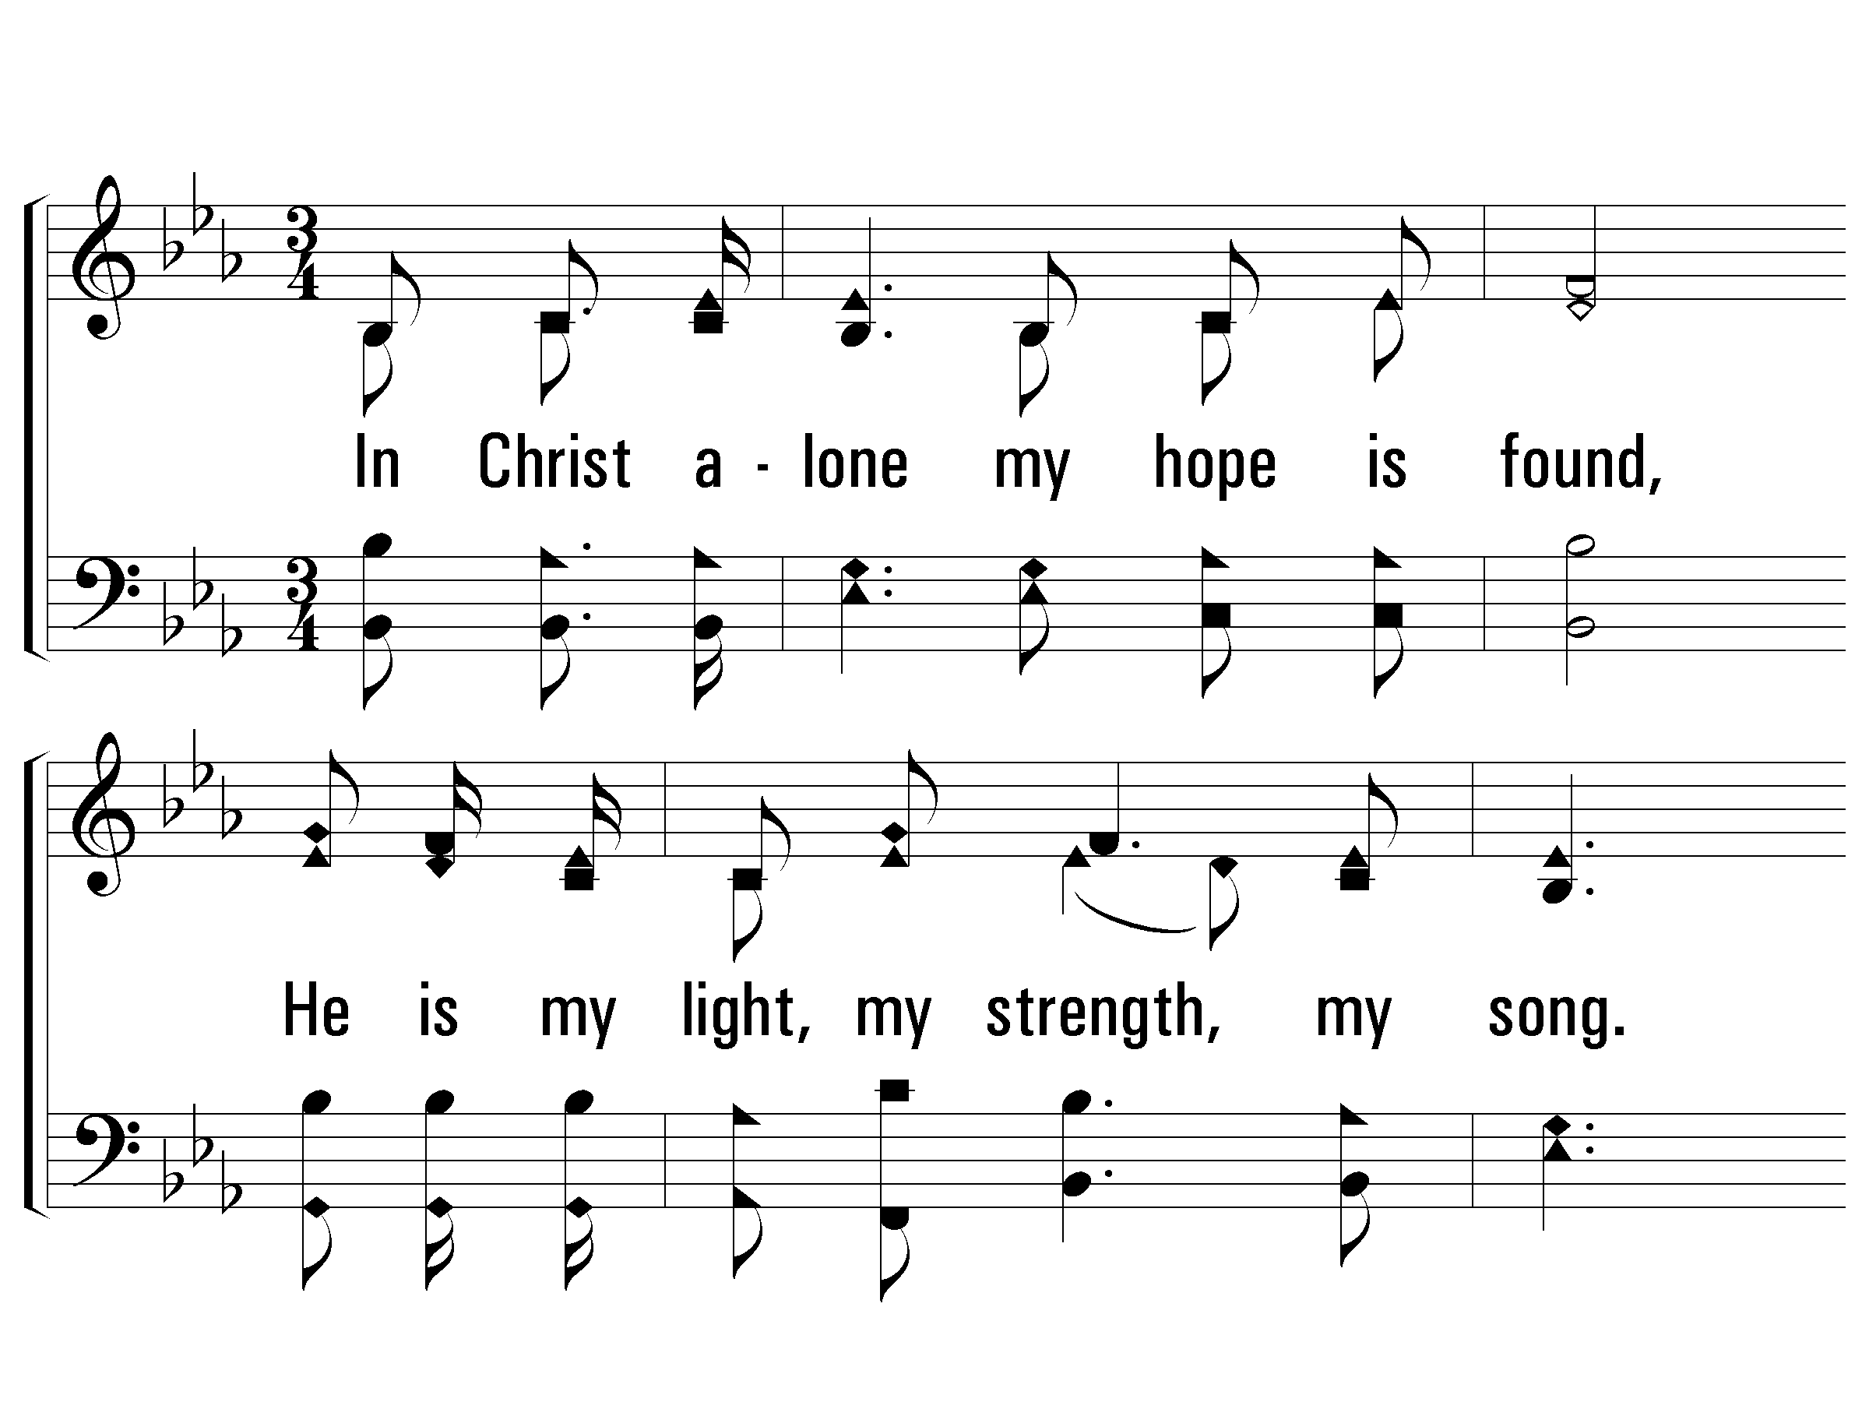
1 - In Christ Alone
1.
In Christ alone my hope is found,
He is my light, my strength, my song.
This cornerstone, this solid ground,
Firm thru the fiercest drought and storm.
What heights of love, what depths of peace,
When fears are stilled, when strivings cease.
My comforter, my all in all,
Here in the love of Christ I stand!
Words & Music: Keith Getty & Stuart Townsend / Arr.: D. J. Bulls
Copyright © 2002 by Thankyou Music (Admin. By EMI Christian Music Publishing)
International Copyright Secured. All Rights Reserved. Used by Permission.
© 2006 The Paperless Hymnal®

Slide 136
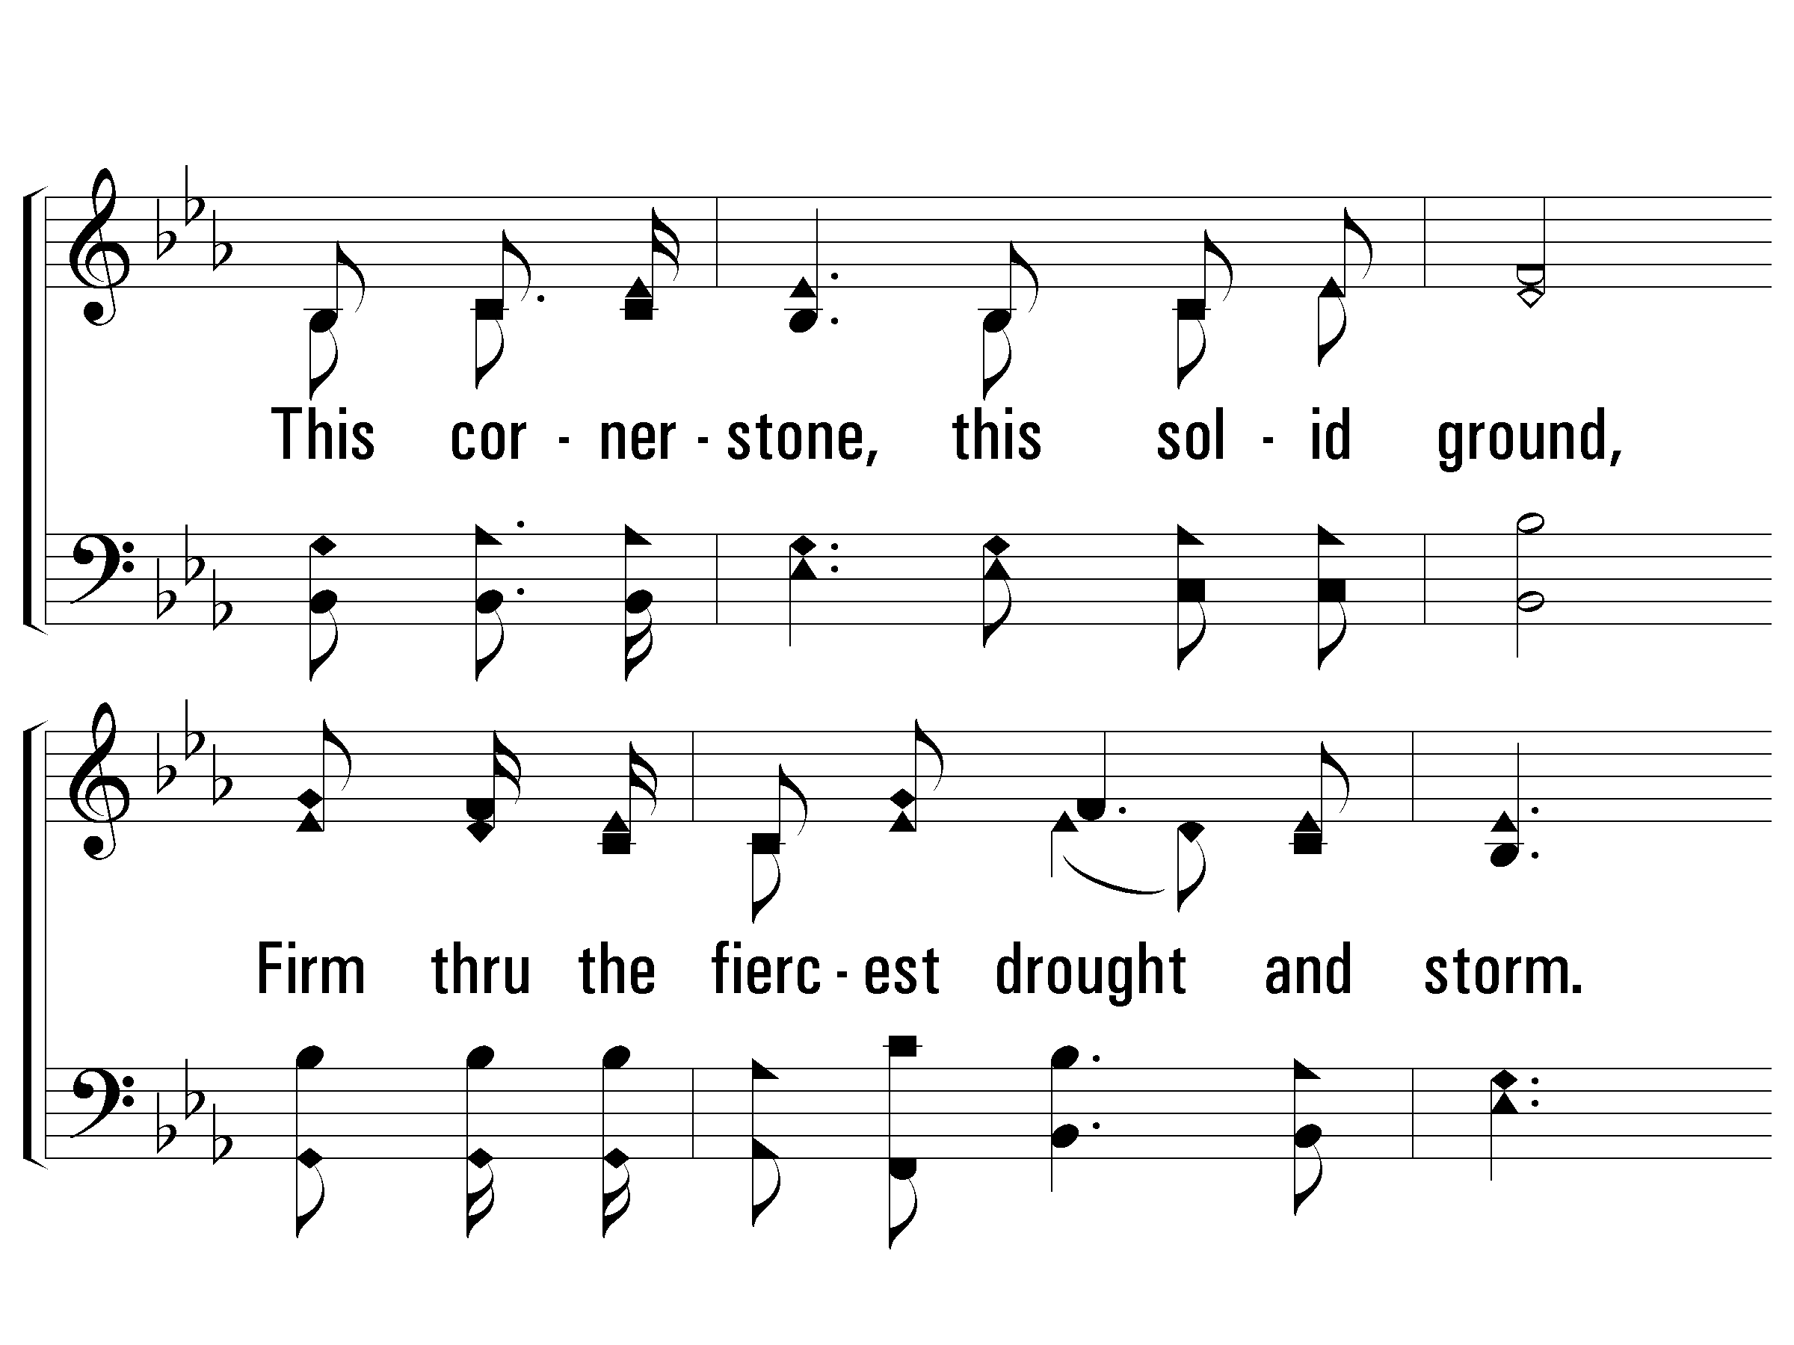
1 - In Christ Alone
© 2006 The Paperless Hymnal®

Slide 137
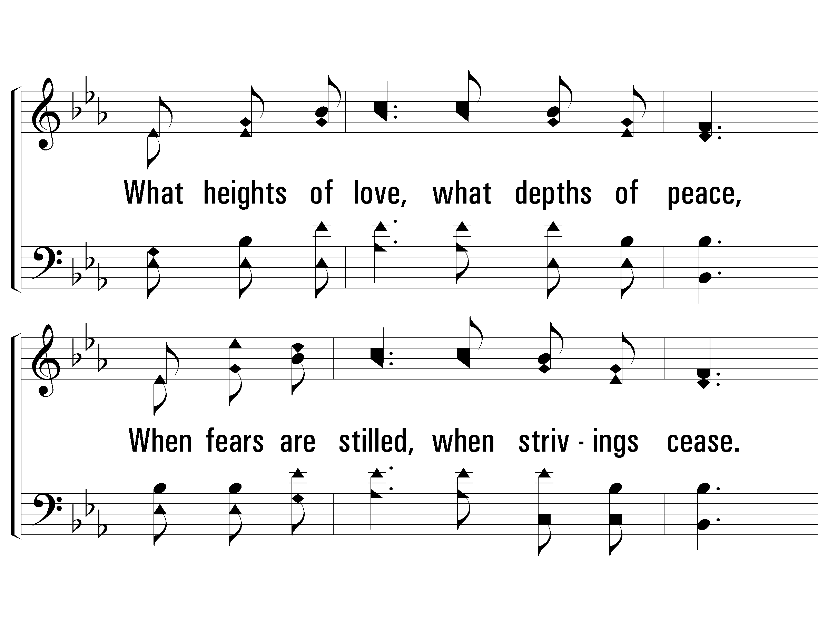
1 - In Christ Alone
© 2006 The Paperless Hymnal®

Slide 138
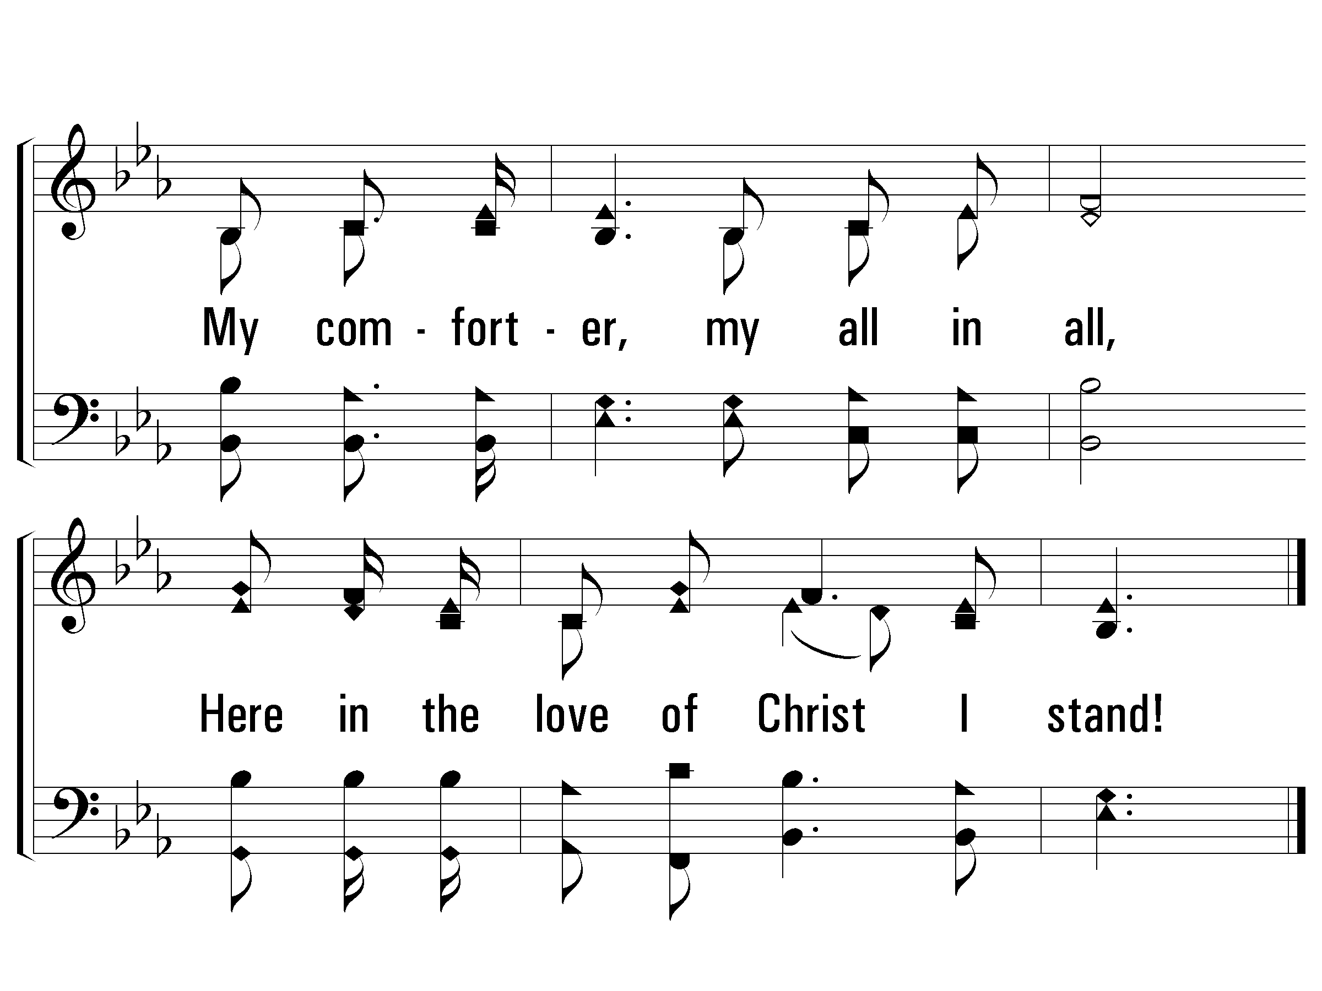
1 - In Christ Alone
© 2006 The Paperless Hymnal®

Slide 139
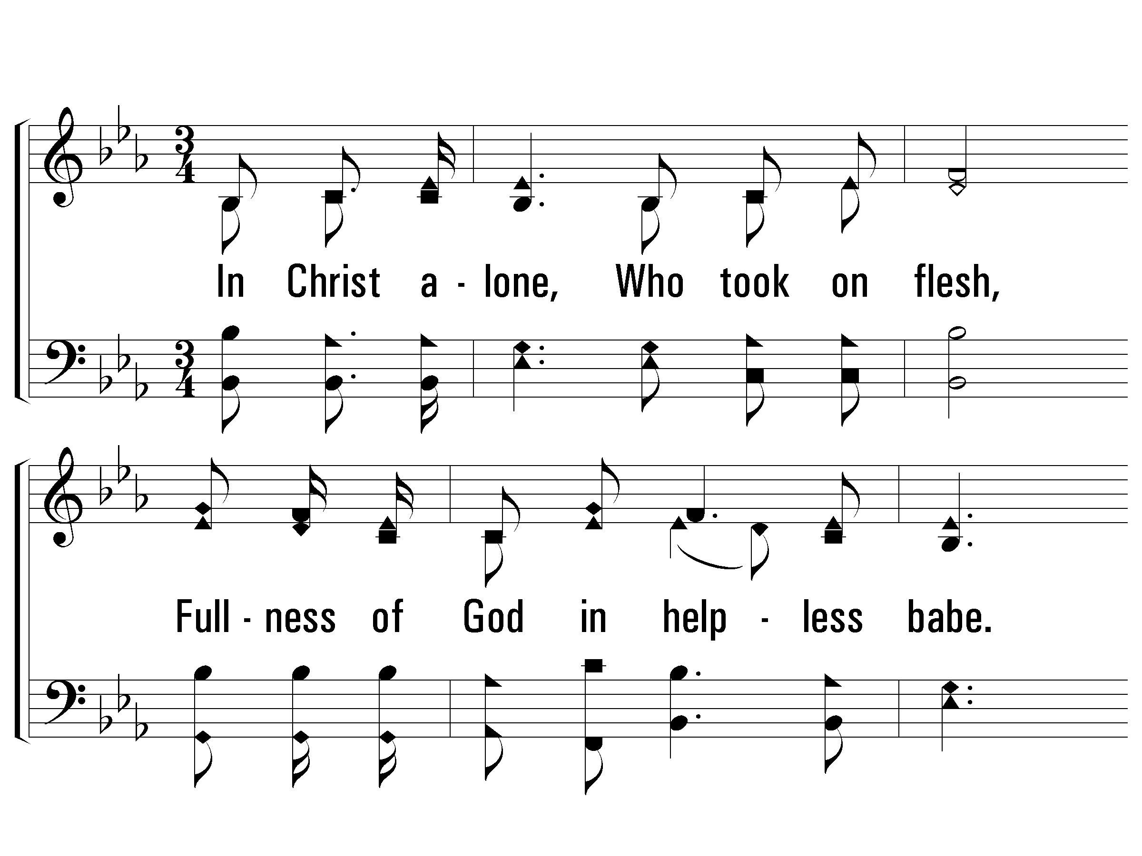
2 - In Christ Alone
2.
In Christ alone, Who took on flesh,
Fullness of God in helpless babe.
This gift of love and righteousness,
Scorned by the ones He came to save.
'Til on that cross as Jesus died,
The wrath of God was satisfied,
For every sin on Him was laid.
Here in the death of Christ I live!
Words & Music: Keith Getty & Stuart Townsend / Arr.: D. J. Bulls
Copyright © 2002 by Thankyou Music (Admin. By EMI Christian Music Publishing)
International Copyright Secured. All Rights Reserved. Used by Permission.
© 2006 The Paperless Hymnal®

Slide 140
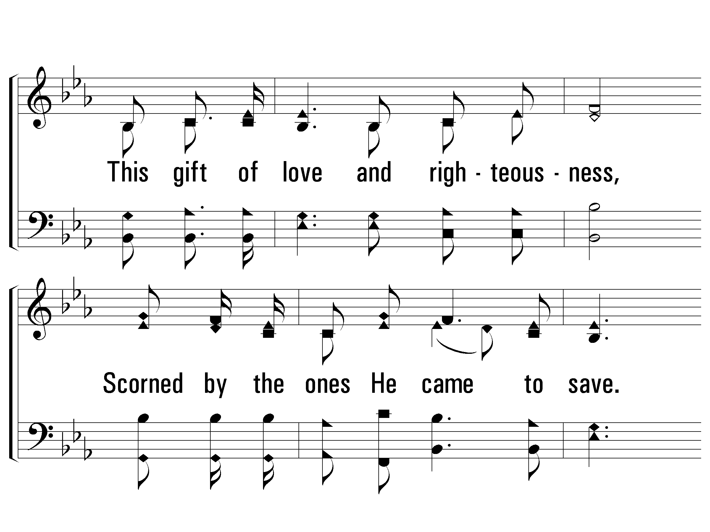
2 - In Christ Alone
© 2006 The Paperless Hymnal®

Slide 141
2 - In Christ Alone
© 2006 The Paperless Hymnal®

Slide 142
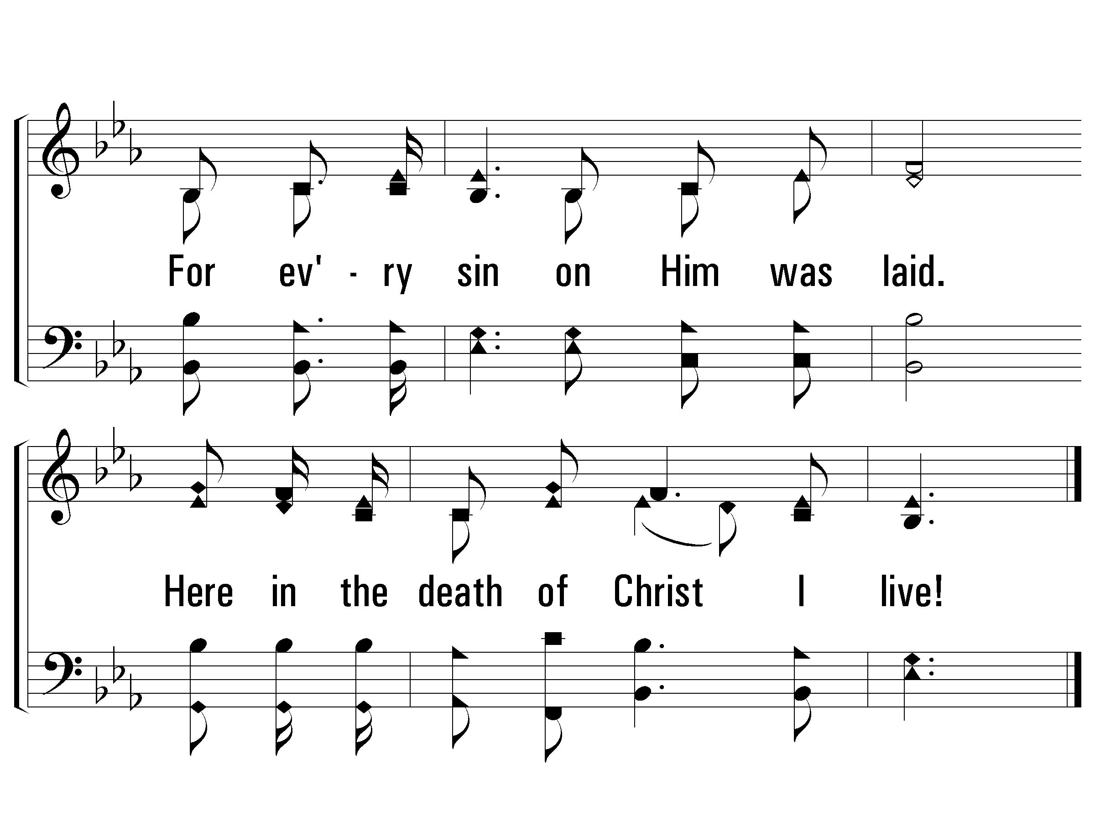
2 - In Christ Alone
© 2006 The Paperless Hymnal®

Slide 143
3 - In Christ Alone
3.
There in the ground His body lay,
Light of the world by darkness slain.
Then bursting forth in glorious day
Up from the grave He rose again.
And as He stands in victory,
Sin's curse has lost its grip on me.
For I am His and He is mine,
Bought with the precious blood of Christ.
Words & Music: Keith Getty & Stuart Townsend / Arr.: D. J. Bulls
Copyright © 2002 by Thankyou Music (Admin. By EMI Christian Music Publishing)
International Copyright Secured. All Rights Reserved. Used by Permission.
© 2006 The Paperless Hymnal®

Slide 144
3 - In Christ Alone
© 2006 The Paperless Hymnal®

Slide 145
3 - In Christ Alone
© 2006 The Paperless Hymnal®

Slide 146
3 - In Christ Alone
© 2006 The Paperless Hymnal®

Slide 147
4 - In Christ Alone
4.
No guilt in life, no fear in death,
This is the power of Christ in me.
From life's first cry to final breath,
Jesus commands my destiny.
No power of hell, no scheme of man
Can ever pluck me from His hand;
'Til He returns or calls me home,
Here in the power of Christ I'll stand.
Words & Music: Keith Getty & Stuart Townsend / Arr.: D. J. Bulls
Copyright © 2002 by Thankyou Music (Admin. By EMI Christian Music Publishing)
International Copyright Secured. All Rights Reserved. Used by Permission.
© 2006 The Paperless Hymnal®

Slide 148
4 - In Christ Alone
© 2006 The Paperless Hymnal®

Slide 149
4 - In Christ Alone
© 2006 The Paperless Hymnal®

Slide 150
4 - In Christ Alone
© 2006 The Paperless Hymnal®

Slide 151
“Paul, looking intently
at the Council,
said, ‘Brethren…’”
Acts 23:1

Slide 152
Happy Am I

Slide 153
1 Happy Am I
Happy Am I

Slide 154
2 Happy Am I
Happy Am I

Slide 155
3 Happy Am I
Happy Am I

Slide 156
4 Happy Am I
Happy Am I

Slide 157
5 Happy Am I
Happy Am I

Slide 158
6 Happy Am I
Happy Am I

Slide 159
Tag Happy Am I
Happy Am I

Slide 160
Let God Arise

Slide 161
V1a – Let God Arise
Arr: John Thompson, Phillip Organ, and The ZOE Group
Words and Music by: Chris Tomlin, Ed Cash, and Jesse Reeves
© 2016 The Acappella Company

Slide 162
V1b – Let God Arise
© 2016 The Acappella Company

Slide 163
V1c – Let God Arise
© 2016 The Acappella Company

Slide 164
V1d – Let God Arise
© 2016 The Acappella Company

Slide 165
C1a – Let God Arise
© 2016 The Acappella Company

Slide 166
C1b – Let God Arise
© 2016 The Acappella Company

Slide 167
C1c – Let God Arise
© 2016 The Acappella Company

Slide 168
V2a – Let God Arise
© 2016 The Acappella Company

Slide 169
V2b – Let God Arise
© 2016 The Acappella Company

Slide 170
V2c – Let God Arise
© 2016 The Acappella Company

Slide 171
V2d – Let God Arise
© 2016 The Acappella Company

Slide 172
C2a – Let God Arise
© 2016 The Acappella Company

Slide 173
C2b – Let God Arise
© 2016 The Acappella Company

Slide 174
C2c – Let God Arise
© 2016 The Acappella Company

Slide 175
B1a – Let God Arise
Unison
Unison -add tenor
© 2016 The Acappella Company

Slide 176
B1b – Let God Arise
Unison -add tenor/alto
Four-part harmony
© 2016 The Acappella Company

Slide 177
C3a – Let God Arise
© 2016 The Acappella Company

Slide 178
C3b – Let God Arise
© 2016 The Acappella Company

Slide 179
C3c – Let God Arise
© 2016 The Acappella Company

Slide 180
Tag – Let God Arise
© 2016 The Acappella Company

Slide 181
Prayer

Slide 182
Welcome Guests!
OLD UNION
NEW LIFE
Following Jesus changes everything!

